Slide 1
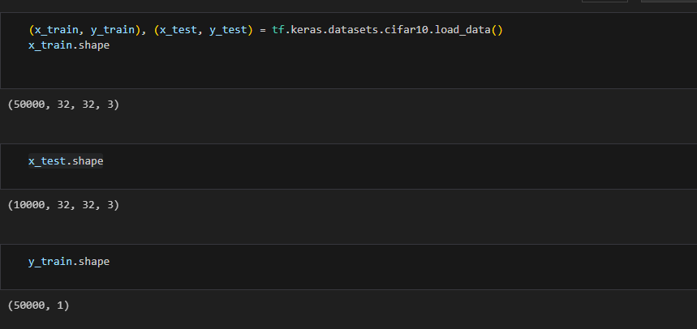
Loading CIFAR-10 Dataset
Load CIFAR-10 dataset
Display directory structure
Read and extract data files

Slide 2
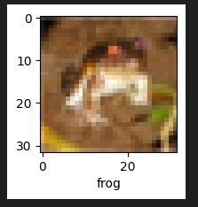
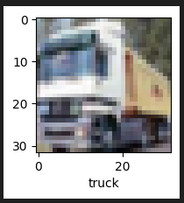
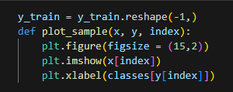
Displaying Sample Images
.
plot_sample(x_train, y_train, 0)
plot_sample(x_train, y_train, 1)
.
.
.

Slide 3
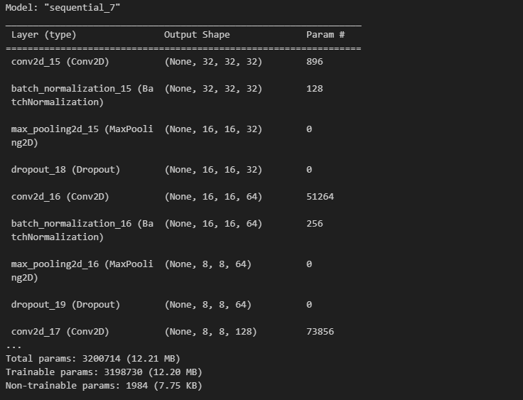
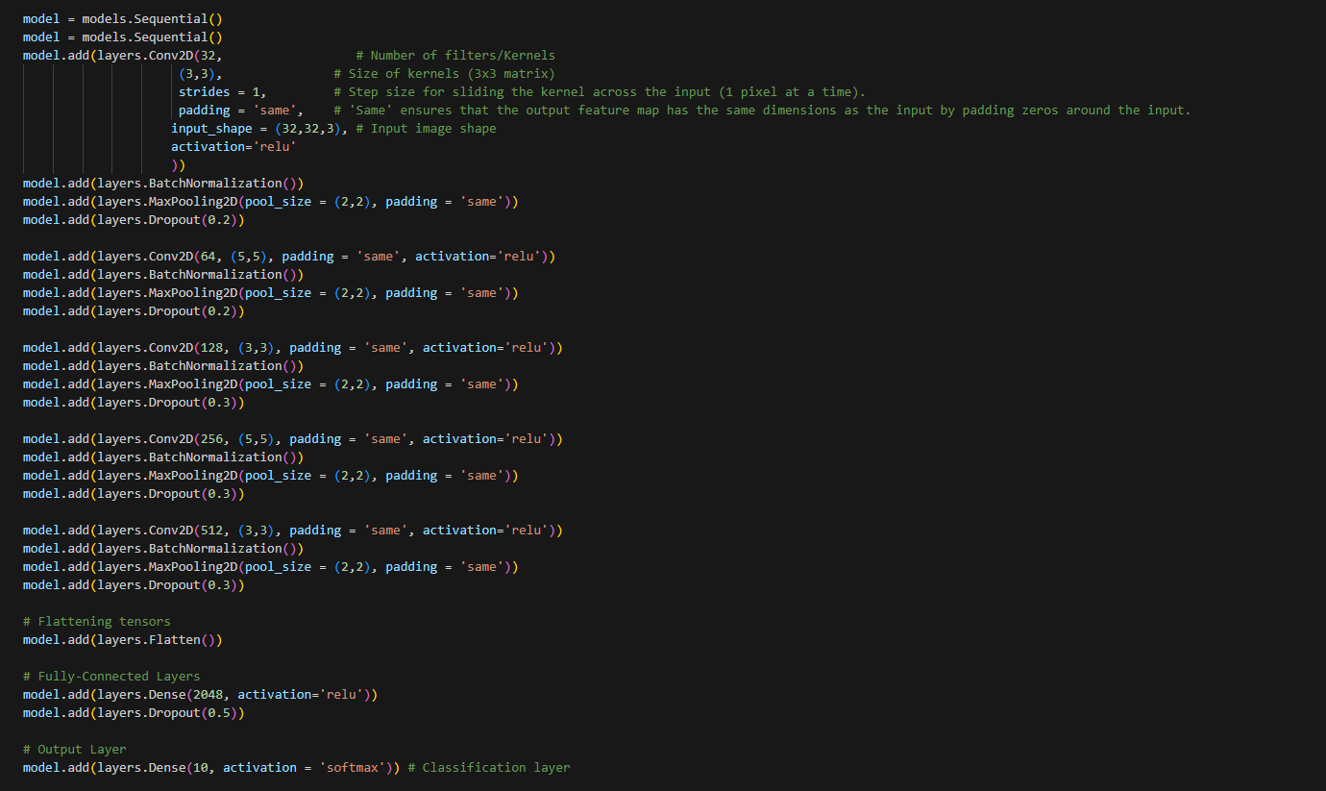
CNN MODEL

Slide 4
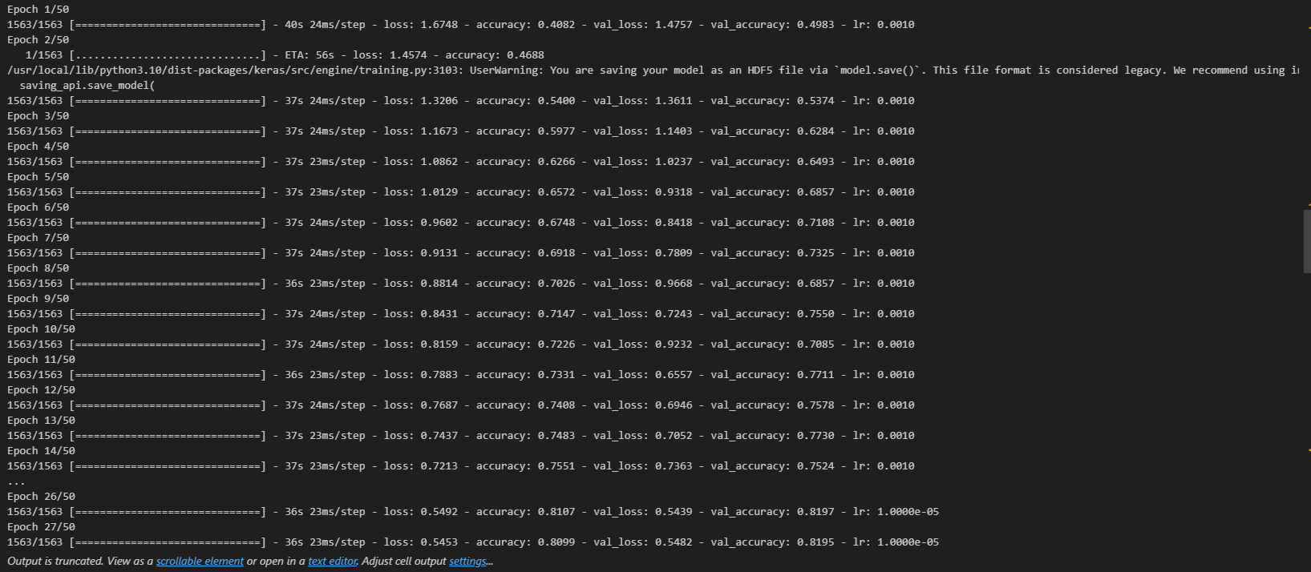
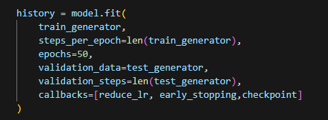
TRAIN model with augmented data

Slide 5
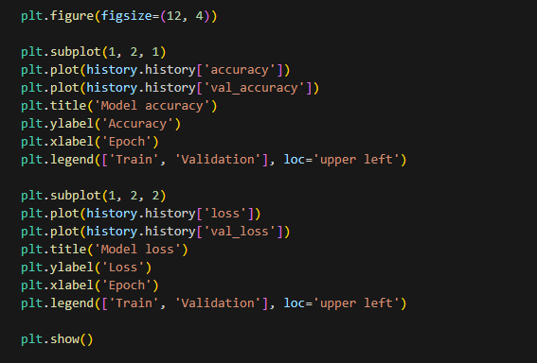
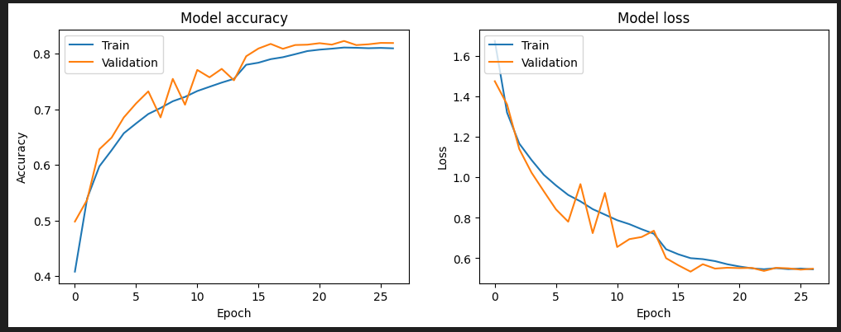
Accuracy and Loss

Slide 6
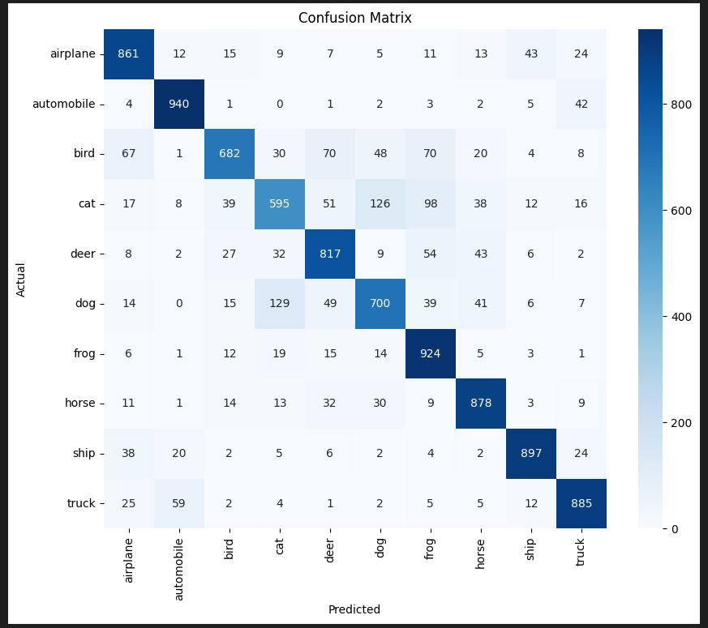

Confusion mAtrix

