Slide 1
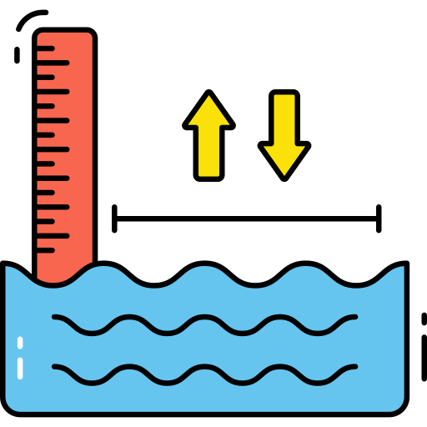












Power Fluctuation Handling
Water Level
Geyser Auto Ignition
Turning Appliances ON/OFF
Auto Fire Extinguishing
GAS
Power Switches
Burglar Alarm
Switching
LPG

