Slide 1


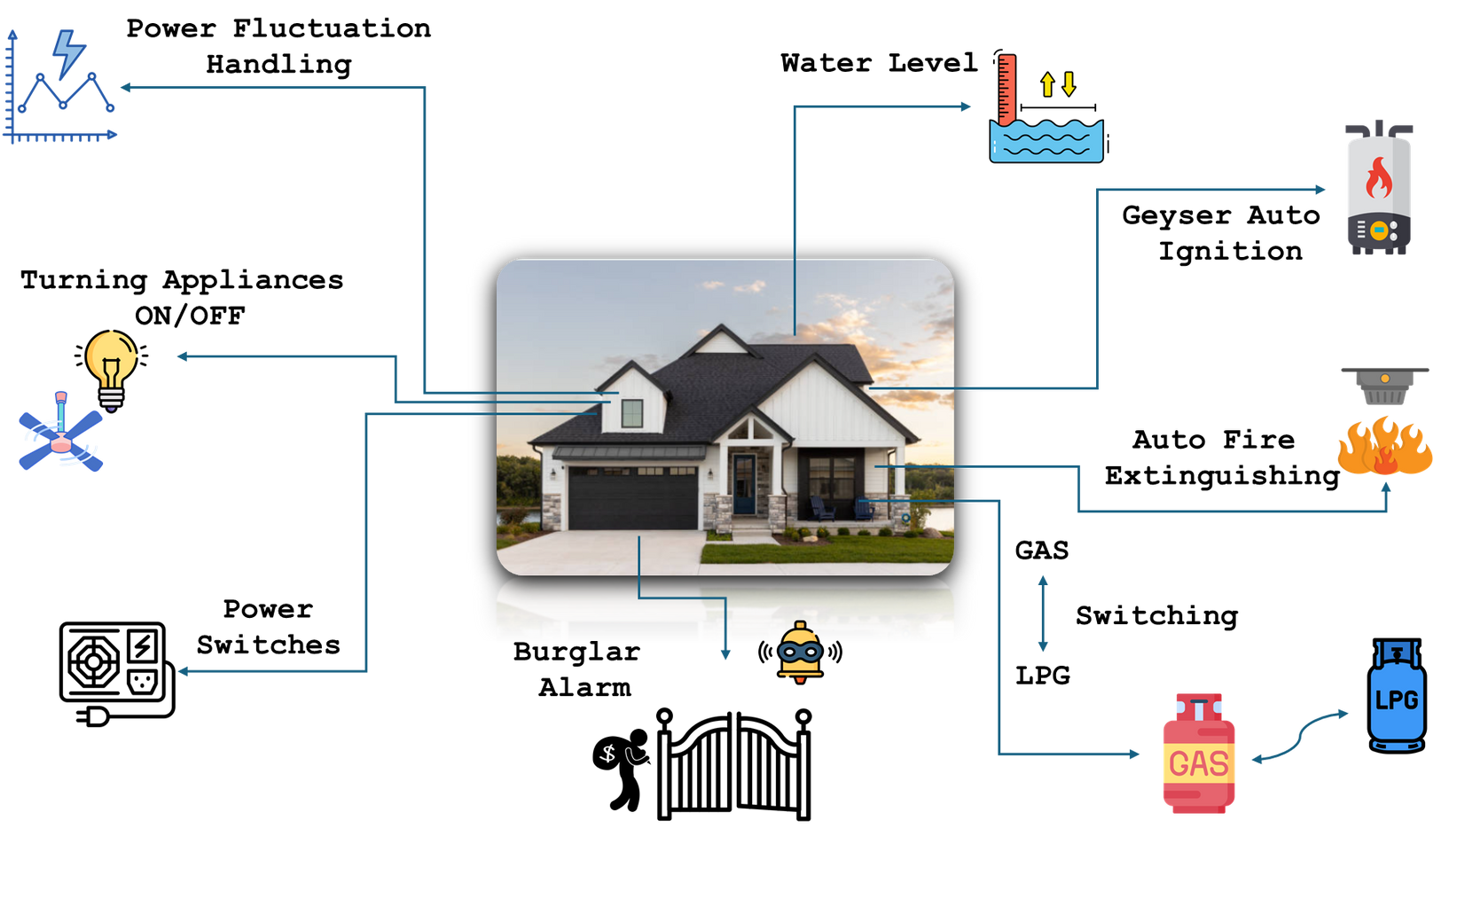



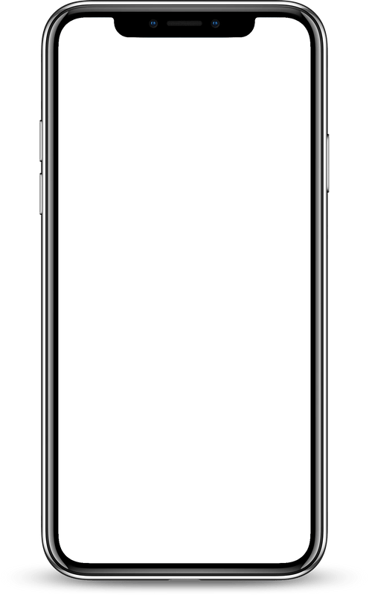

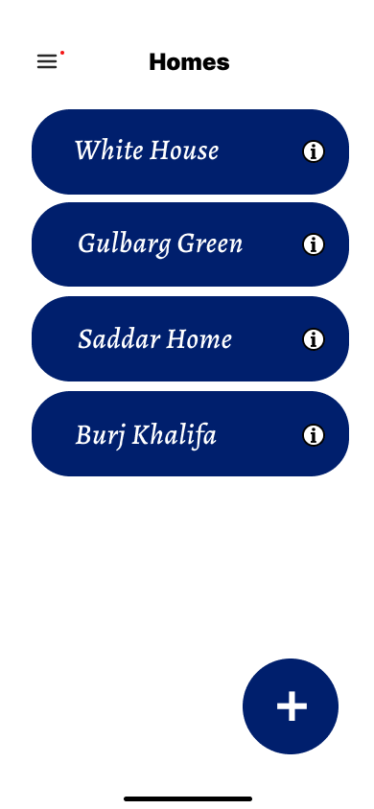
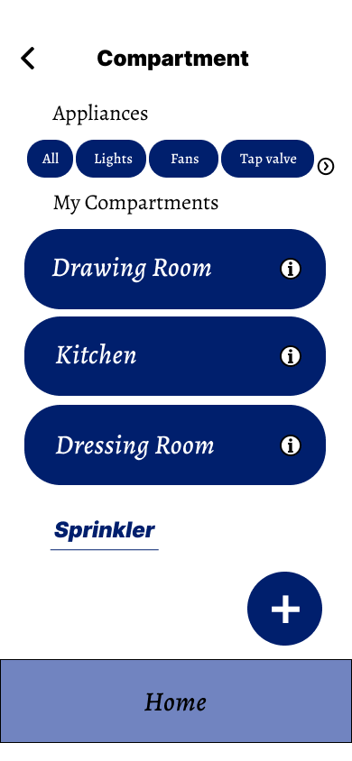
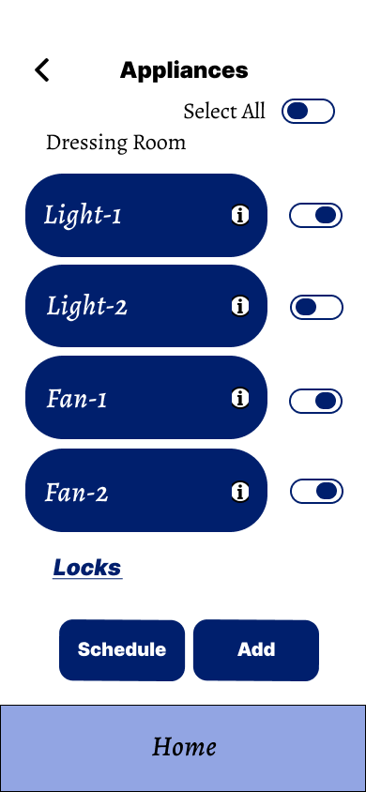

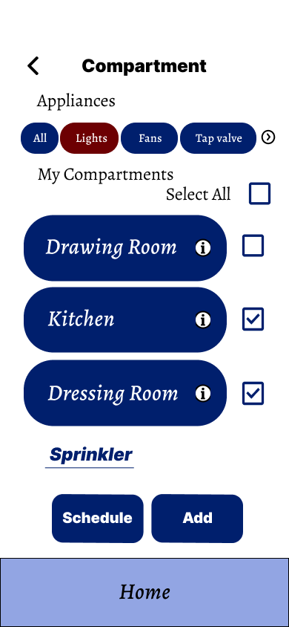
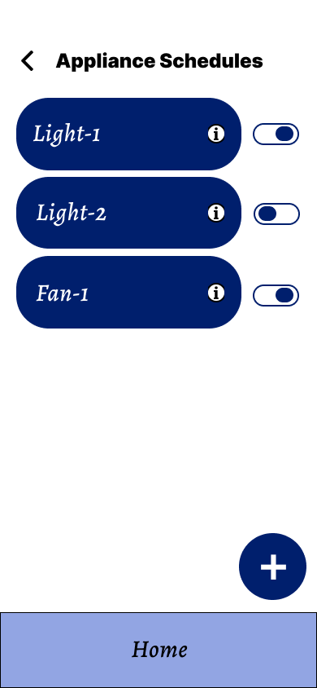
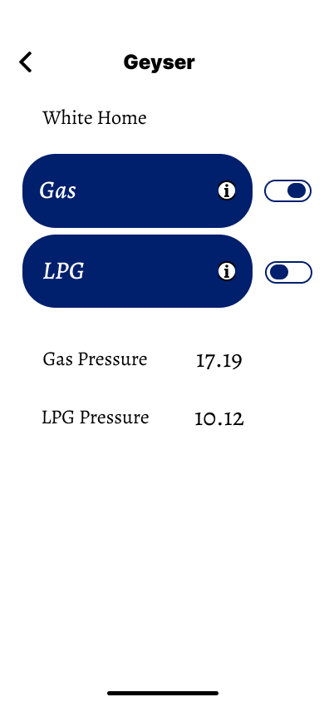
IoT Based Smart Home
Components:
Main Idea:
This IoT-based Smart Home System makes homes smart, secure, and energy-efficient. It allows users to control devices and locks through mobile phone, scheduling of appliances and locks. It also supports auto-ignition for geysers with Gas / LPG switching, detects fire, smoke, intrusions, and automatically shuts down devices during low voltage.
Scheduling of Appliances & Locks
Water Level Monitoring
Mobile App Integration
Smart Security System
Temperature Sensing
Appliance Control
Tools
Visual Studio
Main Objectives:
It allows users to control devices and locks through mobile phone.
Scheduling of appliances and locks through mobile phone.
Auto-ignition for geyser with Gas / LPG switching.
Temperature, smoke, fire, and gas leak detection.
Burglar alarm with alert system, water level sensing and motor control.
Low voltage detection with auto shutdown.
Your pph text
VS Code
SQL Server
App Screens:
9:11
Android Studio
Python
Developed By:
Ayesha Fazil
(21-Arid-4416)
Mughees Qadir
(21-Arid-4486)
Abdullah Akram
(21-Arid-4390)
Mukesh Kumar
(21-Arid-4559)
Home
Compartment
Appliances
Supervised By:
Dr. Hassan Nazeer
Compartment
Scheduling
Schedule

