Slide 1
Sprocket Central Pty Ltd
The Analytics Team
Data analytics approach
Karthik.M

Slide 2
Agenda
Introduction
Data Exploration
Model Development
Interpretation

Slide 3
Introduction
Identify and recommend top 1000 customer to target from datasets
Outline of Problem
Sprocket Central is a company that specializes in high-quality bikes and cycling accessories.
Their marketing team is looking to boost business sales by analyzing provided datasets.
Using the 3 datasets provided the aim is to analyze and recommend 1000 customers that Sprocket Central should target to drive higher value for the company.
This will be done with the three phases of: Data exploration,
Model development and Interpretation.
Content of Data Analysis
'New' and 'Old Customer Age Distributions
Bike related purchases over the last 3 years by gender
Job industry distributions
Wealth segmentation by age category
Number of cars owned and not owned by state
RFM analysis and customer classification

Slide 4
Data Exploration
Data quality assessment and ‘clean up’
Summary table
Key Issues for Data Quality Assessment
Accuracy: Correct Values
Completeness: Data Fields with Values
Consistency: Values Free from Contradiction
Currency: Values up to Date
Relevancy: Data items with Value Meta-data
Validity: Data Containing Allowable Values
 | Accuracy | Completeness | Consistency | Currency | Relevancy | Validity
Customer Demographic | DOB: Inaccurate Age: Inaccurate | Job title: blacks Customer id: incomplete | Gender: inconsistency | Deceased customers : Filler out | Default column: delete
Customer Address |  | Customer id: incomplete | States: inconsistency
Transactions | Profit: missing | Customer id: Incomplete Online Order: blanks Brand: blanks |  |  | Cancelled Status order: Filler out | List price: Format Product sold: Format

Slide 5
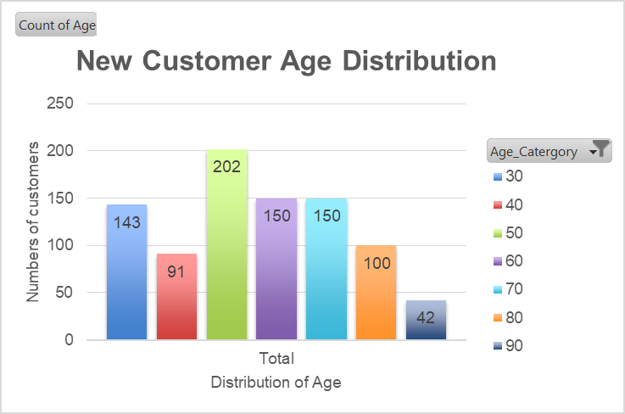
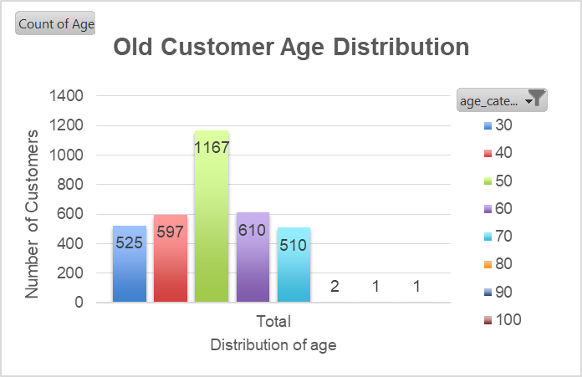
Data Exploration
'New' and 'Old' Customer Age Distributions
Most customers are aged between 40-49 in both 'New’ and ‘Old’.
The lowest age groups are 80+ for 'New' and 70+ for 'Old' customer lists.
The 'New' customer list suggests that age groups under 30 and 40-69 are most populated.
The 'Old' customer list suggests under 70.
There is a step drop of customers in the 30-39 age group in 'New.'

Slide 6
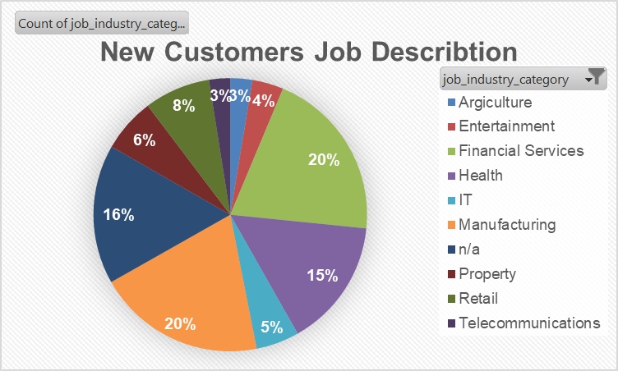
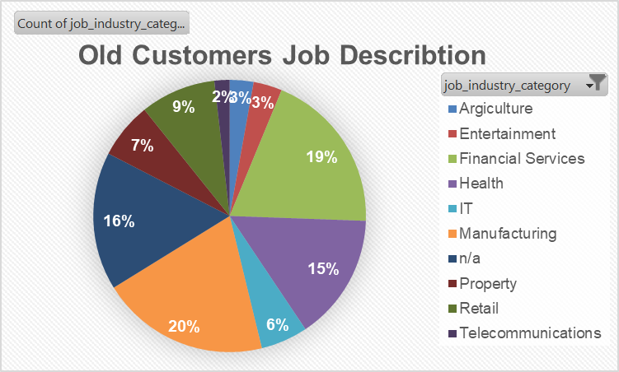
Data Exploration
Job Industry Distribution
20% of 'New' Customers are in Manufacturing and Financial Services.
The smallest number of customers are in Agriculture, Telecommunications and Entertainment at under 5%
Similar pattern in 'Old' customer list, at 20% and 19% in Manufacturing and Financial Services respectively

Slide 7
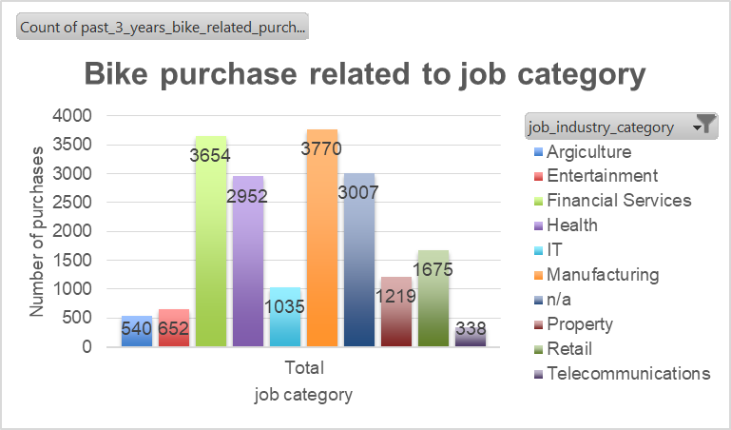
Data Exploration
Bike related purchases over last 3 years by job Industry Distribution
Most purchases taken place in Manufacturing and Financial Services job category.
Lowest purchases taken place in job Telecommunications, Agriculture and property job category.
The bike purchase list suggests job category Manufacturing, Financial Services and Health.
n/a job category means that customers jobs is not available.

Slide 8
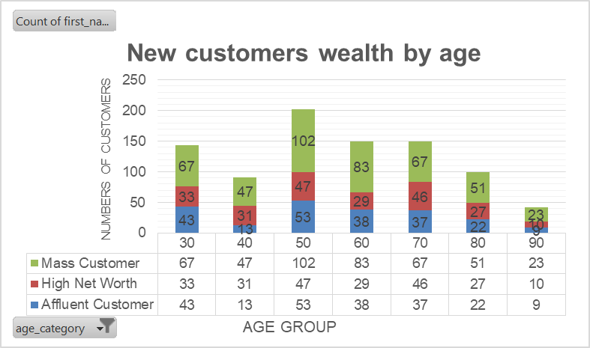
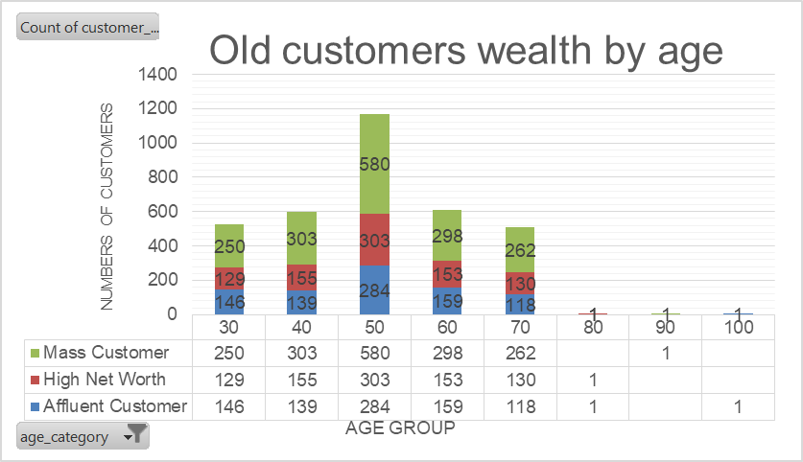
Data Exploration
Wealth Segmentation by age category
In all age categories the largest number of customers are classified as 'Mass Customer‘.
The next largest category is the 'High Net Worth' customers in ‘New’.
In ‘Old’ there is fluctuation between ‘High Net Worth’ and ‘Affluent Customer’.

Slide 9
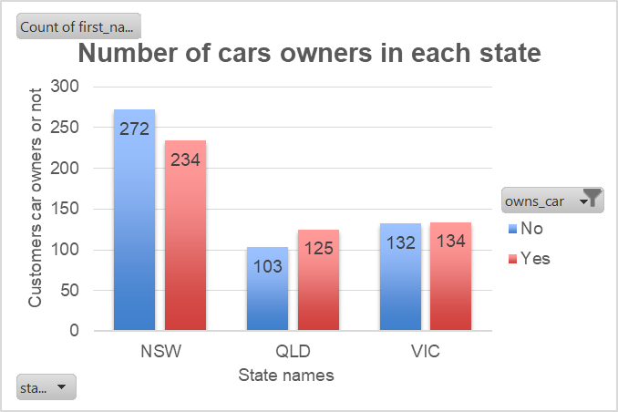
Data Exploration
Number of cars owned and not owned by state
NSW has the largest amount of people that do not own a car. NSW seems to have a higher number of people from which data was collected.
Victoria is also split quite evenly. But both numbers are significantly lower than those of NSW.
QLD has a relatively high number of customers that own a car.

Slide 10
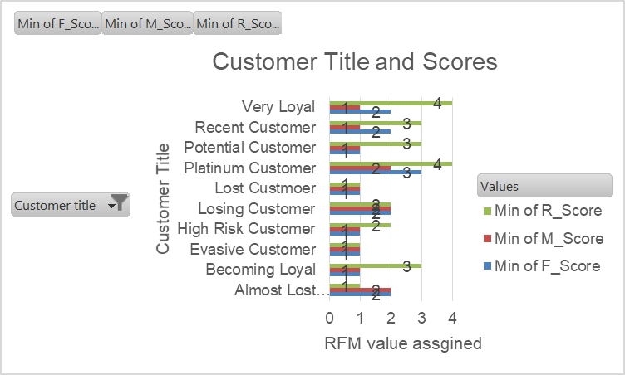
Model Development
RFM Analysis and Customer Classification
RFM analysis is used to determine which customers a business should target to increase its revenue and value.
The RFM (Recency, Frequency and Monetary) model shows customers that have displayed high levels of engagement with the business in the three categories mentioned.

Slide 11
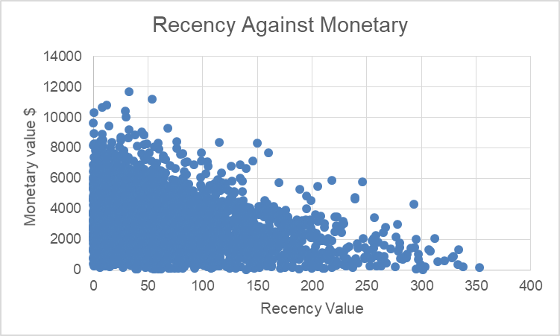
Model Development
Scatter-Plot based off RFM Analysis
The chart shows that customers who purchased more recently have generated more revenue, than customer who visited a while ago.
Customers from recent past (50-100 days) also show to generate a moderate amount of revenue.
Those who visited more than 200 days ago generate low revenue.

Slide 12
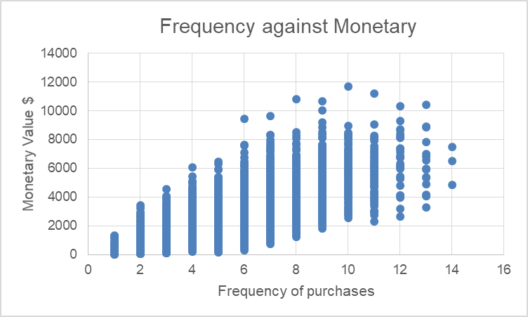
Model Development
Scatter-Plot based off RFM Analysis
Customer classified as "Platinum Customer," "Very Loyal," and "Becoming Loyal" visit frequently, which correlated with increased revenue for the business.
Naturally, there is a positive relationship between frequency and monetary gain for the business.

Slide 13
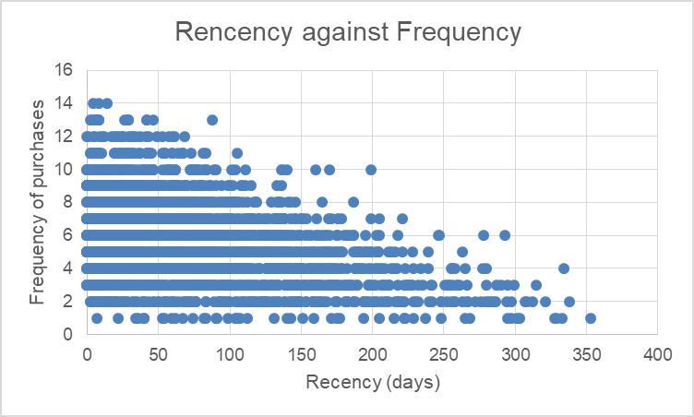
Model Development
Scatter-Plot based off RFM Analysis
Very low frequency of 0-2 correlated with high recency values. i.e. More than 250 days ago.
Customers that have visited more recently (0-50 days) have a higher chance of visiting more frequently (6+).
Higher frequency has a negative relationship with recency values. Such that very recent customers are also frequent customers.

Slide 14
Model Development
Customer Title Definition list with RFM values assigned
S.no | Customer Title | Description | RFM value
1 | Lost Customer | Very Low RFM | 111
2 | Evasive Customer | Very low recency, Very low frequency, small amount spent | 112
3 | Almost Lost Customer | Very low recency, low frequency, but high amount spent | 123
4 | High Risk Customer | Purchase was long time ago, frequency is quite high, amount spent is high | 210
5 | Losing Customer | Purchases was a while ago, below average RFM value | 223
6 | Potential Customer | Bought recently, never bought before, spent small amount | 311
7 | Recent Customer | Bought recently, not very often, average money spent | 323
8 | Becoming Loyal | Relatively recent, bought more than once, spends large amount of money | 343
9 | Very Loyal | Most recent, buys often, spends large amount of money | 420
10 | Platinum Customer | Most recent buy, buys often, most spent | 432

Slide 15
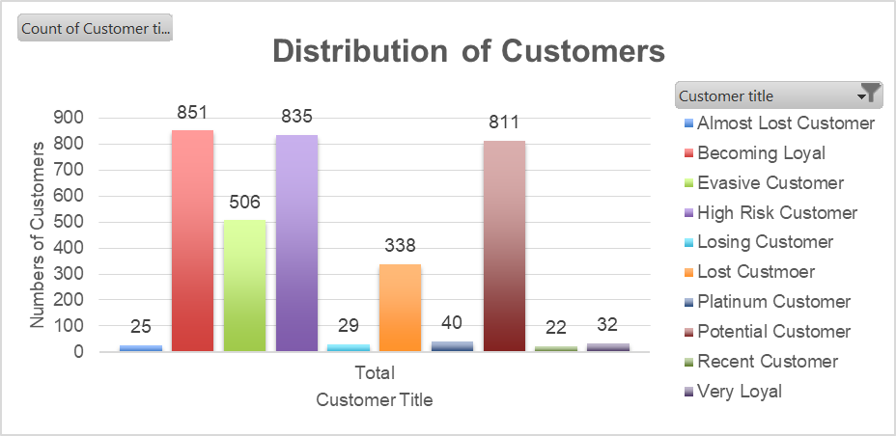
Model Development
Summary Table of the top 1000 Customers to target
Rank | Customer Title | Number of Customers | Cumulative | Customer selection
1 | Platinum Customer | 40 | 40 | 40
2 | Very Loyal | 32 | 72 | 32
3 | Becoming Loyal | 851 | 923 | 851
4 | Recent Customer | 22 | 945 | 22
5 | Potential Customer | 811 | 1756 | 55
6 | Losing Customer | 29 | 1785 | 0
7 | High Risk Customer | 835 | 2620 | 0
8 | Almost Lost Customer | 25 | 2645 | 0
9 | Evasive Customer | 506 | 3151 | 0
10 | Lost Custmoer | 338 | 3489 | 0

Slide 16
Interpretation
Customers target
Rank | Customer Title | Number of Customers | Cumulative | Customer selection
1 | Platinum Customer | 40 | 40 | 40
2 | Very Loyal | 32 | 72 | 32
3 | Becoming Loyal | 851 | 923 | 851
4 | Recent Customer | 22 | 945 | 22
5 | Potential Customer | 811 | 1756 | 55
Filter through the top 1000 customers by assigning the conditions discussed in the table above.
The 1000 customers discovered would have bought recently, they have bought very frequently in the past and tend to spend more than other customers.

Slide 17
THANK YOU

