Slide 1

A Driving Decision Strategy(DDS) Based on Machine learning for an autonomous vehicle
SIR CR REDDY COLLEGE OF ENGINEERING
Guided By :
G.Vihari Asst.Professor(IT)
Team Details :
Kunduru Sankar Reddy(17B81A1254)
Nagala Prabhu Kumar(17B81A1271) Marisa Sai Sandhya(17B81A1264) Sri Harsha Popuru(17B81A1286)

Slide 2

Abstract
A current independent vehicle decides its driving system by thinking about just outer variables (People on foot, street conditions, and so forth.) without considering the inside state of the vehicle. To take care of the issue, this paper proposes "A Driving Decision Strategy(DDS) Based on AI for a self-governing vehicle" which decides the ideal system of a self-governing vehicle by breaking down not just the outer variables, yet additionally the inside elements of the vehicle (consumable conditions, RPM levels and so on.
The DDS learns a hereditary calculation utilizing sensor information from vehicles put away in the cloud and decides the ideal driving procedure of an self-ruling vehicle. This paper contrasted the DDS and MLP what's more, RF neural system models to approve the DDS.

Slide 3
EXISTING SYSTEM
 RF and SVM models are existing methods Although studies have been done in the medical field with an advanced data exploration using machine learning algorithms, orthopedic disease prediction is still a relatively new area and must be explored further for the accurate prevention and cure.

Slide 4
PROPOSED SYSTEM
 We will propose an feature selection with MLP and RF algorithm to compute the sensor data to determine the driving strategy of an autonomous vehicle.

Slide 5

ADVANTAGE
The improvements system to control the vehicle based on sensor data.
DISADVANTAGE
Less efficiency and need more are to explored for prevention.

Slide 6
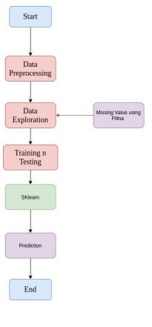
Flow chart

Slide 7

Algorithm models
Random Forest - RF.
Multi Layer Perceptron – MLP Genetic Algorithm

Slide 8

Datasets
The datasets is download from kaggle
https://www.kaggle.com/sensor-vehicle/download

Slide 9
Technology
Machine learning
Deep learning
Python packages

Slide 10
Project implementation
Gathering the dataset.
Pre-processing the dataset and analysing dataset
Splitting the datasets into training and testing in the ratio of 80 % and 20 % and using the RF and MLP models to analysis the data.
Obtain the accuracy in prediction

Slide 11
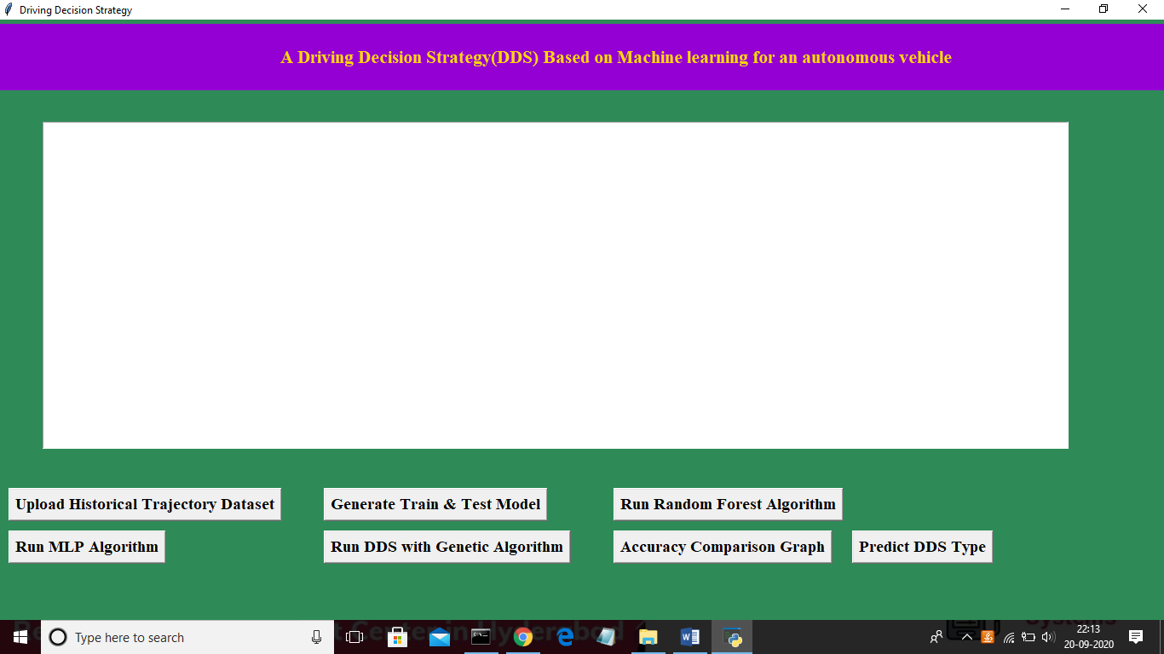
In above screen click on ‘Upload Historical Trajectory Dataset’ button and upload dataset

Slide 12
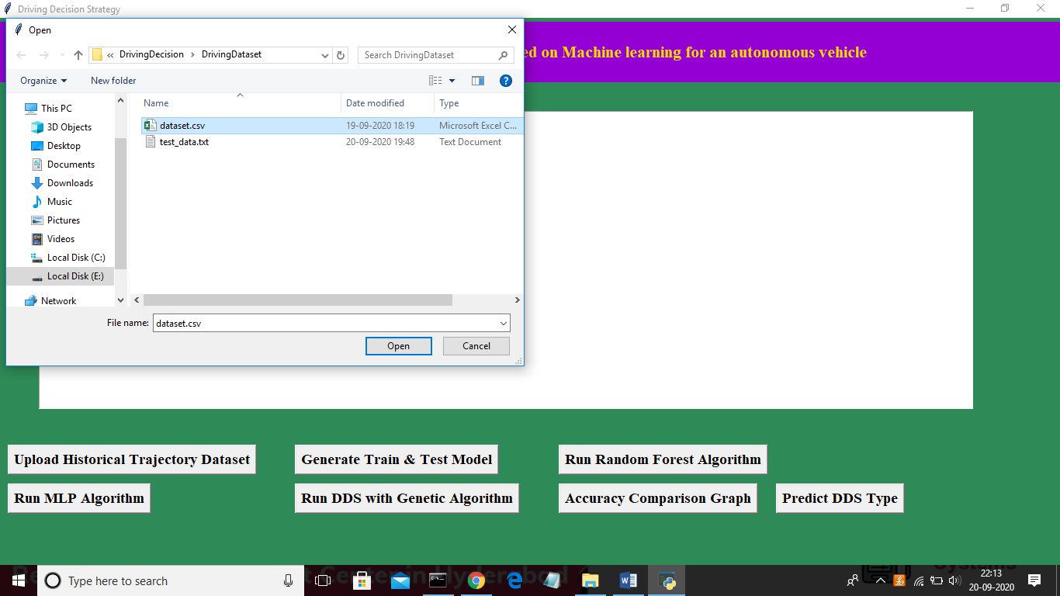
Now select ‘dataset.csv’ file and click on ‘Open’ button to load dataset and to get below screen

Slide 13
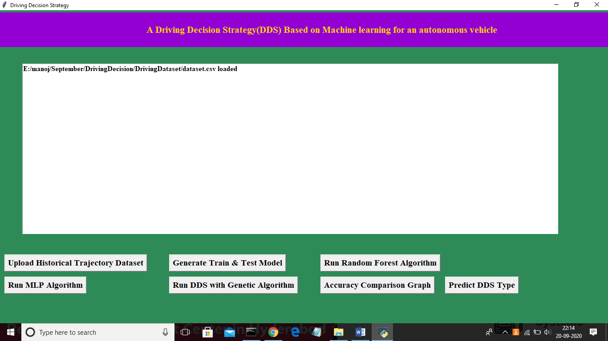
In above screen dataset is loaded and now click on ‘Generate Train & Test Model’ button to read dataset and to split dataset into train and test part to generate machine learning train model

Slide 14
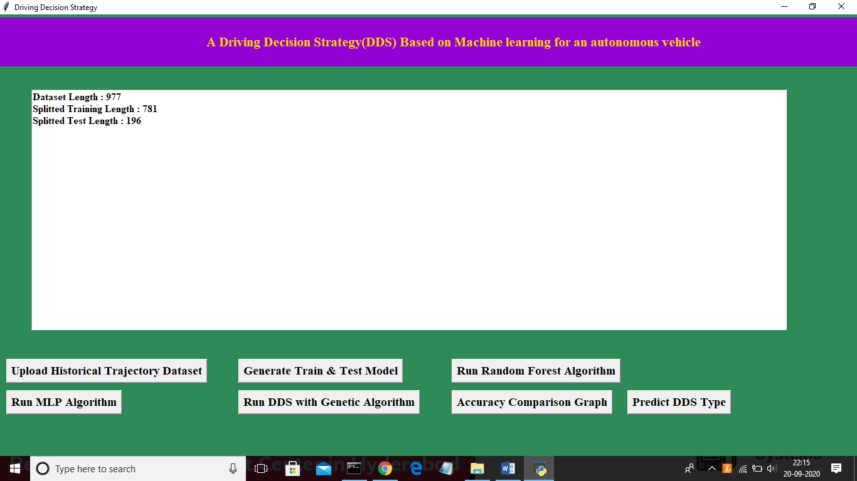

Slide 15
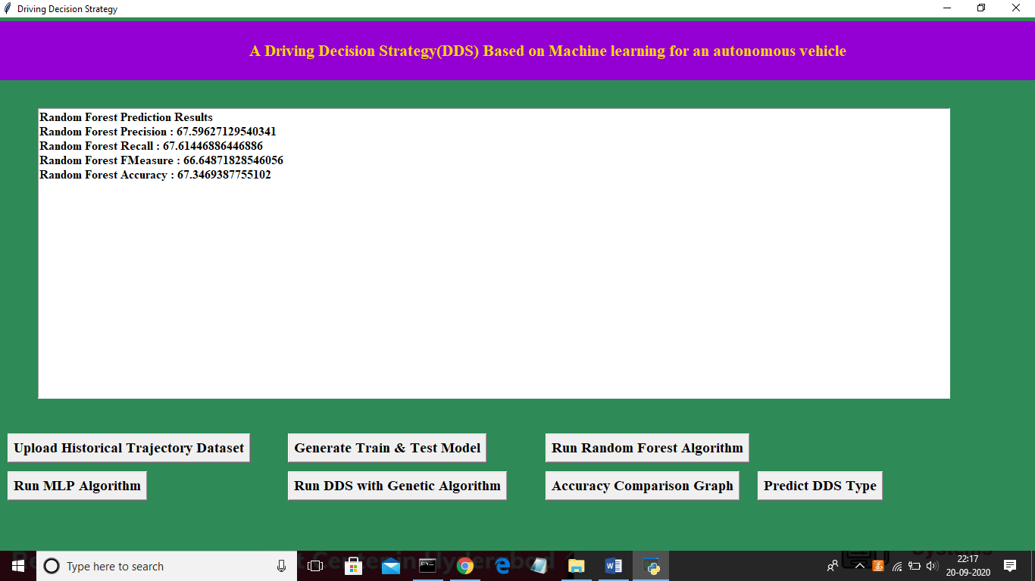

Slide 16


Slide 17
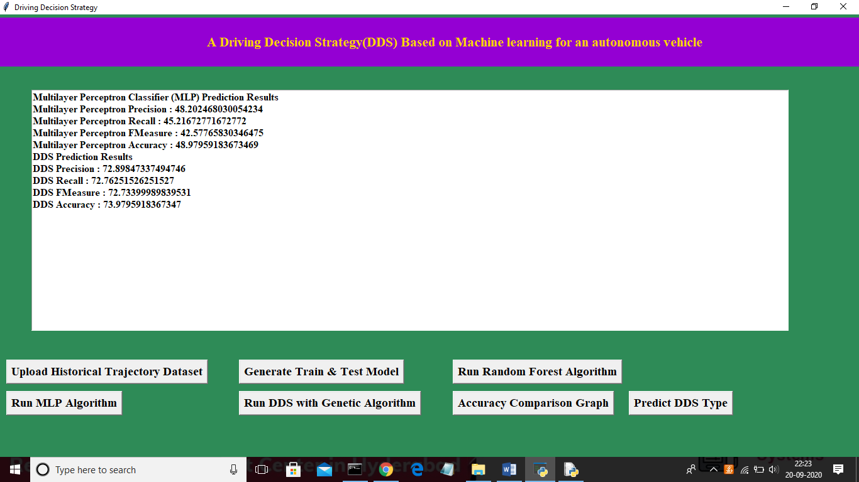

Slide 18
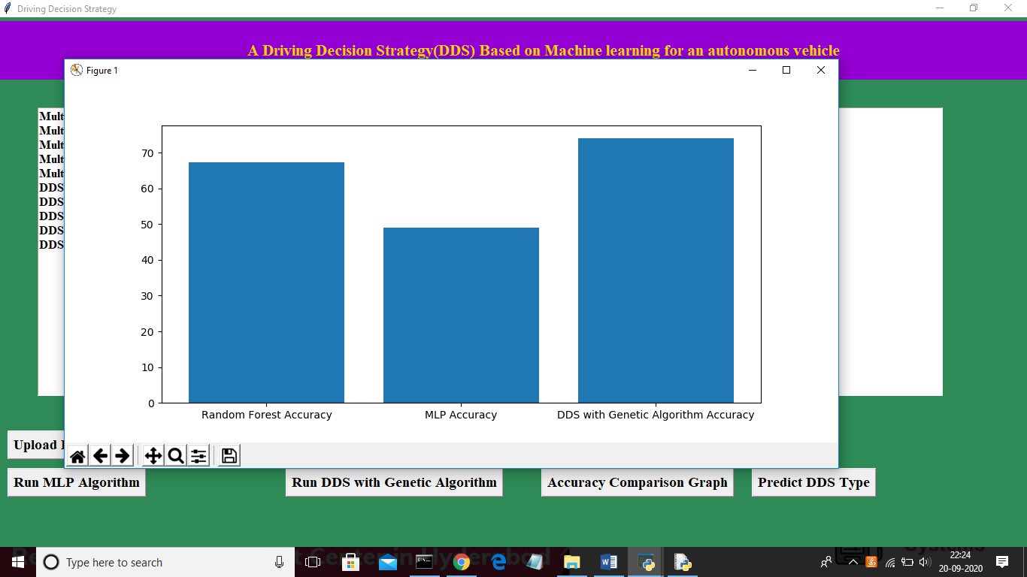

Slide 19


Slide 20
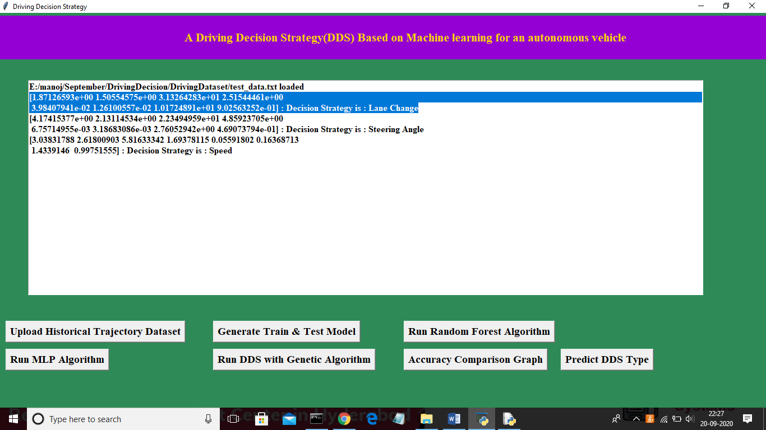

Slide 21

Working modules
Upload Historical Trajectory Dataset
Generate Train & Test Model
Run Random Forest Algorithm
Run MLP Algorithm
Run DDS with Genetic Algorithm
Accuracy Comparison Graph
Predict DDS Type

Slide 22
Input
• Sensor data files
output
• Accuracy in prediction

Slide 23

Software
Python idle 3.7 version
Anaconda 3.7 ( or)
Jupiter (or)
(or)

Slide 24

Hardware
Operating system: windows, Linux
Processor : minimum intel i3
Ram: minimum 4 Gb
Hard disk : minimum 250 Gb

Slide 25

conclusion
 We are proposed a Driving Decision Strategy. It executes the genetic algorithm based on accumulated data to determine the vehicle's optimal driving strategy according to the slope and curvature of the road in which the vehicle is driving and visualizes the driving and consumables conditions of an autonomous vehicle to provide drivers. To verify the validity of the DDS, experiments were conducted to select an optimal driving strategy by analyzing data from an autonomous vehicle.

