Slide 1
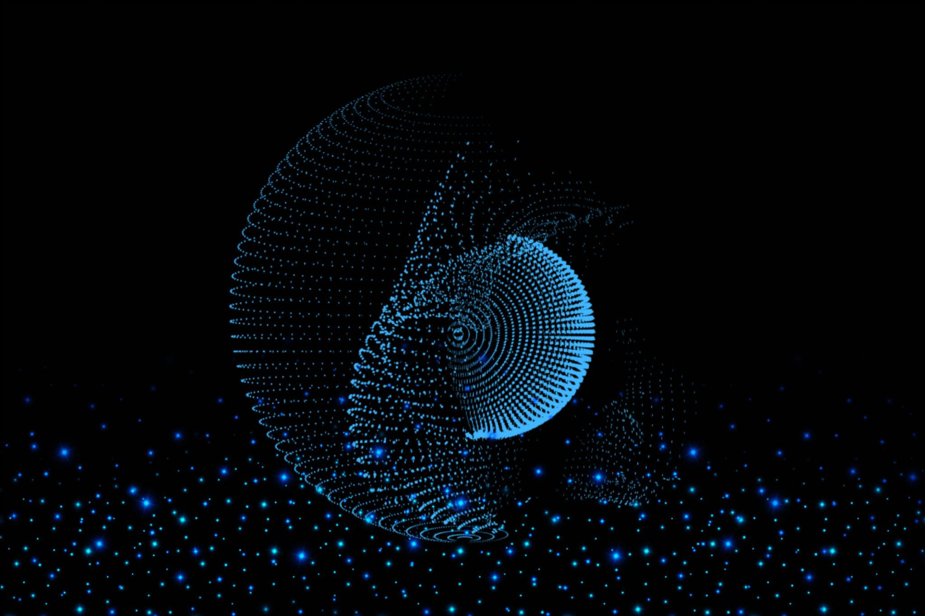
3D Scene Reconstruction from
Multi-View Images; S.P.E.C.T.R.A
Image-Based 3D Reconstruction Dashboard
Image-Based 3D Reconstruction Dashboard
Prepared by Mugwanya Osbert

Slide 2
Introduction
This project focuses on reconstructing a 3D scene from multiple 2D images using computer vision techniques. It combines depth estimation and camera pose estimation to generate a 3D point cloud representation of a real-world environment.

Slide 3
Problem Statement
Turning ordinary phone images into usable 3D assets is still technically demanding.
Manual photogrammetry workflows require many separate tools and careful file handling.
Students and prototype teams need a visible end-to-end reconstruction workflow.
Real captures contain blur, weak texture, changing exposure, reflective surfaces, and incomplete overlap.
The project aims to make the reconstruction stages inspectable, explainable, and exportable.
Core Idea
A Streamlit dashboard that organizes image ingestion, frame selection, depth estimation, pose recovery, dense fusion, cleanup, meshing, and export.
Presentation Focus
Show that the pipeline can reconstruct recognizable real objects and explain where limitations come from.

Slide 4
Project Objectives
Ingest Images
Accept real smartphone image sequences and stage them for processing.
Select Keyframes
Keep sharp and diverse frames so reconstruction uses stronger visual evidence.
Recover Geometry
Estimate depth, camera poses, sparse points, dense clouds, and meshes.
Evaluate Outputs
Inspect point clouds, meshes, metrics, and export-ready files.
Support Baselines
Use synthetic scenes and research datasets for controlled comparisons.
Explain Results
Make every stage understandable during demonstration and assessment.

Slide 5
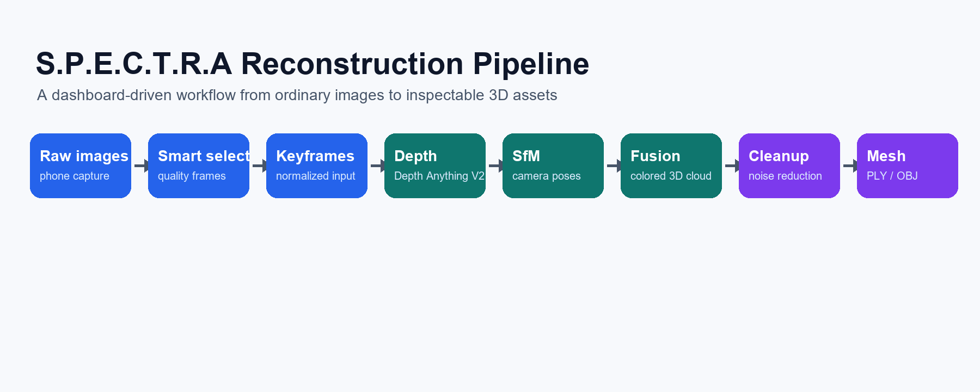
System Pipeline
Each output in the dashboard corresponds to one stage in this flow.

Slide 6
Implementation Stack
Dashboard
Streamlit interface for uploads, live status, previews, output inspection, and synthetic baselines.
Exports
PLY and OBJ assets for inspection in the dashboard, MeshLab, CloudCompare, Blender, or Gaussian Splatting workflows.
Computer Vision
OpenCV ORB features, matching, essential matrix pose recovery, sharpness scoring, and image preprocessing.
Recent Improvements
Lobby keyframes increased to 60; object fusion made more permissive for thin/planar captures; synthetic car import path added.
Depth and 3D
Depth Anything V2, NumPy, Open3D point clouds, DBSCAN cleanup, Poisson surface reconstruction.

Slide 7
What The Output Types Mean
Sparse cloud
Feature matches used to estimate camera alignment.
Pose-aligned dense cloud
Main colored point cloud from depth maps and camera poses.
Legacy dense cloud
Older/fallback dense output kept for comparison.
Cleaned dense cloud
Noise-reduced cloud used before meshing.
Poisson mesh
Continuous surface generated from the cleaned point cloud.
OBJ mesh
Portable mesh format for external 3D software.

Slide 8
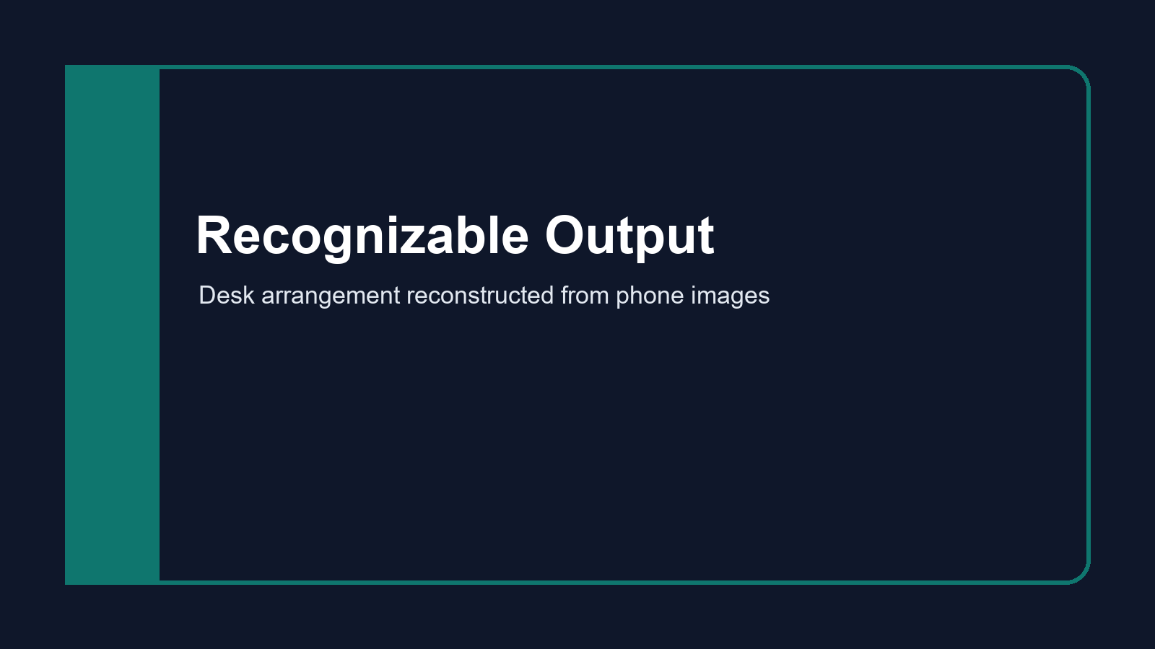
Best Real Reconstruction: Desk Arrangement
The strongest current output is recognizable as a physical workstation scene.
Recognizable elements: desk/table surface, laptop/screens, cups, and surrounding objects.
Point cloud and mesh outputs show that the pipeline is reconstructing real object geometry.
Remaining gaps and stretched areas are expected from monocular depth, reflective surfaces, and pose noise.
This is the best demonstration artifact for the live presentation.

Slide 9
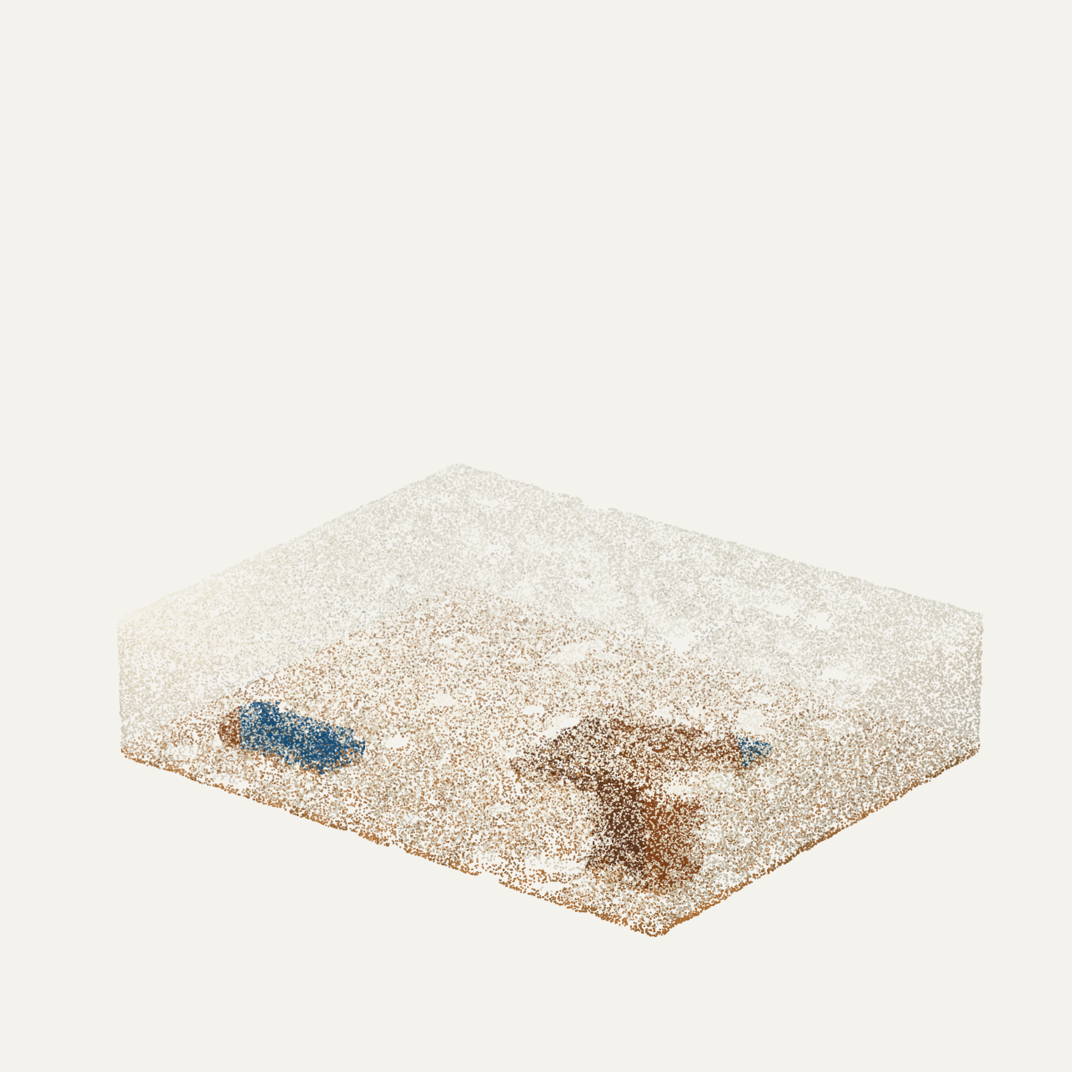
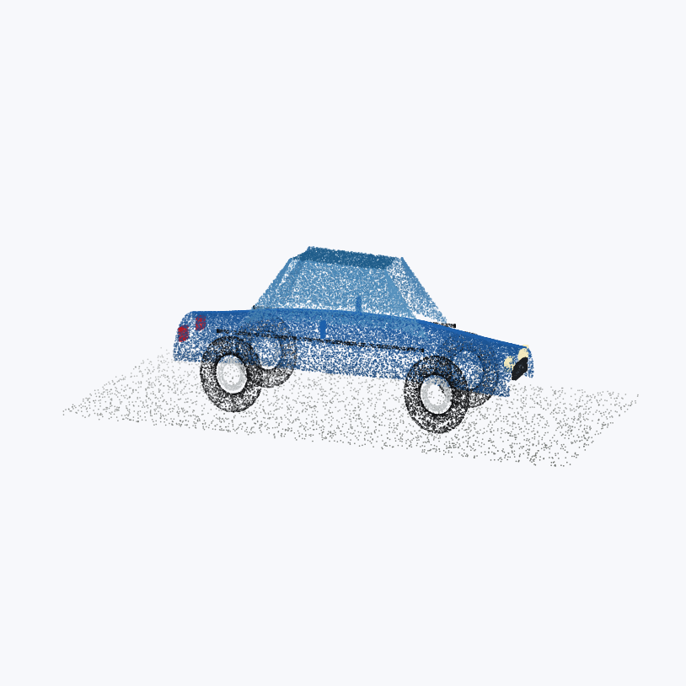
Synthetic Baselines
Synthetic scenes help explain controlled geometry versus real capture uncertainty.

Slide 10
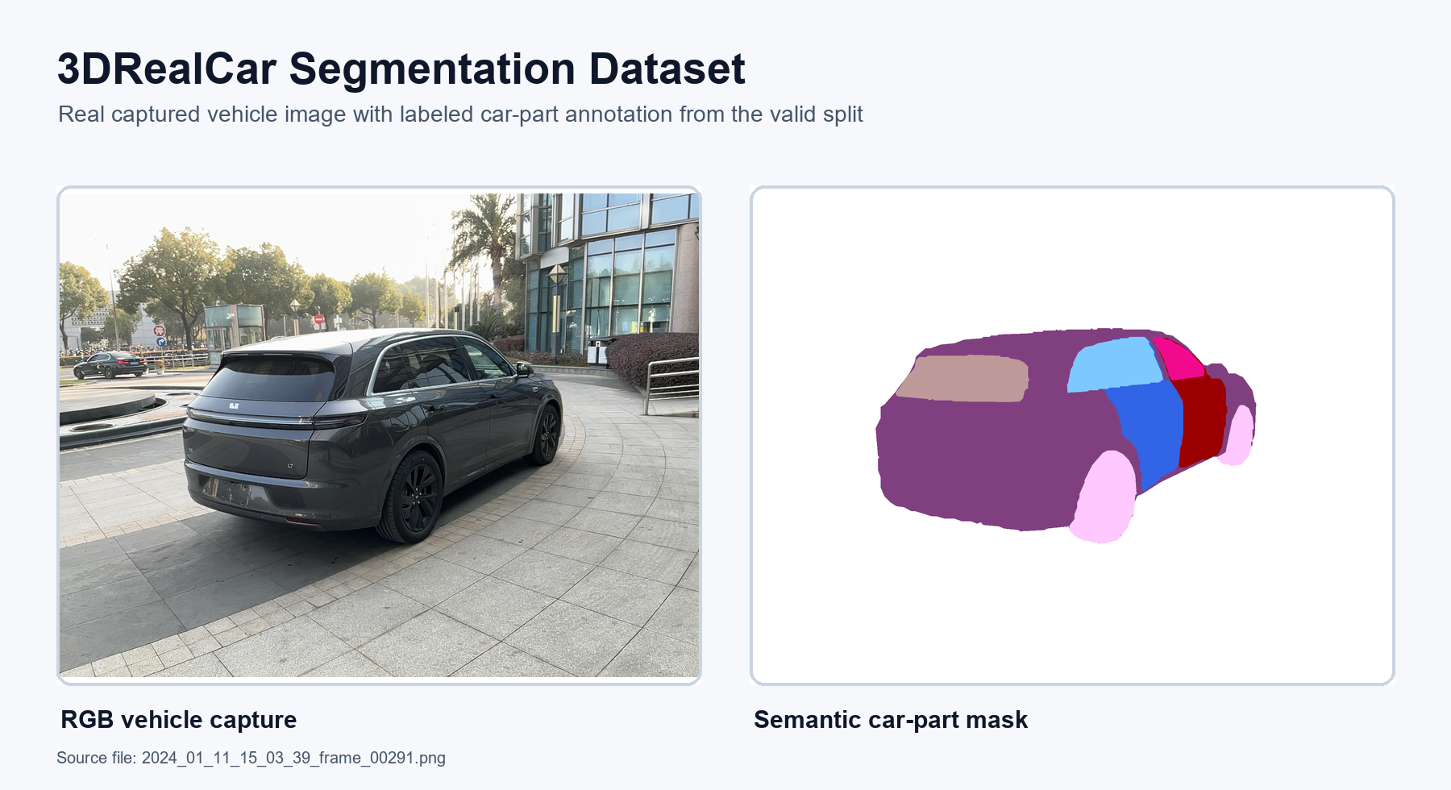
3DRealCar Dataset Integration

Slide 11
Limitations And Risks
Textureless walls, glossy screens, shadows, and repeated patterns can reduce pose accuracy.
Monocular depth provides relative depth, so scale and alignment can drift.
Thin planar objects may need permissive fusion settings to avoid over-filtering.
Poisson meshing can fill gaps or stretch surfaces where the point cloud is incomplete.
Synthetic colors are generated/material colors unless they come from a real scan or texture dataset.
How We Addressed This
Increased keyframes for room captures, loosened object fusion, preserved thin structures, and added a dataset-backed car import path.

Slide 12
Evaluation Strategy
Visual Quality
Can the viewer recognize the object/scene arrangement?
Point Count
Are enough points produced after fusion and cleanup?
Stage Completion
Did depth, SfM, fusion, cleanup, mesh, and export stages complete?
Export Readiness
Can PLY/OBJ outputs be opened in external 3D tools?
Failure Analysis
Do artifacts align with known capture or algorithm limitations?
Baseline Comparison
Compare real reconstructions with synthetic controlled scenes.

Slide 13
Live Demo Flow
1. Open dashboard and show dataset ingestion.
2. Show raw image inventory and preview dropdown.
3. Show keyframe selection and depth preview outputs.
4. Open 3D viewer and compare sparse cloud, dense cloud, cleaned cloud, and mesh.
5. Explain the desk reconstruction as the best real output.
6. Open synthetic baselines and mention 3DRealCar integration path.
7. Close with limitations and future improvements.

Slide 14
Conclusion
S.P.E.C.T.R.A demonstrates a complete image-to-3D workflow in one dashboard.
The project produces inspectable point clouds, meshes, and export-ready files.
The best real result reconstructs a recognizable desk arrangement from phone images.
The system is presentation-ready as a prototype, with clear explanations for artifacts and limitations.
Future work: stronger calibration, real scanned car baseline, texture projection, and measured benchmark evaluation.
Final Message
The project proves the workflow and makes every reconstruction stage visible, explainable, and demonstrable.

