Slide 1
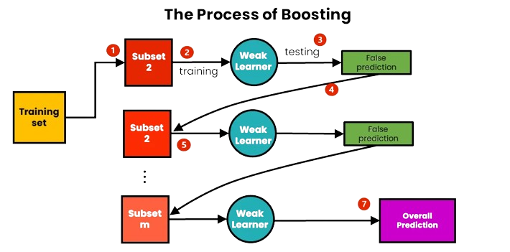
Boosting Algorithms

Slide 2
How Does Boosting Algorithms Work?
The term ‘Boosting’ refers to a family of algorithms which converts weak learner to strong learners.
Step 1: The base learner takes all the distributions and assign equal weight or attention to each observation.
Step 2: If there is any prediction error caused by first base learning algorithm, then we pay higher attention to observations having prediction error. Then, we apply
the next base learning algorithm.
Step 3: Iterate Step 2 till the limit of base learning algorithm is reached or higher accuracy is achieved.
Types :
AdaBoost (Adaptive Boosting)
Gradient Tree Boosting
XGBoost

Slide 3
AdaBoost
Selecting RANDOM data
Creating
Model
Updating Weights
Selecting RANDOM data
Final
Prediction
Creating
Model
Updating Weights
Selecting RANDOM data
Creating
Model

Slide 4
Gradient Boosting
Steps :
Creating Base Model – Average Method
Calculate Residual ( Average and Actual)
Create Another Model using Residuals as Target
Repeat the steps till we achieve 100% Accuracy
Final Model = Base Model + LR*Residual_Model_1 + LR*Residual_Model_2 + …….

Slide 8
XG Boost
Creating Model 1
Prediction
Model 1
New Target e1
Creating Model 2
Prediction
Model 2
Final
Prediction
New Target e2
Creating Model 3
Prediction
Model 3

Slide 9
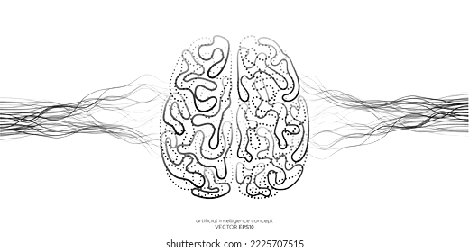
Thank You

