Slide 1
Digital Portfolio
STUDENT NAME : M.MUGIL VANNAN
REGISTER NO : 24131081802521050
NMID : C4A6CDD952032FAADF8431071D96CA0A
DEPARTMENT : II - B.Sc.,Comp. Science (SHIFT-1)
COLLEGE : Thiru Kolanjiappar Arts College affiliated to Annamalai University

Slide 2
PROJECT TITLE DIGITAL PORTFOLIO with Multicolor Navbar

Slide 3


AGENDA
Problem Statement
Project Overview
End Users
Tools and Technologies
Portfolio design and Layout
Features and Functionality
Results and Screenshots
Conclusion
Github Link
3/21/2024 Annual Review

Slide 4

PROBLEM STATEMENT Modern web interfaces often lack visually appealing navigation systems that also incorporate accessibility, responsiveness, and user-friendly interactions. This project solves that by designing a vibrant, animated multicolor navbar with extended JavaScript features to enhance both aesthetics and usability.

Slide 5

PROJECT OVERVIEW This project is a responsive, accessible front-end layouts. Which are, a Featuring a rainbow-gradient sticky navbar, a Dark mode toggle, a Scroll progress bar, a Animated content reveals, a Keyboard navigation — all built with semantic HTML, modern CSS, and vanilla JavaScript.

Slide 6

WHO ARE THE END USERS? * UI/UX designers and developers showcasing their frontend skills * Personal portfolio or landing page visitors * Anyone needing a lightweight, visually engaging navigation component * College students can show their front – end skills for visitors of website.

Slide 7

TOOLS AND TECHNIQUES * HTML & CSS : Semantic structure and modern responsive design with CSS custom properties (variables) and gradients * JavaScript (ES6+) : For dark mode, scroll-spy, header animation, smooth scrolling, and local Storage handling * Accessibility : ARIA roles, keyboard navigation (←/→), focus management * Responsive Design : CSS media queries and mobile navigation toggle * Performance & UX : Scroll-triggered animations, reduced motion support

Slide 8
POTFOLIO DESIGN AND LAYOUT
Design Highlights :
Sticky, animated multicolor navigation bar with optional animation toggle
Dark mode and light mode themes using css
Mobile-responsive menu
Scroll progressing bar
Smooth internal link navigation with scroll offset
Hero section, features and project cards with
reveal-on-scroll animation
Footer with dynamic year
8

Slide 9
FEATURES AND FUNCTIONALITY * Lightweight, standalone front-end template * Fully accessible and responsive navigation experience * Enhanced user engagement with interactive and animated UI * Ideal for personal portfolios, SaaS landing pages, or UI showcases

Slide 10

RESULTS AND SCREENSHOTS * Desktop full width navbar with animation * Dark mode toggled view * Mobile hamburger menu open * Cards revealing on scroll
3/21/2024 Annual Review
10

Slide 11
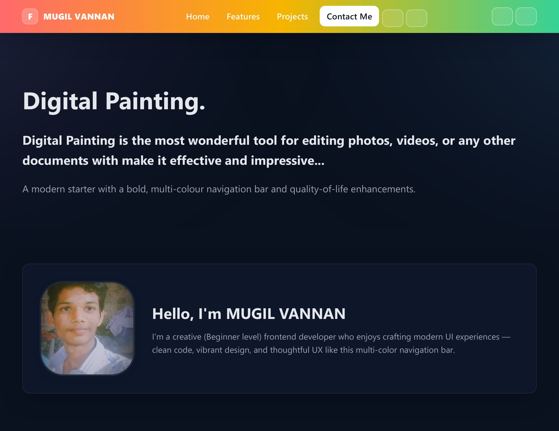
1.Home Page with Gradient Navbar
11

Slide 12
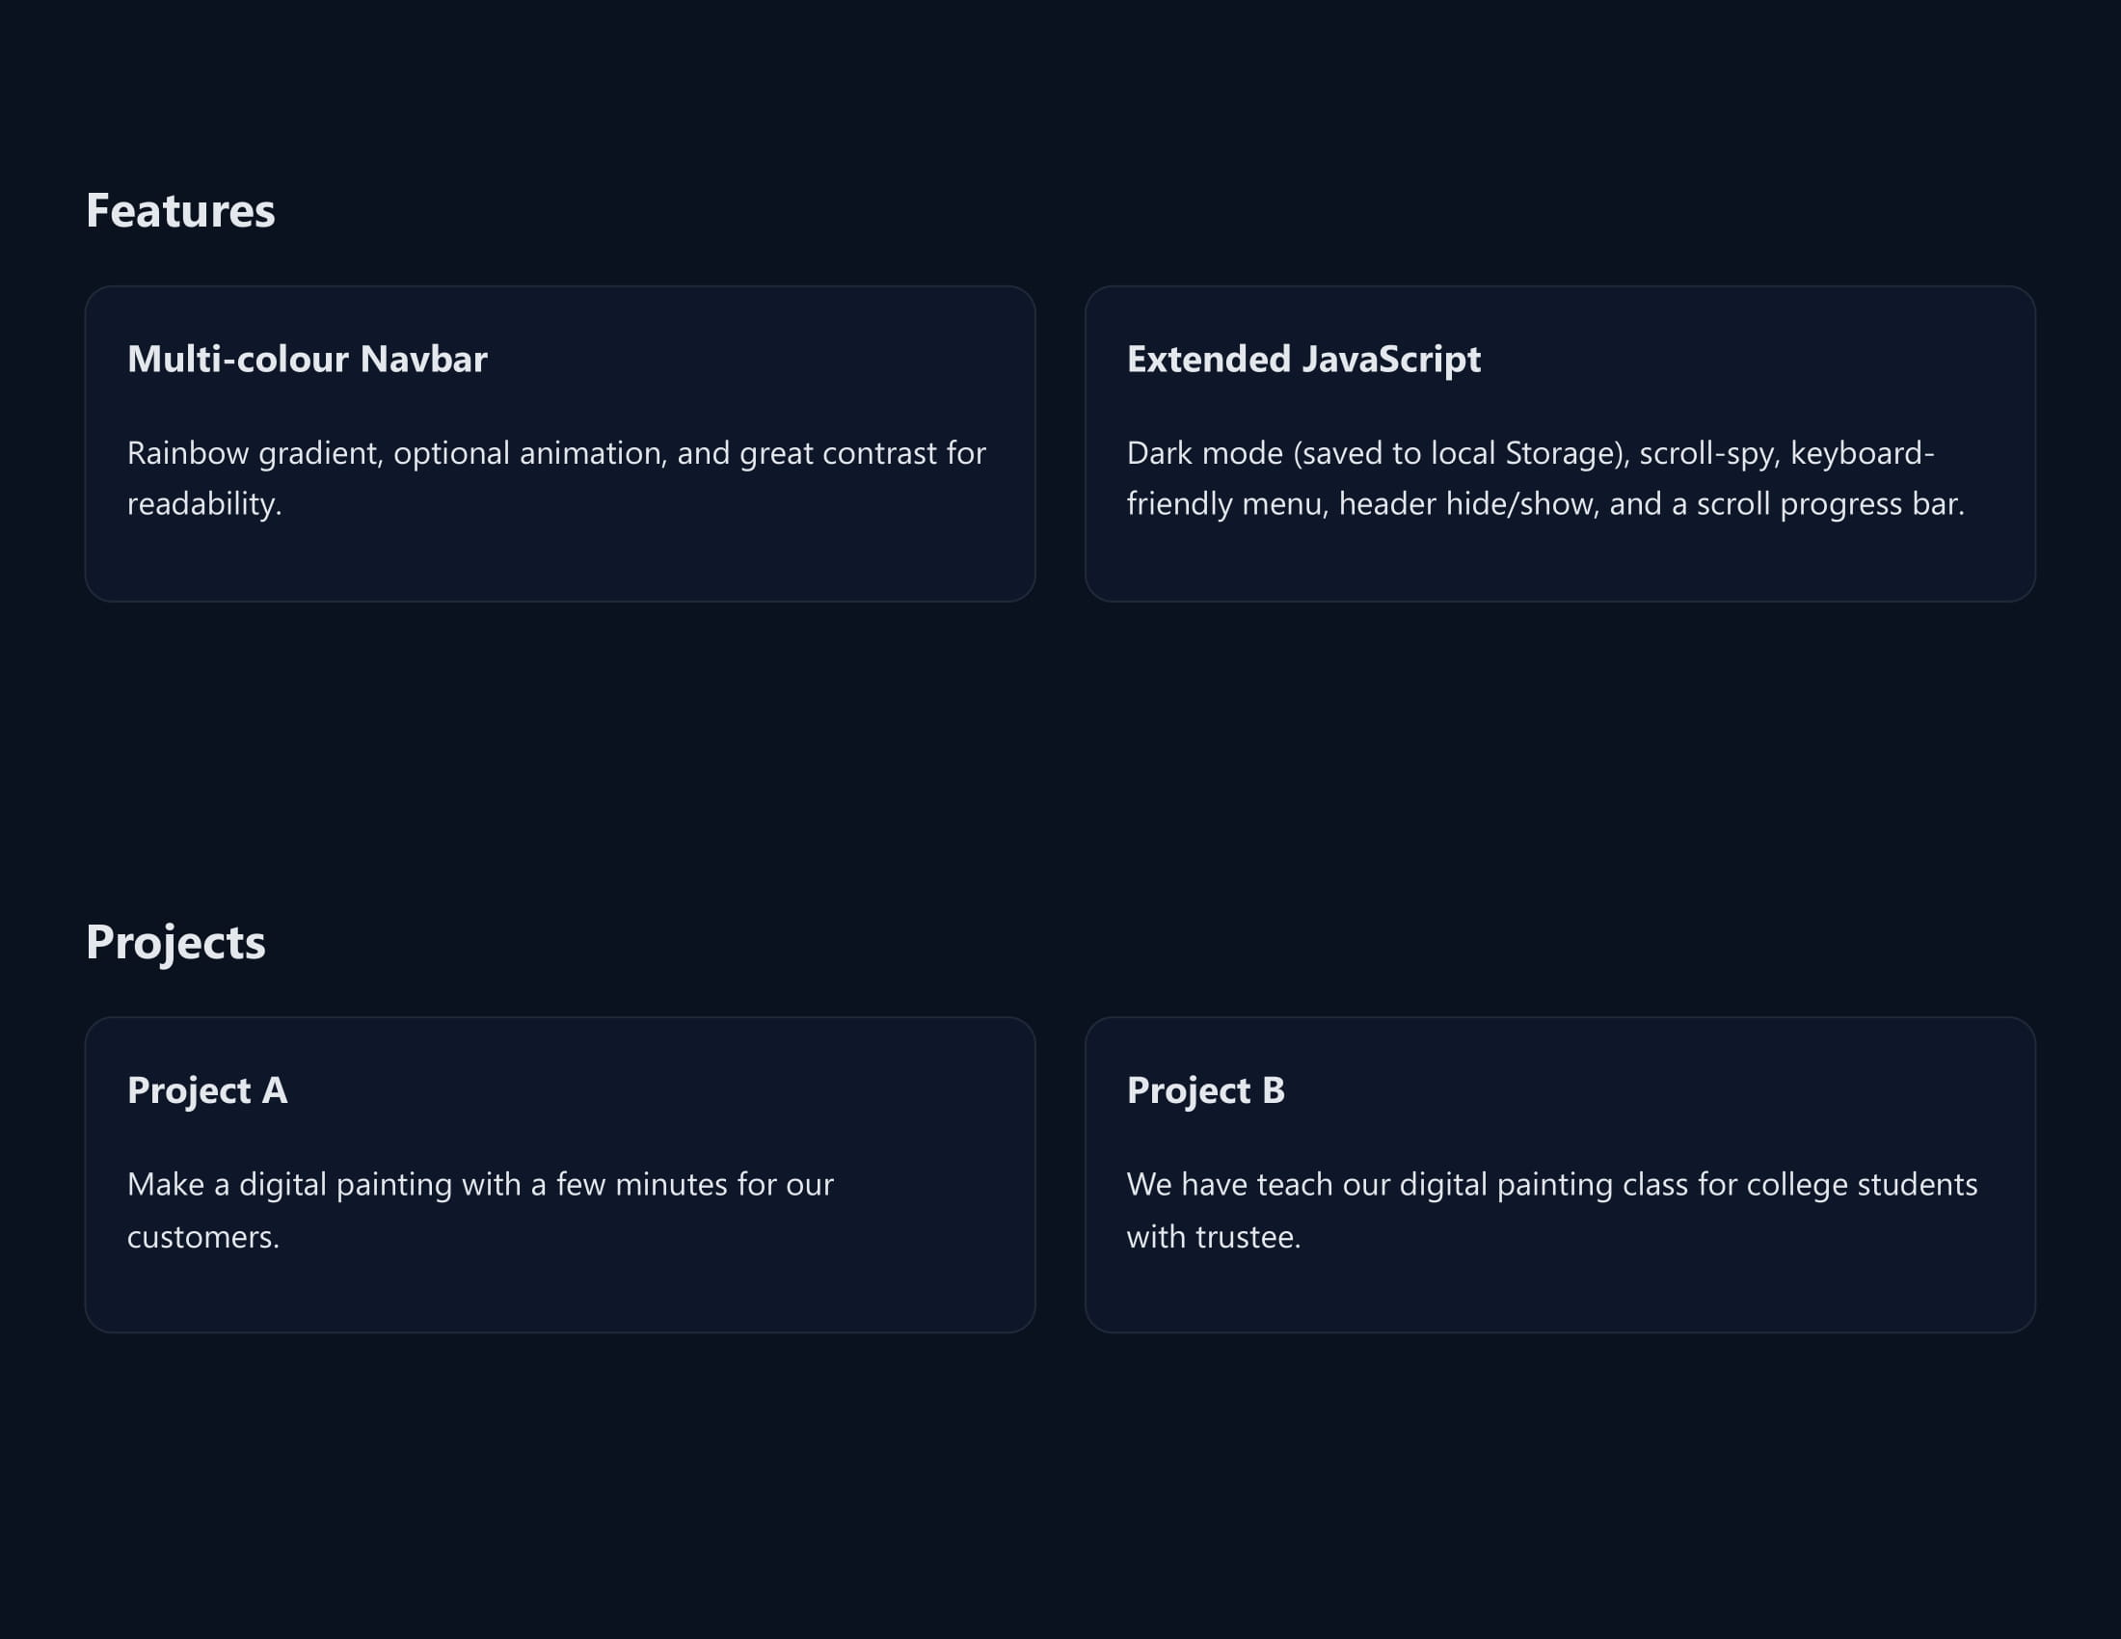
2. Next Page with future projects
12

Slide 13
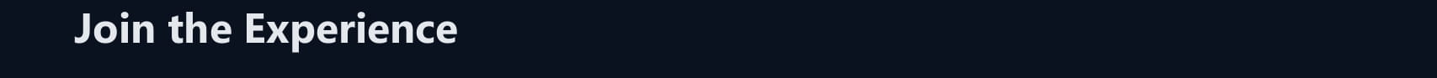
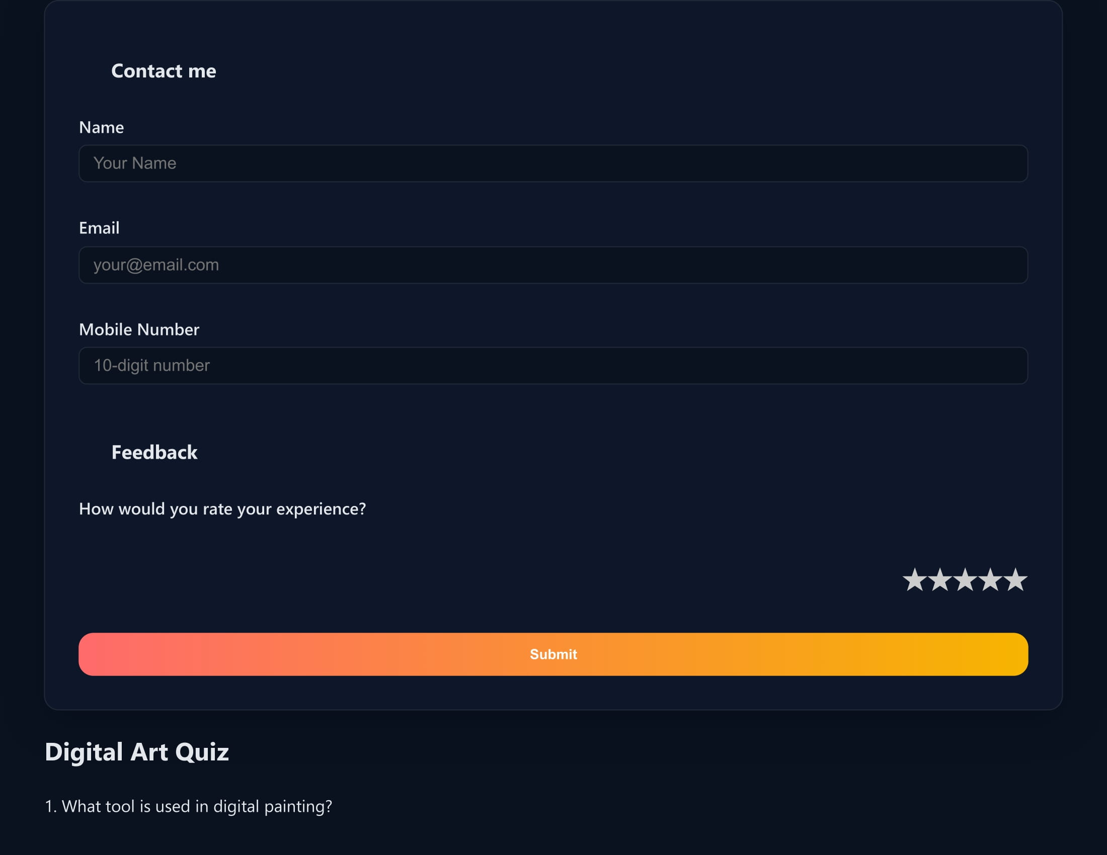
3. Contact me division for getting information about my web page visitors
13

Slide 14
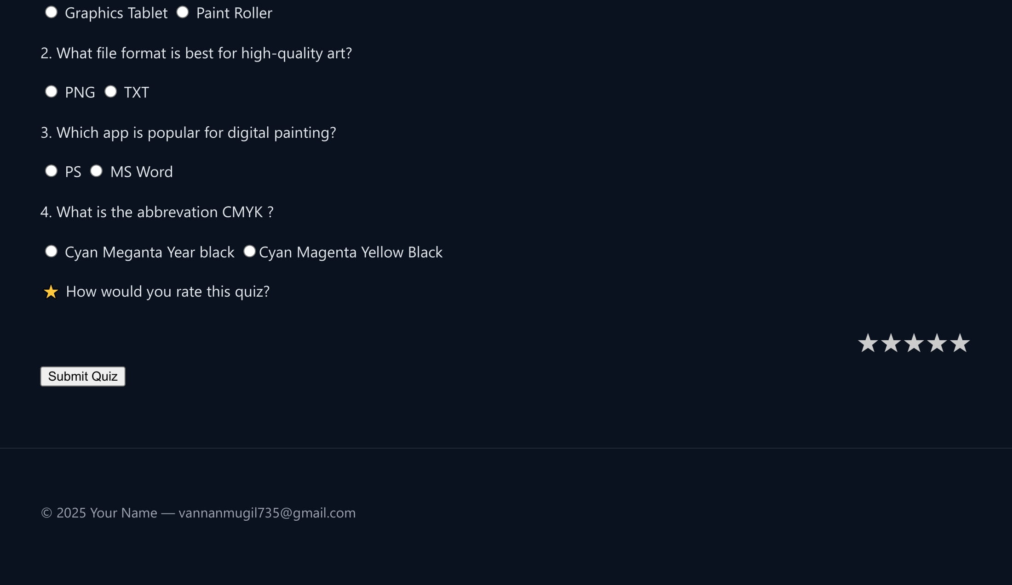
4.Simple Quiz for Digital Paint with result….

Slide 15
CONCLUSION This project demonstrates how powerful and dynamic a simple static HTML/CSS/JS project can be when modern design practices, accessibility, and UX features are thoughtfully integrated. It serves as an excellent base for personal portfolios or UI/UX development projects.
15

