Slide 1
WARFARIN DOSE MODELING STUDY
IWPC calculator benchmarking with machine-learning baselines and explainability
Shared 20% holdout evaluation on the IWPC cohort using the official IWPC clinical and pharmacogenetic formulas alongside linear regression, random forest, XGBoost, neural network, and the tuned LightGBM repository model.
RMSE gain vs IWPC PGx: 0.02 mg/week
Within-20% gain vs IWPC PGx: 0.3 points
Clinical-only IWPC: RMSE 13.84, MAE 10.07
BEST MODEL
Our Model (Tuned LightGBM)
RMSE 11.90 mg/week | MAE 8.70 mg/week | R² 0.421
Within 20% accuracy: 42.0%
Source cohort: IWPC Subject Data
01

Slide 2
LEADERBOARD
Top three models are tightly grouped, but the tuned repository model lands first on RMSE
01
02
03
Our Model (Tuned LightGBM)
IWPC Pharmacogenetic Calculator
Linear Regression
RMSE
RMSE
RMSE
11.90
11.92
11.92
MAE
MAE
MAE
8.70
8.65
8.74
R²
R²
R²
0.421
0.419
0.419
WITHIN 20%
WITHIN 20%
WITHIN 20%
42.0%
41.7%
41.3%
Metric priority: RMSE, then MAE
02

Slide 3
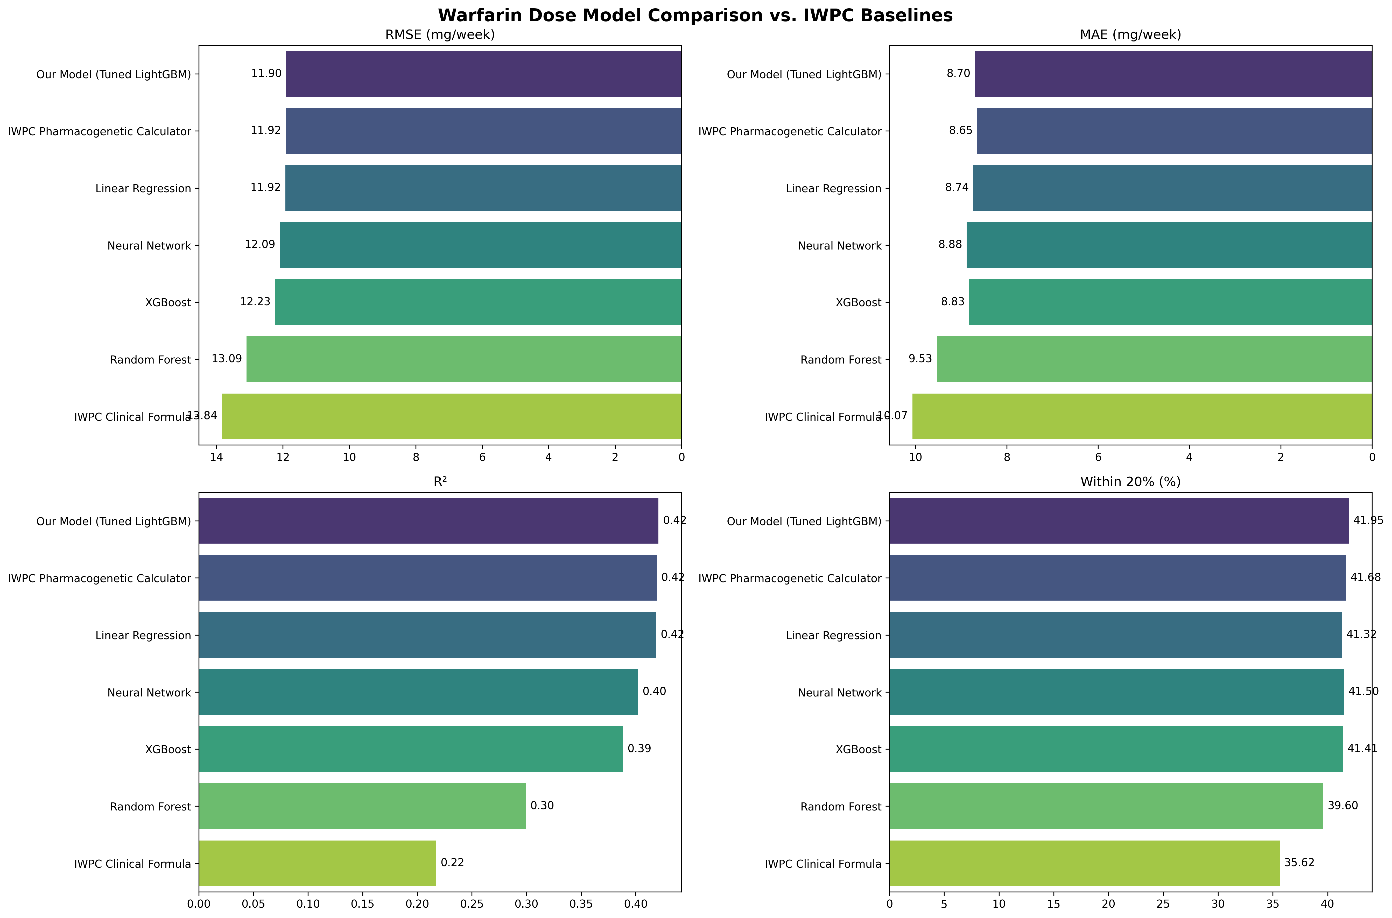
VISUAL COMPARISON
Aggregate metrics show only a narrow edge over the IWPC pharmacogenetic calculator
The tuned LightGBM model leads on RMSE and R², but the IWPC pharmacogenetic formula remains highly competitive.
Linear regression almost matches the top two, which suggests the signal is still strongly structured and not purely nonlinear.
Random forest underperforms on this cohort and should not be treated as a preferred baseline here.
The clinical-only IWPC formula shows a clear drop, which supports keeping genotype-aware modeling in the workflow.
Images generated from repository outputs
03

Slide 4
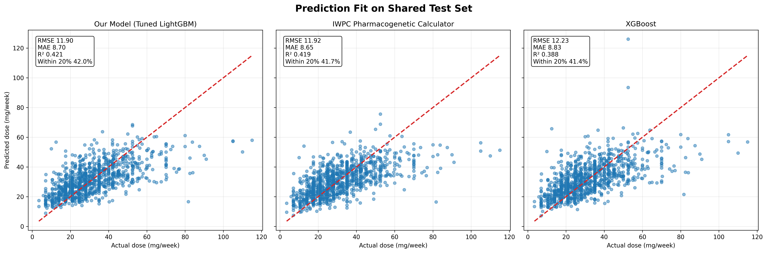
FIT DIAGNOSTICS
Patient-level scatter plots show similar calibration bands for the top genotype-aware approaches
Shared holdout split: random_state 42
04

Slide 5
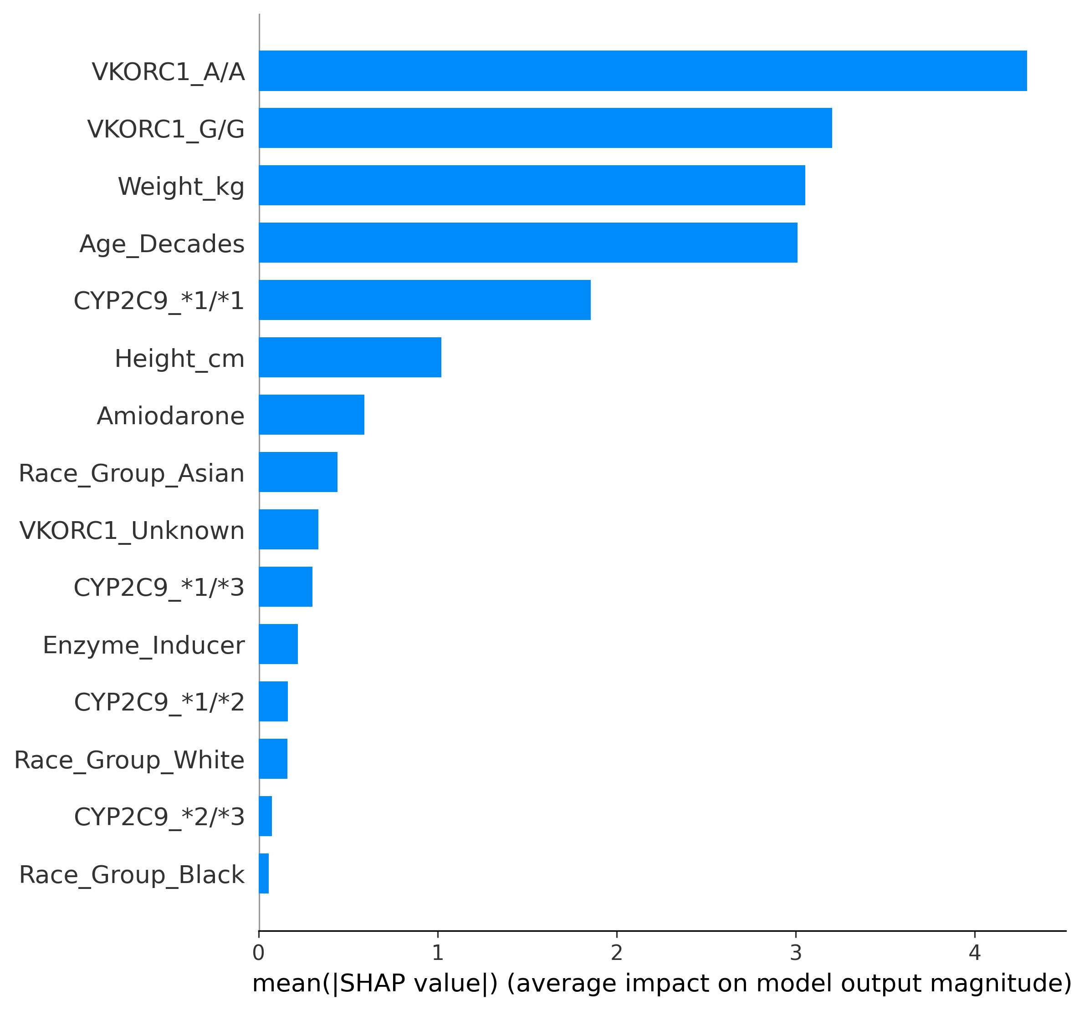
EXPLAINABILITY
SHAP confirms that the best model still follows clinically credible genetic and anthropometric drivers
Global feature influence is led by VKORC1, then weight, age, and CYP2C9.
The strongest SHAP features align with known warfarin dose biology instead of opaque proxy variables.
Best model explained here: Our Model (Tuned LightGBM).
VKORC1 A/A
4.292
VKORC1 G/G
3.202
Weight kg
3.053
Age Decades
3.011
CYP2C9 *1/*1
1.855
Height cm
1.021
Amiodarone
0.589
Race Group Asian
0.440
Best model explainability summary
05

Slide 6
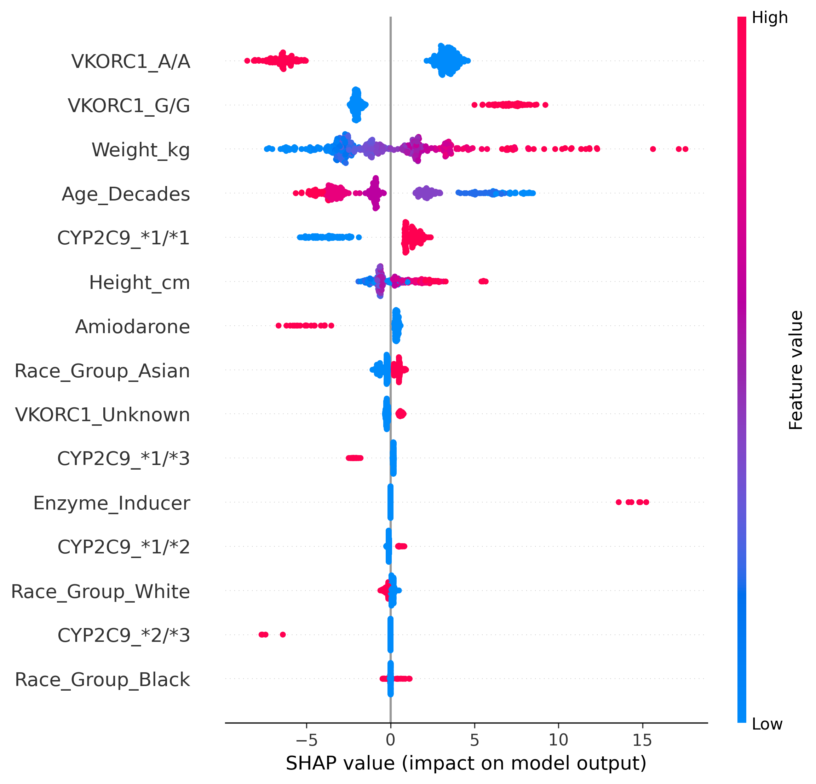
APPENDIX
Complete ranking table and SHAP distribution view
rank | model | rmse | mae | r2 | within_20_pct
1 | Our Model (Tuned LightGBM) | 11.9034 | 8.7012 | 0.4209 | 41.9530
2 | IWPC Pharmacogenetic Calculator | 11.9198 | 8.6526 | 0.4193 | 41.6817
3 | Linear Regression | 11.9238 | 8.7364 | 0.4190 | 41.3201
4 | Neural Network | 12.0937 | 8.8810 | 0.4023 | 41.5009
5 | XGBoost | 12.2332 | 8.8270 | 0.3884 | 41.4105
6 | Random Forest | 13.0928 | 9.5326 | 0.2994 | 39.6022
7 | IWPC Clinical Formula | 13.8394 | 10.0696 | 0.2173 | 35.6239
Generated from iwpc_model_metrics.csv and iwpc_shap_top_features.csv
06

