Slide 1
ATTENDANCE MANAGEMENT SYSTEM
TEAM MEMBERS:
S.KARTHIKEYAN (56)
D UMUGILKRISHNA (73)

Slide 2
TABLE OF CONTENTS
PROBLEM STATEMENT (3)
EXTENDED EXPLORATION OF PROBLEM STATEMENT(5)
MOTIVATION (7)
SCOPE AND LIMITATIONS (10)
CLASS DIAGRAMS (13)
MODULE SPLIT UP (23)
IMPLEMENTATION (29)
DATABASE DESIGN (39)
OUTPUT SCREENSHOTS (43)
OBJECT ORIENTED FEATURES USED (58)
INFERENCE AND FUTURE EXTENSION (60)

Slide 3
PROBLEM STATEMENT

Slide 4
PROBLEM STATEMENT
To develop an integrated Attendance Management System (AMS) that empowers students to autonomously monitor their attendance and provides teachers with tools to manage class-wide attendance records. The system offers students an intuitive interface to log and track their attendance, fostering a sense of responsibility. Simultaneously, teachers have the capability to efficiently oversee and manage attendance records for the entire class.
This collaborative system encourages student engagement in attendance tracking while providing teachers with the administrative control necessary for accurate record-keeping.

Slide 5
EXTENDED EXPORATION OF THE PROBLEM STATEMENT

Slide 6
EXTENDED EXPORATION OF THE PROBLEM STATEMENT
Student-centric:
Involves a system that empowers students to independently monitor and manage their attendance records. The system offers a user-friendly interface allowing students to log their attendance, view personalized attendance reports. This enhancement aims to provide students with a centralized platform where they can not only monitor their attendance but also conveniently access and navigate their timetable.
Teacher-centric
Involves a system tailored for educators, empowering them to efficiently maintain attendance record of the class. The system offers a user-friendly interface that allows teachers to easily record attendance, receive ODs of students, and generate comprehensive reports as needed.
Admin console
Involves a robust Admin Console within the system, enabling administrators to review login logs for enhanced security monitoring and edit class timetables seamlessly. This feature grants administrators the ability to access and analyse login histories, ensuring a heightened level of system security. Additionally, administrators can effortlessly modify class timetables, ensuring adaptability to schedule changes or optimizing class arrangements.

Slide 7
MOTIVATION

Slide 8
EXISTING SYSTEM
Manual, Time-Consuming Processes and prone to errors:
Many traditional systems rely on manual attendance recording methods, such as paper-based registers or manual data entry. This is not only time-consuming but also prone to errors and delays.
In systems that rely on manual entry, human errors such as typos, misinterpretations, or accidental double entries can occur, leading to inaccuracies in the attendance records.
Lack of Accessibility:
Some systems may lack user-friendly interfaces or accessibility features, making it difficult for both students and teachers to conveniently access and input attendance data. This can lead to decreased user engagement.
Inflexibility in Data Analysis:
The inability to generate customizable and insightful reports may limit the system's utility for educators. Analysing attendance trends and patterns becomes challenging without robust reporting capabilities

Slide 9
PROPOSED SYSTEM
User-Friendly Interface:
The system provides an intuitive and user-friendly interface for both students and teachers, making it easy to navigate and record attendance. This promotes user engagement and reduces the learning curve.
Real-Time Updates:
With the inclusion of real-time attendance recording, the system ensures that attendance data is instantly updated. This feature allows for timely intervention and proactive management of attendance-related issues.
The proposed system facilitates quick and efficient updation of the timetable through user-friendly interfaces.
Self-Service for Students:
Empowering students to manage their own attendance promotes a sense of responsibility and ownership. Students can easily track their attendance records and get consolidated reports, fostering a proactive approach to attendance management.
Efficient Teacher Oversight:
Teachers benefit from a streamlined process for managing class-wide attendance records. The system allows for easy input, modification, and verification of attendance, reducing administrative burdens.

Slide 10
SCOPE AND LIMITATIONS

Slide 11
SCOPE
Attendance Recording:
The system facilitates the recording of attendance data, providing a centralized and digitized platform for capturing accurate attendance information.
User Roles and Permissions:
Different user roles, including administrators, educators, and attendees, are defined with specific permissions. This ensures that each user has the appropriate level of access and functionality within the system.
Real-Time Tracking:
Real-time updates on attendance are a core feature, allowing users to access the most current information promptly. This supports timely decision-making and intervention based on live attendance data.
Scalability:
The system is scalable to accommodate the evolving needs of educational institutions or organizations. It can effectively handle increased user numbers, growing data volumes, and changing requirements without compromising performance.

Slide 12
LIMITATIONS
Dependency on Technology:
The system's effectiveness relies on the availability and reliability of technology. Technical issues, such as server outages or software glitches, may disrupt normal system functioning.
Integration Complexity:
Integrating the system with existing institutional databases or systems may be complex, especially if there are compatibility issues. A seamless integration process is essential to avoid disruptions.
Maintenance and Updates:
Regular maintenance and updates are essential to keep the AMS secure and functional. Failure to perform timely updates could expose the system to security vulnerabilities.
Limited Customization:
Depending on the system's design, there may be limitations in customization, hindering its adaptability to unique institutional or organizational requirements.

Slide 13
CLASS DIAGRAMS

Slide 14
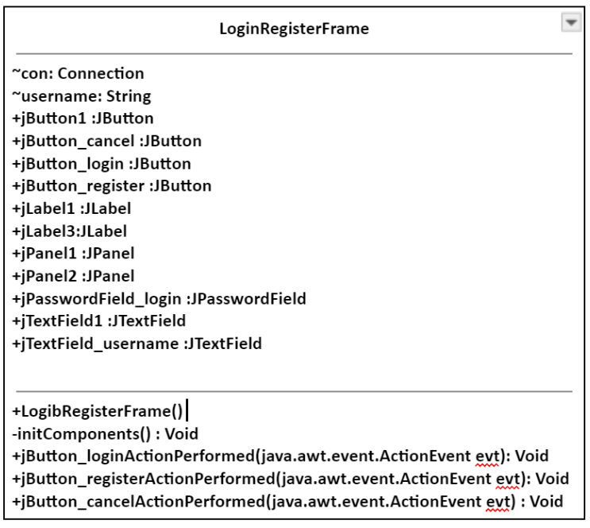
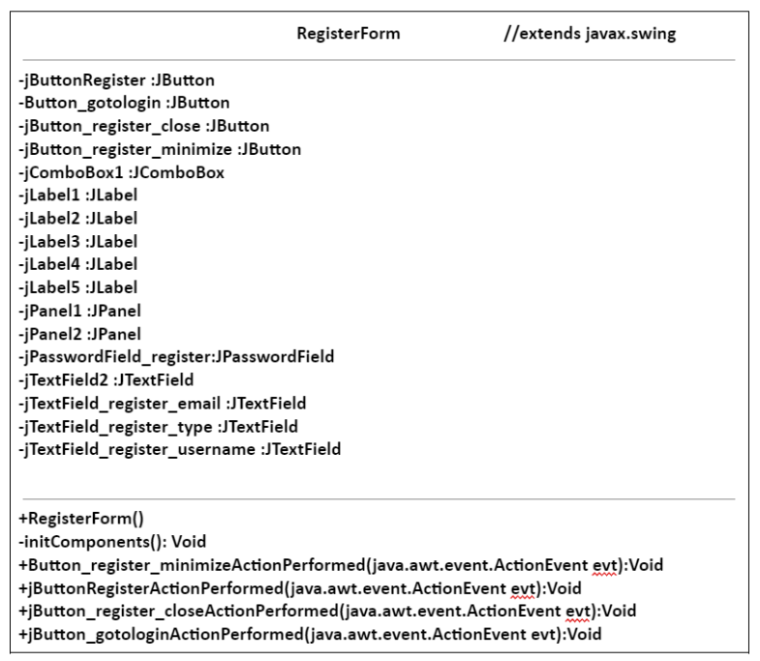
REGISTER MODULE
LOGIN MODULE

Slide 15
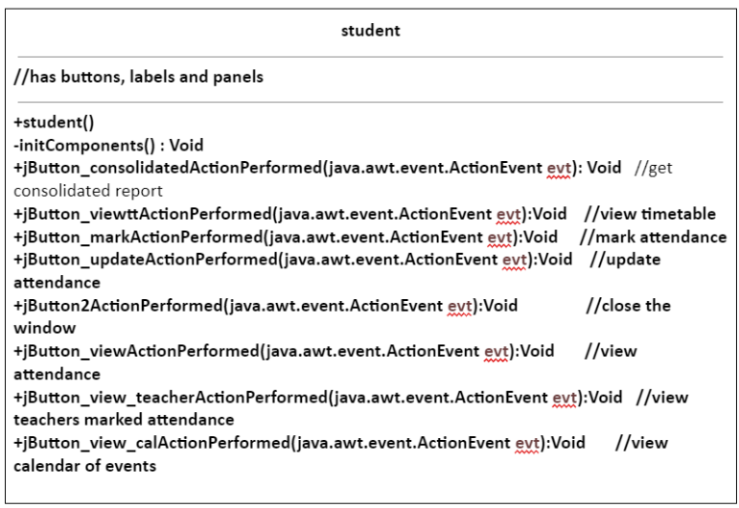
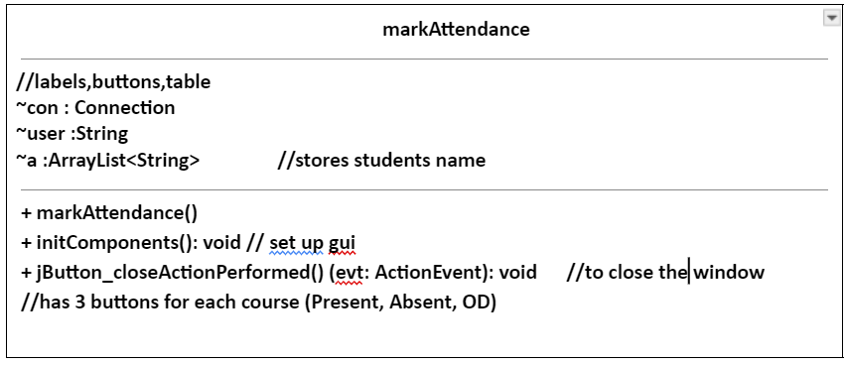
STUDENT MODULE

Slide 16
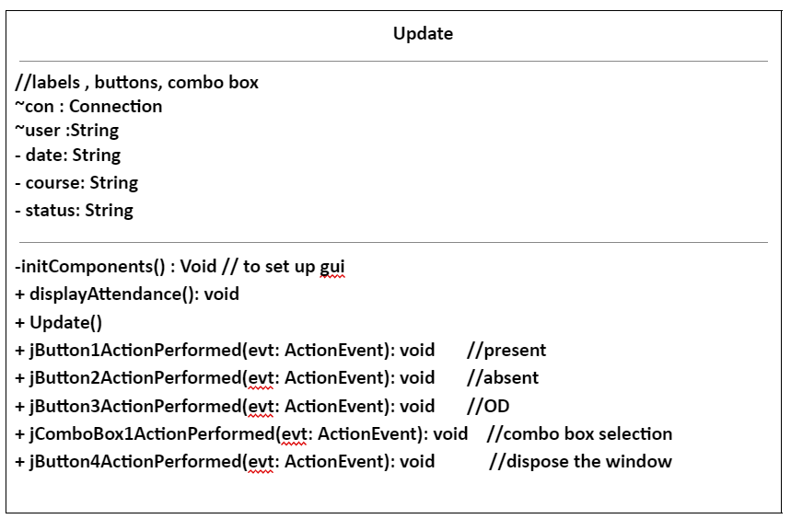
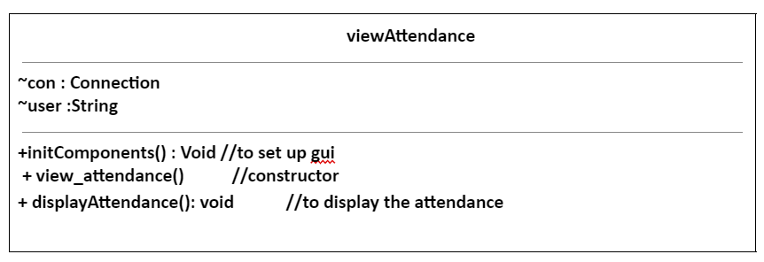
STUDENT MODULE

Slide 17
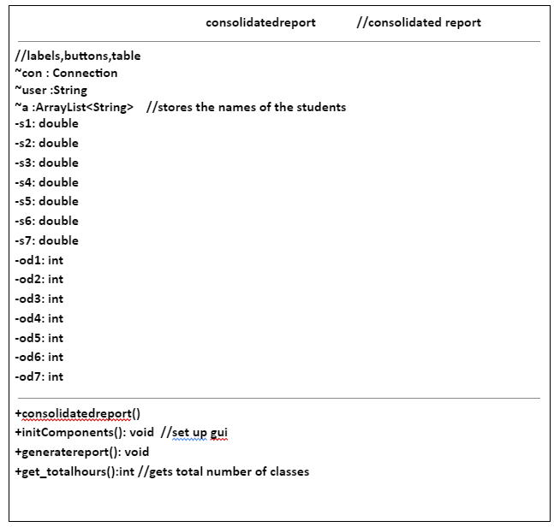
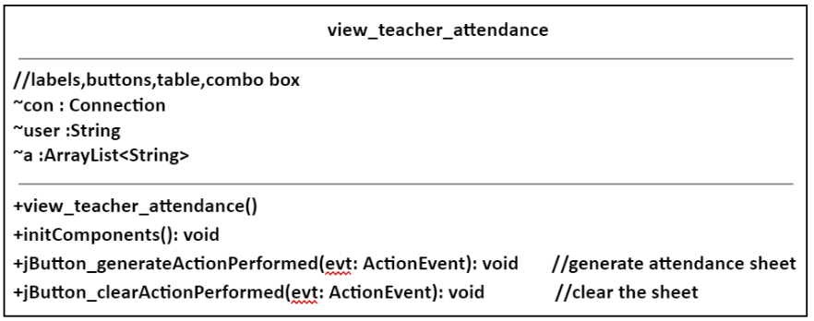
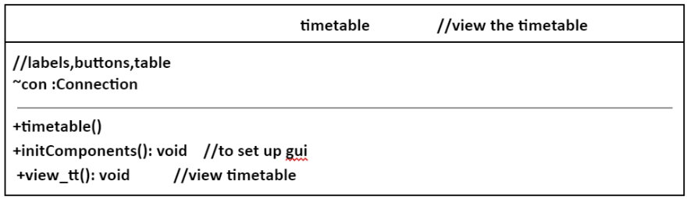
STUDENT MODULE

Slide 18
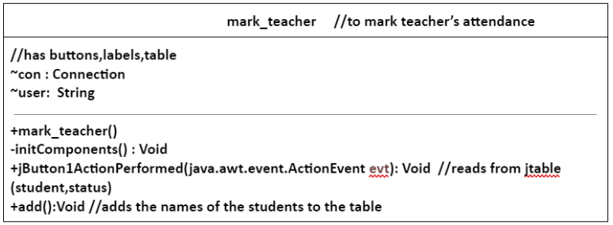
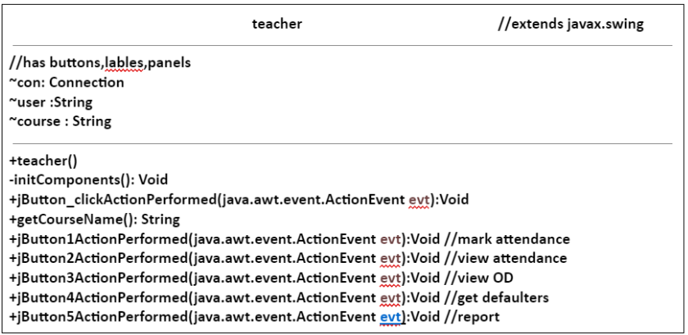
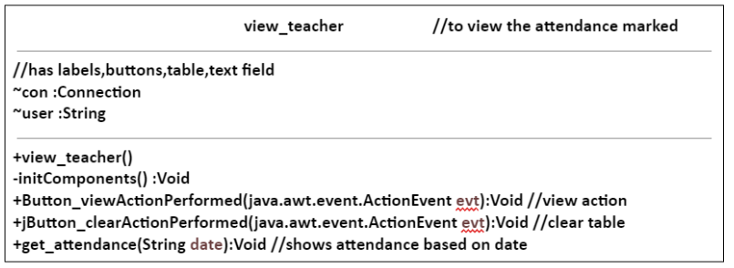
TEACHER MODULE

Slide 19
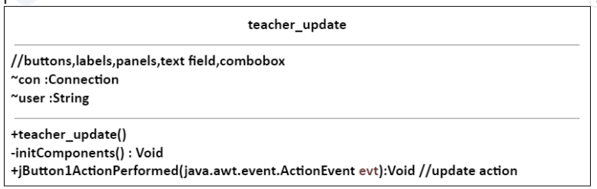
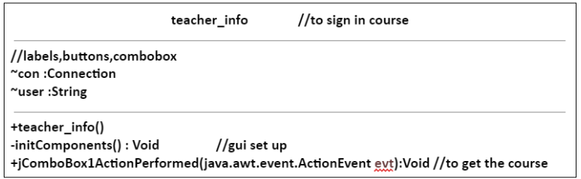
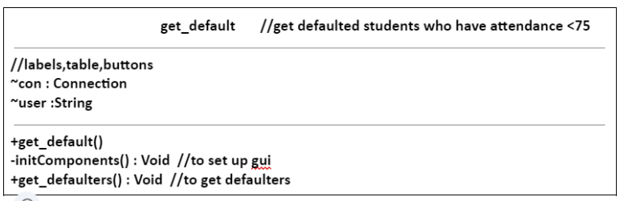
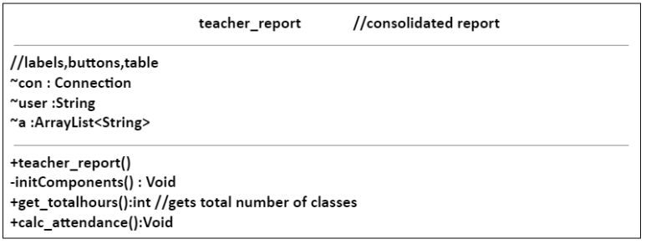
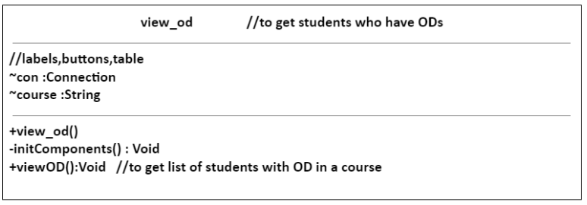
TEACHER MODULE (contd)

Slide 20
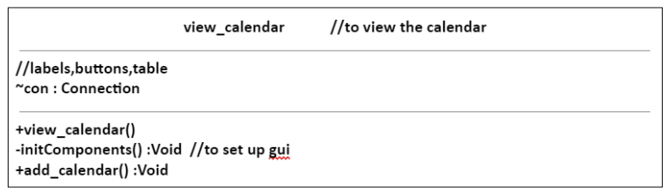
VIEW CALENDAR CLASS (Common to student and teacher)

Slide 21
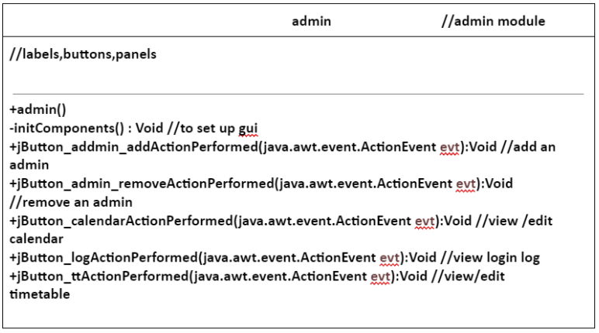
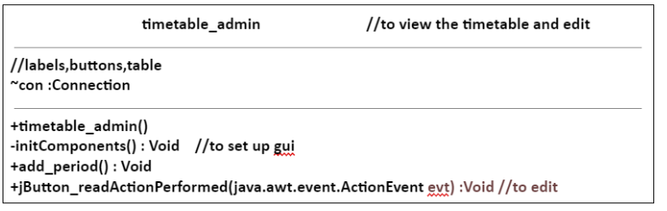
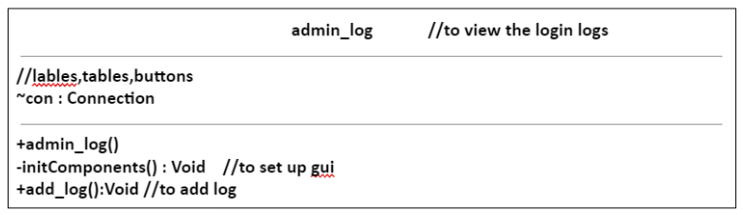
ADMIN MODULE

Slide 22
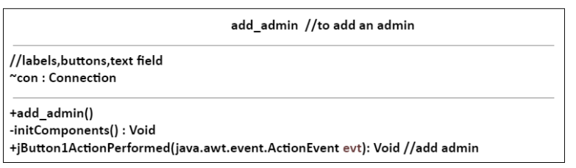
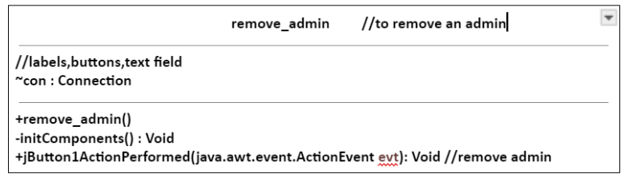
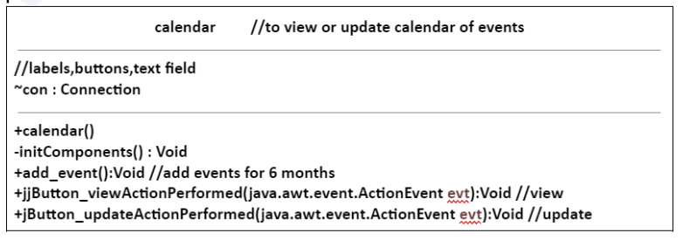
ADMIN MODULE(contd)

Slide 23
MODULE SPLIT UP

Slide 24
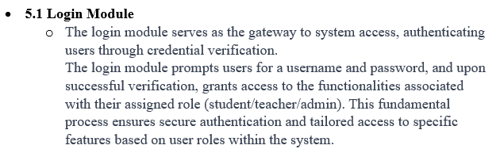
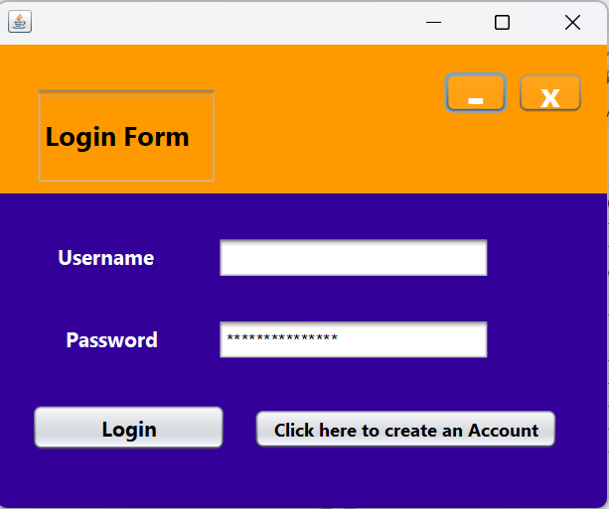
MODULE SPLIT-UP
LOGIN MODULE

Slide 25
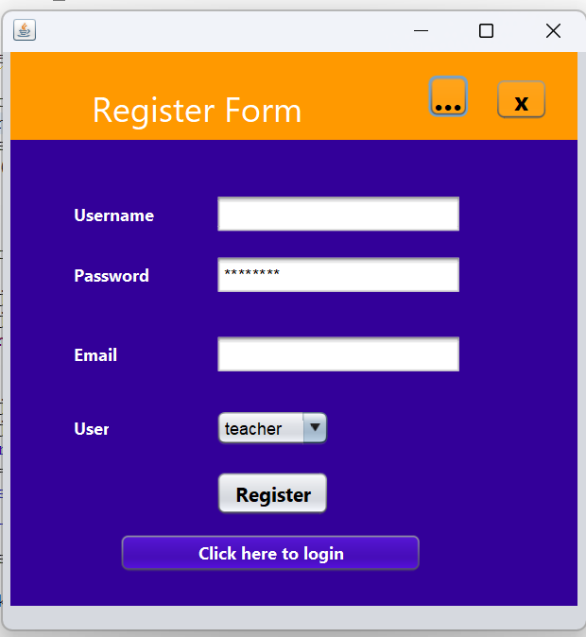
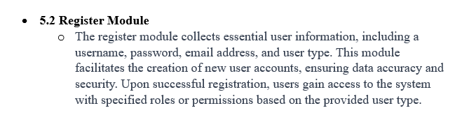
MODULE SPLIT-UP
REGISTER MODULE

Slide 26
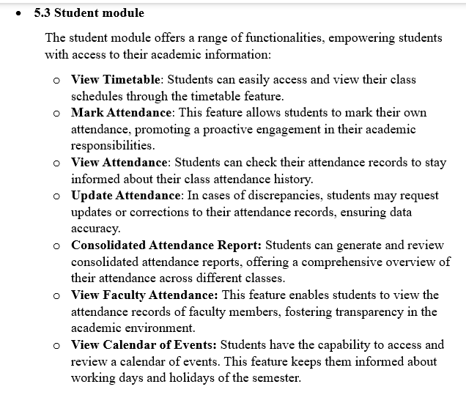
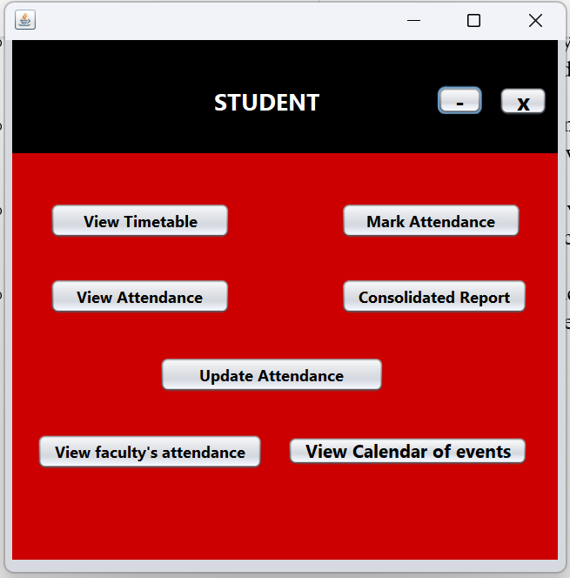
MODULE SPLIT-UP
STUDENT MODULE

Slide 27
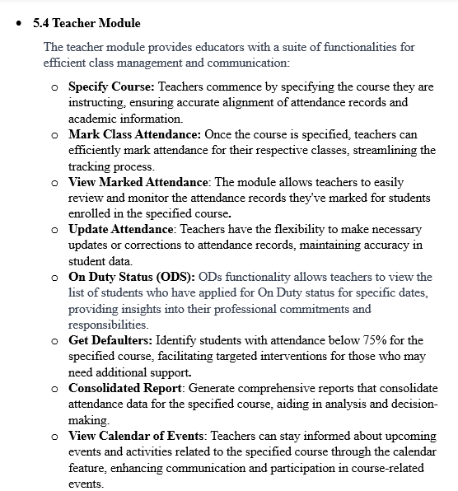
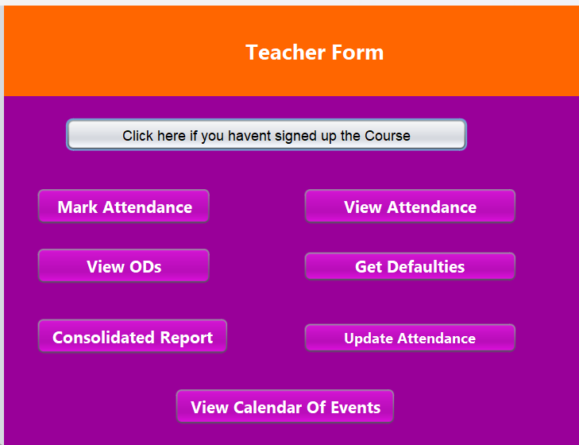
MODULE SPLIT-UP
TEACHER MODULE

Slide 28
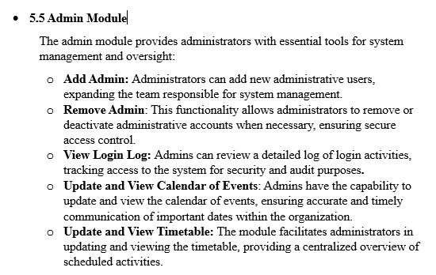
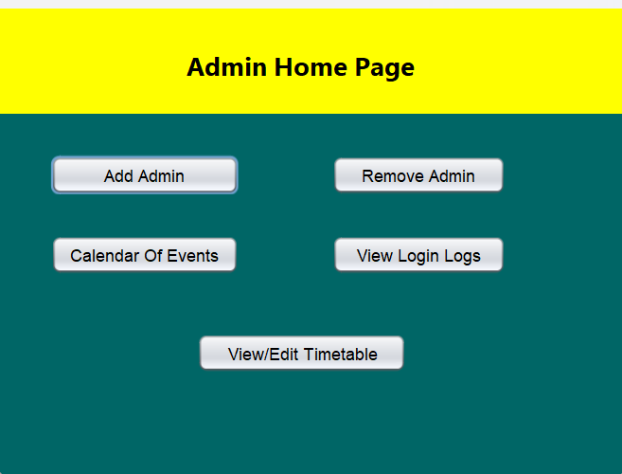
MODULE SPLIT-UP
ADMIN MODULE

Slide 29
IMPLEMENTATION

Slide 30
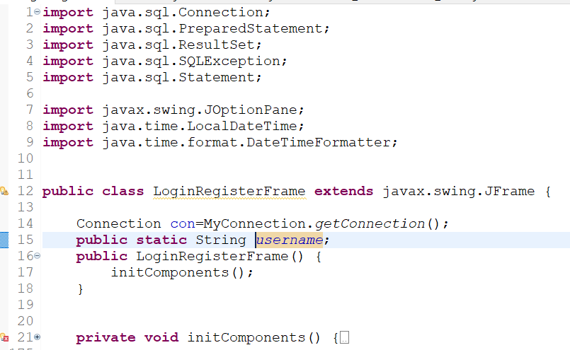
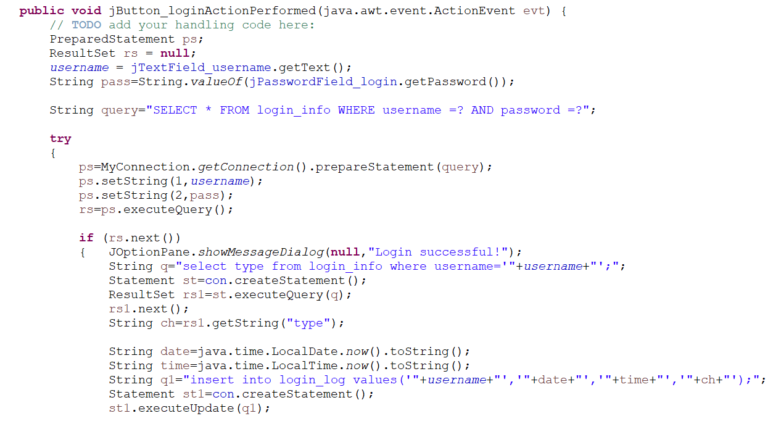
IMPLEMENTATION
LOGIN MODULE

Slide 31
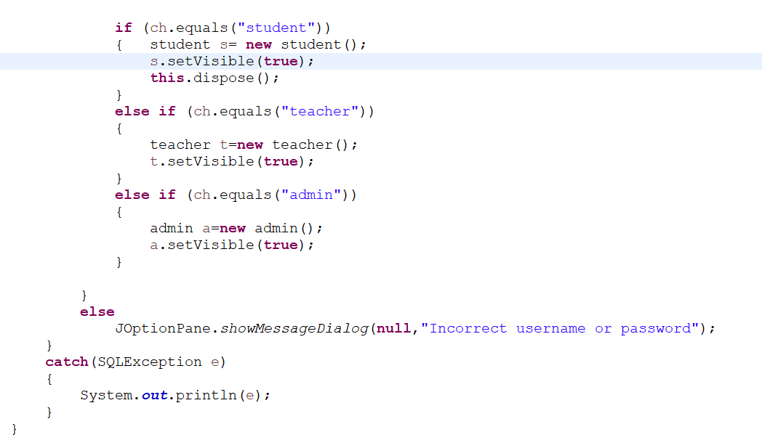
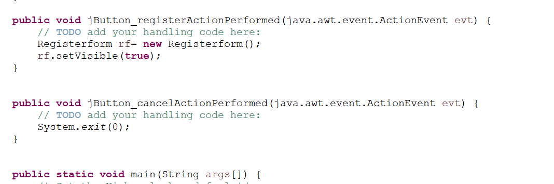
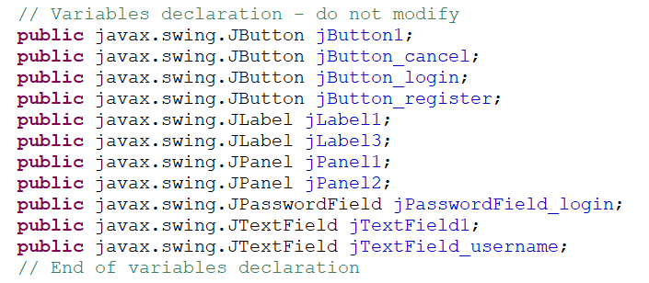
IMPLEMENTATION
LOGIN MODULE

Slide 32
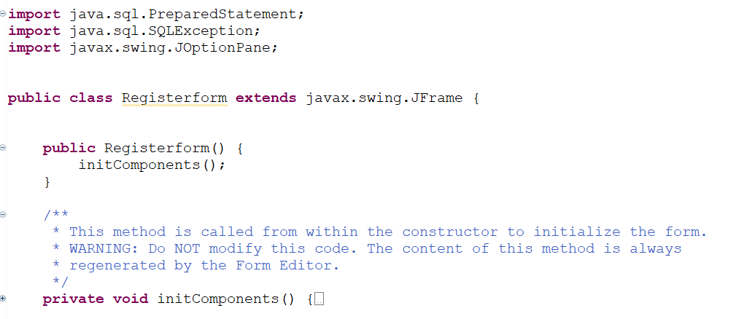
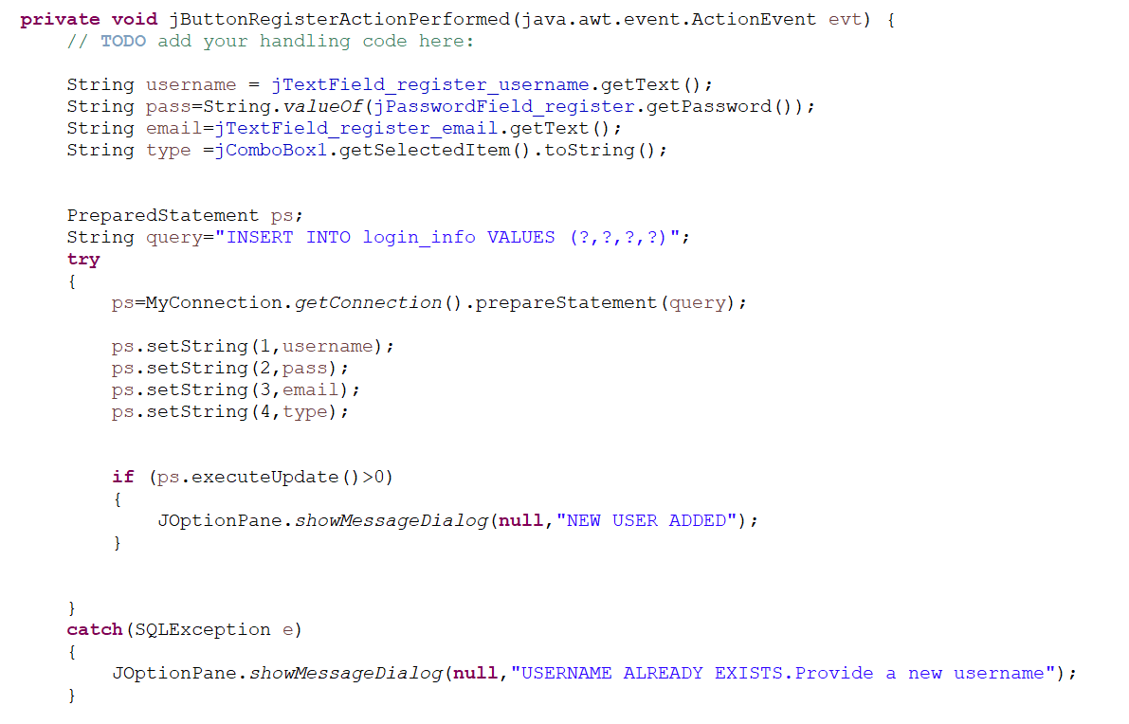
IMPLEMENTATION
REGISTER MODULE

Slide 33
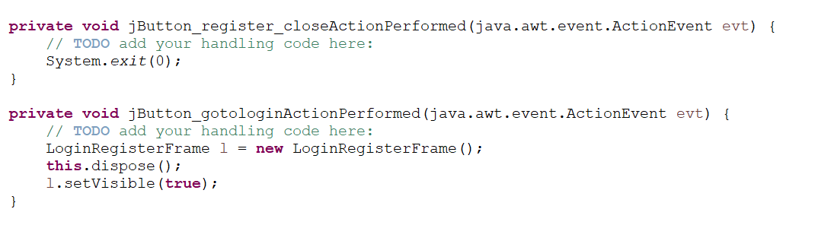
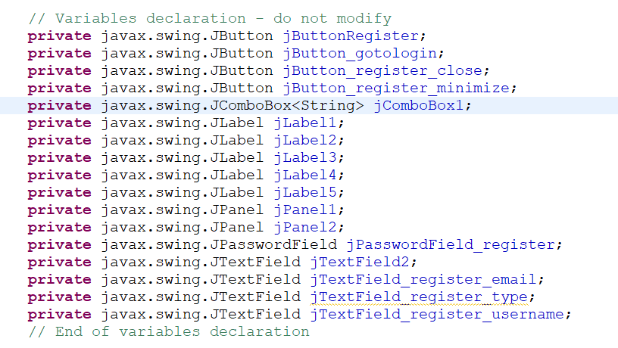
IMPLEMENTATION
REGISTER MODULE

Slide 34
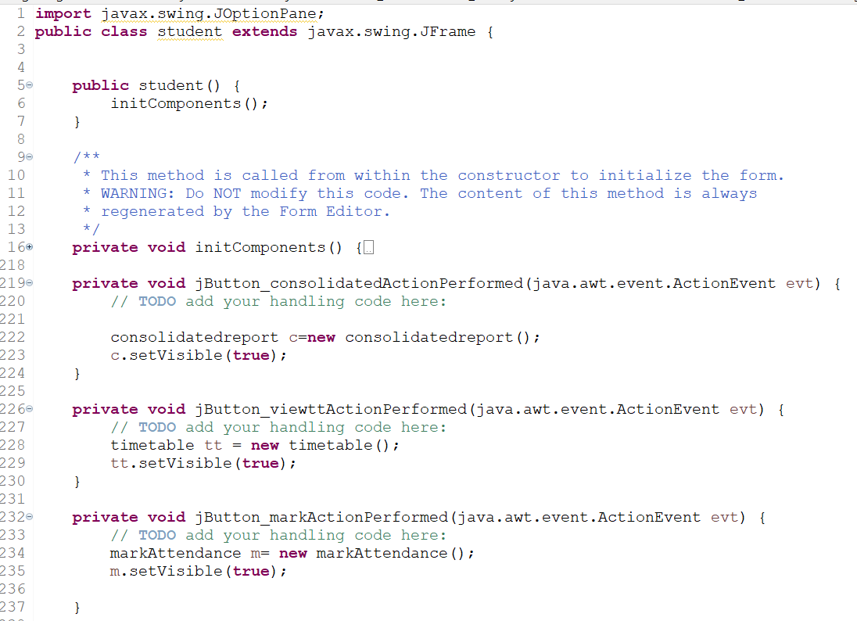
IMPLEMENTATION
STUDENT MODULE

Slide 35
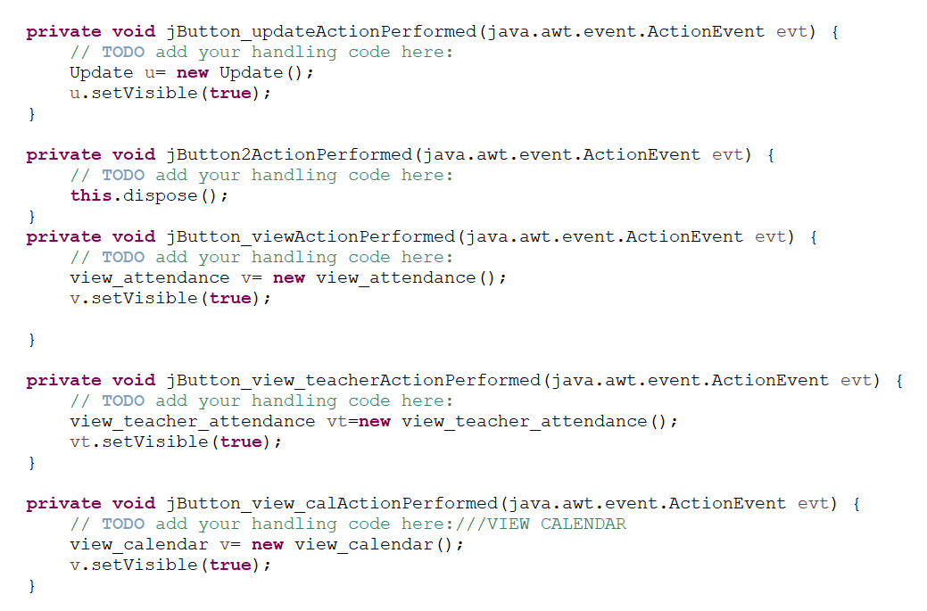
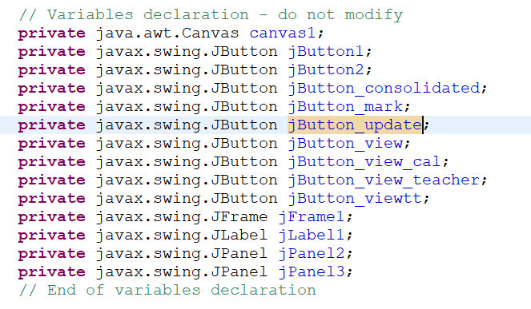
IMPLEMENTATION
STUDENT MODULE

Slide 36
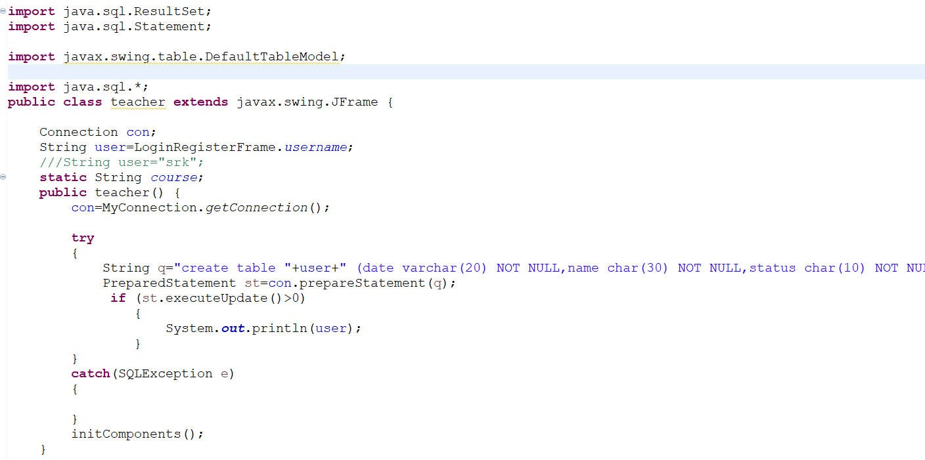
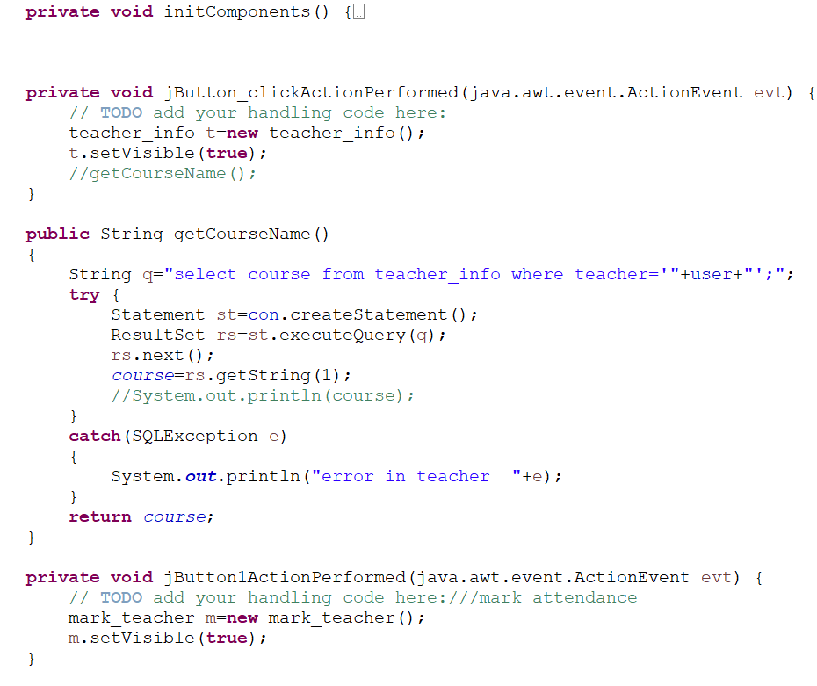
IMPLEMENTATION
TEACHER MODULE

Slide 37
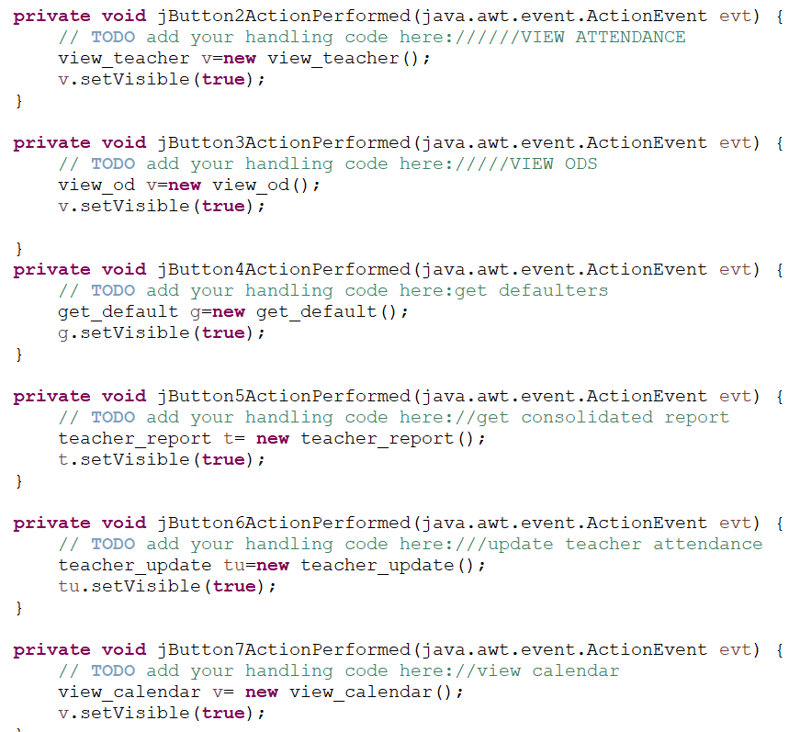
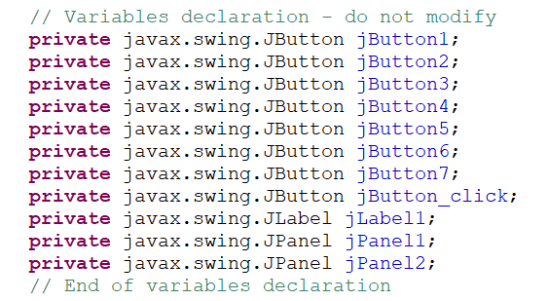
IMPLEMENTATION
TEACHER MODULE

Slide 38


IMPLEMENTATION
ADMIN MODULE

Slide 39
DATABASE DESIGN

Slide 40



DATABASE DESIGN
Table login_info
Table timetable
Table calendar

Slide 41


DATABASE DESIGN
Table login_log
Table teacher_info

Slide 42


DATABASE DESIGN
Table that stores student
attendance
Table that stores teachers’
Class attendance

Slide 43
OUTPUT SCREENSHOTS

Slide 44


OUTPUT SCREENSHOTS
LOGIN AND REGISTER FORM

Slide 45


OUTPUT SCREENSHOTS
SIGNING IN AS A STUDENT
STUDENT FORM
View Timetable

Slide 46


OUTPUT SCREENSHOTS
SIGNING IN AS A STUDENT
Mark Attendance
View Attendance

Slide 47


OUTPUT SCREENSHOTS
SIGNING IN AS A STUDENT
Consolidated Report
(of that student)
Update Attendance

Slide 48



OUTPUT SCREENSHOTS
SIGNING IN AS A STUDENT
View Faculty Attendance
(drop down box that lets you to choose)
Calendar Of Events

Slide 49


OUTPUT SCREENSHOTS
SIGNING IN AS A TEACHER
TEACHER FORM
Course Sign Up

Slide 50


OUTPUT SCREENSHOTS
SIGNING IN AS A TEACHER
Mark Attendance
View their marked attendance
By providing the date

Slide 51


OUTPUT SCREENSHOTS
SIGNING IN AS A TEACHER
View ODs of students
(sorted by date)
View defaulted students (attendance <75%)
[sorted by name]

Slide 52


OUTPUT SCREENSHOTS
SIGNING IN AS A TEACHER
Consolidated Report of students
Based on tecacher’s marked attendance
Update Attendance

Slide 53

OUTPUT SCREENSHOTS
SIGNING IN AS A TEACHER
Calendar Of Events

Slide 54


OUTPUT SCREENSHOTS
SIGNING IN AS AN ADMIN
ADMIN FORM
Add an admin

Slide 55


OUTPUT SCREENSHOTS
SIGNING IN AS AN ADMIN
Remove an admin
Login logs

Slide 56


OUTPUT SCREENSHOTS
SIGNING IN AS AN ADMIN
View/Edit the calendar of events

Slide 57

OUTPUT SCREENSHOTS
SIGNING IN AS AN ADMIN
View/Edit the timetable

Slide 58
OBJECT ORIENTED FEATURES USED

Slide 59
OBJECT ORIENTED FEATURES USED
In a modular system like AMS, several object-oriented features are employed to enhance code organization, reusability, and maintainability.
Classes and Objects:
Example: Classes for "Student," "Teacher," "Adminare created, with objects instantiated for each specific instance in the system.
Encapsulation:
Example: Each module encapsulates related functionalities, ensuring that the internal workings of one module are hidden from others, promoting modular design.
Inheritance:
Example: Every class extends javax.swing for easier Graphic User Interface.
Modularity:
Example: Each module (e.g., "Login," "Attendance," "Timetable") can be represented as a modular and independent unit, promoting the separation of concerns.

Slide 60
OBJECT ORIENTED FEATURES USED(contd)
Interfaces:
Example: The CompareTo<T> generic interface was used to sort the ODs of students according to their date.
Dependency Injection:
Example: Injecting dependencies, such as a "DatabaseConnector" into classes to enhance flexibility and maintainability.
Exception Handling:
Example: SQL Exceptions were used to catch any error in SQL command or operation on an empty result set.
Event Handling:
Example: Incorporating event handling mechanisms for user actions or system events, enabling responsive and interactive user experiences.
When a button was pressed, an event was triggered.

Slide 61
INFERENCE AND FUTURE EXTENSION

Slide 62
INFERENCE AND FUTURE EXTENSION
INFERENCE
User-Centric Approach:
The system prioritizes user-centric features, allowing students to actively manage their attendance, view timetables, and access relevant information. Teachers and administrators also have tools tailored to their roles. Teachers can maintain their class attendance and get concise reports. Admins can view/update timetable and calendar of events.
Modularity and Object-Oriented Design:
The system adopts a modular and object-oriented design, promoting code organization, reusability, and maintainability. Different modules cater to distinct functionalities, enhancing system flexibility.
Security and Authentication Focus:
The inclusion of features like login logs, authentication and security measures reflects a strong emphasis on safeguarding user data and ensuring secure access to the system.
Interconnected Data Flow:
The system appears to facilitate seamless data flow between modules, allowing users, teachers, and administrators to access and update relevant information, enhancing the overall user experience.

Slide 63
INFERENCE AND FUTURE EXTENSION
INFERENCE(contd)
Flexibility and Customization:
Features such as customizable attendance policies, role-based access, and user preferences suggest a commitment to flexibility, enabling adaptation to diverse institutional or organizational requirements.
Comprehensive Reporting:
The inclusion of consolidated reports for attendance, defaulters, and overall development scores indicates a focus on providing administrators and educators with insightful data for decision-making.
Event and Calendar Management:
Calendar-related features for viewing events and timetables, applicable to both students and teachers, enhance communication and organization within the educational or organizational environment.
User Engagement and Responsibility:
The system encourages user engagement by allowing students to mark their attendance and providing teachers with tools to actively manage class attendance, promoting a sense of responsibility among users.

Slide 64
INFERENCE AND FUTURE EXTENSION
FUTURE EXTENSION
Integration with Biometric Authentication:
Implement biometric authentication methods, such as fingerprint or facial recognition, to enhance security and streamline the attendance marking process.
Machine Learning for Attendance Prediction:
Integrate machine learning algorithms to predict attendance patterns based on historical data, helping educators and administrators identify potential attendance issues in advance.
Enhanced Reporting and Analytics:
Expand reporting capabilities by incorporating advanced analytics, data visualization tools, and predictive modelling to derive deeper insights into attendance trends and student performance.
Mobile Application for On-the-Go Access:
Develop a mobile application that allows students, teachers, and administrators to access attendance data, timetables, and other relevant information conveniently from their smartphones.

Slide 65
INFERENCE AND FUTURE EXTENSION
FUTURE EXTENSION(contd)
Automated Communication Alerts:
Implement automated communication features that send alerts and notifications to students, teachers, and administrators regarding attendance updates, important events, or policy changes.
Enhanced Timetable Management:
Improve timetable management by incorporating features like dynamic scheduling, room availability tracking, and automated conflict resolution.
Internet of Things (IoT) for Smart Classrooms:
Utilize IoT devices to automate attendance tracking through connected devices in classrooms, providing real-time data and reducing manual input.
Voice Recognition for Accessibility:
Integrate voice recognition technology to allow students with disabilities to mark their attendance or access system features through voice commands.

Slide 66
Thank You

