Slide 1


LIBRARY MANAGEMENT SYSTEM - PROJECT
PRESENTED BY
D U Mugilkrishna (073)
Nikilesh Jayaguptha (081)
Niranjan B (082)

Slide 2







Contents
1
Problem Statement
5
DBMS Concepts used
Members and Classifications
2
6
Implementation
3
Relations
7
Future Extensions
Schema Diagram and ER Diagram
4
8
Novelties

Slide 3

Problem Statement
The Library Management System (LMS)
project in operations,
NetBeans automates including book and
library patron
management, borrowing, returning, and reservations. It uses SQLPlus for Oracle Database to handle database tasks like creating schemas, tables, and executing SQL queries for data integrity. Librarians can add, update, and remove books with details such as title, author, genre, and availability. Patrons can search the catalog,
check out accounts.
books, and manage SQLPlus ensures a
their well-
organized database, seamlessly integrating with the user-friendly frontend in NetBeans.

Slide 4
Members and Classifications
Membership Management: Members are classified by type (Regular, Premium), impacting their borrowing limits and access privileges.
Role Management: Workers have defined roles (Librarian, Assistant) that determine their responsibilities and access within the library system.
Fines and Payments: Both members and workers can accumulate fines, tracked in the Member Info table, with payment transactions recorded in the Payment table.
Reservations and Access: Members can reserve books and access e-books, with their actions logged in the Reservation and E-Book Access tables.

Slide 5
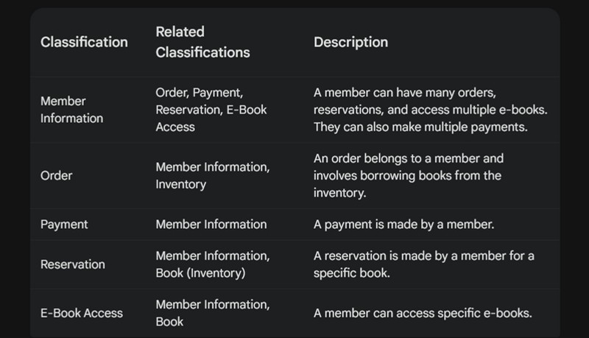
Members and Classifications

Slide 6

Relations - Book
This table stores information about the books available in the library.
Attributes:
BookID (ISBN): The International Standard Book Number, a unique identifier for the book.
Title: The title of the book.
Author: The author(s) of the book.
Publisher: The publishing company of the book.
Genre: The genre or category of the book (e.g., Fiction, Non- fiction, Science).
Pub_yr: The year the book was published.
Language: The language in which the book is written. Status: The current status of the book (e.g., Available, Checked Out, Reserved).
Type: The type of book (e.g., Hardcover, Paperback, eBook).

Slide 7
Relations - Member Info
This table stores information about the members of the library.
Attributes:
Member ID: A unique identifier for each member.
Name: The name of the member.
Address: The address of the member.
Phone no: The contact phone number of the member.
E mail: The email address of the member.
Mem type: The type of membership (e.g., Regular, Premium).
Join Date: The date when the member joined the library.
Exp Date: The expiration date of the membership.
Fines: The total amount of fines the member has accumulated. Rolename: The role or title of the member if applicable (e.g., Student, Teacher).
Salary: The salary of the member if applicable.
Role id: The identifier for the role if applicable.

Slide 8
Relations - Worker Info
This table stores information about the workers in the library.
Attributes:
Worker ID: A unique identifier for each worker.
Name: The name of the worker.
Role: The role or position of the worker (e.g., Librarian, Assistant).
Phno: The contact phone number of the worker.
Email ID: The email address of the worker.
Hire date: The date when the worker was hired.

Slide 9

Relations - Payment
This table stores information about the payment transactions made by members.
Attributes:
TransID: A unique identifier for each transaction. MemID: The ID of the member making the payment. Fine amt: The amount of fine being paid.
Method: The method of payment (e.g., Credit Card, Cash).
Status: The status of the transaction (e.g., Successful, Failed).
Transaction reference: A reference number for the transaction, not present if the transaction fails.
Date: The date when the transaction was made.

Slide 10

Relations - Order
This table stores information about book orders made by members.
Attributes:
OrderID: A unique identifier for each order. MemID: The ID of the member who made the order.
Checkout date: The date when the order was checked out.
Due date: The date when the order is due to be returned.
Return date: The date when the order was returned.
Fine amt: The amount of fine applicable if the order is returned late.

Slide 11
Relations - Inventory
This table stores information about the inventory of books in different branches of the library.
Attributes:
BookID: The ID of the book.
BranchID: The ID of the branch.
Total copies: The total number of copies of the book available in the branch.
Available copies: The number of copies currently available for lending.
Lending type: The type of lending available (e.g., Short-term, Long-term).

Slide 12

Relations - Branch
A table containing information about the branches.
Attributes:
BranchID: The ID of the branch. Name: The name of the branch. Location: The location of the branch.
Contact_no: The contact number of the branch.

Slide 13
Relations - Delivery
This table stores information about the delivery of ordered books.
Attributes:
Delid: A unique identifier for each delivery.
Orderid: The ID of the order being delivered. Del_address: The address to which the order is being delivered.
Del_status: The status of the delivery (e.g., Dispatched, Delivered).
Dispatch_date: The date when the order was dispatched.
Deli_personid: The ID of the delivery person. Deli_person name: The name of the delivery person. Deli_person phone_no: The contact phone number of the delivery person.

Slide 14

Relations - Reservation
This table stores information about reservations made by members for books.
Attributes:
Resid: A unique identifier for each reservation.
Bookid: The ID of the book being reserved. Memberid: The ID of the member making the reservation.
Res_date: The date when the reservation was made.
Status: The status of the reservation (e.g., Pending, Completed).

Slide 15

Relations - E-book Access
This table stores information about the access of e-books by members.
Attributes:
Accessid: A unique identifier for each e-book access.
Bookid: The ID of the e-book.
Memid: The ID of the member accessing the e-book. Access_date: The date when the e-book was accessed. Expiry: The expiration date of the e-book access.

Slide 16
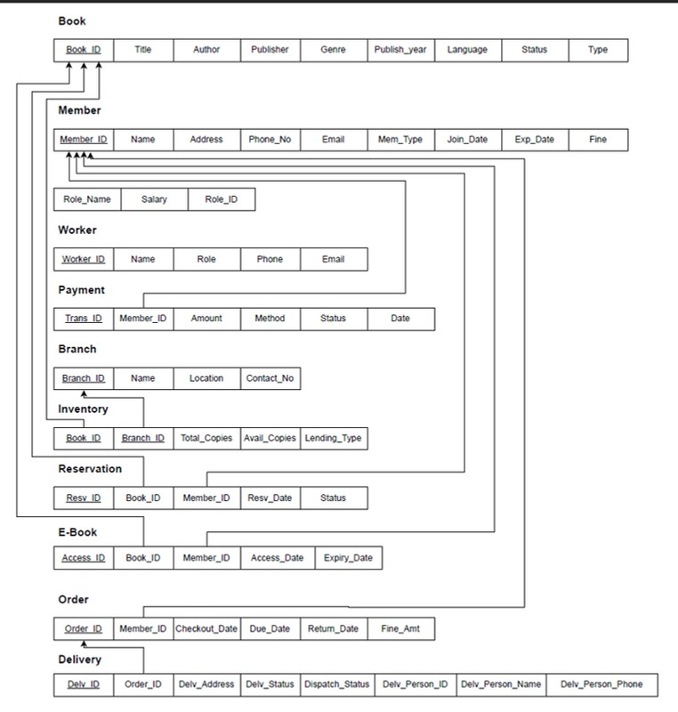
SCHEMA DIAGRAM

Slide 17
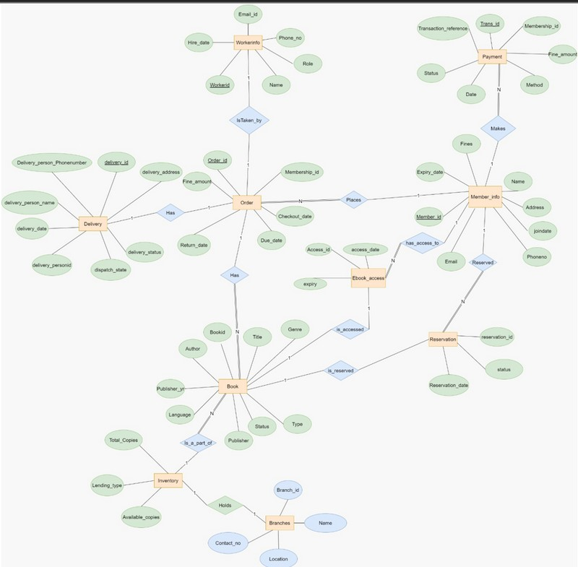
ER DIAGRAM

Slide 18
DBMS Concepts used Triggers
1. Setting the Expiry Date for a Member:
Trigger Name: SET_EXPIRY_DATE
Purpose: Automatically sets the expiry date to one year after the join date when a new member is created.
Trigger Logic: This trigger is activated after a new row is inserted into the Member_Info table. It updates the Exp_Date column to be one year after the Join_Date.

Slide 19
DBMS Concepts used Triggers
2. Creating a Worker ID:
Trigger Name: SET_WORKER_ID
Purpose: Automatically sets the worker ID using a sequence.
Trigger Logic: This trigger is activated before a new row is inserted into the Worker_Info table. It fetches the next value from the WORKER_ID_SEQ sequence and assigns it to the Worker_ID.

Slide 20
DBMS Concepts used Triggers
3. Creating an Order ID:
Trigger Name: SET_ORDER_ID
Purpose: Automatically sets the order ID using a sequence.
Trigger Logic: This trigger is activated before a new row is inserted into the Order table. It fetches the next value from the ORDER_ID_SEQ sequence and assigns it to the Order_ID.

Slide 21
DBMS Concepts used Triggers
4. Calculating and Updating the Due Date for an Order:
Trigger Name: SET_DUE_DATE
Purpose: Automatically calculates and sets the due date when a new order is created.
Trigger Logic: This trigger is activated after a new row is inserted into the Order table. It calls the CALCULATE_DUE_DATE procedure to determine the due date and updates the Due_Date column.

Slide 22
DBMS Concepts used Triggers
5. Updating the fine for late returns
Trigger Name: UPDATE_FINE
Purpose: Calculates the fine if a book is returned late and updates the respective member and order records.
Trigger Logic: This trigger is activated after the Return_Date is updated in the Order table. It calls the CALCULATE_FINE procedure to determine the fine and updates the Fine_Amt column in both the Member_Info and Order tables.

Slide 23
DBMS Concepts used Procedures
1. Calculating the Due Date for an Order:
Procedure Name: CALCULATE_DUE_DATE
Purpose: Calculates the due date for a book based on the checkout date.
Procedure Logic: This procedure adds a fixed period (e.g., 14 days) to the checkout date and returns the result as the due date.

Slide 24
DBMS Concepts used Procedures
2. Calculating the Fine for Late Book Returns:
Procedure Name: CALCULATE_FINE
Purpose: Calculates the fine for returning a book late. Procedure Logic: This procedure computes the fine based on the number of days past the due date and a fixed daily fine amount (e.g., 10 Rs per day).

Slide 25
DBMS Concepts used Sequences
1. Setting the Member ID:
Sequence Name: MEMBER_ID_SEQ
Purpose: Generates unique IDs for new members. Sequence Logic: This sequence provides incremental values used to set the Member_ID.

Slide 26
DBMS Concepts used Sequences
2. Setting the Worker ID:
Sequence Name: WORKER_ID_SEQ
Purpose: Generates unique IDs for new workers. Sequence Logic: This sequence provides incremental values used to set the Worker_ID.

Slide 27
DBMS Concepts used Sequences
3. Setting the Order ID:
Sequence Name: ORDER_ID_SEQ
Purpose: Generates unique IDs for new orders. Sequence Logic: This sequence provides incremental values used to set the Order_ID.

Slide 28
Implementation
The implementation part of this presentation includes the below features:
Login with worker id Home page
Create worker id Adding new member View all members Search for members Add new book
View all books Search for books
Check if member of book is found before entering them Lend a book
Return book
View total number of books lent on the home page

Slide 29
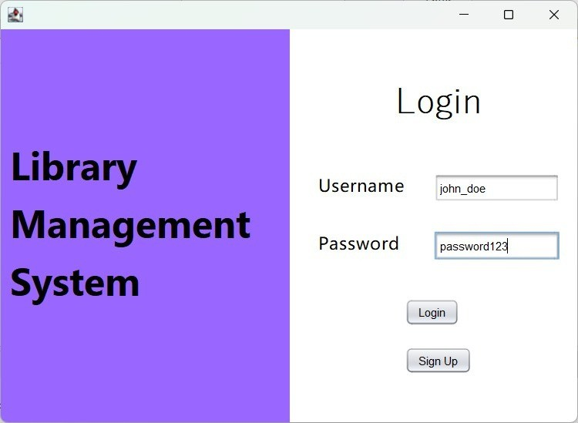
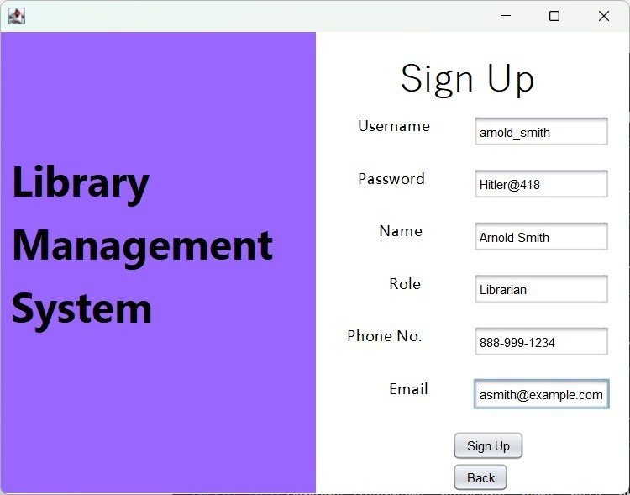
Implementation - Login with worker id

Slide 30
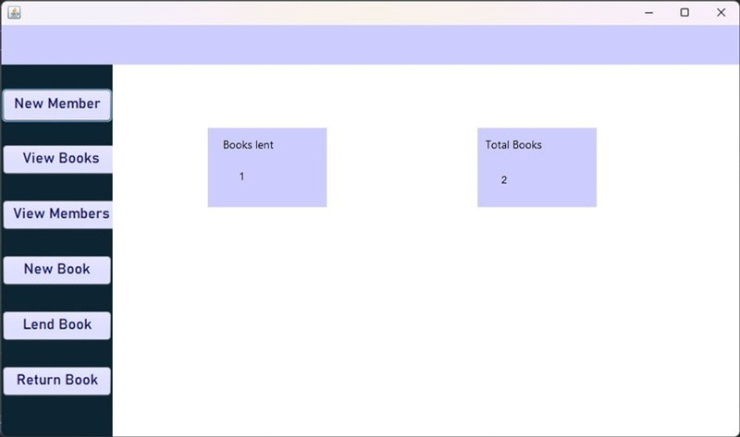
Implementation - Home Page

Slide 31
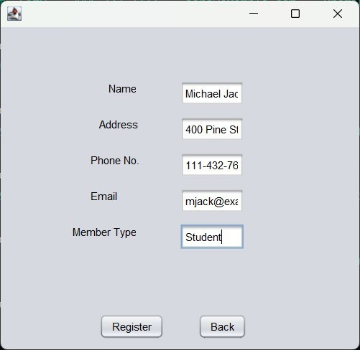

Implementation - Adding new member

Slide 32
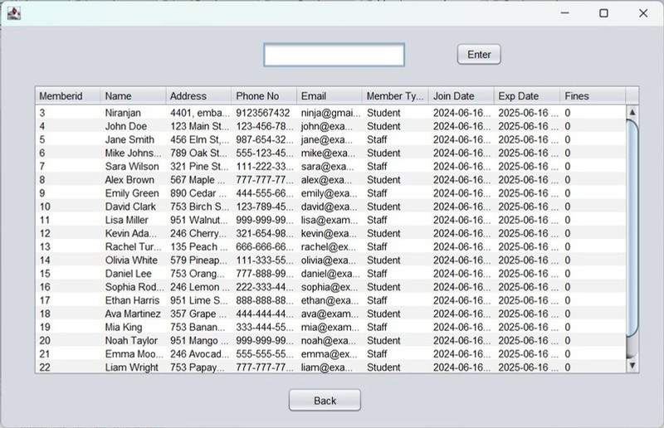
Implementation - View all members

Slide 33
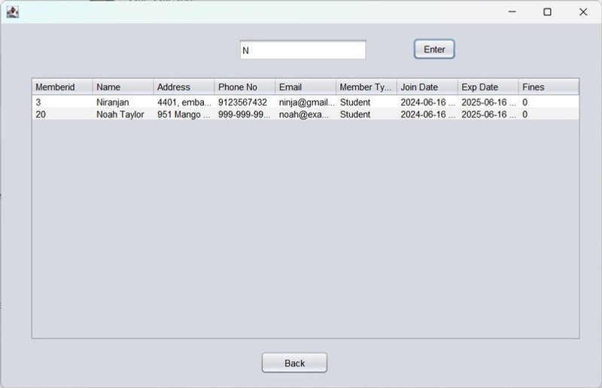
Implementation - Search for members

Slide 34
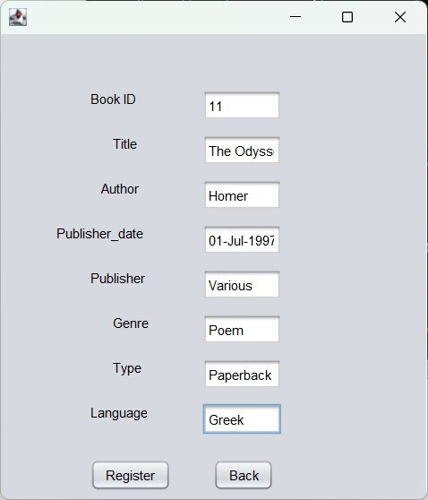
Implementation - Add new book

Slide 35
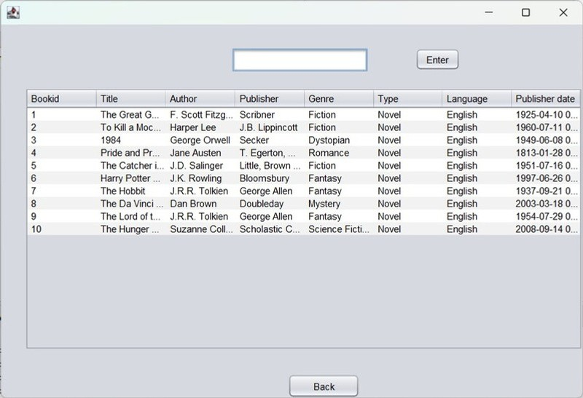
Implementation - View all books

Slide 36
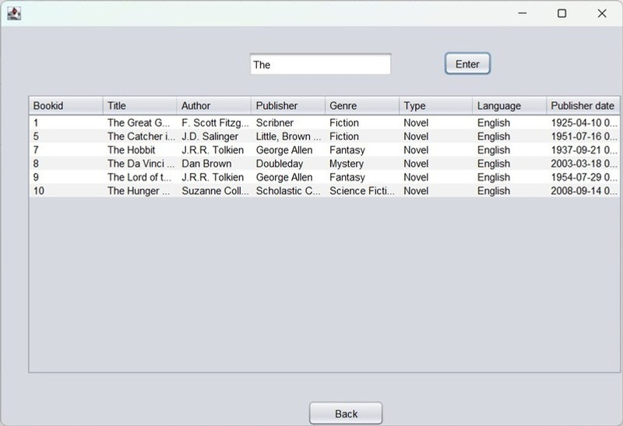
Implementation - Search for books

Slide 37
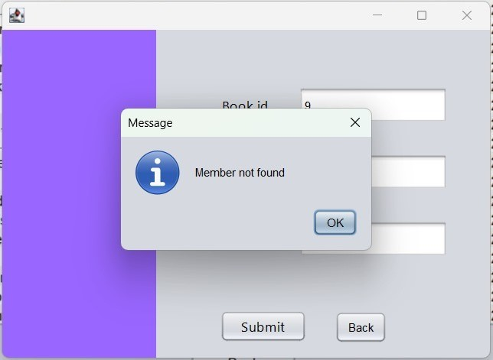
Implementation - Check if member of book is found before entering them

Slide 38
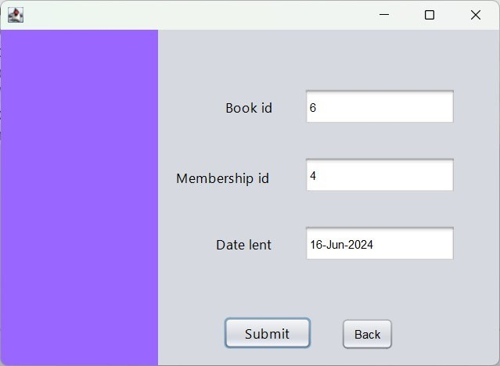
Implementation - Lend a Book

Slide 39
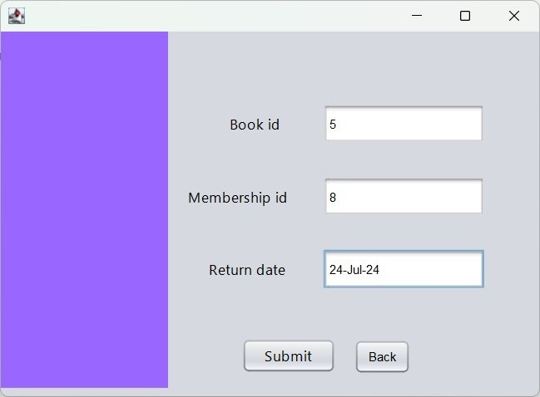
Implementation - Return a book

Slide 40
Implementation - View total number of books lent on the home page

Slide 41
Future Extensions
1 Enhanced Member Management and Advanced Book Management
₂ Expanded Worker Management and Improved borrowing and returning processes
₃ Improved Reservation System and Enhanced User Interface and Experience
₄ Enhanced Payment and Fine Management and Advanced Reporting and Analytics
5 Integration with External System
6 Security Enhancements

Slide 42
Novelties
1 Automated Membership Expiry Date Management
2 Automated ID Assignment
3 Automated Due Date Calculation for Orders
4 Fine Calculation and Update for Late Returns
5 Enhanced Borrowing and Returning Processes
6 Automated Payment Transaction Management

Slide 43


