Slide 1

Dominos – Predictive Purchase Order System
MUGIL

Slide 2
Problem Statement
Goal: Domino’s wants to optimize inventory by predicting future sales & automating purchase orders.
Challenges:
Overstock → waste & cost
Understock → lost sales & unhappy customers
Need: A data-driven forecasting + ingredient planning system.

Slide 3
Business Use Cases
Inventory Management → Right ingredients, right time.
Cost Reduction → Lower waste, avoid stockouts.
Sales Forecasting → Accurate demand prediction.
Supply Chain Optimization → Smarter purchase orders.
Use an infographic style with icons for inventory, cost, forecasting, supply chain.

Slide 4
Approach
Data Cleaning & Outlier Handling
EDA (Sales trends, top pizzas, seasonal demand)
Feature Engineering (time-based, lag, rolling averages)
Modeling (ARIMA, SARIMA, Prophet, LSTM, Random Forest)
Model Evaluation (MAPE metric)
Sales Forecasting (next 7 days)
Ingredient Calculation & Purchase Order Generation

Slide 5
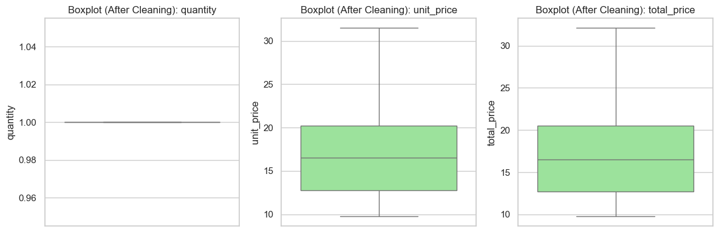
Data Cleaning & Outliers
Removed duplicates, formatted dates.
Outlier detection using IQR method.
Example: ~927 outliers detected in quantity.
Outliers capped at bounds.

Slide 6
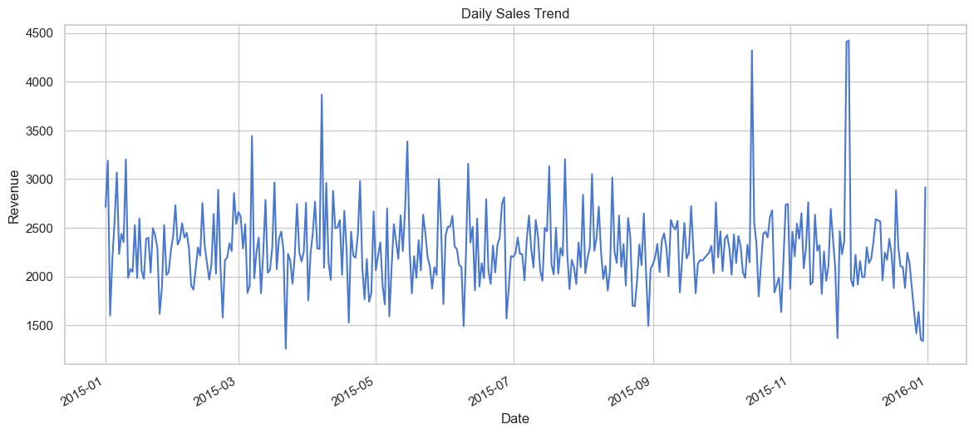
Exploratory Data Analysis
Top Insights:
Most sales from Large size pizzas.
Classic & Supreme categories dominate revenue.
Sales peak in weekends and evenings.

Slide 7
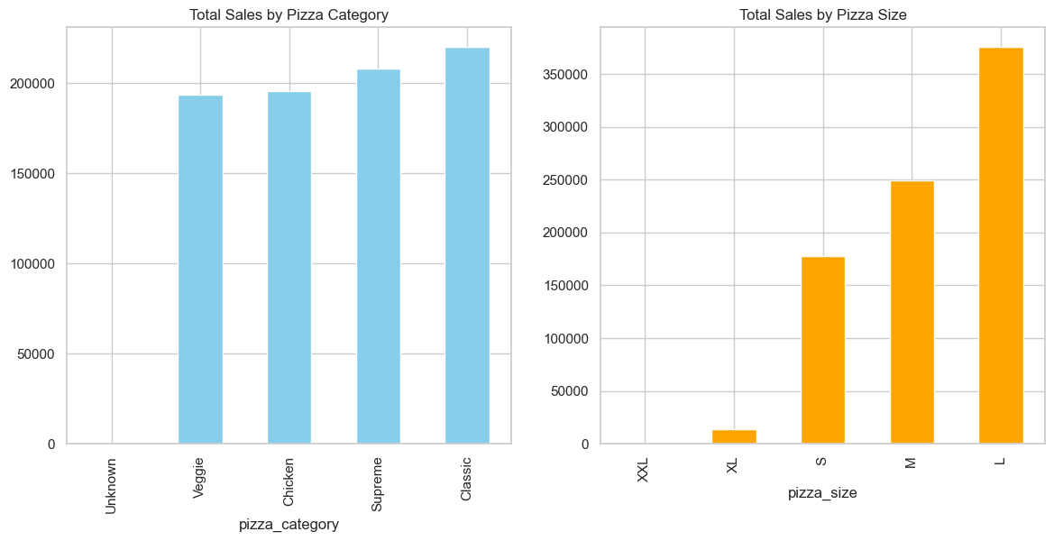
Total Sales by pizza Category & Size

Slide 8
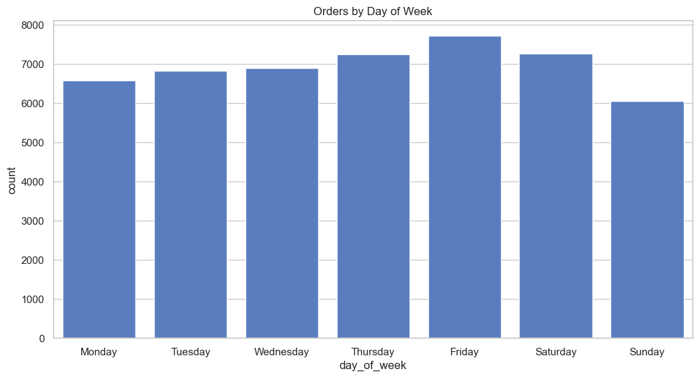
Sales Peak

Slide 9
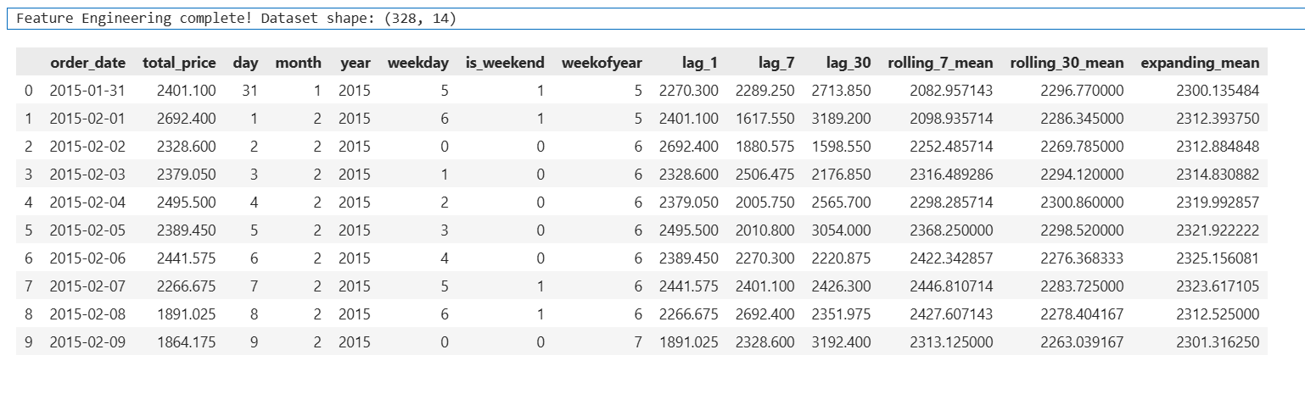
Feature Engineering
Added:
day, month, weekday, is weekend
Lag features (lag_1, lag_7, lag_30)
Rolling averages (rolling_7_mean, rolling_30_mean)
Expanding mean

Slide 10
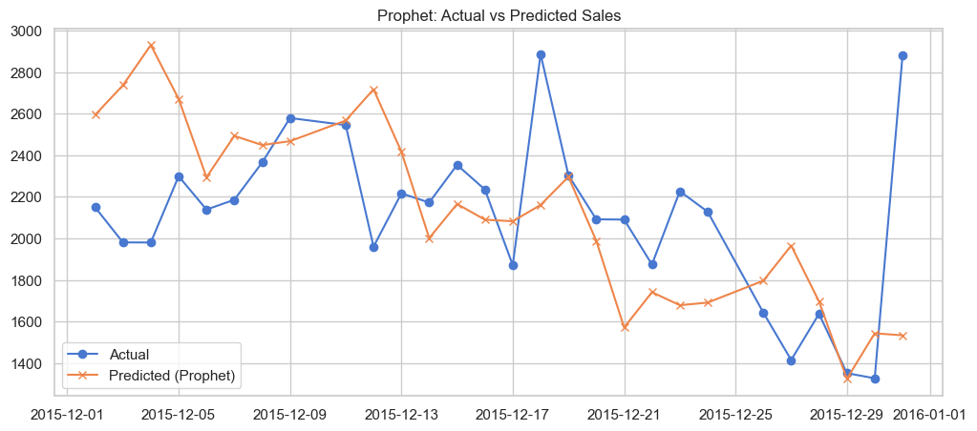
Model Selection & Training
Tried multiple models:
ARIMA, SARIMA, Prophet, LSTM, Random Forest
Training on historical sales, testing on last 28 days.
Evaluation metric: MAPE (Mean Absolute Percentage Error).

Slide 11
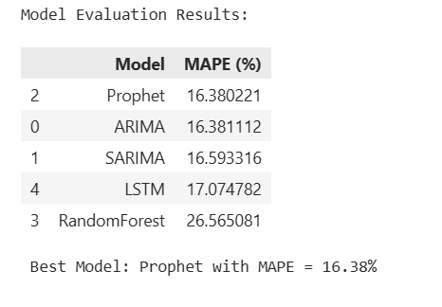
Model Evaluation Results

Slide 12
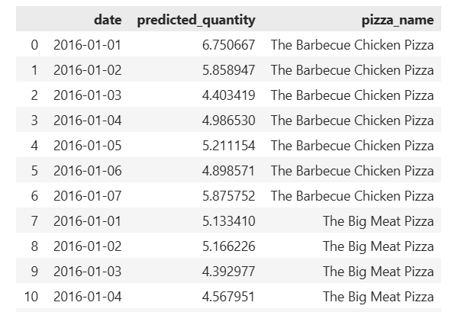
Sales Forecasting (Next 7 Days)
Forecasted daily sales revenue & pizza-wise quantities.
Example (Barbecue Chicken Pizza):
01-01-2016 → ~7 pizzas
02-01-2016 → ~6 pizzas
03-01-2016 → ~4 pizzas

Slide 13
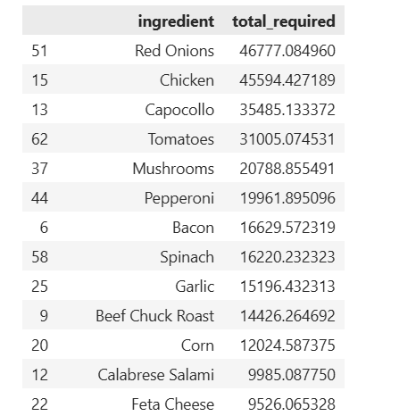
Ingredient Requirement
Pizza forecast mapped to ingredient dataset.
Calculated: ingredient_required_grams = forecasted_qty × qty_per_pizza_grams
Aggregated to ingredient level.

Slide 14
"Thank You" Email:mugilkv@gamil.com github:github/MugilCodes

