Slide 1
Industrial Human Resource Geo - Visualization
A Data-Driven Approach Using NLP and Machine Learning

Slide 2
Introduction
Problem Statement :
In India, the industrial classification of the workforce is crucial to understand labor distribution across sectors.
Current data on main and marginal workers is outdated and may not reflect the current state of the workforce.
The aim of this study is to provide accrete data for policy making and employment planning.

Slide 3
Tools
Tools & Technologies Used
Pandas ,NumPy , NLTK for Data Processing
Machine Learning : Scikit-Learn
Matplotlib help of Data Visualization
And Folium is Geo-Visualization map
Streamlit for web application

Slide 4
Approach
Data Loading :
Preprocessing
Data Exploration
Geo- Visualization

Slide 5
Exploratory Data Analysis
Distribution of workers across different industries.
High workforce concentration in sectors like Retail, Agriculture, and Manufacturing.
Word frequency analysis revealed common terms defining each sector.

Slide 6
Dashboard &Visualization
Developed an interactive dashboard using Streamlit.
Users can input an industry description and get predicted industry classification.
Visualization of industry workforce distribution using Plotly.

Slide 7
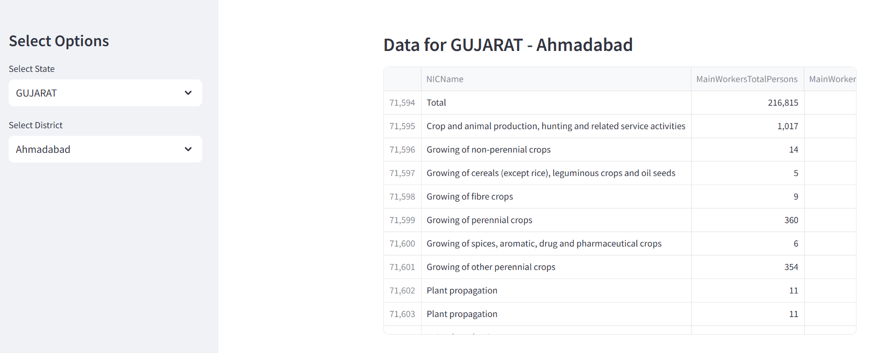
Tabulation of selected state

Slide 8
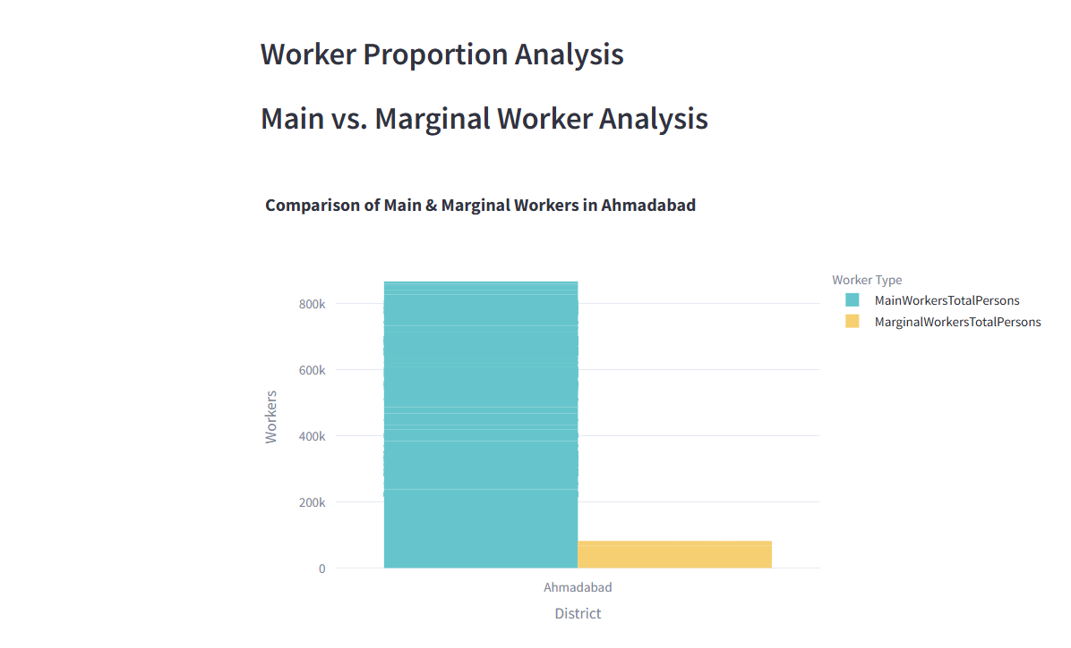
Workers Proportion Analysis

Slide 9
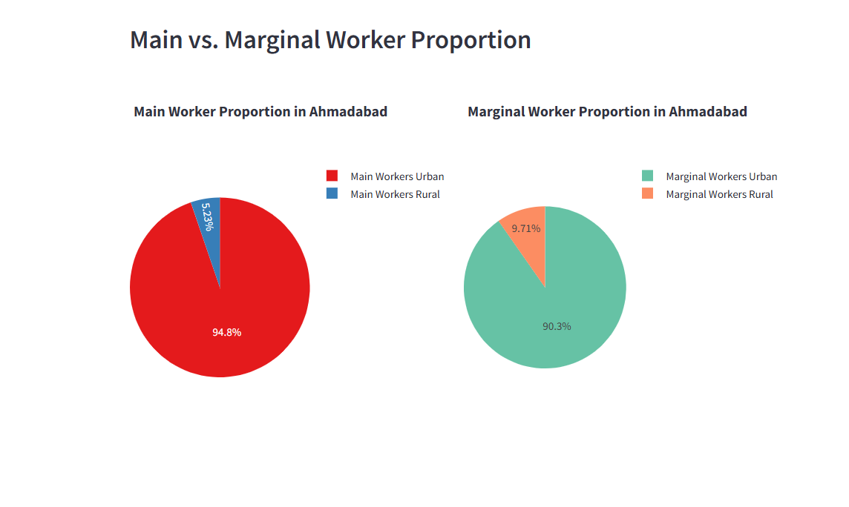
Workers Proportion

Slide 10
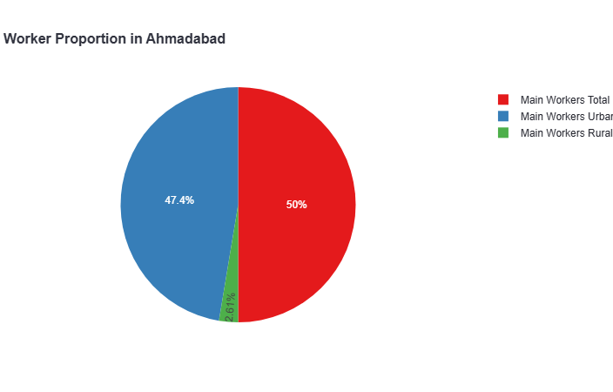
Pie Chart

Slide 11
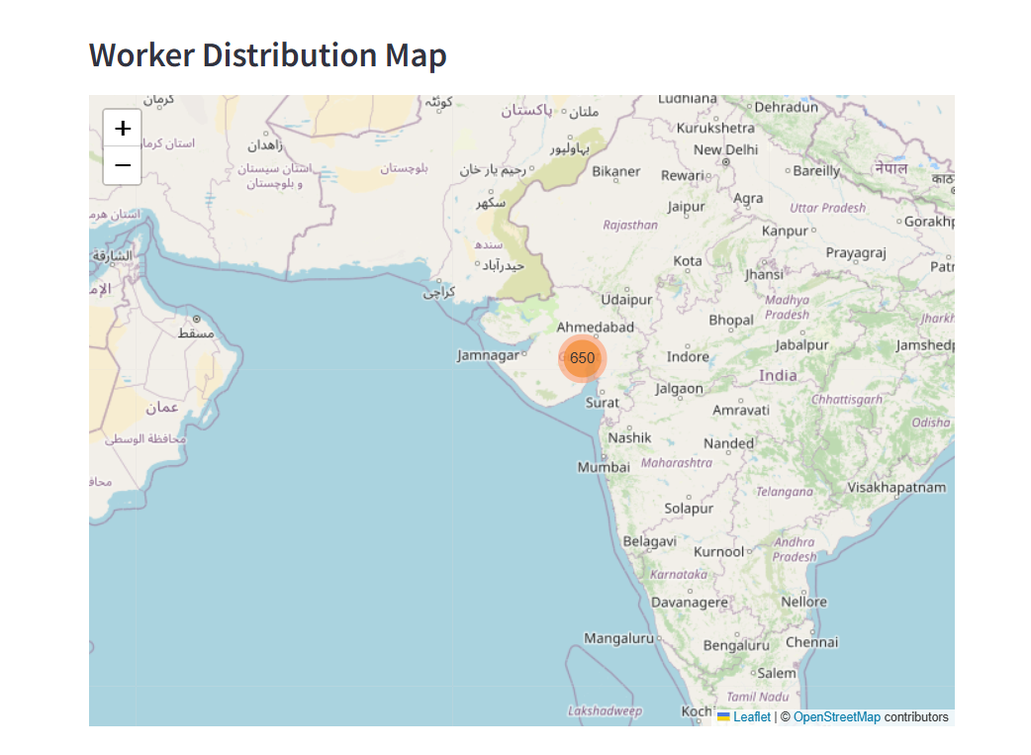
Map visualization

Slide 12

Thank You

