Slide 1



HANOVER AND TYKE
Home
Discussion
Conclusion
Contact
Microsoft CyberSecurity Classifier
Improving SOC efficency using intellignet triage classification
MUGIL

Slide 2

HANOVER AND TYKE
Home
Discussion
Conclusion
Contact
Why Do we need this model?
Challenge faced by SOCs: too many alerts, too many false positives
Need to automate incident classification
Target labels: True Positive, Benign Positive, False Positive
Goal: Reduce alert fatigue, prioritize real threats

Slide 3


HANOVER AND TYKE
Home
Discussion
Conclusion
Contact
Where this model helps
SOCs: Automated triage, improved analyst productivity
Incident Response: Faster resolution, fewer escalations
Threat Intelligence: Improved alert quality with historical evidence
Enterprise Security: Better visibility, reduced false alarms

Slide 4
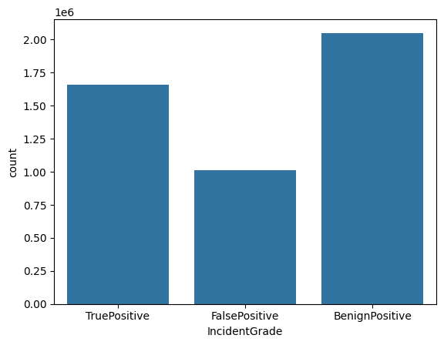
HANOVER AND TYKE
Home
Discussion
Conclusion
Contact
Dataset Overview
9.5 million rows → Used 4.75 million for training
45 columns: IDs, timestamps, alert details, entity info
Hierarchy: Evidence → Alert → Incident
Target: IncidentGrade with TP, BP, FP
Data Preprocessing
Dropped >50% null columns
Extracted time-based features: Hour, Day, Month
Encoded: Category, EntityType, EvidenceRole
Dropped high-cardinality ID columns
Exploratory Data Analysis (EDA)
Count plots of IncidentGrade
Time distribution (e.g., hourly alerts)
Correlation heatmap of features

Slide 5
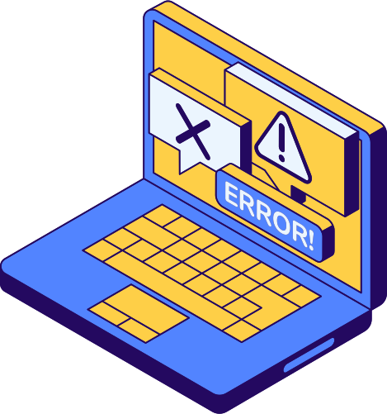
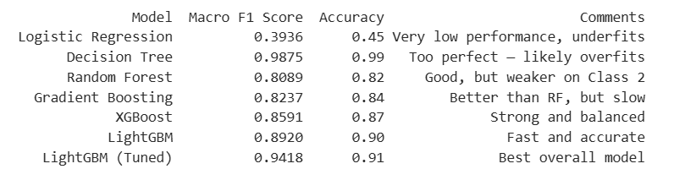
HANOVER AND TYKE
Home
Discussion
Conclusion
Contact
Model Building and Evaluation
Baseline Models: Logistic Regression, Decision Tree
Advanced: Random Forest, Gradient Boosting, XGBoost, LightGBM
Tuned LightGBM (with GridSearchCV)

Slide 6
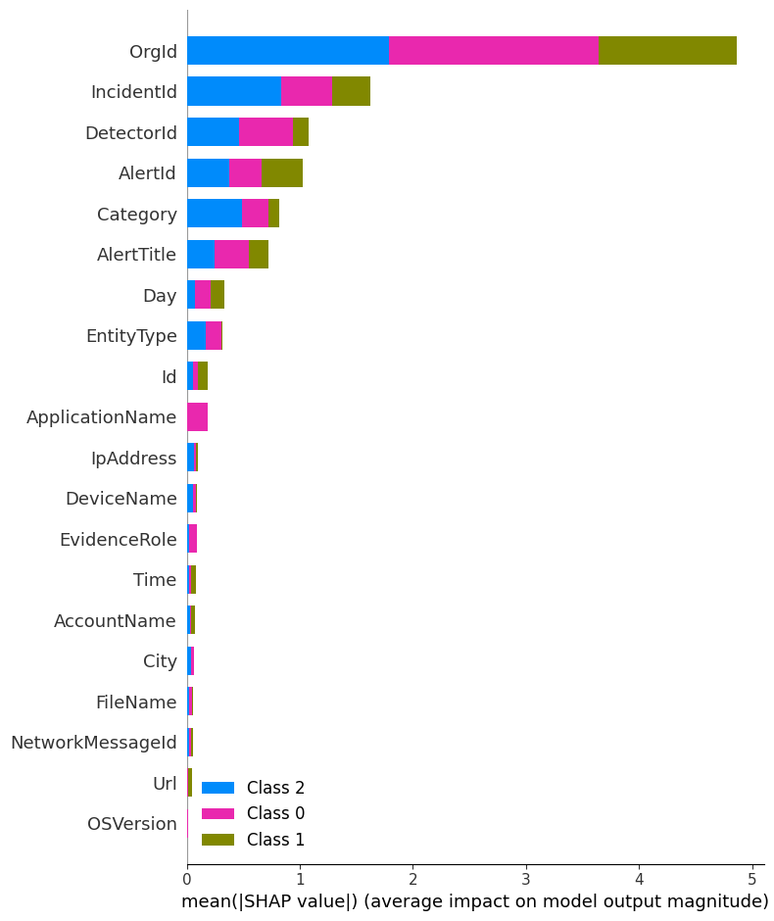
HANOVER AND TYKE
Home
Discussion
Conclusion
Contact
Feature
Importance
SHAP values used for interpretation
Top features: DetectorId, EntityType, Hour, EvidenceRole
To show how your model makes decisions (interpretability)
To prove that your model is explainable and not a black box
To highlight which features drive predictions (SOC-relevant)

Slide 7
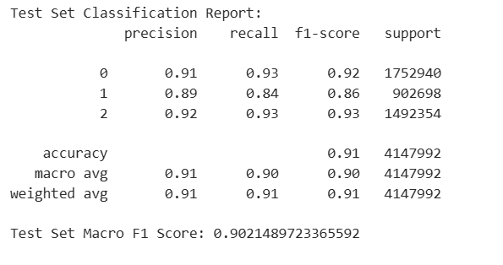
HANOVER AND TYKE
Home
Discussion
Conclusion
Contact
How Well Did It Work?
Tested on 4.1 million rows
Final macro-F1 score: 0.9021
Class-wise precision/recall:

Slide 8

HANOVER AND TYKE
Home
Discussion
Conclusion
Contact
Recommendations & Conclusion
Deploy with FastAPI + Docker
Retrain monthly, monitor drift
Add NLP for alert description
Try deep learning (LSTM, Transformers)
Ensemble model for added robustness
"Impact: This model enables intelligent, explainable, and scalable triage for modern SOCs."

Slide 9

HANOVER AND TYKE
Home
Discussion
Conclusion
Contact
Thank You
GitHub
https://github.com/MugilCodes/Microsoft_cybersecurity_classifier.git

