Slide 1
Slide 1 – Title Slide
BLUESTOCK MUTUAL FUND ANALYTICS CAPSTONE PROJECT
- SUBMITTED BY : MUGILAN M
- TECHNOLOGIES: PYTHON, SQL, SQLITE , POWER BI
- JUNE 2026

Slide 2
Slide 2 – Problem Statement & Objectives
Problem statement
Mutual fund data is high-volume, heterogeneous and time-series driven, which makes manual comparison slow, error-prone and unsuitable for scalable investment decisions. Analysts need a consistent, auditable way to compare performance and risk.
Objectives
Ingest and normalise mutual fund data into a single SQLite repository for reproducible analysis
Perform exploratory data analysis (EDA) to surface data quality issues and distributional patterns
Compute performance metrics (Alpha, Beta) and derive a transparent Risk Grade
Assemble a composite fund scorecard to enable apples-to-apples comparisons
Deliver an interactive Power BI dashboard for analyst exploration and reporting

Slide 3
Slide 3 – Data Sources
Primary inputs
Mutual Fund master dataset (fund identifiers, vintage, category)
Fund performance time-series (daily/monthly returns)
Category & benchmark definitions (for peer grouping)
Precomputed return metrics (annualised returns, volatility)
Benchmark data (index returns aligned to fund horizons)
Preparation steps
Data cleaning: date parsing, ticker normalization, type conversions
Missing-value checks and targeted imputations or exclusions
Cross-source validation (IDs, dates, benchmark alignment)
Persist cleaned tables into SQLite for deterministic querying

Slide 4

Slide 4 – Project Architecture
Architecture workflow
Raw Dataset
Data Cleaning
SQLite DB
SQL Queries
This end-to-end pipeline ensures traceability: raw inputs are transformed, stored, and queried to produce reproducible metrics that feed the BI layer.
Python
SQLite
Data munging, metric calculation, and automation scripts (Pandas, NumPy).
Single-file, version-controlled store for cleaned tables and derived metrics.
Power BI
GitHub
Interactive dashboards, filters, KPI cards and scheduled refreshes for analysts.
Code, notebooks and documentation for reproducibility and peer review.

Slide 5

Slide 5 – EDA Highlights (Part 1)
Exploratory Data Analysis — what we checked
01
02
03
Category distribution
Fund counts & vintages
Data quality
Count and AUM by category to identify dominant segments and potential sampling bias.
Active vs closed funds, vintage years and survivorship bias assessments.
Missing dates/returns, outliers, and alignment mismatches with benchmarks.
Key observation: a handful of categories account for most funds and AUM — this influences peer-benchmark choices and weighting in comparative analysis.

Slide 6
Slide 6 – EDA Highlights (Part 2): Return & Risk
Analyses performed
Return distribution (annualised, by fund & category)
Risk distribution (volatility, drawdowns)
Time-series trends and regime shifts
Observations: dispersion in returns and risks is high between categories; tail-risk and volatility clustering are present for some equity-focused funds.

Slide 7
Slide 7 – Performance Metrics
Alpha
Beta
Risk Grade
Excess return vs benchmark after adjusting for market exposure — computed via regression of fund excess returns on benchmark excess returns.
Sensitivity of the fund to benchmark movements (slope of the regression). Used to scale expected return volatility.
Rule-based grade derived from volatility, max drawdown and tail-risk metrics — mapped to a standardised A–E scale for quick comparison.
Outcome: a standardised performance framework enabling objective comparisons beyond headline returns.

Slide 8
Slide 8 – Fund Scorecard Analysis
Scorecard components
Comparability
Normalises for scale and category to enable fair peer comparisons.
Alpha, Beta, Risk Grade, Recent performance, AUM and Expense Ratio combined into a single score to rank funds within categories.
Actionability
Score thresholds trigger review, rebalancing or deeper due diligence.
Transparency
Each component is auditable via underlying SQL queries and stored intermediate tables.

Slide 9
Slide 9 – Dashboard Overview
Power BI dashboard — primary capabilities
Interactive filters
KPI cards
Date ranges, category, risk grade and AUM buckets to refine cohorts.
Alpha, Beta, volatility and top/bottom fund snapshots for quick monitoring.
Category analysis
Performance monitoring
Side-by-side comparisons with peer medians and percentile bands.
Rolling return and rolling volatility panels for trend detection.

Slide 10
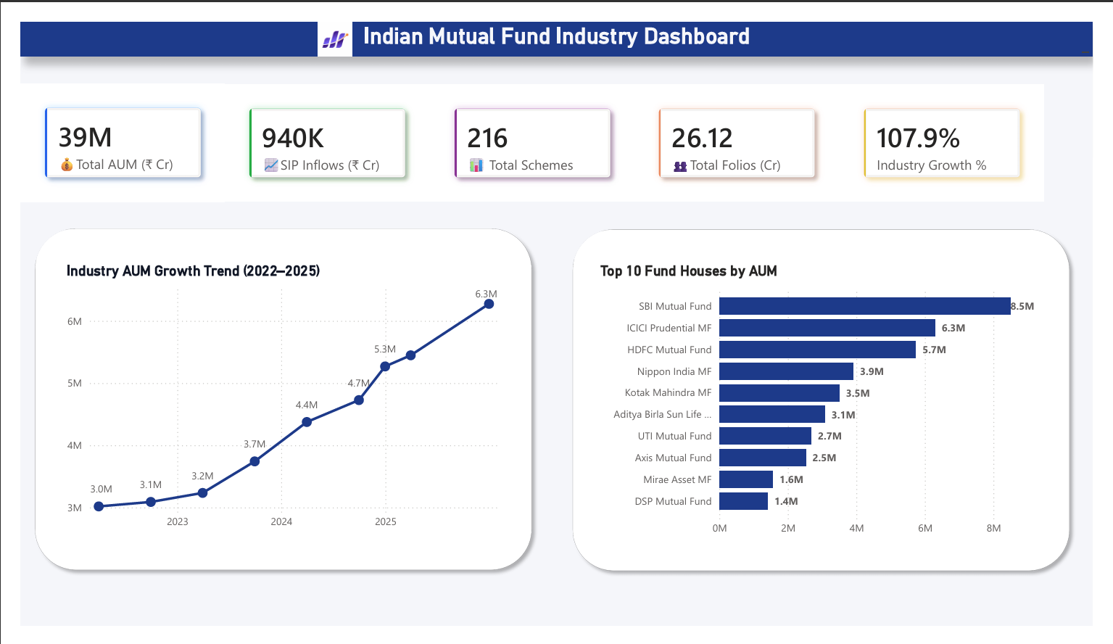
Slide 10 – Dashboard Screenshots

Slide 11
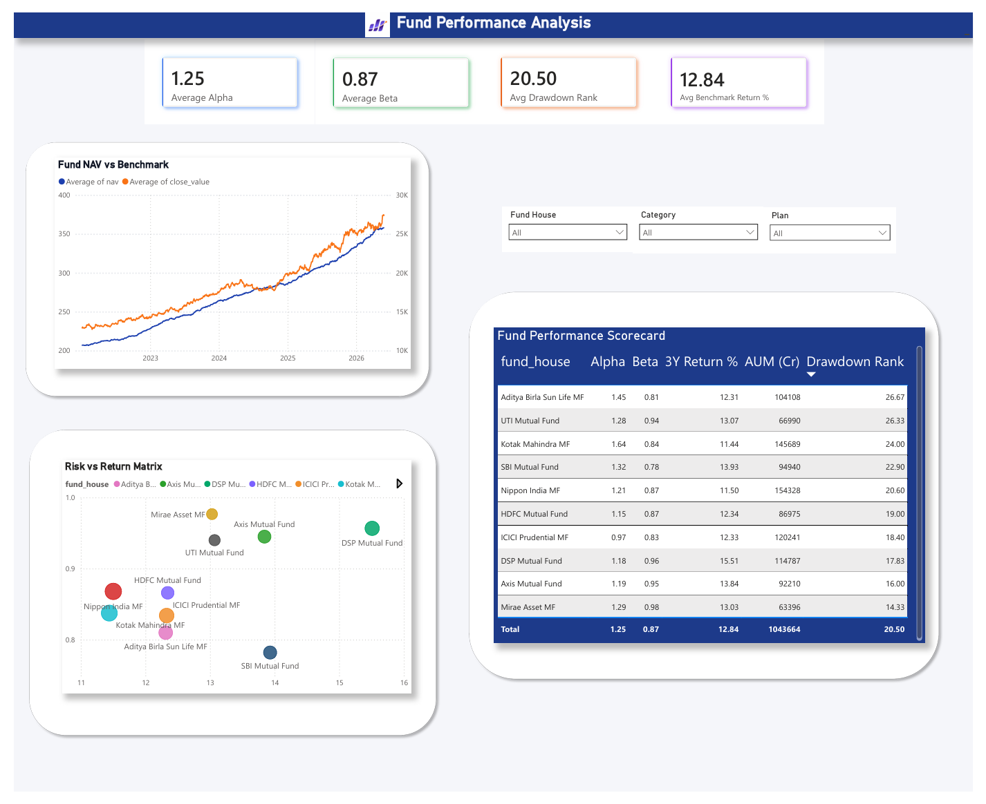
Slide 11 – Dashboard Screenshots

Slide 12
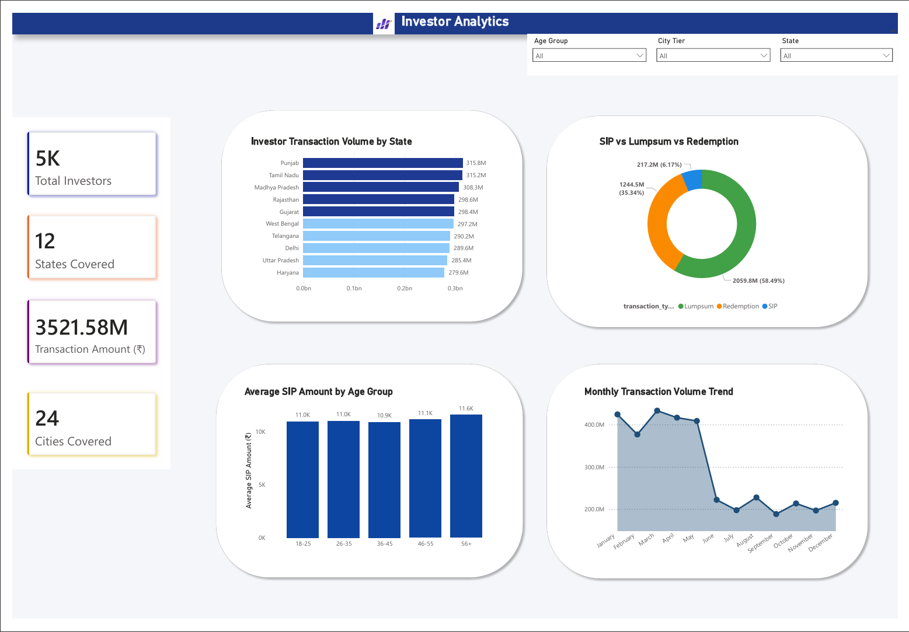
Slide 12 – Dashboard Screenshots

Slide 13
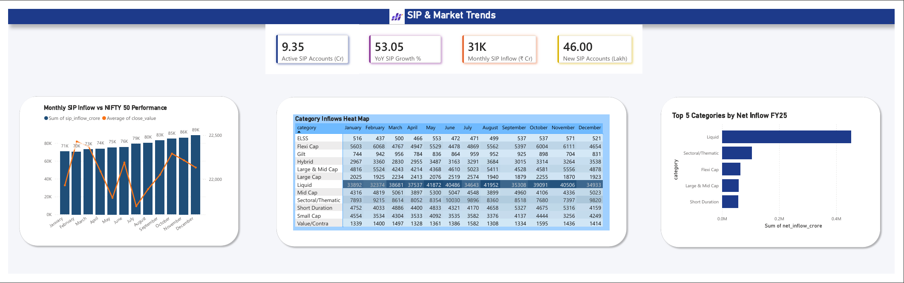
Slide 12 – Dashboard Screenshots

Slide 14
Slide 11 – Key Findings
Distribution imbalance
Performance dispersion
Certain categories dominate fund counts and AUM; ensure category-weighted comparisons to avoid bias.
Returns and risk vary widely across and within categories — composite metrics improve signal detection.
Risk heterogeneity
Dashboard value
Tail-risk and drawdowns materially affect grade assignments; include scenario analysis in reviews.
Visualisation and filters significantly accelerate hypothesis testing and reporting cadence.

Slide 15
Slide 12
THANK YOU
BLUESTOCK MUTUAL FUND ANALYTICS CAPSTONE PROJECT

