Slide 1
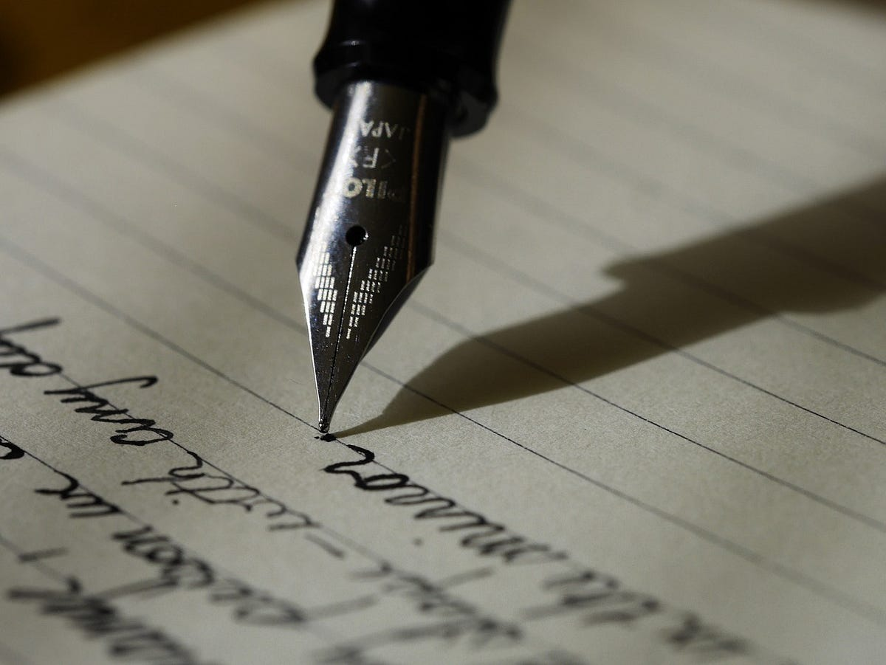
Handwriting_Recognition
Presented by: MUGILAN S B.TECH AI&DS III Sir Issac Newton College Of Engineering & Technology

Slide 2
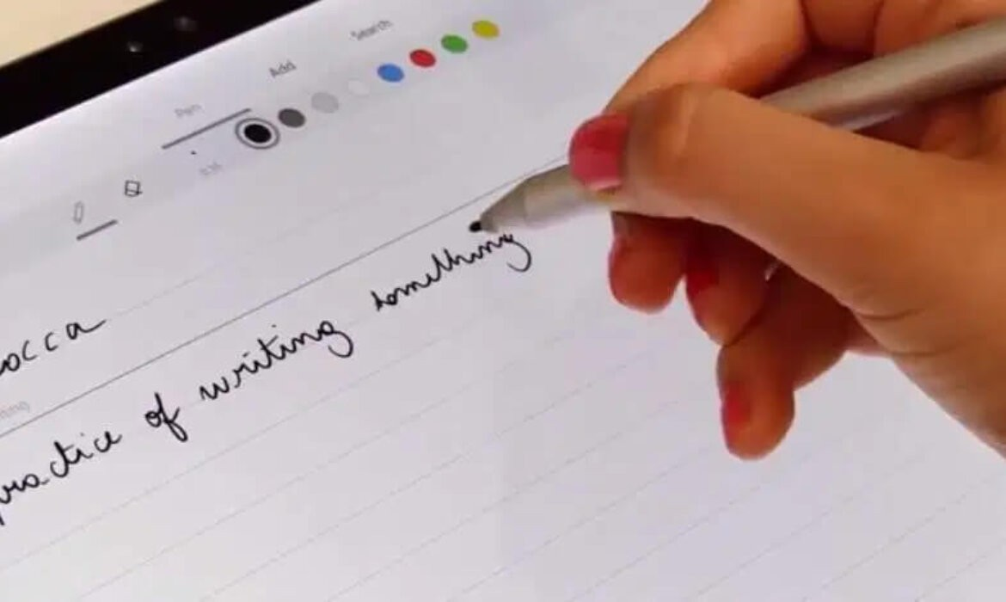
Neural Network Project on Handwriting Recognition Tool using Autoencoders source code
3/21/2024 Annual Review

Slide 3


AGENDA
Introduction: Provide an overview of handwriting recognition and its significance in digitizing handwritten content.
Challenges: Discuss the difficulties and complexities involved in recognizing handwritten text, such as variability in handwriting styles and character shapes.
Techniques: Explore the various methods and algorithms used for handwriting recognition, including neural networks, Hidden Markov Models (HMMs), and Support Vector Machines (SVMs).
Applications: Highlight the practical applications of handwriting recognition, such as converting handwritten text to digital format, signature verification, and form processing.
Recent Advances: Discuss recent advancements in handwriting recognition technology, including the role of deep learning and artificial intelligence.
3/21/2024 Annual Review

Slide 4

PROBLEM STATEMENT
Creating a robust and efficient handwriting recognition system to address the increasing demand for digitizing handwritten content. The system must accurately interpret a wide range of handwriting styles and characters, including cursive and print, while handling potential challenges such as varying writing sizes, angles, and quality of input images. Additionally, the system should be capable of real-time processing to ensure seamless integration into various applications, such as document digitization, signature verification, and form processing. Overall, the goal is to develop a versatile solution that improves productivity, enhances accessibility, and facilitates the transition from traditional pen-and-paper methods to digital platforms.

Slide 5

PROJECT OVERVIEW
The handwriting recognition project aims to develop an accurate system for converting handwritten text into digital format. It involves data collection, preprocessing, feature extraction, model development, evaluation, and integration into practical applications. The goal is to improve efficiency and accessibility in handling handwritten content, facilitating seamless interaction between analog and digital mediums.

Slide 6
WHO ARE THE END USERS?
End users of handwriting recognition systems include individuals, businesses, educational institutions, and government agencies, who utilize the technology for tasks such as document digitization, form processing, signature verification, and data entry, among others.

Slide 7

YOUR SOLUTION AND ITS VALUE PROPOSITION
Our handwriting recognition solution utilizes cutting-edge machine learning and computer vision techniques to accurately convert handwritten text into digital format. By collecting diverse datasets and preprocessing input images, we extract relevant features and develop robust models for recognition. Rigorous evaluation ensures high accuracy and reliability across various scenarios.
Value Proposition
Our solution offers:
High Accuracy: Reliable conversion of handwritten text into digital format.
Efficiency: Streamlined automation of handwriting recognition tasks, saving time and effort.
Versatility: Capability to recognize diverse handwriting styles and languages.
Integration: Seamless integration into existing workflows and applications.
Enhanced Productivity: Improved efficiency and reduced operational costs in handling handwritten documents.

Slide 8

THE WOW IN YOUR SOLUTION
The "wow" factor in our handwriting recognition solution is its remarkable accuracy, lightning-fast real-time processing, universal compatibility across languages and writing styles, intuitive user experience, and commitment to continuous improvement.
3/21/2024 Annual Review

Slide 9
MODELLING
In modeling handwriting recognition, we employ machine learning techniques to process diverse handwritten samples. We extract features, such as stroke direction and curvature, and train models like convolutional neural networks (CNNs) or recurrent neural networks (RNNs). Through training and optimization, we ensure high accuracy and robustness. Finally, validated models are deployed for real-time recognition tasks.

Slide 10
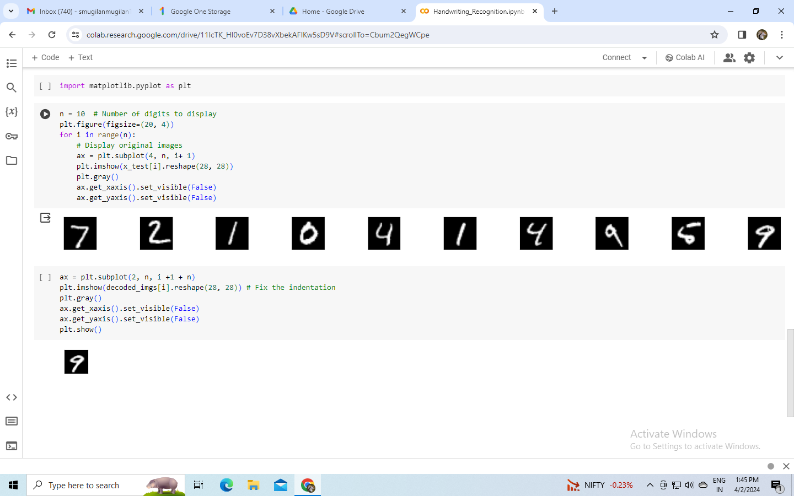
RESULTS

Slide 11
THANK YOU!

