Slide 1
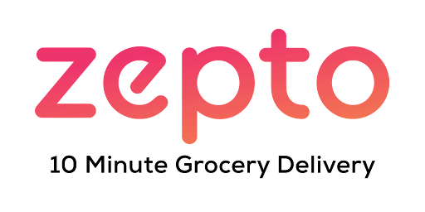
Zepto Product Data Analysis
Cleaned and Visualized in Python with Pandas, Seaborn, Matplotlib and
PowerBI

Slide 2
Project Objective
Goal: To analyze Zepto product data for understanding trends, product availability, pricing, and sales patterns using data cleaning and visualization techniques.

Slide 3
Dataset Overview
Source: Zepto (CSV file) From KAGGLE.COM
Key Features: Product Name, Category, MRP,
Discount %, Discounted Price, Available Quantity,
Sales Quantity, Weight, etc.

Slide 4
Initial Data Exploration
Methods Used:
df.head(): First 5 rows
df.tail(): Last 5 rows
df.info(): Data types and null counts
df.describe(): Summary statistics
df.shape: Rows and columns

Slide 5
Data Cleaning Steps
Converted Data Types:
Converted string columns like MRP, Discount %,
etc., to numeric format
Handled Missing Values:
Replaced or dropped rows/columns with
missing data
Removed Duplicates:
Used df.drop_duplicates()
Filtered Rows:
Removed irrelevant or out-of-stock rows

Slide 6
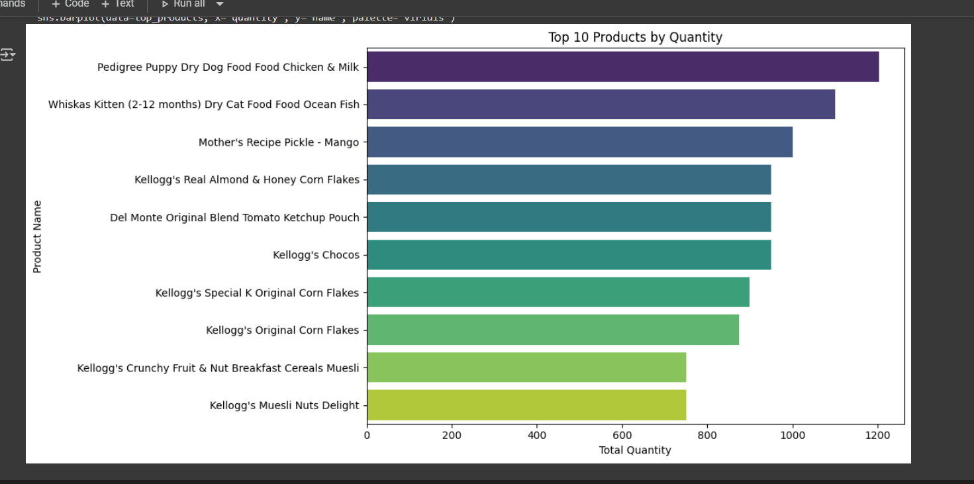
TOP10 PRODUCTS BY QUANTITY

Slide 7
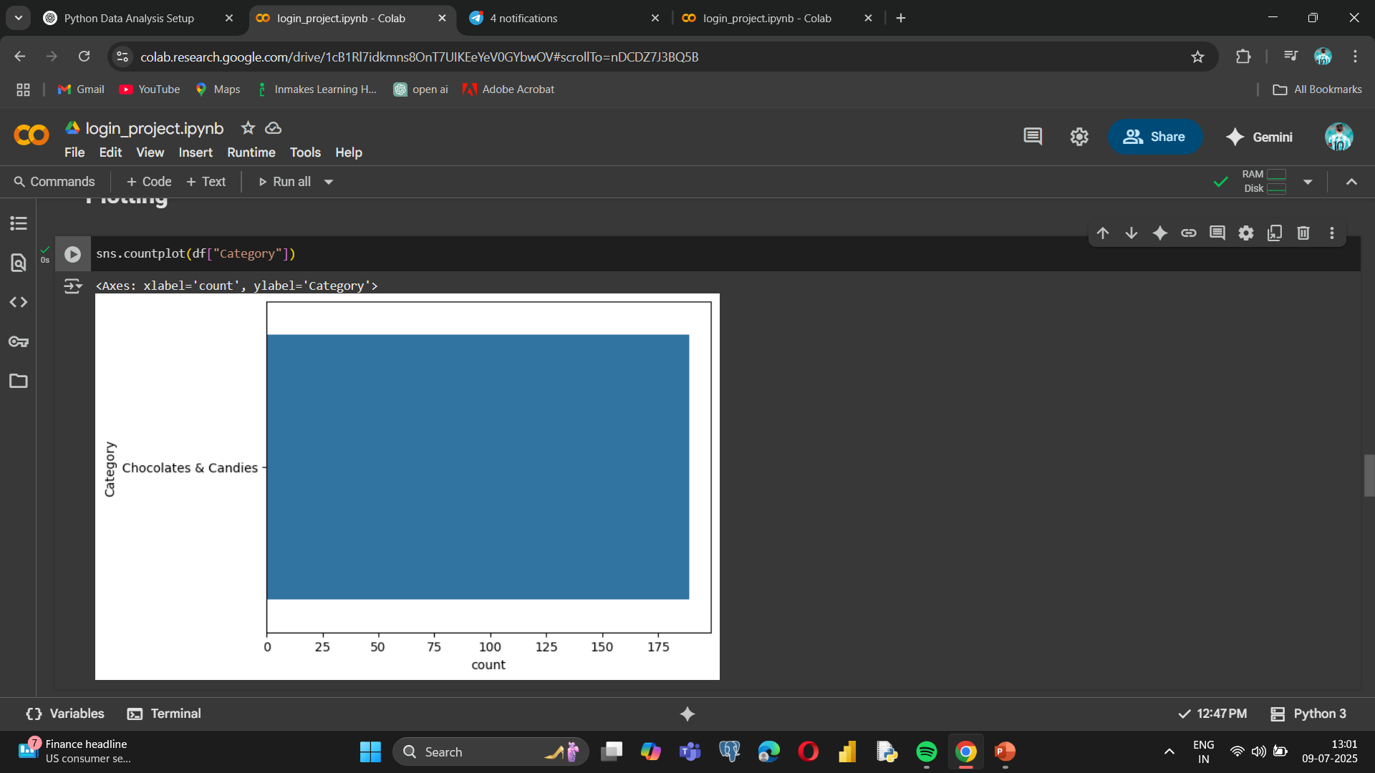
VISUALIZATION
USING SEABORN:

Slide 8
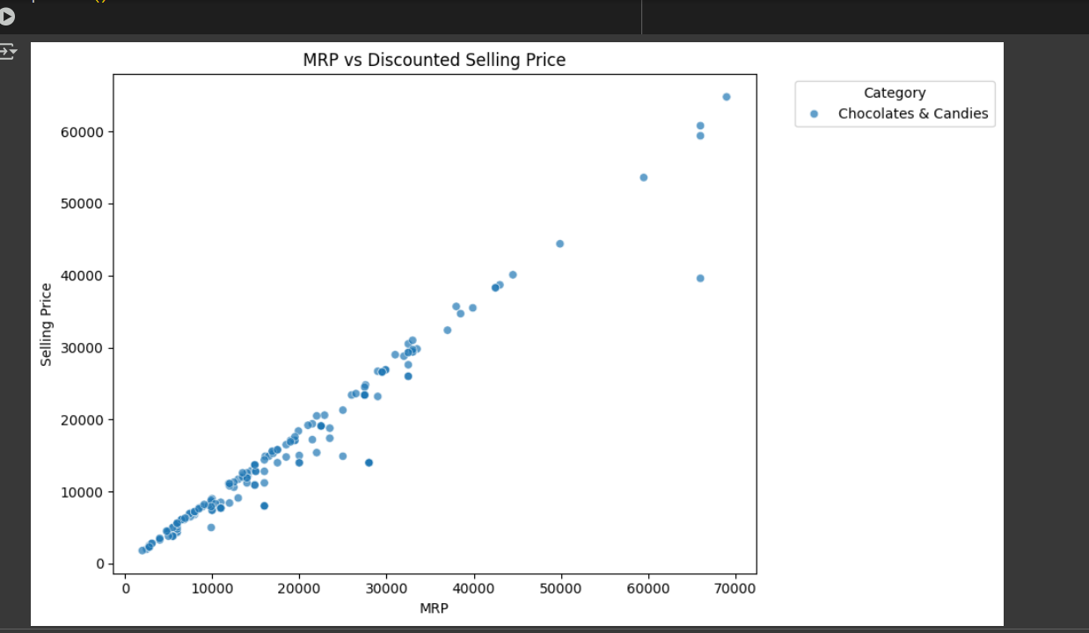
MRP VS Discounted Selling Price

Slide 9
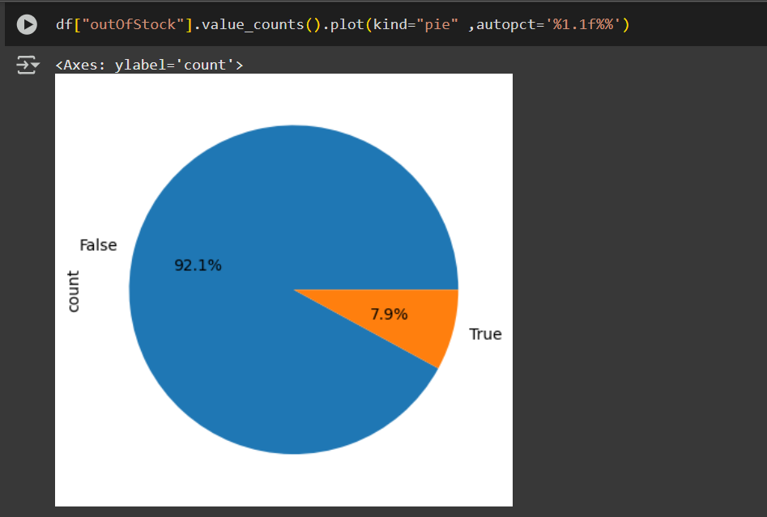
OUT OF STOCK (TRUE VS FALSE) %

Slide 10
Key Insights
🍫 'Chocolates & Candies' is the most frequent category
📦 Top-selling products have large quantity values
💸 Some categories offer average discounts above 20%
📉 Many products have no discount (discountPercent = 0)
❌ Some categories frequently go out of stock

Slide 11
Tools & Libraries
🔍 Pandas – Data cleaning & Transformation
📊 Seaborn – Statistical Visualizations
📈 Matplotlib – Plots and Graphs
🧼 Numpy – Numeric fixes and Conversions

