Slide 1













Name: Mugunthan S
Register Number: 71772117127
Naan Mudhalvan ID: au71772117127
Class: 3rd year B.E CSE
College Name: Government College of Technology,Coimbatore

Slide 2



Halliburton Q&A Chatbot using RAG

Slide 3


1
Problem Statement
2
Project Overview
3
Who are the end Users
Agenda
4
Solution and It’s value Proposition
5
The Wow in Solution
6
Modelling
7
Results

Slide 4


Problem Statement
To develop a Q&A bot for pdfs telling about the Company,
Fine-tuning an open-source Language Model (LLM) or integrate a Retrieval-Augmented Generation (RAG) technique with an LLM.

Slide 5

Project Overview
The project aims to develop a Q&A bot capable of extracting relevant information from PDF documents about a specific company. The approach involves utilizing advanced techniques such as Data Chunking and Embedding, Model Loading, Query Processing, Context Retrieval, Model Inference, and Integration and Automation.

Slide 6








Who are the End Users ?
Company Employees
Job Applicants
Investors
Genral public

Slide 7

SOLUTION AND ITS VALUE PROPOSITION
1. Data Chunking &Embedding
Utilize LangChain to divide PDFs into 512-sized chunks with 100-sized overlapping, embedding them with a chosen model, and storing them in ChromaDB for efficient retrieval.
2. Model Loading
Load Mistral, a pre-trained transformer model, to process queries and contexts for question-answering tasks.
3. Query Processing
Submit queries to FAISS to retrieve relevant documents. The top 10 documents are selected based on relevance to the query.

Slide 8
4. Context Retrieval
Extract context from the retrieved documents and concatenate it with the query, preparing it for input to the model.
5. Model Inference
Pass the concatenated query and context, along with a prompt, to the DistilBERT model for inference, which predicts the answer to the query.
6. Integration and Automation
Integrate the entire pipeline into an automated system for seamless execution, enabling efficient and accurate retrieval of information from PDF documents.

Slide 9









The Wow in solution
Comprehensive Company History
Quick Access to Information
Personalized Responses

Slide 10
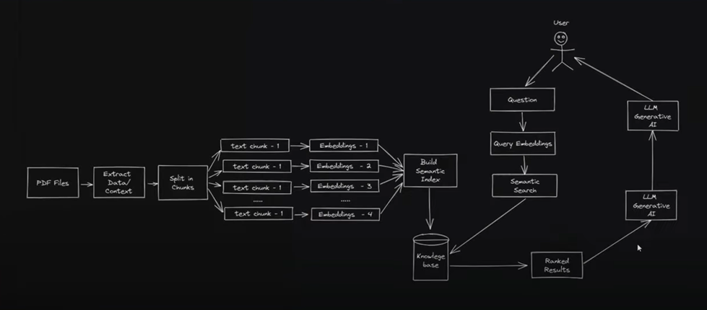

Modelling

Slide 11
RESULTS
The chatbot's accuracy, confirmed by cross-referencing with PDF content, solidifies its reliability as a source for company history.This validation showcases its proficiency in parsing and delivering precise insights from extensive data.
Demo Link

Slide 12
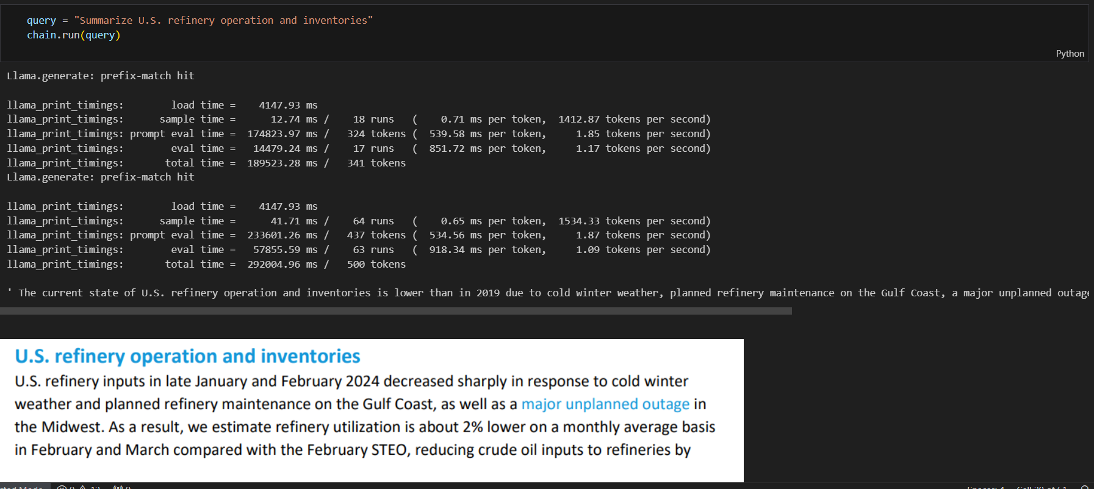

Slide 13
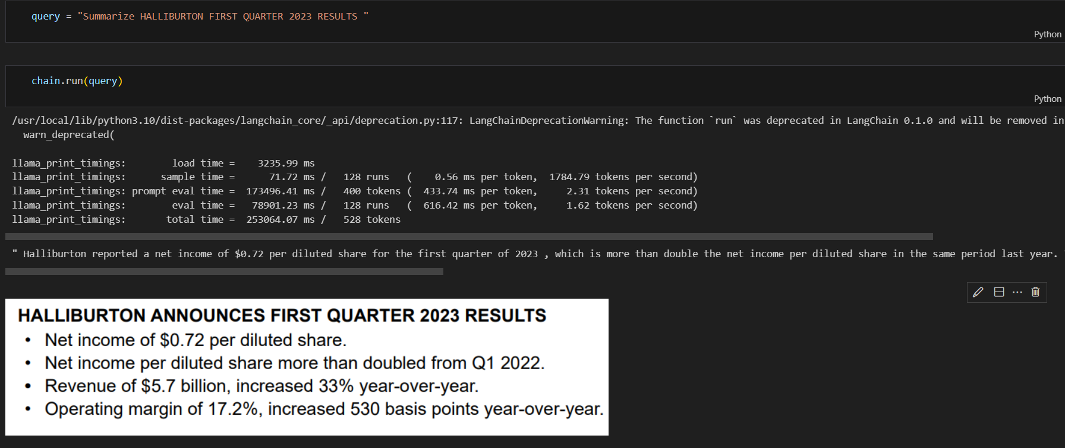

Slide 14





Thank You

