Slide 1
Sales Dataset Analysis – Advanced Excel Project
Presented By,
Muguntharaj A
DADS JUNE 2025
Notes:
NOTE:
To change the image on this slide, select the picture and delete it. Then click the Pictures icon in the placeholder to insert your own image.

Slide 2
Project Overview & Objectives
1. Analyze the dataset containing sales transaction information from a retail business.
2. Conduct comprehensive data analysis to extract valuable insights.
3. Create interactive visualizations using Microsoft Excel.
GOALS:
Utilize advanced Excel features, such as What-If Analysis, Goal Seek, Macros, Power Query, and Power Pivot, to deepen your analysis and automate tasks.

Slide 3
Data Description and Preparation
Dataset Overview: Gives Superstores Sales dataset exists with 2740 rows, columns such as RowID, ColumnID, Order Date, Ship Date, Customer ID, Customer Name, Segment, Country, City, State, Postal code, Region, Product ID, Category, Sub category, Product Name, Sales, Quantity, Discount, Profit, Adjusted Sales.
Data Cleaning Process:
Remove duplicate rows and blank entries from the dataset.
Use data validation to ensure consistency in sales numbers and dates,
ensuring values like Sales and Discounts are not negative.
Employ IF or IFERROR to flag any negative or erroneous entries.
Identify and resolve outliers or incorrect values in Sales and Discounts.

Slide 4
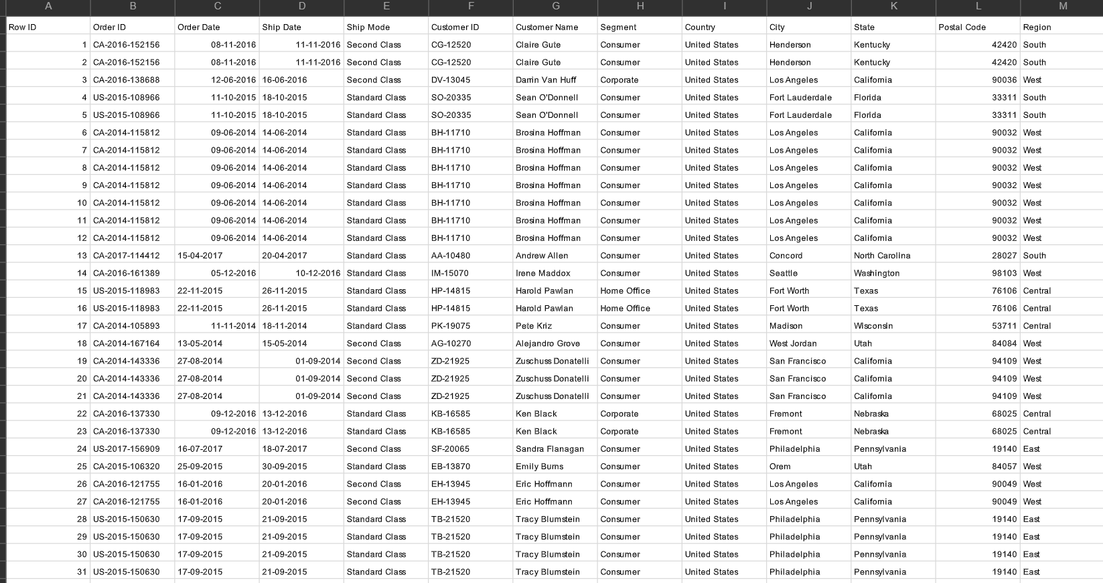
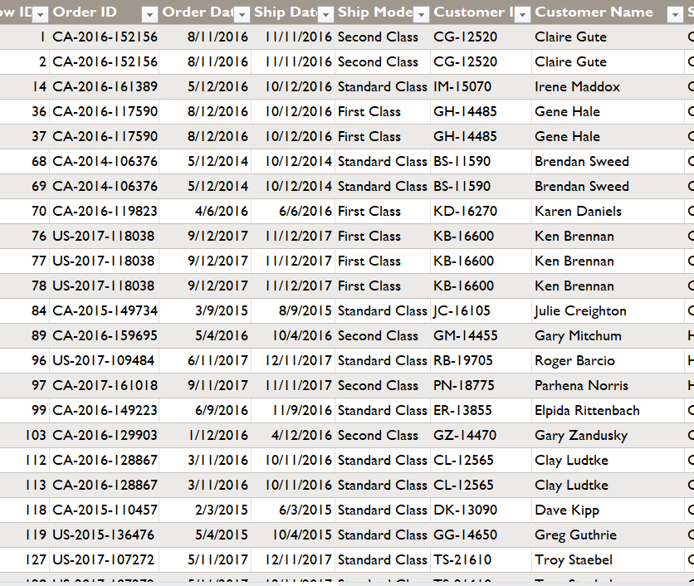
Dataset Before and After Cleaning

Slide 5
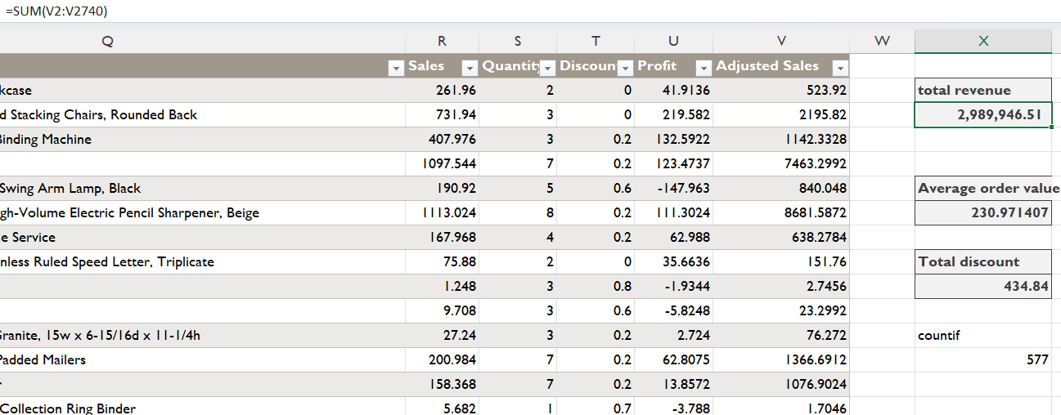
Key Metrics Calculation and Data Analysis
Total Revenue
= 2,989,946.51
2. Average orders
= 230.971407
3. Total Discount
= 434.84

Slide 6
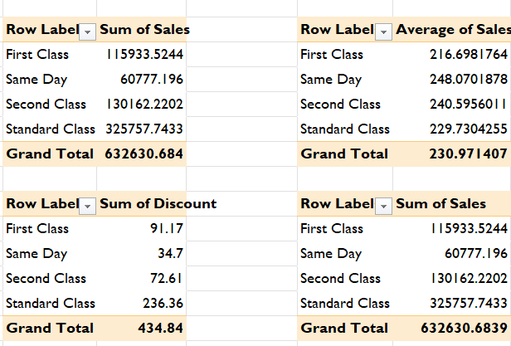
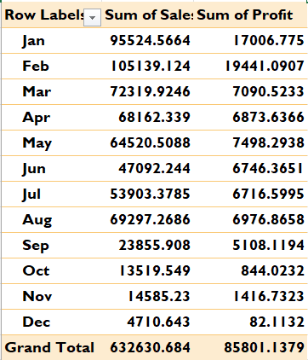
Pivot Tables and Pivot Charts
Monthly Sales & Profit Trends: Peak sales and profit occur in January and February, with a drop in December.
Adjusted Sales by Month: January and February show the highest revenue, indicating seasonal patterns.
Standard Class dominates sales volume.
Discount Distribution: Highest discounts are in Standard Class, suggesting potential for promotions.
Category Wise Quantity & Sales: Furniture shows high-value, low-volume transactions.
Monthly sales and profit analysis :
Shipment analysis :

Slide 7
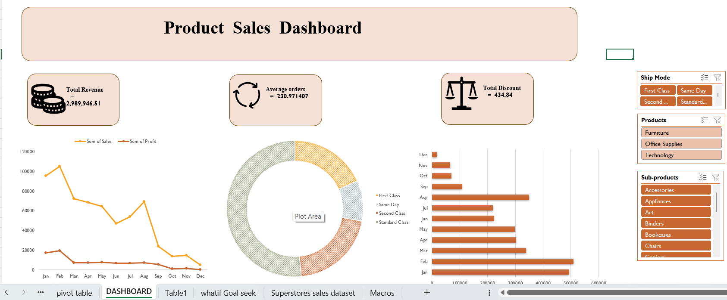
Dashboard Overview

Slide 8
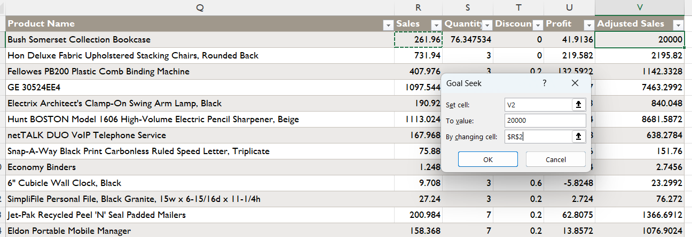
What-If Analysis & Goal Seek
What-If Scenarios:
Sales will increase by 10%, impacting total revenue.
If the discount rate decreases by 5%, we should compare various sales and discount scenarios and their effects on adjusted sales or profit.
What if - Analysis Goal Seek result
Goal Seek: Used to determine the sales target required to reach a specific revenue or profit goal. For example, if I set a target for adjusted sales or profit, I can use Goal Seek to calculate the number of product units that need to be sold to meet that target.

Slide 9
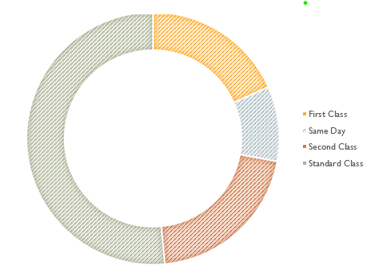
Insights and Recommendations
Key Insights:
Top Sales Channel: Standard Class leads with ₹3.25L; Same Day has the highest avg. sale (₹248).
Best Months: Jan & Feb show peak sales (₹95K+ & ₹1.05L) and profits (₹17K+ & ₹19K+).
Low Months: Sales dip significantly from Sep–Dec; Dec is the weakest.
Minimal Discount Impact: ₹435 total discount shows little reliance on pricing tactics.
Profit Trend: High profit aligned with high sales; some months like Aug & Mar remain profitable despite moderate sales.
Recommendations:
Promote Same Day Delivery: High avg. The sale value makes it a growth area.
Targeted Discounts: Focus discounts on Second Class & Same Day channels.
Monitor Margins: Keep evaluating the profit-to-sales ratio for smarter decisions

Slide 10
Conclusion
Summary
Sales peaked in Jan–Feb, with strong profits and adjusted sales.
Standard Class dominates overall sales; Same Day offers high average value per order.
Discounts were minimal but could be strategically optimized.
Seasonal trends and ship modes significantly influence performance.
Next Steps
Forecast sales for the upcoming quarter.
Explore customer segmentation and buying patterns.
Improve data accuracy and integrate return/refund analysis.

Slide 11
❓Any Questions?

Slide 12
THANK YOU

