Slide 1
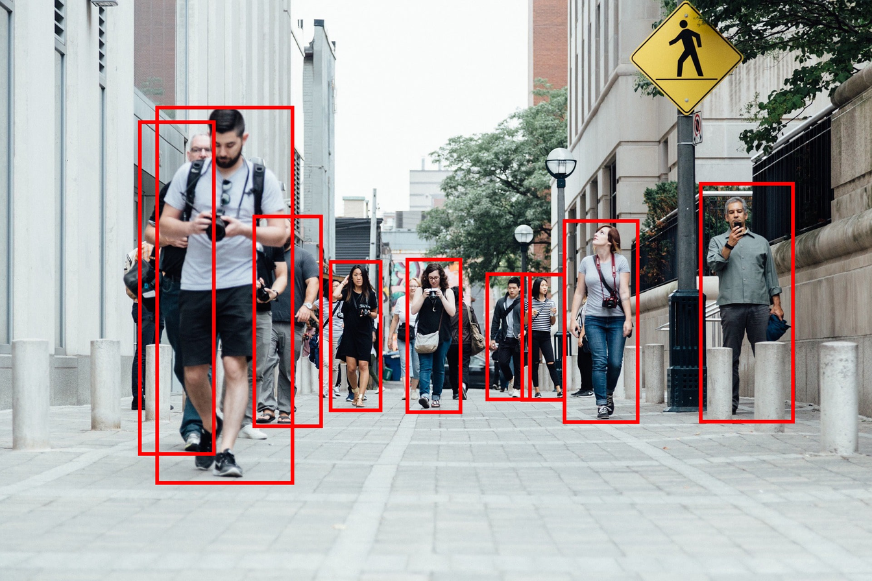
DETECTION AND TRACKING OF HUMAN
USING DEEP LEARNING
By Fei-Fei Li Team

Slide 2
Background
WHY HUMAN-TRACKING ?
Human tracking is essential in applications such as:
Surveillance and crowd monitoring
Smart environments and robotics
Behavior and activity analysis
Traditional tracking methods often fail in:
Complex backgrounds
Occlusion
Real-time performance constraints
Deep learning models like YOLOv and Faster R-CNN offer fast and accurate object detection suitable for tracking tasks

Slide 3
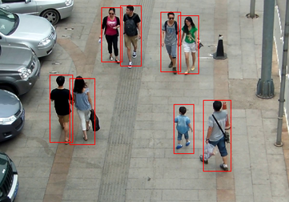
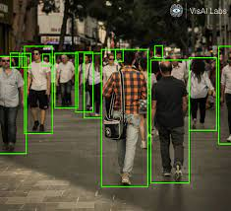
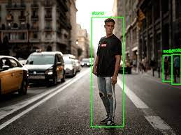
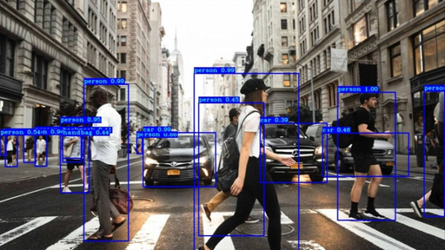
OBJECTIVE
To detect and track object (human) using YOLO variants and Faster R-CNN
To evaluate YOLO performance on human tracking tasks

Slide 4
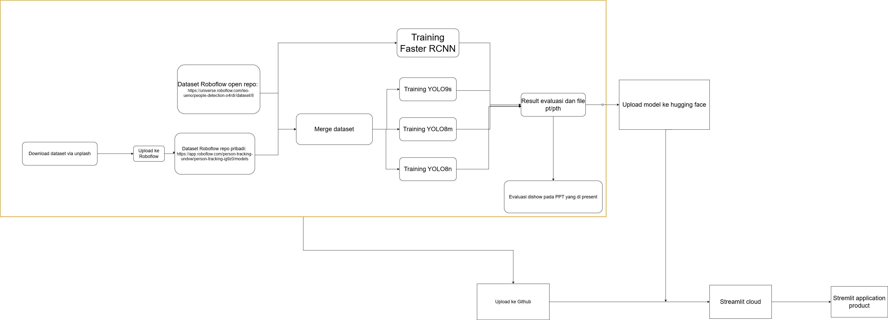
FLOW OVERVIEW

Slide 5
DATA PREPARATION
Dataset | Source | Augmentation | Number of Train Images | Number of validation Images | Number of Test Images
Dataset 1 (Public dataset) | https://universe.roboflow.com/leo-ueno/people-detection-o4rdr/dataset/8 | Outputs per training example: 3 Flip: Horizontal Crop: 0% Minimum Zoom, 25% Maximum Zoom Grayscale: Apply to 25% of images Hue: Between -25° and +25° Saturation: Between -25% and +25% Brightness: Between -25% and +25% Exposure: Between -25% and +25% Blur: Up to 2.5px Noise: Up to 1% of pixels Mosaic: Applied | 15210 | 1431 | 760
Dataset 2 (custom dataset) | https://app.roboflow.com/person-tracking-undvw/person-tracking-ig9z0/1 | Outputs per training example: 3 Flip: Horizontal Grayscale: Apply to 22% of images Brightness: Between -50% and +50% | 342 | 41 | 8
Label verification → ensure there are no duplicates and the YOLO format is consistent.
Path normalization → convert all file paths to absolute paths to ensure cross-OS compatibility.
data augmentation by Roboflow
Caching ensures efficient loading during training

Slide 6
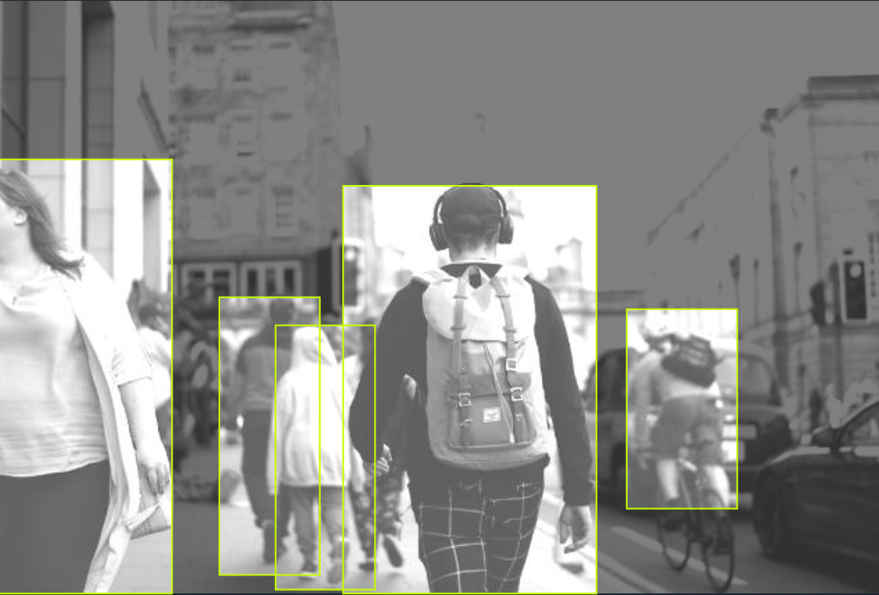
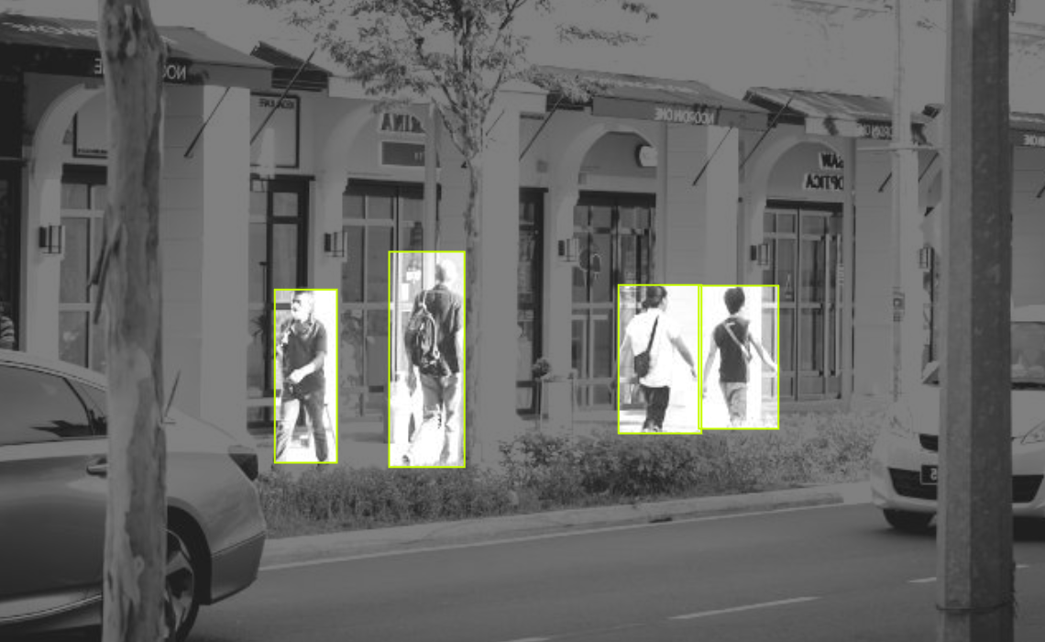
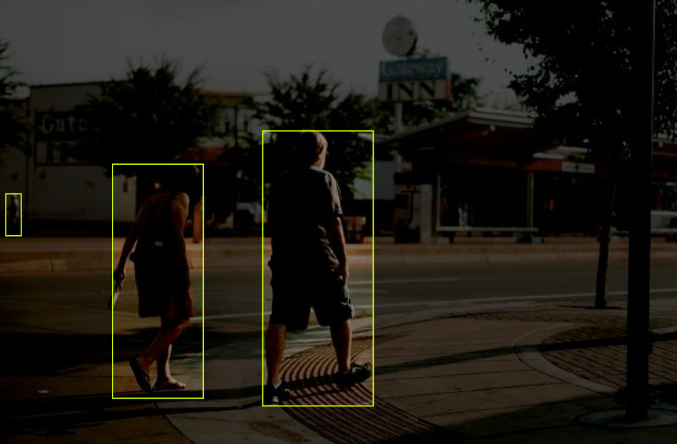
DATA PRE-PROCESSING
Label verification → ensure there are no duplicates and the YOLO format is consistent.
Path normalization → convert all file paths to absolute paths to ensure cross-OS compatibility.
data augmentation by Roboflow
Caching ensures efficient loading during training

Slide 7
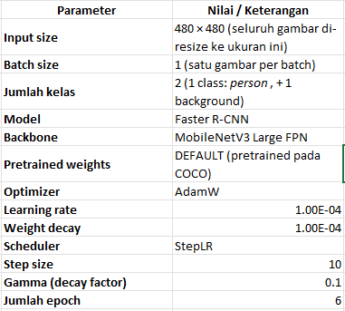
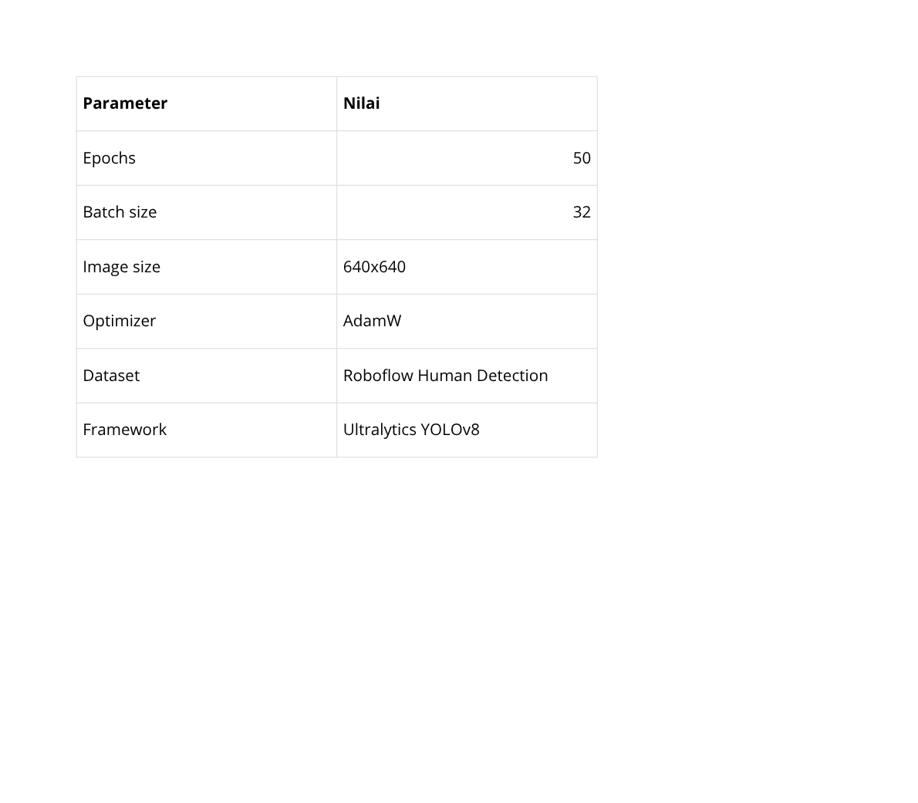
MODEL TRAINING
Model Training using Yolov9, Yolov8m, and Yolov8n
Model Training using Faster RCNN

Slide 8
COMPARISON
Model | Presisi | Recall | mAP50 | mAP50-95
YOLOv8m | 0.8177 | 0.6624 | 0.7424 | 0.4682
YOLOv8n | 0.8579 | 0.7539 | 0.833 | 0.6015
YOLOv9s | 0.839 | 0.7058 | 0.7822 | 0.5337
Faster RCNN | 0.2874 | 0.1693
YOLOv8m: Performa cukup baik, namun presisi dan mAP masih di bawah varian lainnya.
YOLOv8n: Hasil terbaik secara keseluruhan, presisi dan mAP tertinggi, paling seimbang.
YOLOv9s: Stabil dan kompetitif, tapi sedikit di bawah YOLOv8n.
Faster R-CNN: Performa terendah, kurang cocok untuk dataset ini.

Slide 9
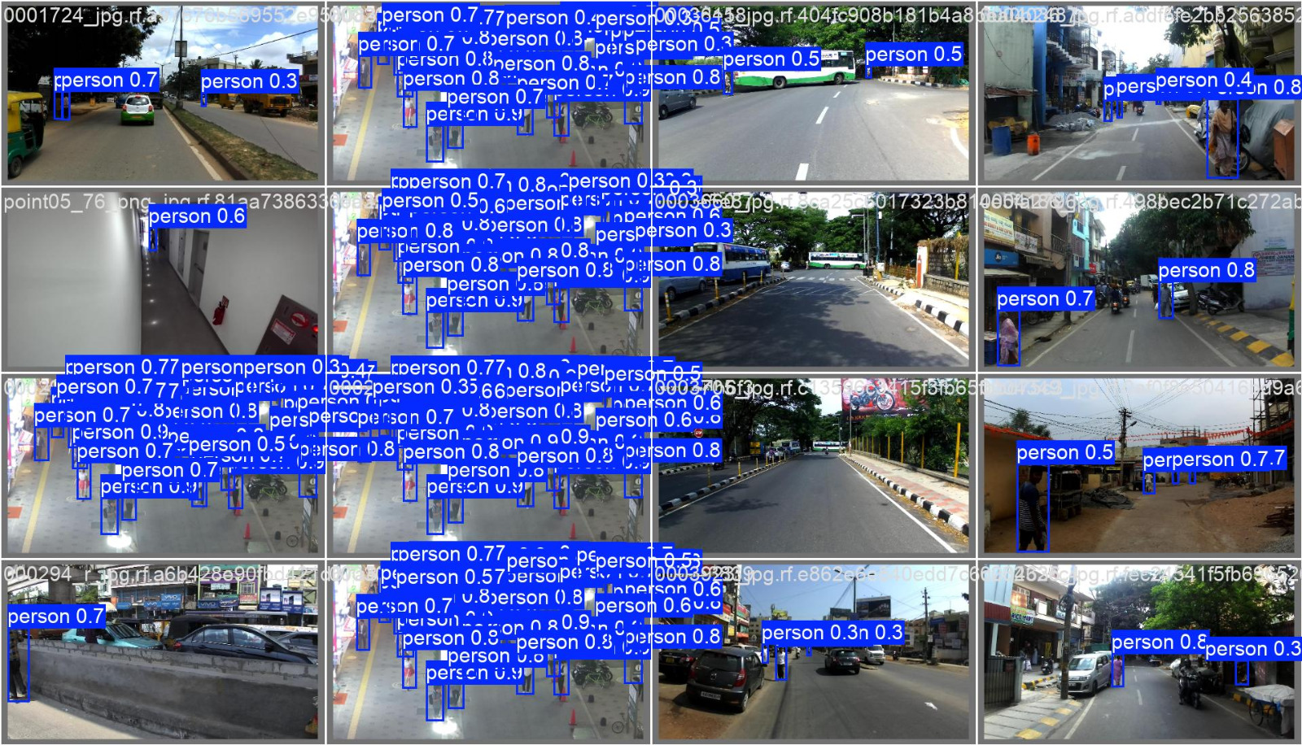
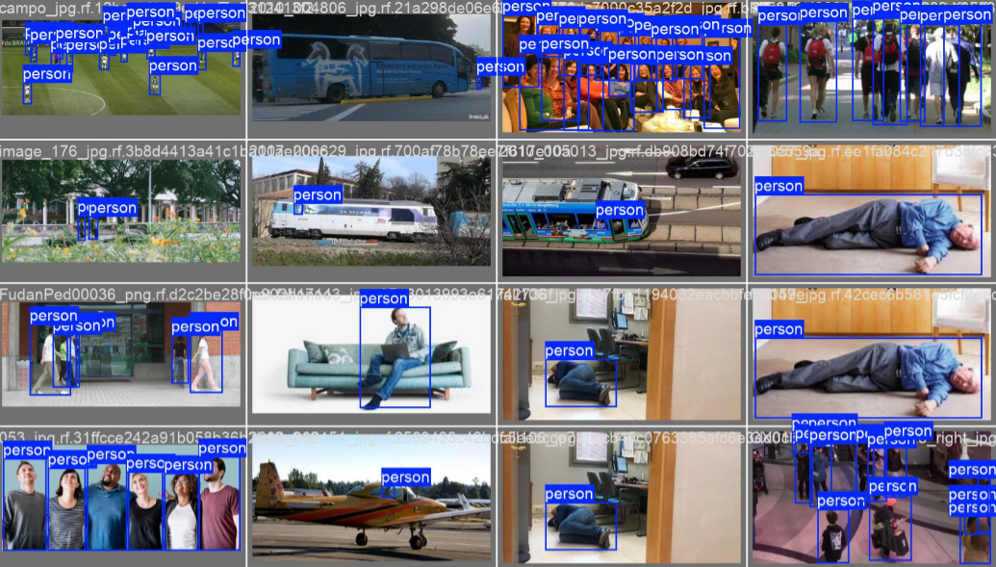
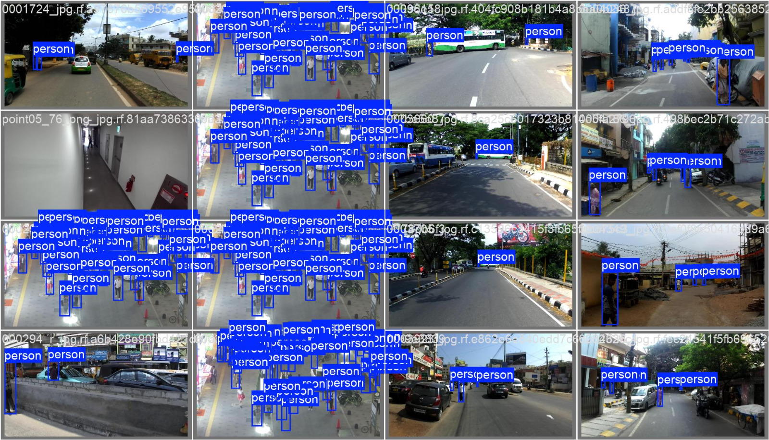
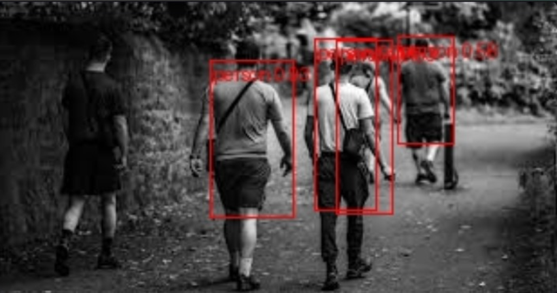
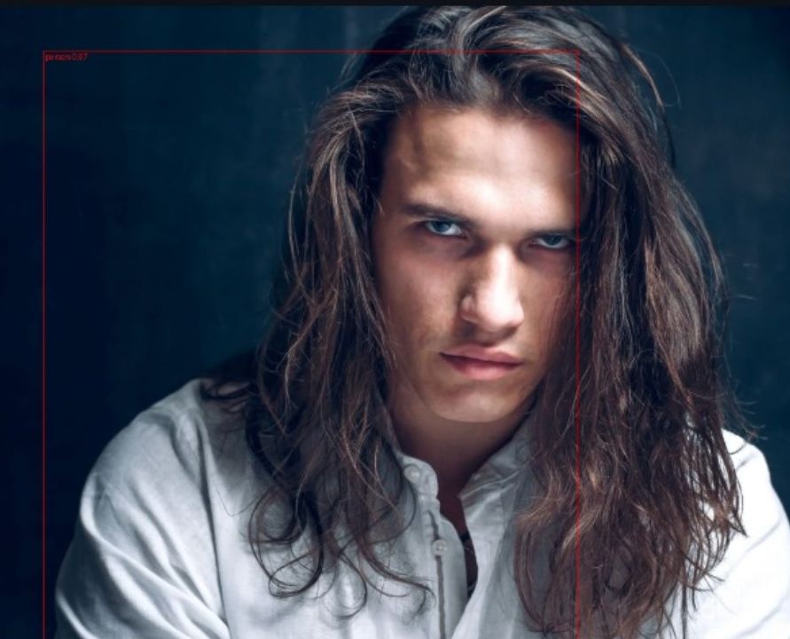
COMPARISON
Model Training using Yolov8n
Model Training using Yolov9s
Model Training using Yolov8m

Slide 10
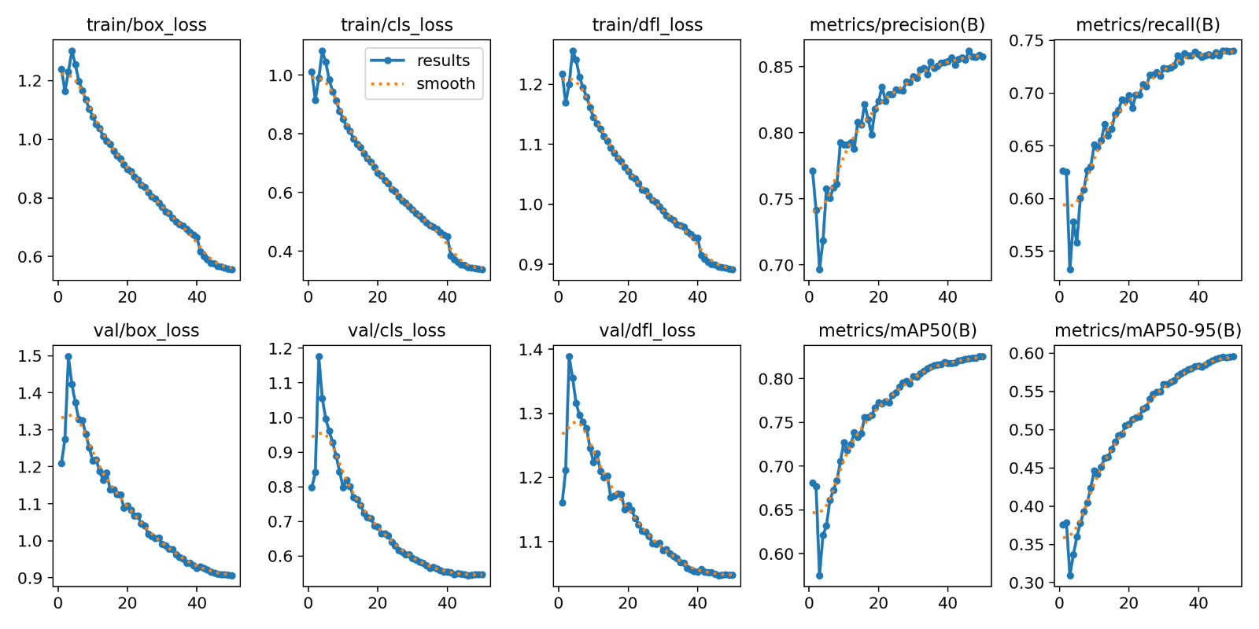
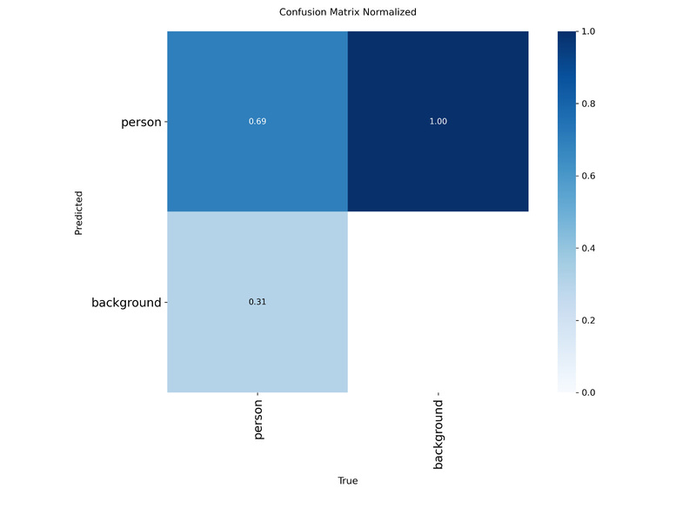
YOLOV8M RESULTS

Slide 11
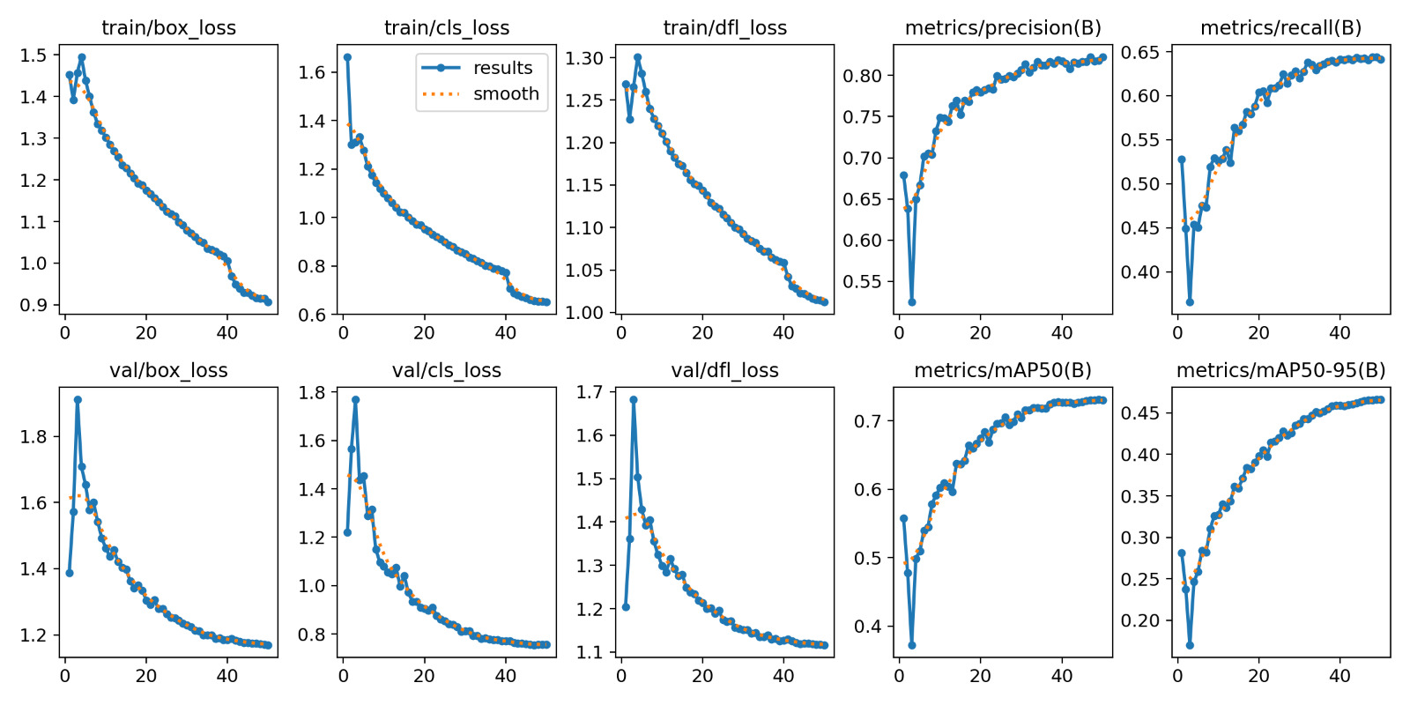
YOLOV8N RESULTS

Slide 12
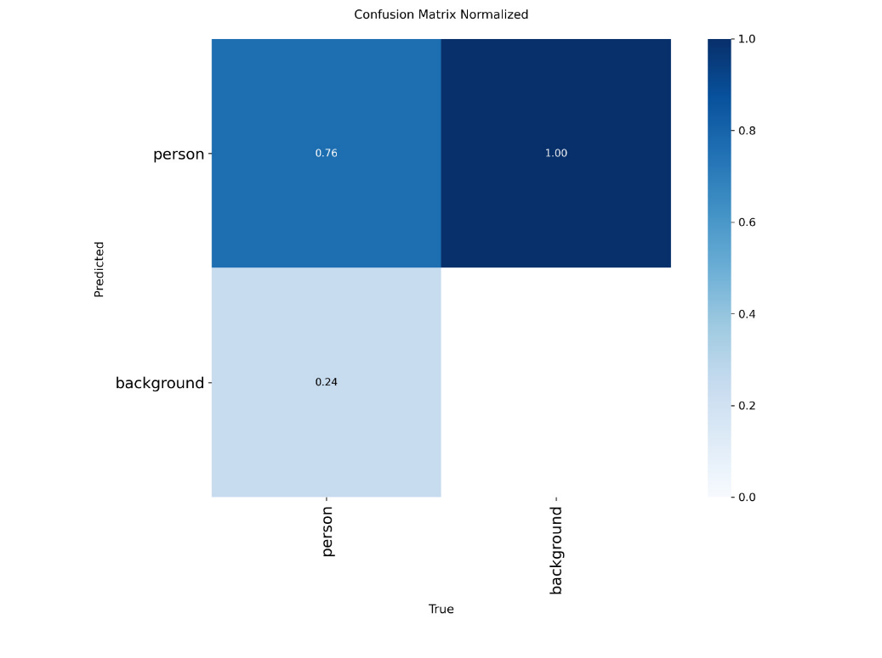
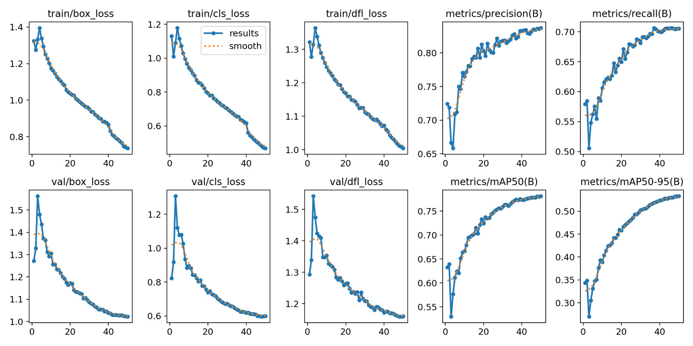
YOLOV9s RESULTS

Slide 13
Conclusion and Future Work
Result in streamlit.
Running local
Streamlit run streamlit/main.py
Access here
https://github.com/MuhArifBudiman/Object-Detection-Tracking/tree/main/streamlit
YOLOv8n provides accurate and efficient human detection and tracking.
Faster RCNN requires more GPU memory and longer inference time.
Future Work:
Using various images for powerful performance

Slide 14
THANK YOU

