Slide 1

SHUNT ACTIVE POWER FILTER AND ANALYSIS OF IPQCs
Presented by:
Hakim Shaiq Hussain (19207145029)
Rizwana Ramzan (19207145025)
Filza Shah (192071450320)
Muhafiz Bilal Khan (19207145053)
Under the supervision of:
Ms. Nousheen Khan (Guide)
Mr. Malik Younis Ahmed (Co-Guide)
DEPARTMENT OF ELECTRICAL ENGINEERING
INSTITUTE OF TECHNOLOGY, ZAKURA

Slide 2
Table of contents
Literature Review
Power Quality: An Introduction
Conventional Phase Controlled AC-DC Converters
Harmomic Filtering techniques for power quality improvement
Passive filters
Active filters
Conclusion

Slide 3
Literature Review
Bhim Singh, Ambrish Chandra and Kamal Al-Haddad, Power Quality Problems and Mitigation Techniques, The Atrium, Southern Gate, Chichester, West Sussex, PO19 8SQ, United Kingdom: Wiley, 2015 | The term electric power quality (PQ) is generally used to assess and to maintain the good quality of power at the level of generation, transmission, distribution, and utilization of AC electrical power. Since the pollution of electric power supply systems is much severe at the utilization level, it is important to study at the terminals of end users in distribution systems.
Muhammad H. Rashid, Power Electronics: Devices, Circuits, and Applications, Fourth Edition, USA: Pearson, 2014. | The output voltage of thyristor rectifiers is varied by controlling the delay or firing angle of thyristors. A phase-control thyristor is turned on by applying a short pulse to its gate and turned off due to natural or line commutation; in the case of a highly inductive load, it is turned off by firing another thyristor of the rectifier during the negative half-cycle of input voltage.
Michael McCarty, Taufik Taufik, Andre Pratama, Makbul Anwari, “Harmonic Analysis of Input Current of Single-Phase Controlled Bridge Rectifier”, IEEE ISIEA, October 4-6, 2009. | This paper presents Harmonic Analysis of Input Current of Single-Phase Controlled Bridge Rectifier.

Slide 4
Power Quality : An Introduction
PQ is quantified in terms of V, I, f deviation of supply system, which may result in failure or mal-operation of equipments.
Various PQ problem related to voltage at the point of common coupling (PCC) are: harmonics, notches, dc offset, swell, sag, unbalance, flicker, outages and so on.
These problems arise from various disturbances in the system or due to presence of non-linear loads.

Slide 5
Effect of poor power quality on users
Equipment damage
Loss of important data
Mal Operation of protection devices
Disturbance to tele-communication network, TVs, computers, metering

Slide 6
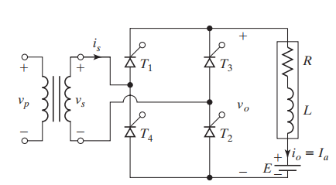
Single phase full bridge AC-DC converters

Slide 7
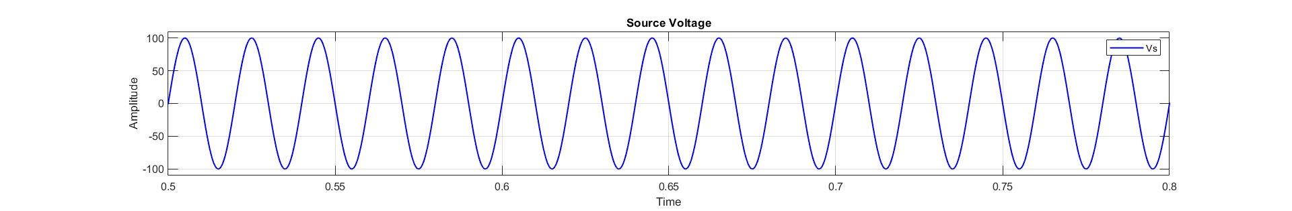
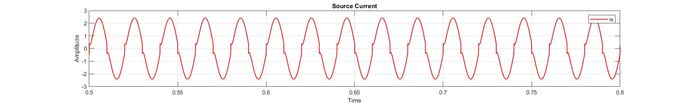
Single phase full bridge AC-DC converters
Simulation Results

Slide 8
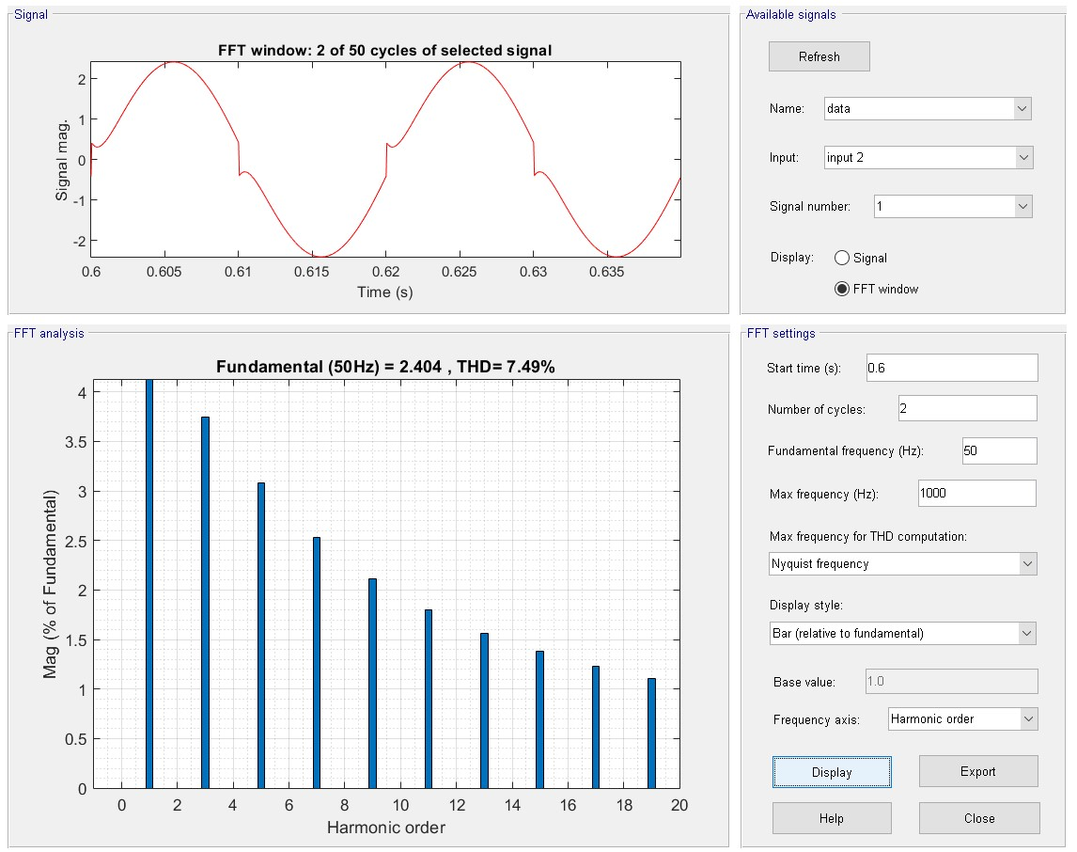
Single phase full bridge AC-DC converters
Fourier Analysis of input current

Slide 9
THD for different firing angles :
Problems:
Firing Angle | %age THD
0° | 7.49
15° | 2.32
30° | 10.41
45° | 19.56
60° | 30.20
75° | 41.73
90° | 53.65
The injected harmonic currents, and reactive power burden, cause low system efficiency and poor power factor.
Also results in disturbance to other consumers and protective devices and interference to nearby communication networks.
The source current is far from being sinusoidal.
The THD is far greater than 5%.
Therefore, various techniques are used for this purpose, and we shall discuss one such technique that makes use of filters to mitigate the harmonics in rectifiers.

Slide 10
Filter Techniques used for PQ improvement
Types of filters
Active filters
Passive filters

Slide 11
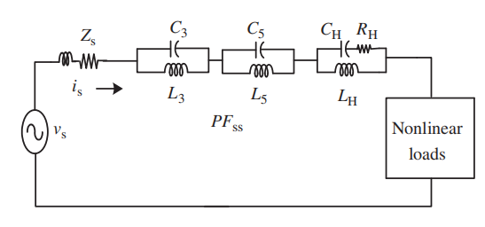
Passive filters

Slide 12
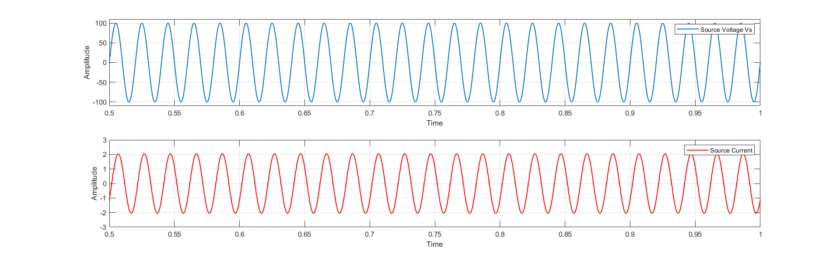
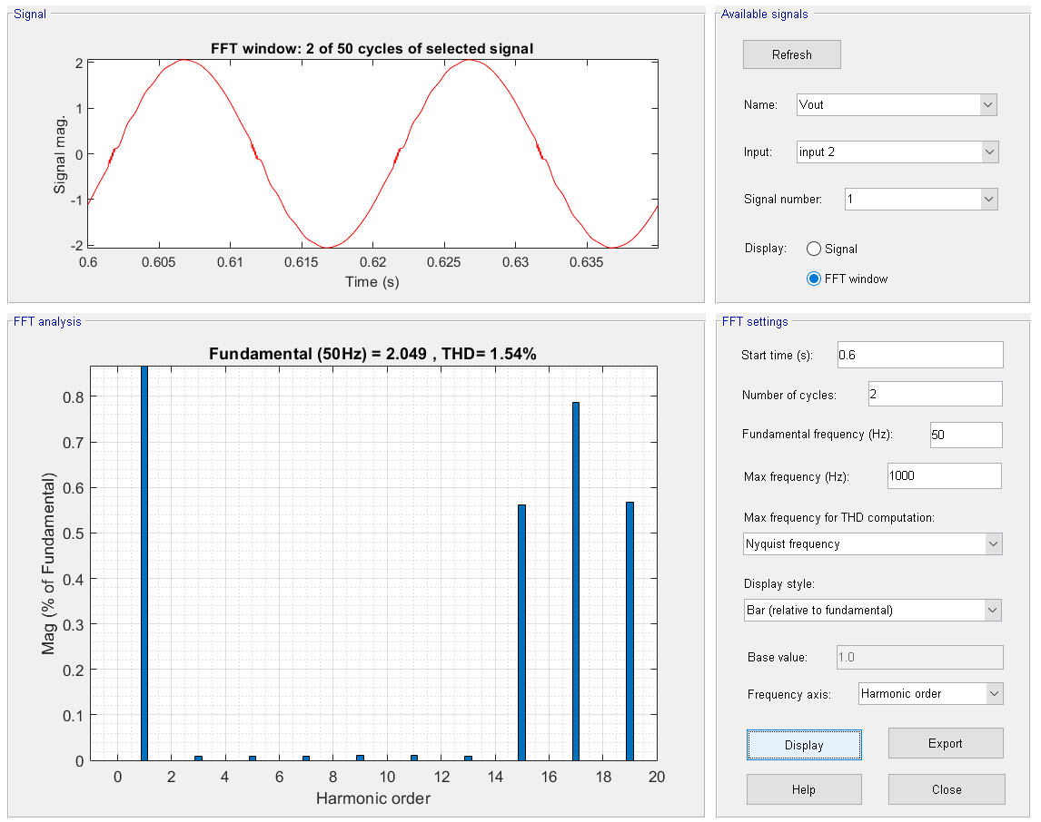
Simulation Results

Slide 13
Disadvantages of Passive Filters
Size is large.
For each harmonic frequency, a separate LC filter is to be designed.
L and C components are subjected to ageing.
They are bulky due to inductors.
They cannot adapt to changes in circuit parameters.

Slide 14
Firing Angle | %age THD before passive filter is installed | %age THD after passive filter is installed
0° | 7.49 | 1.54
15° | 2.32 | 1.54
30° | 10.41 | 1.72
45° | 19.56 | 4.69
60° | 30.20 | 12.87
75° | 41.73 | 24.39
90° | 53.65 | 44
Problems:-
The use of passive filters in systems with nonlinear loads decreased the THD of source current as seen in Table .
The inductor used in the LC filters are quite bulky.
To eliminate harmonics, we must install a separate LC filter for each harmonic frequency.
Also, the passive filters are not adaptable to changes in the system.
So due to these reasons, we use Shunt Active Power Filters.

Slide 15
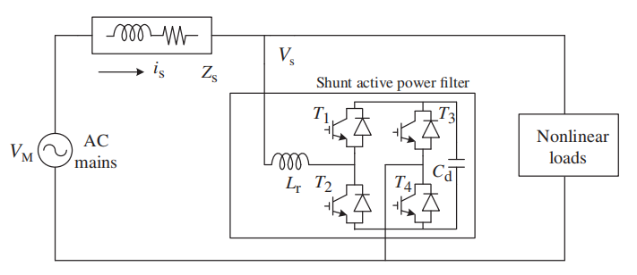
Shunt Active Power Filters
Main objective: Mitigate multiple power quality problems in a distribution system.
Such as reactive power, unbalanced currents, neutral current, harmonics, and fluctuations, present in the consumer loads.
Provides sinusoidal balanced currents in the supply along with its DC bus voltage control.

Slide 16
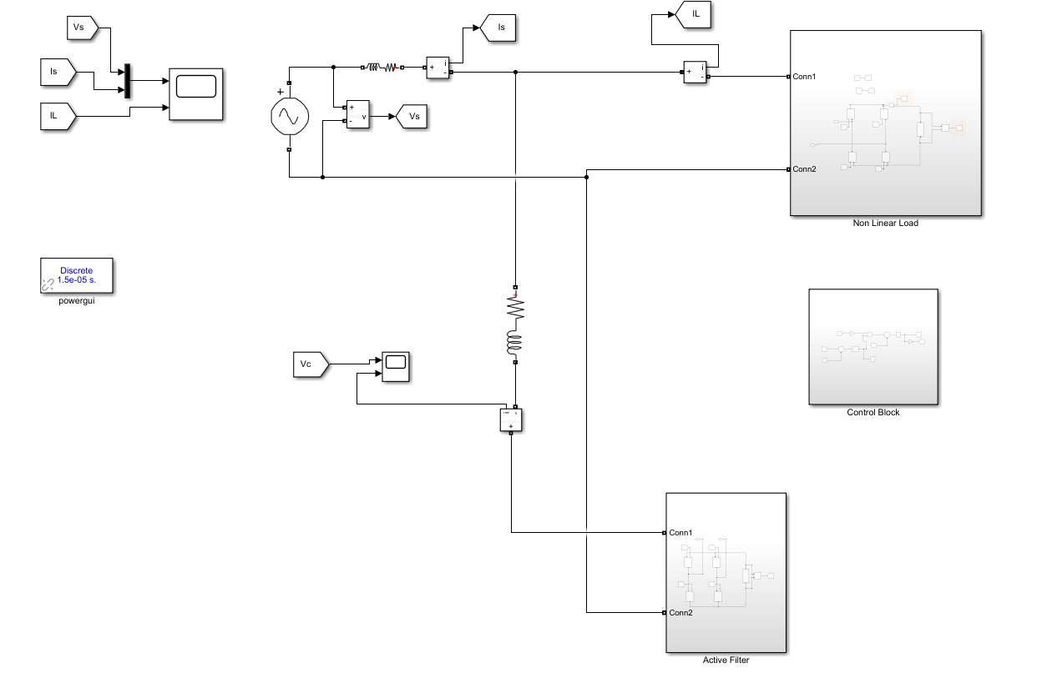
Simulation

Slide 17
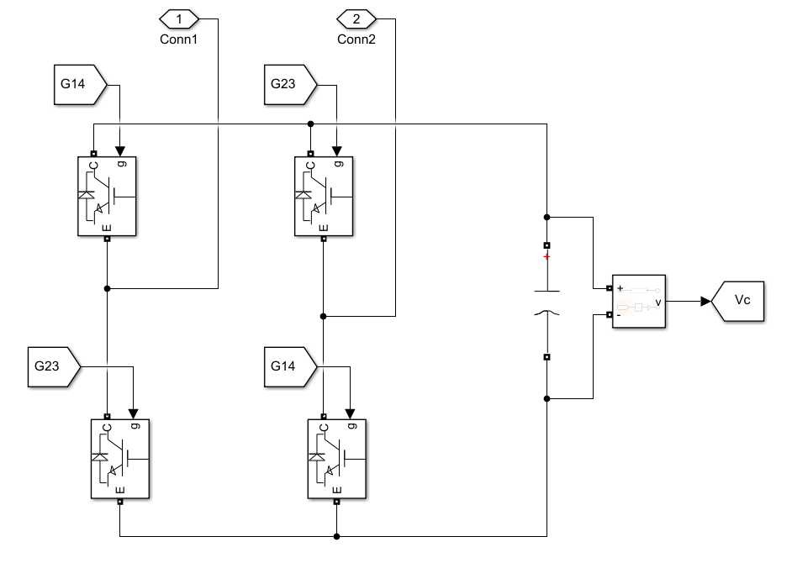
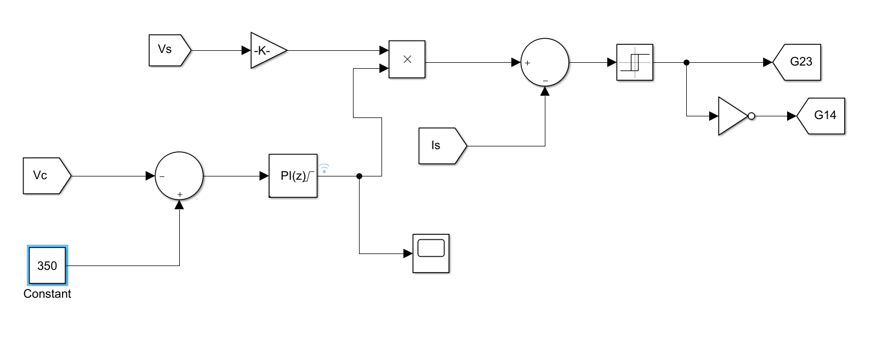
Shunt Active Power Filter
Control Circuit for SAPF

Slide 18
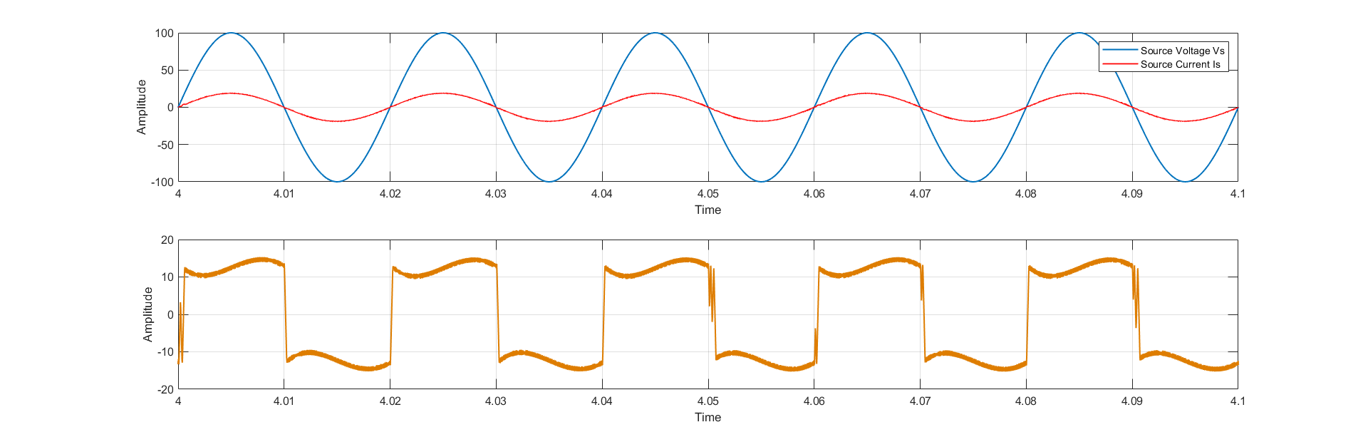
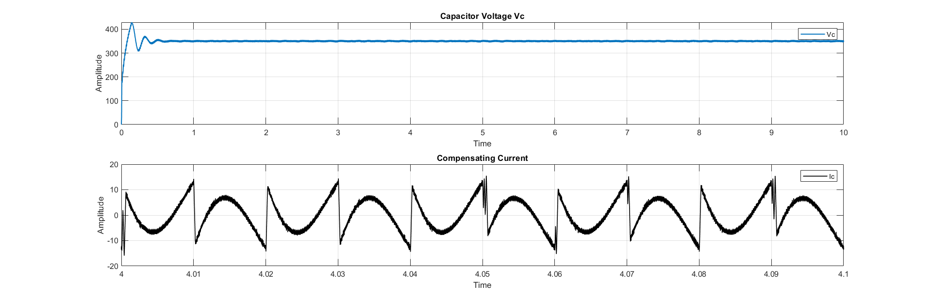
System Parameter | Value
Supply Voltage (Vs) | 100V (peak)
Frequency | 50Hz
Source Impedance (Zs) | 0.01Ω, 3mH
Filter Impedance | 0.001Ω, 3mH
DC link Capacitor (C) | 550µF
DC reference voltage (Vdc) | 350V
Proportional Gain (Kp) | 0.05
Integral Gain (Ki) | 5
Simulation Results (firing angle 0 degree)

Slide 19
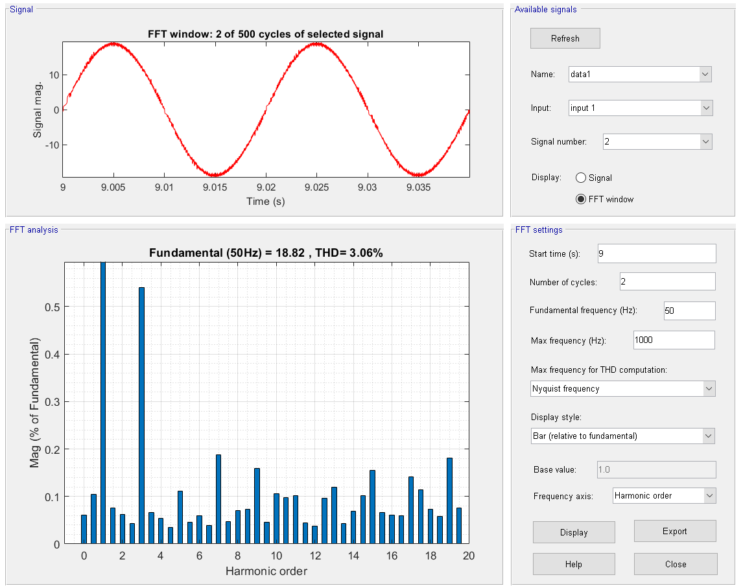
Firing angle | %THD |  | Power Factor | Factor
 | Before SAPF | After SAPF | Before SAPF | After SAPF
0° | 25.11 | 3.06 | 0.8679 | 1
15° | 25.33 | 3.18 | 0.8438 | 1
30° | 23.24 | 3.77 | 0.7607 | 1
45° | 16.90 | 4.94 | 0.6351 | 1
FFT analysis of Source Current

Slide 20
Disadvantages of SAPF:
Expensive
Complex Control
Limited frequency range
Can’t handle high power rating

Slide 21
Conclusion:
We noted that the THD for source current waveform Is came out to be 3.06% which was less than 5%.
Moreover, on analyzing the source voltage Vs and source current Is, we observed that the phase angle between Vs and Is was 0°.
Thus, the power factor was unity.

Slide 22
Thank you

