Slide 1
Expanded Depth-First Search
Features of the expanded DFS algorithm
  We use colorings of the vertices, using white, gray and black
    white: undiscovered
    gray: discovered, but we have not yet scanned all of its adjacent vertices
    black: discovered and all adjacent vertices have been scanned
  When a vertex v is discovered while scanning the adjacency list of vertex u, we set π[v] = u (parent array) and paint it gray
  We timestamp each vertex, using a “clock” variable
    d[u] the time at which u was discovered
    f[u] the time at which we finish scanning the adjacent vertices of u and paint u
    black
The timestamps will be used in applications of DFS
Timestamp properties:
  d[u] < f[u]
  u is colored white before time d[u], gray between time d[u] and f[u] and black after time f[u]

Slide 2
DFS Pseudocode
DFS(G)
1 for each vertex u ∈ V[G]
do color[u] ← WHITE
π[u] ← NIL
time ← 0
5 for each vertex u ∈ V[G]
do if color[u] = WHITE
then DFS-Visit(u)

Slide 3
DFS Pseudocode
DFS-Visit(u)
color[u] ← GRAY  WHITE vertex has just been discovered
time ← time + 1
d[u] ← time
for each v ∈ Adj[u]  Explore edge (u,v)
do if color[v] = WHITE
then π[v] ← u
DFS-Visit(v)
color[u] ← BLACK
time ← time + 1
f[u] ← time

Slide 4
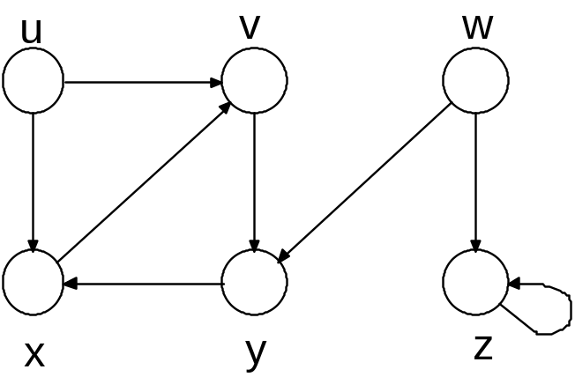
Directed Graph Example
We illustrate the execution of DFS on the digraph below.

Slide 5
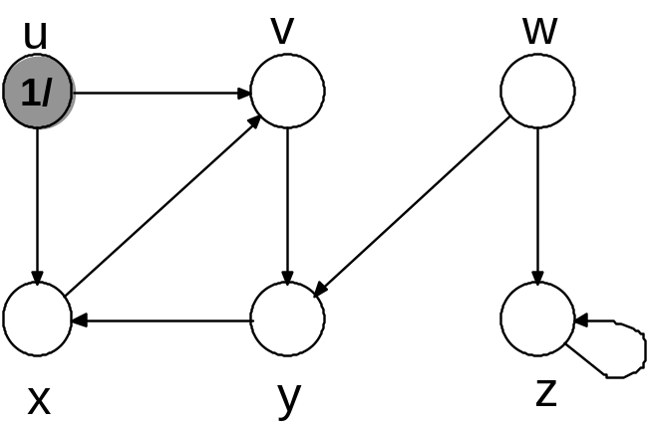
Directed Graph Example

Slide 6
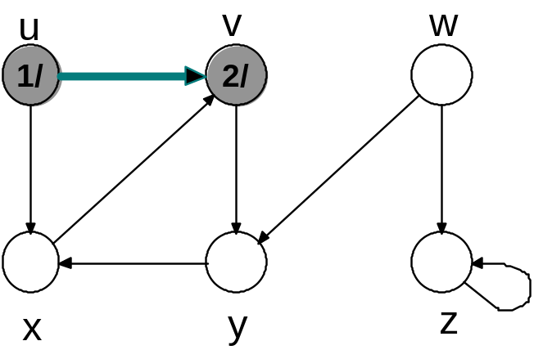
Directed Graph Example

Slide 7
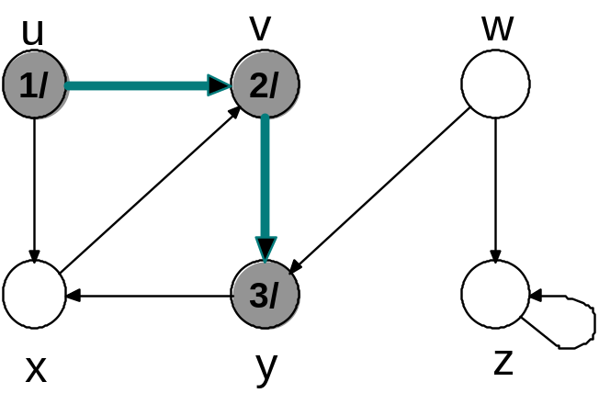
Directed Graph Example

Slide 8
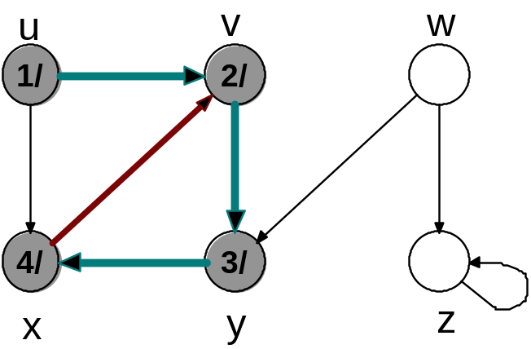
Directed Graph Example

Slide 9
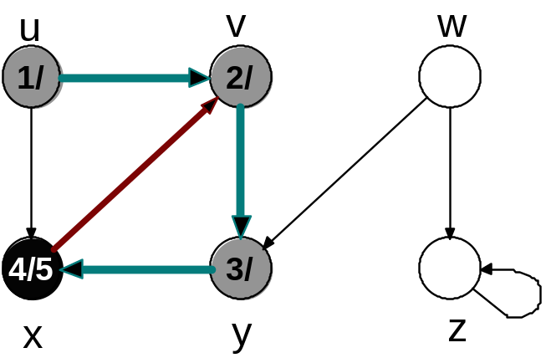
Directed Graph Example

Slide 10
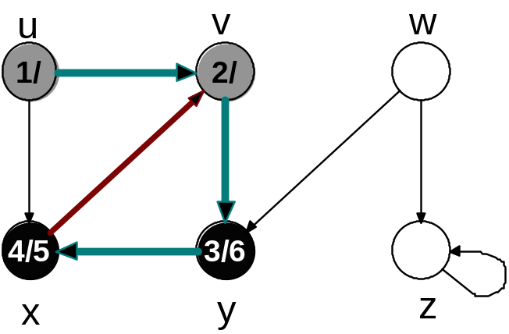
Directed Graph Example

Slide 11
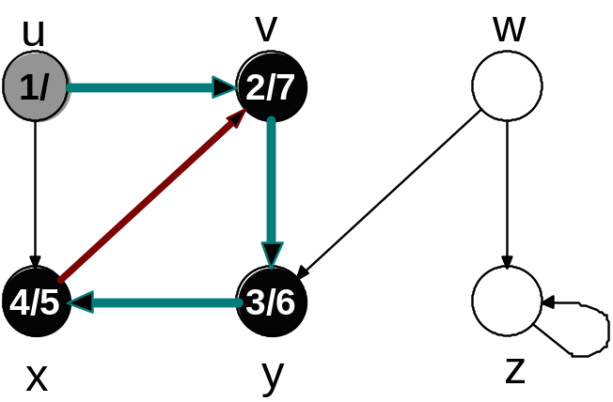
Directed Graph Example

Slide 12
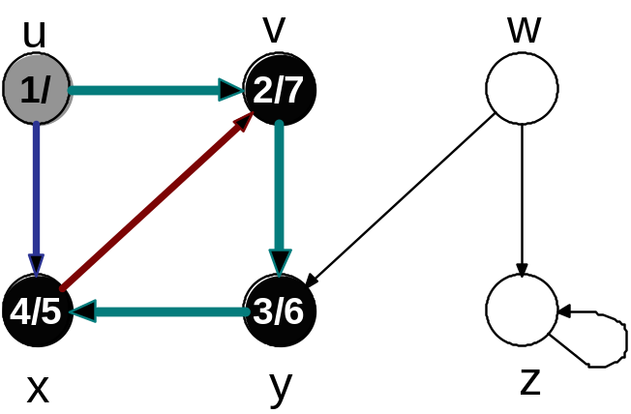
Directed Graph Example

Slide 13
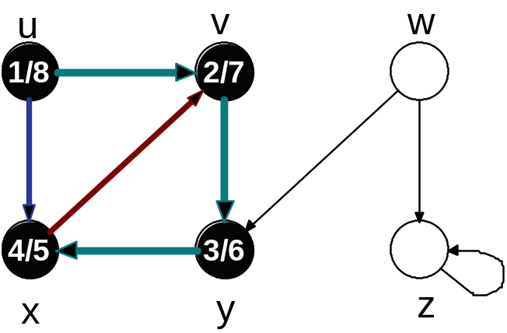
Directed Graph Example

Slide 14
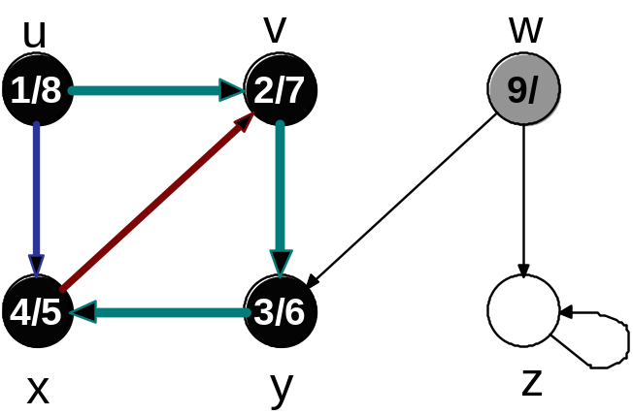
Directed Graph Example

Slide 15
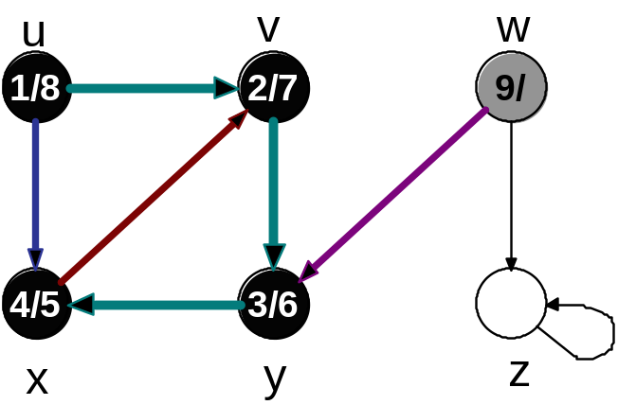
Directed Graph Example

Slide 16
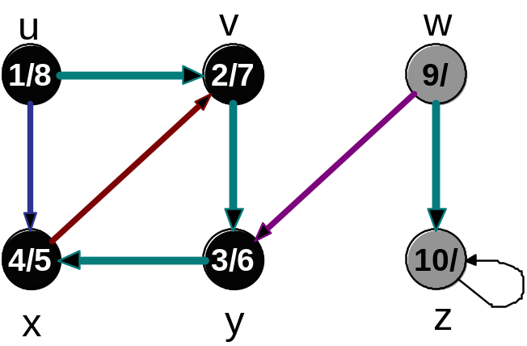
Directed Graph Example

Slide 17
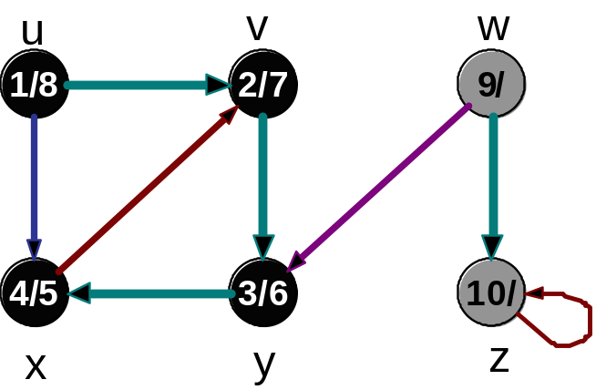
Directed Graph Example

Slide 18
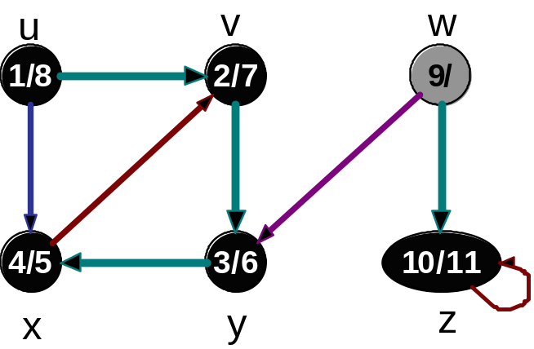
Directed Graph Example

Slide 19
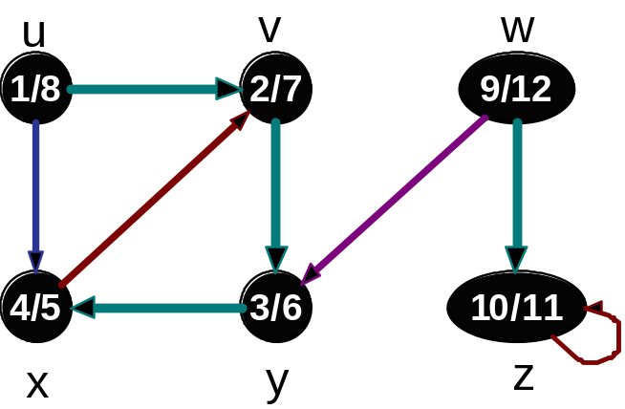
Directed Graph Example

Slide 20
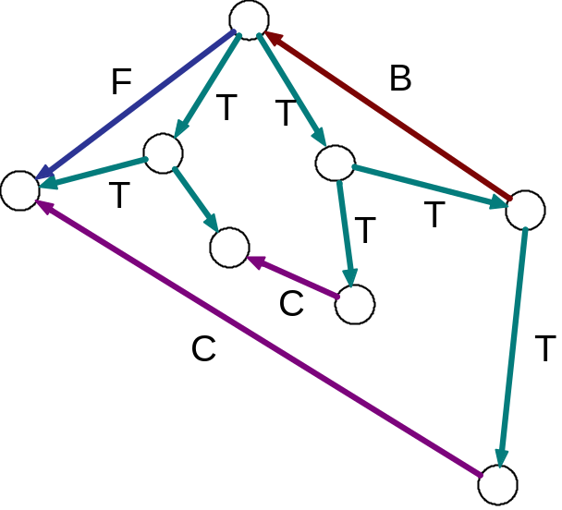
Edge Classification
Edges may be classified as follows
  Tree edge From a parent to a child in the DFS forest
  Back edge From a tree descendant to an ancestor
  Forward edge From a tree ancestor to a tree descendant
  Cross edge Between vertices in different component tree or
  between two “cousin” vertices in the same component
  tree
In our previous example directed graph, the edges are colored according to their classification

Slide 21
Edge Classification in DFS
We may modify the DFS algorithm to classify the edges as they are examined during the search
This method will be unable to distinguish between forward and cross edges
When we look down edge (u,v) while exploring from u, the classification depends on the color of v at that time:
  WHITE: (u,v) is a tree edge
  GRAY: (u,v) is back edge
  BLACK: (u,v) is either a forward edge or a cross edge
Theorem
In a DFS search of an undirected graph every edge is either a tree edge or a back edge.

Slide 22
Running Time
DFS(G)
1 for each vertex u ∈ V[G]
do color[u] ← WHITE
π[u] ← NIL
time ← 0
5 for each vertex u ∈ V[G]
do if color[u] = WHITE
then DFS-Visit(u)
O(|V|)
O(|V|) + cost of DFS-Visit Calls

Slide 23
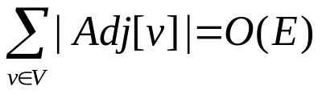
Running Time
DFS-Visit(u)
color[u] ← GRAY
time ← time + 1
d[u] ← time
for each v ∈ Adj[u]
do if color[u] = WHITE
then π[v] ← u
DFS-Visit(v)
color[u] ← BLACK
time ← time + 1
f[u] ← time
O(|Adj[v]|)
Aggregate Analysis (over all calls)
DFS-Visit is called once for each vertex u
Total cost:
Total Running Time of DFS: O( |V| + |E| )

Slide 24
Properties of DFS
DFS yields valuable information about graph structure
Vertex v is a descendant in the DFS forest of vertex u if and only if v was discovered during the period in which u was colored GRAY
Parenthesis Theorem
Suppose DFS is run on a directed or undirected graph G = (V,E). Then for any two vertices u,v of G, exactly one of the following three conditions holds:
  Intervals [ d[u],f[u] ] and [ d[v],f[v] ] are disjoint and neither u nor v is a descendant of the other in the DFS forest
  [ d[u],f[u] ] ⊂ [ d[v],f[v] ] and u is a descendant of v in the DFS forest
  [ d[v],f[v] ] ⊂ [ d[u],f[u] ] and v is a descendant of u in the DFS forest

Slide 25
Proof of the Parenthesis Theorem
Case 1: d[u] < d[v]
  Sub-case 1: d[v] < f[u]
  Thus v was discovered while u was still colored GRAY
  → v is a descendant of u and f[v] < f[u] and thus the gray interval of v is
  a subset of the gray interval of u
  Sub-case 2: f[u] < d[v]
  Then the two gray intervals are disjoint since d[u] < f[u] < d[v] < f[v]
Case 2: d[v] < d[u]
Same argument as in Case 1 with roles of u and v reversed shows that either the gray interval for u is contained in the gray interval of v or the two gray intervals are disjoint.

Slide 26
Corollary
Corollary to the Parenthesis Theorem
Vertex v is a proper descendant of vertex u in the DFS forest for a (directed or undirected) graph G if and only if d[u] < d[v] < f[v] < f[u]

Slide 27
White-Path Theorem
White-path Theorem
In a DFS forest of a (directed or undirected) graph G = (V,E), vertex v is a descendant of vertex u iff at time d[u], v can be reached from u along a path consisting of only white vertices.
Proof
If v is a descendant of u in the DFS forest, then all vertices on the path from u to v in the forest (excepting u) must have discovery time later than d[u]. Thus, at time d[u], they are all white, so there is a white path from u to v at time d[u].
We next want to show that if there is a white path from u to v at time d[u], then v is a descendant of u in the DFS forest.
Suppose not, and let v be a vertex with the shortest white-path length at time d[u] that is not a descendant of u in the forest and let w be the predecessor of v on a shortest u-v white path at time d[u].

Slide 28
Strongly Connected Components
A strongly connected component of a directed graph G = (V,E) is a subset C of V with the following properties:
  1. ∀ u,v ∈ C, u is reachable from v in G and v is reachable from u in G
  If C is a proper subset of another subset D of V, then D does not satisfy property 1
In short: C is a maximal subset of V having property 1
Many directed graph algorithms proceed as follows:
  decompose the directed graph into its strongly connected components;
  run the algorithm separately on each of the strongly connected components
  combine the solutions according to the connections between the strongly connected components
Thus we need an efficient algorithm for finding the strongly connected components of directed graphs
Depth-first search is the basis for a Θ(|V| + |E|) method for solving this problem

Slide 29
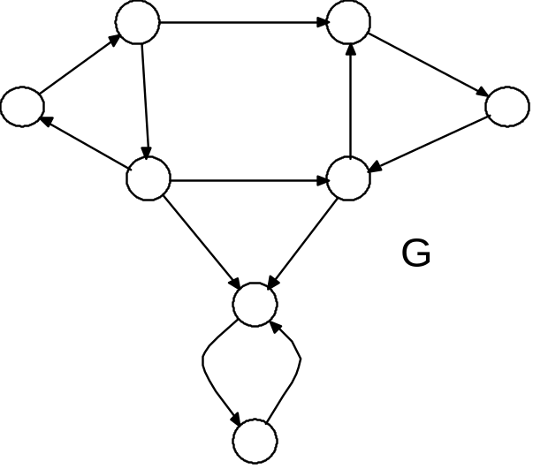
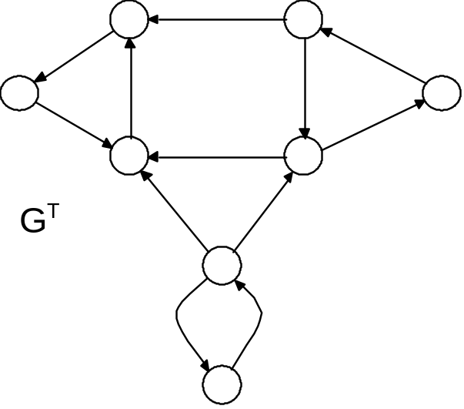
Strongly Connected Components
We will use the transpose (or reversal) of a directed graph in our algorithm
If G = (V,E) is a digraph, then the transpose G^{T} of G is the digraph with vertex set V and edge set E^{T} = { (v,u) | (u,v) ∈ E }
Given an adjacency-list representation of G, the time to create G^{T} is O(|V|+|E|).

Slide 30
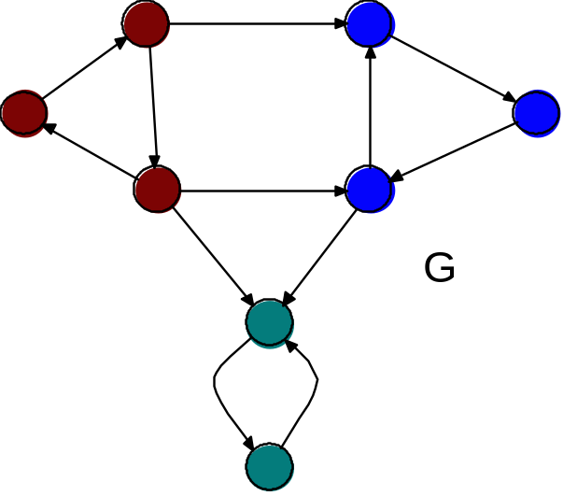
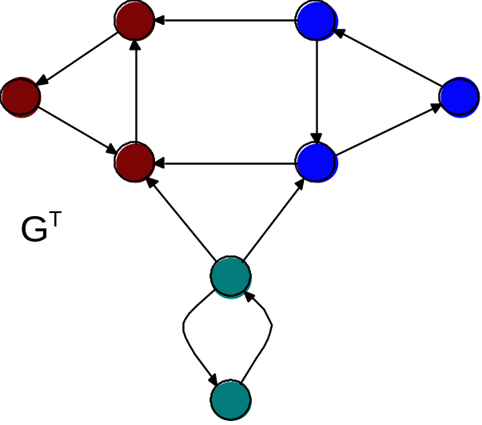
Strongly Connected Components
Proposition 1
A directed graph and its transpose have exactly the same strongly connected components

Slide 31
Strongly Connected Components Algorithm
The algorithm runs DFS twice
First on G, to compute the finishing times f[u] of each vertex u
Second on G^{T} with vertices considered in order of decreasing f[u] from the run of DFS on G
The DFS trees obtained from the second run of DFS are the strongly connected components
Strongly-Connected-Components(G)
call DFS(G) to compute the finishing times f[u] for each vertex u
compute GT
call DFS(GT), but in the main loop of DFS, consider vertices in order of decreasing f[u] as computed in 1
output the vertices of each tree if the DFS-forest formed in line 3 as a separate strongly connected component

Slide 32
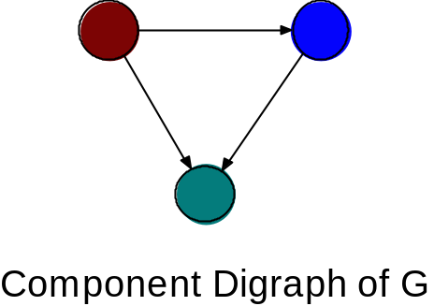
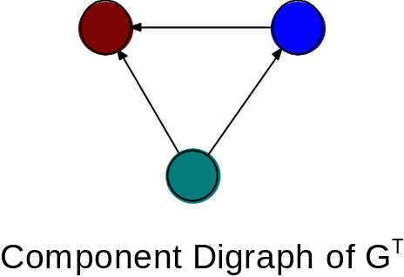
Component Digraph
The component digraph of a directed graph G is the digraph with one vertex v_{C} for each strongly-connected component of G and edges those pairs (v_{C},v_{D}) such that there is an edge in G from a vertex of C to a vertex of D.
The component digraphs for our previous example is

Slide 33
Component Digraph Lemma
Lemma 2
Let C and C′ be strongly connected components of a digraph G = (V,E), let u, v ∈ C, let u′,v′ ∈ C′, and suppose there is a path from u to u′ in G.
Then there cannot be a path from v′ to v in G.
Corollary
The component digraph of a directed graph is a directed acyclic graph

Slide 34
Discovery and Finish Times
In the ensuing discussions, d[u] and f[u] will always refer to the discovery and finishing times during the first call of DFS (on G).
Definition
If U is a subset of the vertex set of G, then
d(U) = min { d[u] | u ∈ U }
f(U) = max { f[u] | u ∈ U }

Slide 35
Component Finishing Lemma
Lemma 3
Let C and C′ be distinct strongly connected components of digraph
G = (V,E).
If there is an edge (u,v) in G with u ∈ C and v ∈ C′ then f(C) > f(C′).
The proof is broken down into two cases depending on which component is discovered first.
Suppose d(C) < d(C‘) and let w be the first vertex of C to be discovered.
Then at time d[w] = d(C), all the vertices of C and C‘ except w are white.
Thus all the vertices of C‘ are descendants of w in the DFS tree.
Therefore f[x] < f[w] for all vertices x of C‘, hence
f(C) = max{f[y] | y is in C} ≥ f[w] > max{f[x] | x is in C‘} = f(C’)

Slide 36
Component Finishing Lemma
Lemma 3
Let C and C′ be distinct strongly connected components of digraph
G = (V,E).
If there is an edge (u,v) in G with u ∈ C and v ∈ C′ then f(C) > f(C′).
Second case:
Suppose d(C) > d(C‘) and let z be the first vertex of C‘ to be discovered.
Then, by the White Path Theorem, all vertices of C‘ will be descendants of z in the DFS tree.
Moreover, no vertex of C will be descendants of z in the tree, since there cannot be a path in G from z to any vertex of C.
Therefore all vertices of C‘ will be finished before any vertex of C is discovered.
But this means that all vertices of C‘ will be finished before any vertex of C is finished and thus f(C) > f(C‘).

Slide 37
Component Finishing Lemma
Corollary 4
Let C and C′ be distinct strongly connected components of digraph
G = (V,E).
If there is an edge (u,v) in G^{T} with u ∈ C and v ∈ C′ then f(C) < f(C′).
.
Immediate from Lemma 3

Slide 38
Strong Component Algorithm Correctness
Theorem
Stongly-Connected-Components(G) correctly computes the strongly connected components of a digraph G
Proof by induction on the number of trees produced at each step of the DFS on G^{T}
TO BE FILLED IN LATER

