Slide 1
Graph Algorithms Using Depth First Search
Analysis of Algorithms
Week 8, Lecture 1
Prepared by
John Reif, Ph.D.
Distinguished Professor of Computer Science
Duke University

Slide 2
Graph Algorithms Using Depth First Search
Graph Definitions
DFS of Graphs
Biconnected Components
DFS of Digraphs
Strongly Connected Components

Slide 3
Readings on Graph Algorithms Using Depth First Search
Reading Selection:
  CLR, Chapter 22

Slide 4
Graph Terminology
Graph G=(V,E)
Vertex set V
Edge set E pairs of vertices which
        are adjacent

Slide 5
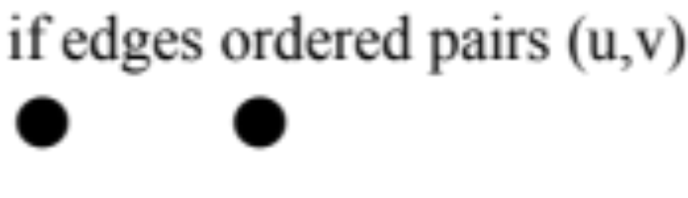
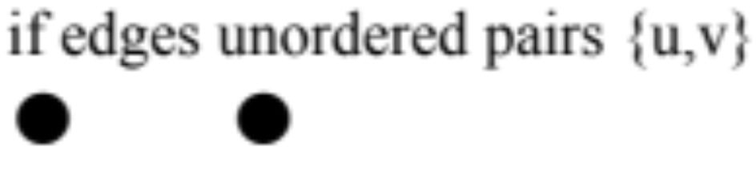
Directed and Undirected Graphs
G directed
G undirected
u
v
u
v

Slide 6
Proper Graphs and Subgraphs
Proper graph:
  No loops
  No multi-edges
Subgraph G‘ of G
G‘ = (V‘, E‘) where
V‘ is a subset of V, E‘ is a subset of E

Slide 7
Paths in Graphs
Path p
P is a sequence of vertices v₀, v₁, …, v_{k}
where for i=1,…k, v_{i-1} is adjacent to v_{i}
Equivalently, p is a sequence of edges
e₁, …, e_{k} where for i = 2,…k edges
e_{i-1,} e_{i} share a vertex
e₁
e₂
e_{k}
V_{o}
V₁
V₂
V_{k-1}
V_{k}

Slide 8
Simple Paths and Cycles
Simple path
no edge or vertex repeated,
except possibly v_{o} = v_{k}
Cycle
a path p with v_{o} = v_{k} where k>1
V_{k} = V_{o}
V₁
V₂
V_{k-1}

Slide 9
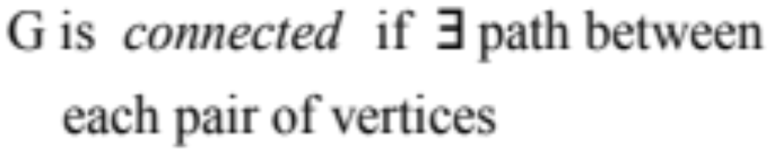
A Connected Undirected Graph

Slide 10
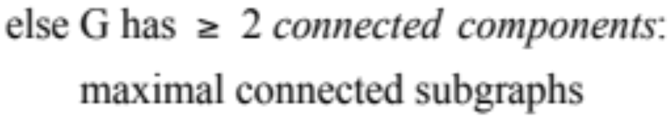
Connected Components of an Undirected Graph

Slide 11
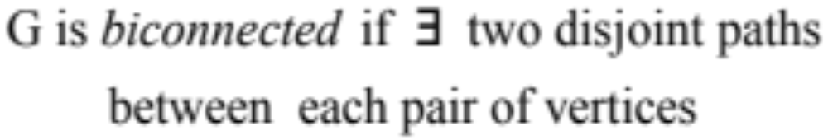
Biconnected Undirected Graphs
(or G is single edge)

Slide 12
Size of a Graph
Graph G = (V,E)
      n = |V| = # vertices
      m = |E| = # edges
      size of G is n+m
1
2
3
4

Slide 13
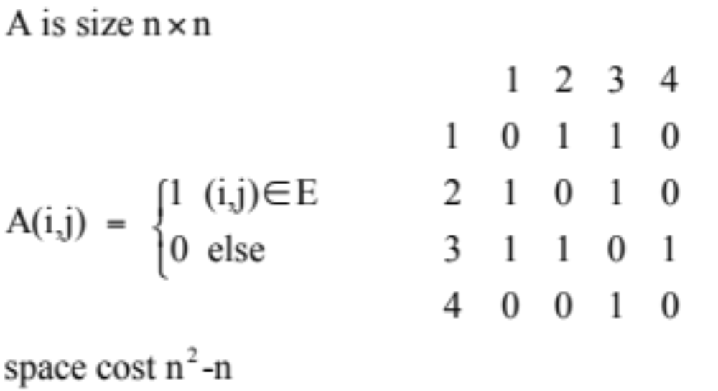
Representing a Graph by an Adjacency Matrix
Adjacency Matrix A

Slide 14
Adjacency List Representation of a Graph
Adjacency Lists Adj (1),…,Adj (n)
Adj(v) = list of vertices adjacent to v
space cost O(n+m)
1
2
3
2
1
3
3
1
2
4
4
3

Slide 15
Definition of an Undirected Tree
Tree
T is graph with unique simple path
between every pair of vertices
n = # vertices
n-1 = # edges
Forest
  set of trees

Slide 16
Definition of a Directed Tree
Directed Tree
T is digraph with distinguished vertex root r such that each vertex reachable from r by a unique path
Family Relationships:
- ancestors
- descendants
- parent
- child
- siblings
r
leaves have no proper descendants

Slide 17
An Ordered Tree
Ordered Tree
  is a directed tree with siblings ordered
A
B
C
D
F
E
H
I

Slide 18
Preorder Tree Traversal
Preorder A,B,C,D,E,F,H,I
[1] root (order vertices as pushed on stack)
[2] preorder left subtree
[3] preorder right subtree
A
B
C
D
F
E
H
I

Slide 19
Postorder Tree Traversal
Postorder B,E,D,H,I,F,C,A
[1] postorder left subtree
[2] postorder right subtree
[3] root (order vertices as popped off
stack)
A
B
C
D
F
E
H
I

Slide 20
Spanning Tree and Forest of a Graph
T is a spanning tree of graph G if
(1) T is a directed tree with the same vertex
set as G
(2) each edge of T is a directed version of an edge of G
Spanning Forest:
forest of spanning trees of connected components of G

Slide 21
Example Spanning Tree of a Graph
root
1
back edge
tree edge
2
5
9
12
3
6
8
10
11
7
4
cross edge

Slide 22
Classification of Edges of G with Spanning Tree T
An edge (u,v) of T is tree edge
An edge (u,v) of G-T is back edge if u is a descendent or ancestor of v.
Else (u,v) is a cross edge

Slide 23
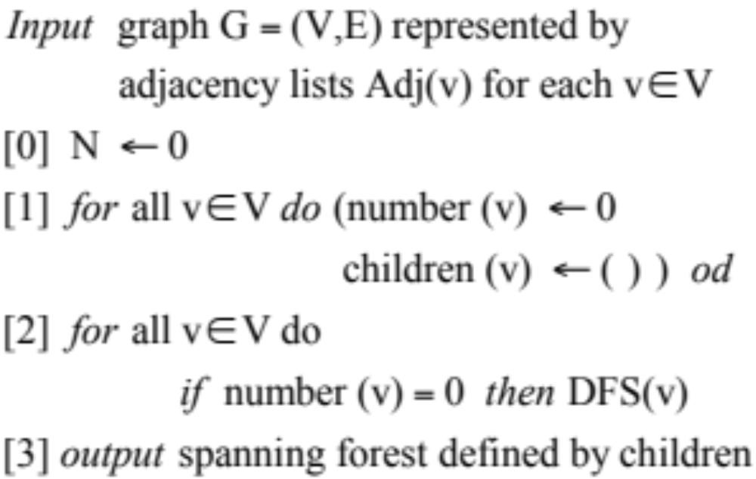
Tarjan’s Depth First Search Algorithm
We assume a RAM machine model
Algorithm Depth First Search

Slide 24
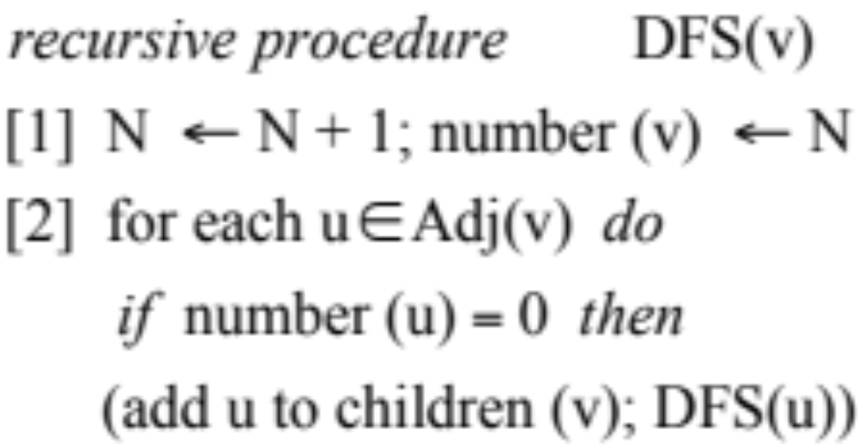
Recursive DFS Procedure

Slide 25
Time Cost of Depth First Search Algorithm on a RAM
Input size n = |V|, m = |E|
Theorem
Depth First Search takes total time cost O(n+m)
Proof
can associate with each edge and vertex
a constant number of operations.

Slide 26
Classification of Edges of G via DFS Spanning Tree T
G
1
2
5
1
T
3
6
8
2
5
7
4
3
6
8
4
7

Slide 27
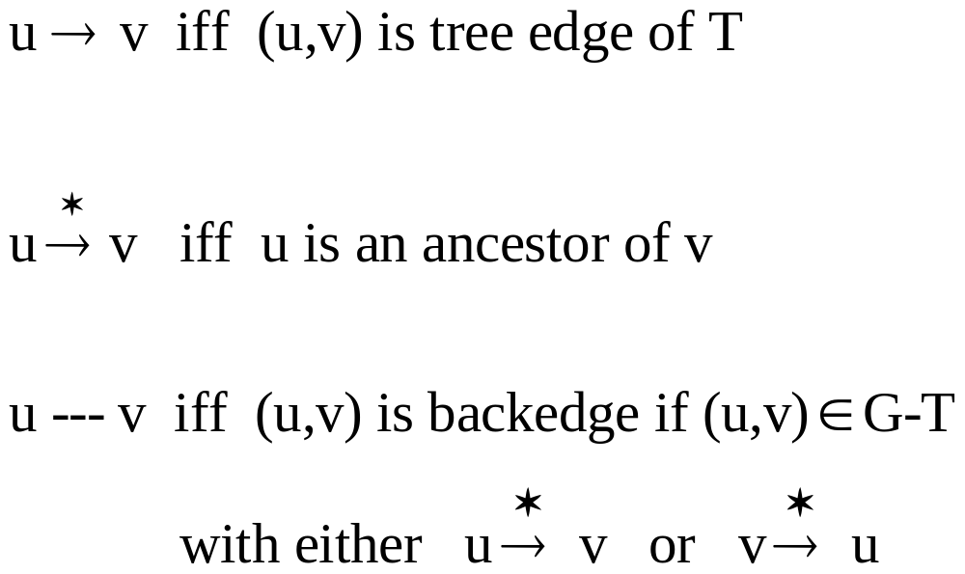
Classification of Edges of G via DFS Spanning Tree T
Edge notation induced by
Depth First Search Tree T

Slide 28
Classification of Edges of G via DFS Spanning Tree T (cont’d)
Note DFS tree T has no cross edges
will number vertices by order
visited in DFS (preorder of T)

Slide 29
Verifying Vertices are Descendants via Preordering of Tree
Suppose we preorder number a Tree T
Let D_{v} = # of descendants of v
Lemma
u is descendant of v
iff v < u < v + D_{v}
W
*
v
D_{v}
u

Slide 30
Testing for Proper Ancestors via Preordering
Lemma
If u is descendant of v
and (u,w) is back edge s.t. w < v
then w is a proper ancestor of v

Slide 31
Low Values
For each vertex v,
define low(v) = min ( {v} ∪ {w | v→ - - - w} )
Can prove by induction:
Lemma
can be computed during DFS
in postorder.
*

Slide 32
Graph with DFS Numbering and Low Values in Brackets
v[low(v)]
1[1]
5[1]
2[2]
3[2]
8[1]
6[5]
4[2]
7[5]
Number vertices by DFS number

Slide 33
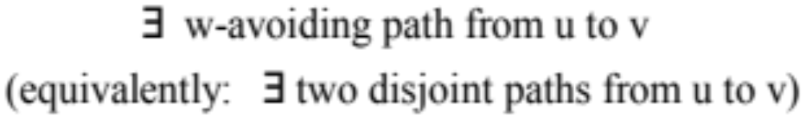
Biconnected Components
G is Biconnected iff either
(1) G is a single edge, or
(2) for each triple of vertices u,v,w

Slide 34
Example of Biconnected Components of Graph G
Maximal subgraphs
of G which are biconnected.
1
1
G
1
2
5
2
5
2
8
3
⇒
5
6
8
3
4
6
7
4
7

Slide 35
Biconnected Components Meet at Articulation Points
The intersection of two biconnected components consists of at most one vertex called an Articulation Point.
Example: 1,2,5 are articulation points
1
G
2
5
3
6
8
4
7

Slide 36
Discovery of Biconnected Components via Articulation Points
  If can find articulation points
  then can compute biconnected components:
  Algorithm:
  During DFS, use auxiliary stack to store visited edges.
  Each time we complete the DFS of a tree child of an articulation point, pop all stacked edges
  currently in stack
  These popped off edges form a biconnected component

Slide 37
Characterization of an Articulation Point
Theorem
  a is an articulation point iff either
  (1) a is root with ≥ 2 tree children
  or
  (2) a is not root but a has a tree child v with
  low (v) ≥ a
  (note easy to check given low computation)

Slide 38
Proof of Characterization of an Articulation Point
Proof
The conditions are sufficient since any
a-avoiding path from v remains in the
subtree T_{v} rooted at v, if v is a child of a
To show condition necessary, assume a is
an articulation point.

Slide 39
Characterization of an Articulation Point (cont’d)
Case (1)
If a is a root and is articulation point,
a must have ≥ 2 tree edges to two distinct biconnected components.
Case(2)
If a is not root, consider graph G - {a}
which must have a connected component C consisting of only descendants of a, and
with no backedge from C to an ancestor
of v. Hence a has a tree child v in C and
low (v) ≥ a

Slide 40
Proof of Characterization of an Articulation Point (cont’d)
root
Case (2)
Articulation Point a
is not the root
no
back
edges
a
v
subtree T_{v}
C

Slide 41
Computing Biconnected Components
Theorem
The Biconnected Components of G = (V,E) can be computed in time O(|V|+|E|) using a RAM
Proof idea
Use characterization of Bicoconnected components via articulation points
Identify these articulation points dynamically during depth first search
Use a secondary stack to store the edges of the biconnected components as they are visited
When an articulation point is discovered , pop the edges of this stack off to output a biconnected component

Slide 42
Biconnected Components Algorithm
[0] initialize a STACK to empty
During a DFS traversal do
[1] add visited edge to STACK
[2] compute low of visited vertex v using Lemma
[3] test if v is an articulation point
[4] if so, for each u ∈ children (v) in order
where low (u) > v
do Pop all edges in STACK
upto and including tree edge (v,u)
Output popped edges as a
biconnected component of G
od

Slide 43
Time Bounds of Biconnected Components Algorithm
Time Bounds:
Each edge and vertex can be associated
with 0(1) operations. So time O(|V|+|E|).

Slide 44
Depth First Search in a Directed Graph
Depth first search tree T of Directed Graph
G = (V,E)
8
forward
1
i = DFS number
i
2
7
v
cycle
i = postorder
= order vertex
popped off
DFS stack
5
cycle
3
7
4
6
4
8
cross
cross
5
2
edge set E partitioned
1
cross
6

Slide 45

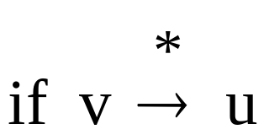
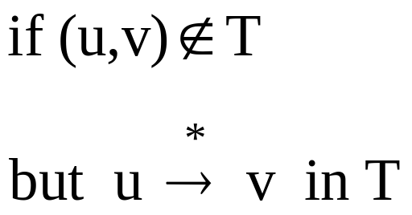

Classification of Directed Edge (u, v) via DFS Spanning Tree T
Tree edge
Cycle edge
Forward edge
Cross edge

Slide 46
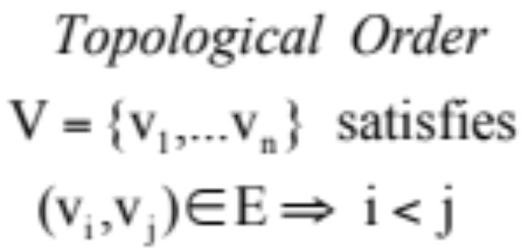
Topological Order of Acyclic Directed Graph
Digraph G = (V,E) is acyclic if it has
no cycles

Slide 47
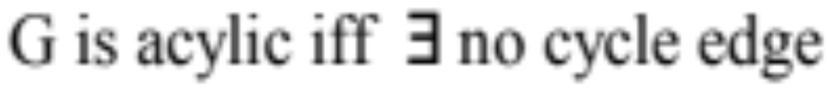
Characterization of an Acyclic Digraph
Proof
Case (1):
Suppose (u,v) ∈ E is a cycle edge, so v → u.
But let e₁,…e_{k} be the tree edges from v to u.
Then (u,v), e₁,…e_{k} is a cycle.
*

Slide 48
Characterization of an Acyclic Digraph (cont’d)
Case (2):
Suppose G has no a cycle edge
Then order vertices in postorder of DFS spanning forest (i.e. in order vertices are popped off DFS stack).
This is a reverse topological order of G.
So, G can have no cycles.
Note:
Gives an O(|V|+|E|) algorithm
for computing Topological Ordering
of an acyclic graph G = (V,E)

Slide 49
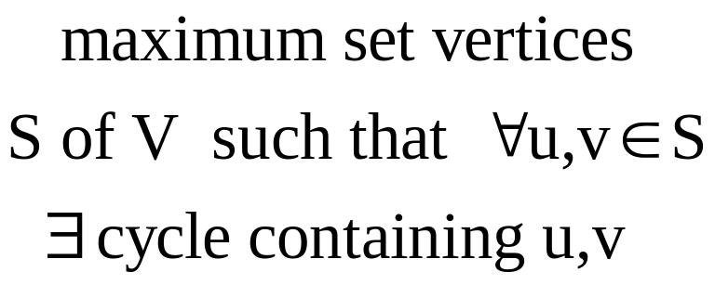
Strong Components of Directed Graph
Strong Component
Collapsed Graph
G* derived by
collapsing each strong component
into a single vertex.
note: G* is acyclic.

Slide 50
Directed Graph with Strong Components Circled
1
4
Directed Graph G = (V,E)
2
5
8
3
6
7

Slide 51
Algorithm Strong Components
Input digraph G
[1] Perform DFS on G. Renumber vertices by postorder.
[2] Let G⁻ be the reverse digraph derived from G by reversing direction of each edge.

Slide 52
Algorithm Strong Components (cont’d)
[3] Perform DFS on G⁻, starting at highest numbered vertex.
Output resulting DFS tree of G⁻ as a strongly connected component of G.
[4] repeat [3], starting at highest numbered vertex not so for visited (halt when all vertices visited)

Slide 53
Time Bounds of Algorithm Strong Components
Time Bounds
each DFS costs time c(|V|+|E|)
So total time = 2*c(|V|+|E|)
≤ O(|V|+|E|)

Slide 54
Example of Step [1] of Strong Components Algorithm
Example Input Digraph G
1
4
8
5
2
5
7
4
8
1
3
6
6
3
7
2

Slide 55
Example of Step [2] of Strong Components Algorithm
Reverse Digraph G⁻
1
4
8
5
2
5
7
4
8
1
3
6
6
3
7
2

Slide 56
Proof of Strong Components Algorithm
Theorem
The Algorithm outputs the
strong components of G.
Proof
We must show these are exactly the vertices in each DFS spanning forest of G⁻

Slide 57
Proof of Strong Components Algorithm (cont’d)
Suppose:
  v,w in the same strong component and DFS search in G⁻ starts at vertex r and reaches v.
Then w will also be reached.
So v,w are output together in same spanning tree of G⁻.

Slide 58
Proof of Strong Components Algorithm (cont’d)
Suppose:
  v,w output in same spanning tree of G⁻.
Let r be the root of that spanning tree.
Then there exists paths in G⁻ from r to each of v and w.
So there exists paths in G to r from each of v and w.

Slide 59
Proof of Strong Components Algorithm (cont’d)
Suppose:
  no path in G to r from v.
Then since r has a higher postorder than v, there is not path in G from v to r, a contradiction.
Hence, there exists path in G from r to v, and similar argument gives path from r to w.
So v and w are in a cycle of G and must be in the same strong component.

Slide 60
Graph Algorithms Using Depth First Search
Analysis of Algorithms
Week 8, Lecture 1
Prepared by
John Reif, Ph.D.
Distinguished Professor of Computer Science
Duke University

