Slide 1

Problem Solving by Searching
Finding a good/best solution to a problem amongst many possible solutions.
Ways of methodically deciding which solutions are better than others.

Slide 2
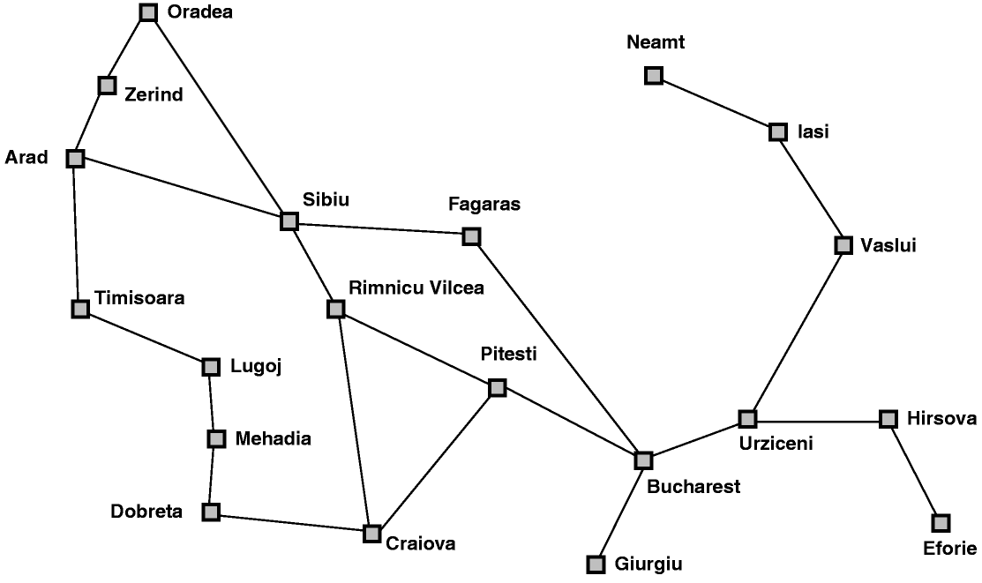
Example: Arad to Bucharest
start
end

Slide 3
Representing Search
Arad
Zerind
Sibiu
Timisoara
Arad
Oradea
Fagaras
Rimnicu Vilcea
Sibiu
Bucharest

Slide 4
Search Terminology
Completeness
  solution will be found, if it exists
Time complexity
  number of nodes expanded
Space complexity
  number of nodes in memory
Optimality
  least cost solution will be found

Slide 5
Searching Techniques
Breadth first
Depth-first
Iterative deepening
Hill-climbing

Slide 6
Time & Space Complexity
a function of
  b- maximum branching factor
  d- depth of least cost solution
  m- max depth of state space, maybe infinite

Slide 7
Breadth first
QUEUING-FN:- successors added to end of queue
Arad
Zerind
Sibiu
Timisoara
Arad
Oradea
Fagaras
Rimnicu Vilcea

Slide 8
Properties of Breadth first
Complete ?
  Yes if branching factor (b) finite
Time ?
  1 + b + b² + b³ +…+ b^{d} = O(b^{d}), so exponential
Space ?
  O(b^{d}), all nodes are in memory
Optimal ?
  Yes (if cost = 1 per step), not in general

Slide 9
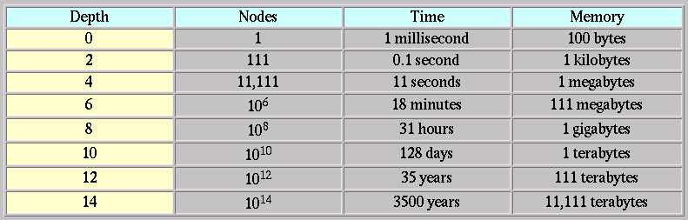
Properties of Breadth first cont.
Assuming b = 10, 1 node per ms and 100 bytes per node

Slide 10
Depth-first
QUEUING-FN:- insert successors at front of queue
Arad
Zerind
Sibiu
Timisoara
Arad
Oradea
Zerind
Sibiu
Timisoara

Slide 11
Properties of Depth-first
Complete ?
  No:- fails in infinite- depth spaces, spaces with loops
  complete in finite spaces
Time ?
  O(b^{m}), bad if m is larger than d
Space ?
  O(bm), linear in space
Optimal ?:- No

Slide 12
Properties of IDS
Complete ?
  Yes
Time ?
  (d + 1)b⁰ + db¹ + (d - 1)b² + .. + b^{d} = O(b^{d})
Space ?
  O(bd)
Optimal ?
  Yes if step cost = 1

Slide 13
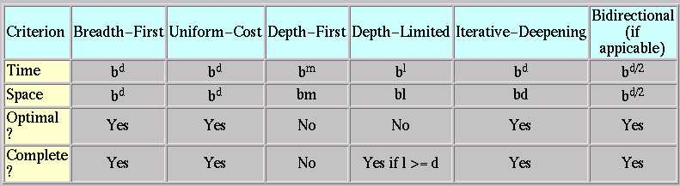
Comparisons

