Slide 1
FINAL PROJECt JCDS07 BSD Harley-Davidson motorcycle recommendation
Muhamad ahsanul habib | JCDS07

Slide 2
Project description
Recommendation system is important machine learning that can give several suggestions to users.
This project's aim is to suggest user with top 5 recommendation of Harley-Davidson based on Type, Model, and Condition.

Slide 3
Project GOALS
Create a local page which can offers some recommendation to user who want to buy a Harley-Davidson.

Slide 4
DATA INSIGHT
Source : Ebay Motorcycle Priced in (Kaggle)
Total Data : 7492 rows
Columns : 23 Features (
Unnamed: 0, Condition, Condition_Desc, Model_Year, Mileage, Exterior_Color, Make, Warranty, Model, Sub_Model, Type, OBO, Vehicle_Title, Feedback_Perc, Watch_Count, N_Reviews, Seller_Status, Vehicle_Tile, Auction, Buy_Now, Bid_Count )

Slide 5
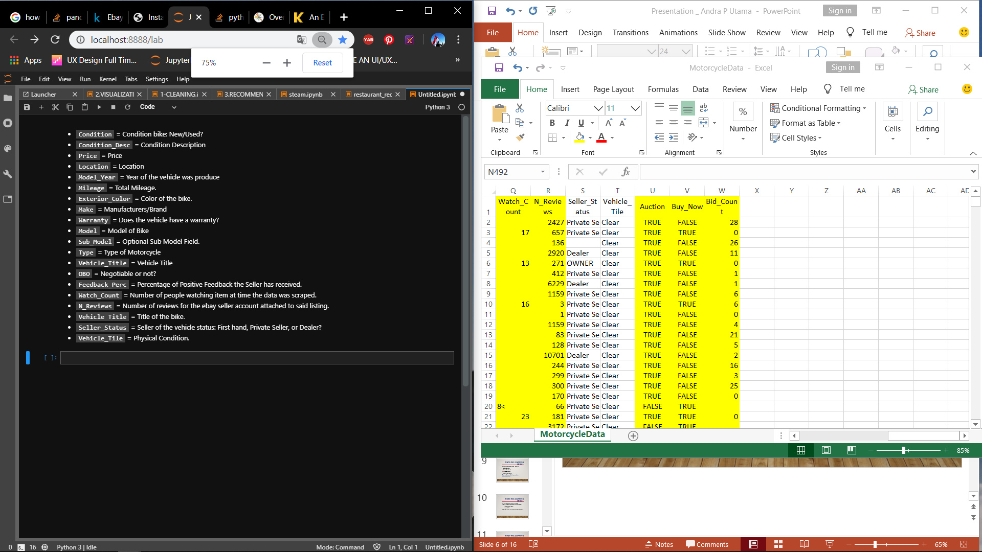
DATA INSIGHT

Slide 6
DATA INSIGHT
There are several assumption from the datasets :
There’s some negative and 0 amount of price and not counted as NaN.
Possibility of seller put random information.
Harley-Davidson is the target, and only call row with HD on it & several features with less NaN.
Drop location, condition_desc, color, warranty, auction, buy_now, bid count, feedback, watch_count, reviews.
Group several categories less than (x) into ‘Others’.

Slide 7
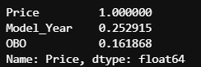
DATA INSIGHT
Numerical
Target : Price
Correlation:
Model Year (25%)
OBO (16%)

Slide 8
MACHINE LEARNING MODEL
I only use 2 models for recommendation:
Count Vectorizer
Cosine Similarity

Slide 9
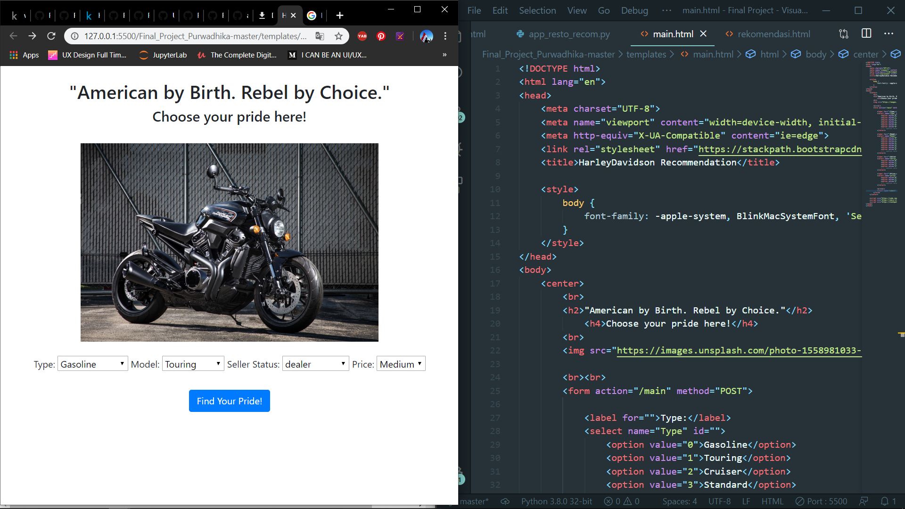
homepage
Expect APPS

Slide 10
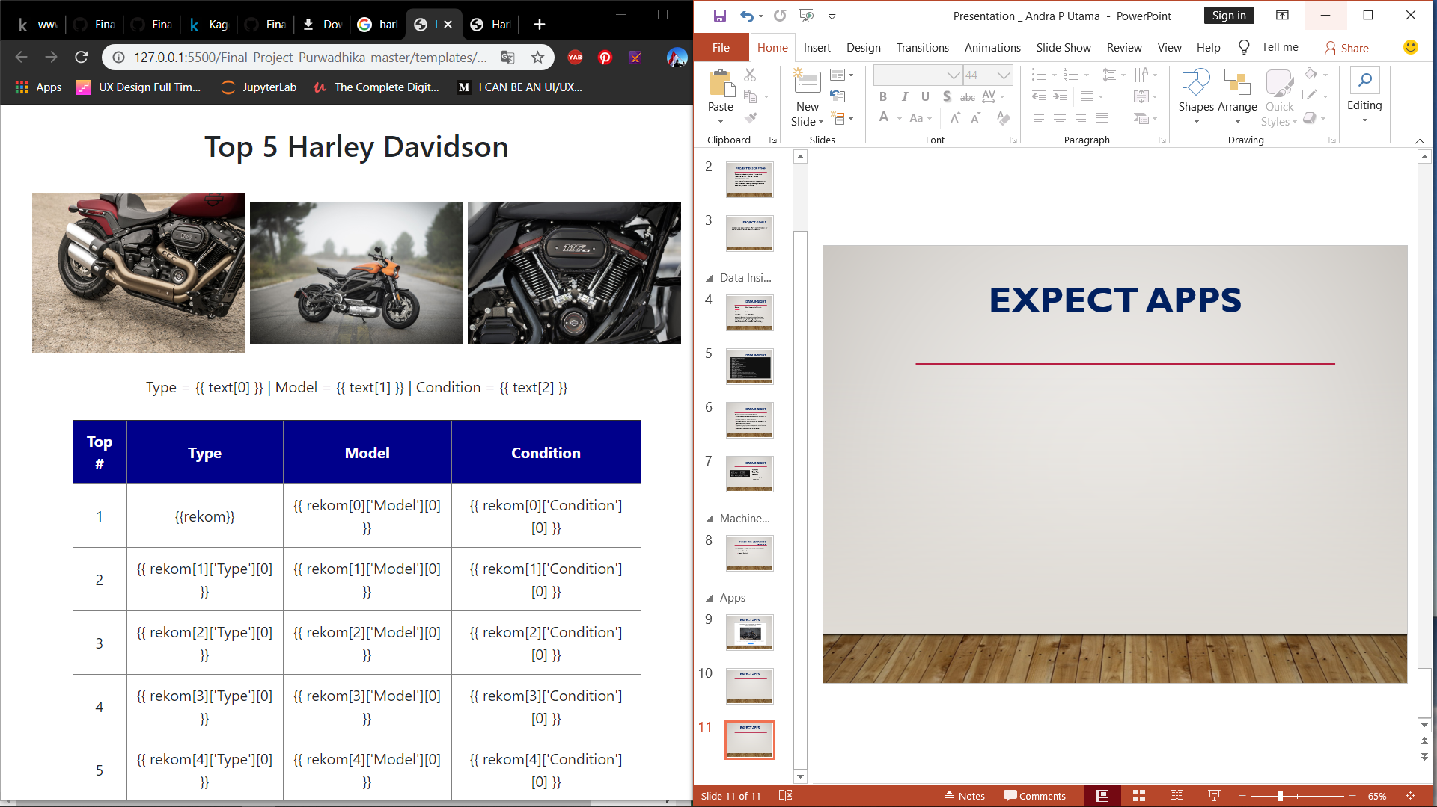
result
Expect APPS

