Slide 1
Deep Learning from Scratch
Theory + Practical
FAHAD HUSSAIN
MCS, MSCS, DAE(CIT)
Computer Science Instructor of well known international Center
Also, Machine Learning and Deep learning Practitioner
For further assistance, code and slide https://fahadhussaincs.blogspot.com/
YouTube Channel : https://www.youtube.com/fahadhussaintutorial

Slide 2
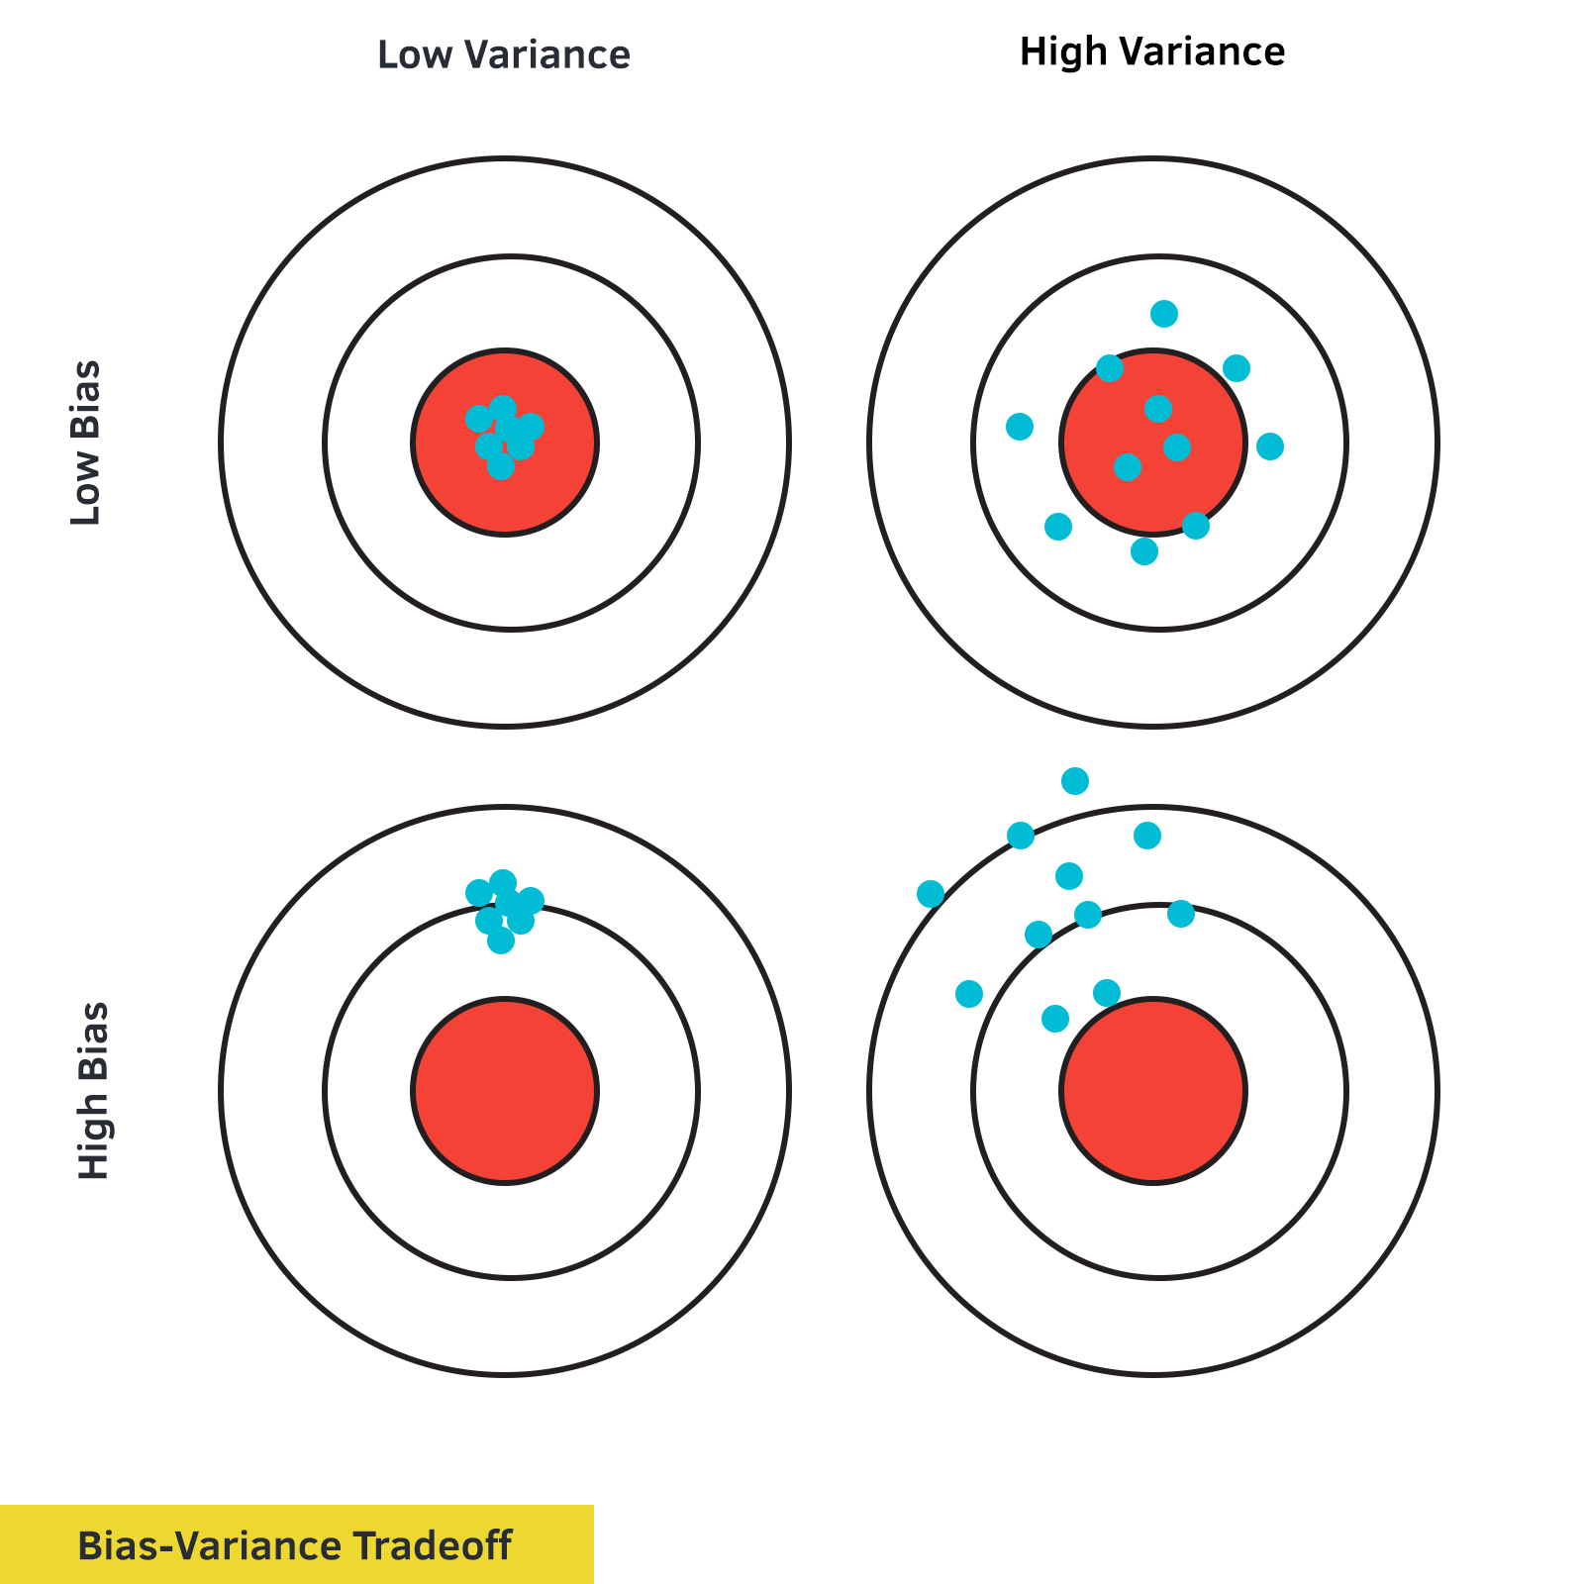

Slide 3
To Handle Overfitting Problem
Bias and Variance Problem (tradeoff)
          irreducible Error
Regularization (L1 Ridge Regression , L2 Lasso Regression
Drop out Method (Regularization)
For further assistance, code and slide https://fahadhussaincs.blogspot.com/
YouTube Channel : https://www.youtube.com/fahadhussaintutorial

Slide 4
What is Bias and Variance
For further assistance, code and slide https://fahadhussaincs.blogspot.com/
YouTube Channel : https://www.youtube.com/fahadhussaintutorial

Slide 5
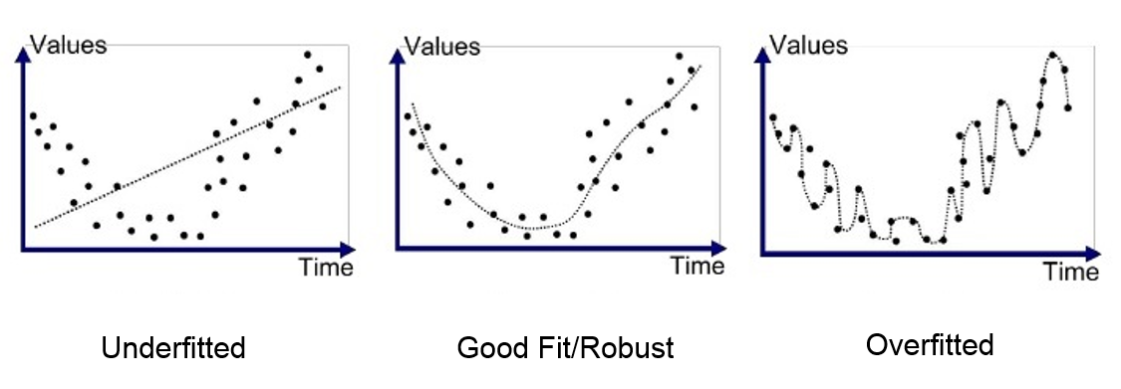
Underfitting and Overfitting (Bias and Variance)
For further assistance, code and slide https://fahadhussaincs.blogspot.com/
YouTube Channel : https://www.youtube.com/fahadhussaintutorial

Slide 6
So, What will be the best model
Low Bias, Low Variance

Slide 7
So, what about the irreducible Error, actually it is errors in data collected at the source. Noisiness and outlies introduced at source level from data collected!
Thanks
Helpful link:
https://towardsdatascience.com/holy-grail-for-bias-variance-tradeoff-overfitting-underfitting-7fad64ab5d76
First we create the K fold in Breast Cancer dataset first then, we understand the others Regularization then finally we move towards the Parameters Tuning…

