Slide 1
Deep Learning from Scratch
Theory + Practical
FAHAD HUSSAIN
MCS, MSCS, DAE(CIT)
Computer Science Instructor of well known international Center
Also, Machine Learning and Deep learning Practitioner
For further assistance, code and slide https://fahadhussaincs.blogspot.com/
YouTube Channel : https://www.youtube.com/fahadhussaintutorial

Slide 2
Back Propagation in deep learning
What is Bias
Back Propagation (reduce Cost function)
(Batch Gradient Descent, Stochastic Gradient Descent, Mini-batch Gradient Descent)
For further assistance, code and slide https://fahadhussaincs.blogspot.com/
YouTube Channel : https://www.youtube.com/fahadhussaintutorial

Slide 3
What is Bias
Bias is just like an intercept added in a linear equation. It is an additional parameter in the Neural Network which is used to adjust the output along with the weighted sum of the inputs to the neuron. Moreover, bias value allows you to shift the activation function to either right or left.
output = sum (weights * inputs) + bias
The output is calculated by multiplying the inputs with their weights and then passing it through an activation function like the Sigmoid function, etc. Here, bias acts like a constant which helps the model to fit the given data. The steepness of the Sigmoid depends on the weight of the inputs.
A simpler way to understand bias is through a constant c of a linear function
y =mx + c
For further assistance, code and slide https://fahadhussaincs.blogspot.com/
YouTube Channel : https://www.youtube.com/fahadhussaintutorial

Slide 4
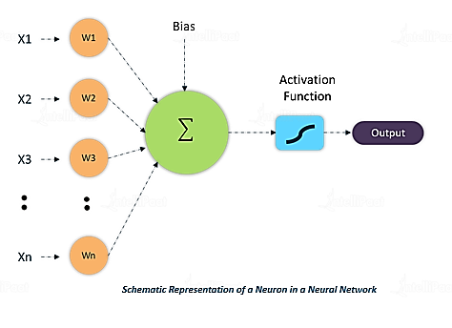
What is Bias
W * x + b
For further assistance, code and slide https://fahadhussaincs.blogspot.com/
YouTube Channel : https://www.youtube.com/fahadhussaintutorial

Slide 5
What is Gradient Descent (BGD)
Gradient Descent is an optimization technique that is used to improve deep learning and neural network-based models by minimizing the cost function.
Gradient Descent is a process that occurs in the backpropagation phase where the goal is to continuously resample the gradient of the model’s parameter in the opposite direction based on the weight w, updating consistently until we reach the global minimum of function J(w).
More Precisely,
Gradient descent is an algorithm, which is used to iterate through different combinations of weights in an optimal way.....to find the best combination of weights which has a minimum error.
For further assistance, code and slide https://fahadhussaincs.blogspot.com/
YouTube Channel : https://www.youtube.com/fahadhussaintutorial

Slide 6
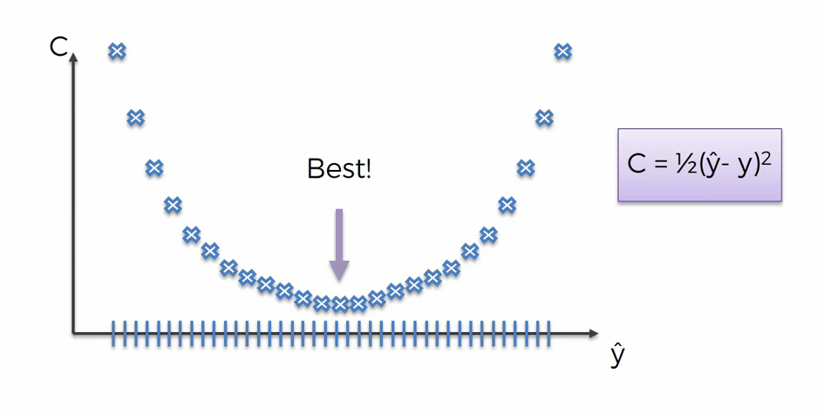
Brute force algorithm
Curse of dimensionality
Brute Force Algorithms refers to a programming style that does not include any shortcuts to improve performance, but instead relies on sheer computing power to try all possibilities until the solution to a problem is found. A classic example is the traveling salesman problem (TSP).
For further assistance, code and slide https://fahadhussaincs.blogspot.com/
YouTube Channel : https://www.youtube.com/fahadhussaintutorial

Slide 7
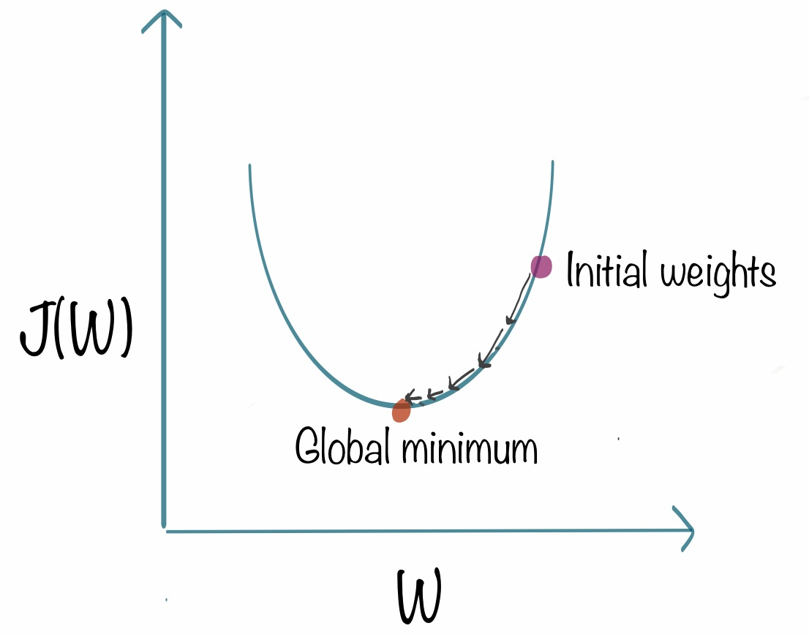
What is Gradient Descent
For further assistance, code and slide https://fahadhussaincs.blogspot.com/
YouTube Channel : https://www.youtube.com/fahadhussaintutorial

Slide 8
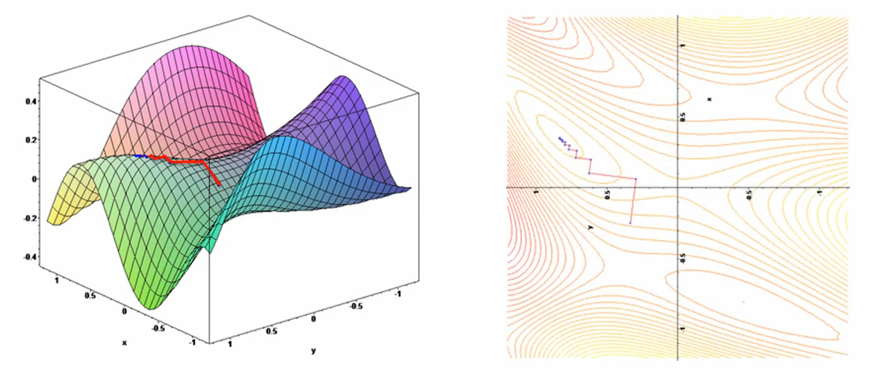
What is Gradient Descent
For further assistance, code and slide https://fahadhussaincs.blogspot.com/
YouTube Channel : https://www.youtube.com/fahadhussaintutorial

Slide 9
Useful link
https://towardsdatascience.com/understanding-the-mathematics-behind-gradient-descent-dde5dc9be06e
For further assistance, code and slide https://fahadhussaincs.blogspot.com/
YouTube Channel : https://www.youtube.com/fahadhussaintutorial

Slide 10
Thank You!
For further assistance, code and slide https://fahadhussaincs.blogspot.com/
YouTube Channel : https://www.youtube.com/fahadhussaintutorial

