Slide 1
Personality Detection using Sentiment Analysis
Final Year Project

Slide 2
Introduction
Predicting the Politician personalities using Sentiment Analysis.
Group Members:
Muhammad Asad (BITF16M012).
Muhammad Ali Haider (BITF16M043).

Slide 3

Step 1: Scrapping Tweets
Scrapping 2000Tweets of each of five Politicians from Twitter using Tweepy API. And Store them in csv file.

Slide 4
Step 2: Preprocessing
Cleaning the Tweets from Unwanted Text.
Removing Http links.
Removing Re-Tweets.
Removing @ mentions.
Removing Emotions Stickers.
Removing numbers and special characters.
Removing Stopwards.

Slide 5
Step 3: Feature Engineering
Extracting Emotions from Tweets and mapping them using NRC Emotion Lexicon.
Adding author as dependent feature of each of Tweet.
Converging Independent Features .

Slide 6
Step 4: Applying ML and DL Algorithms.
Machine Learning Algorithms.
Decision Tree.
Random Forest.
Naive Bayesian.
Logistic Regression.
Support Vector machine.
Deep Learning Algorithm.
Recurrent Neural Network ( Long Short Term Memory)

Slide 7
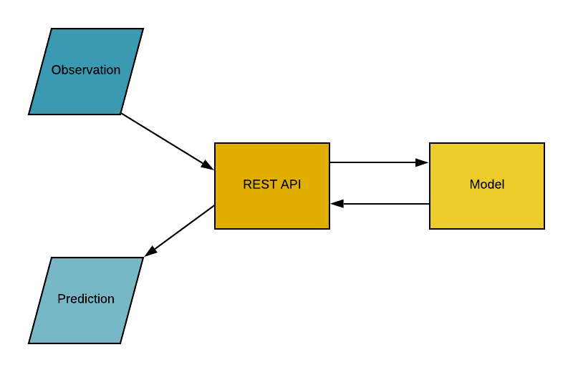
Step 5: Pickling Models

Slide 8
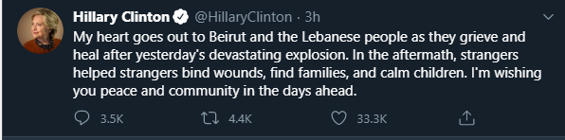
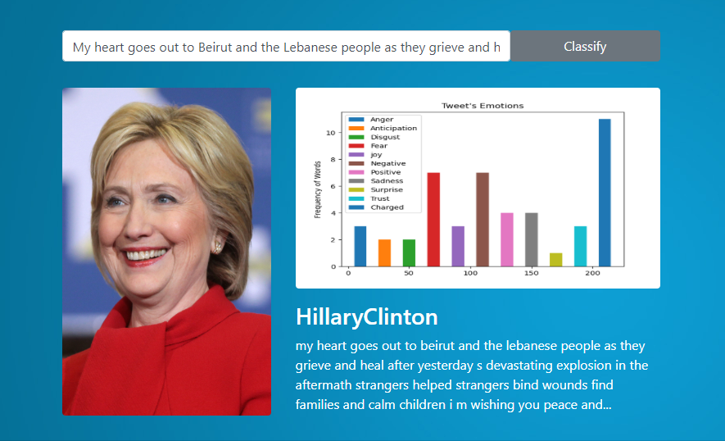
Step 6: Prediction

Slide 9
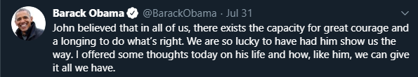
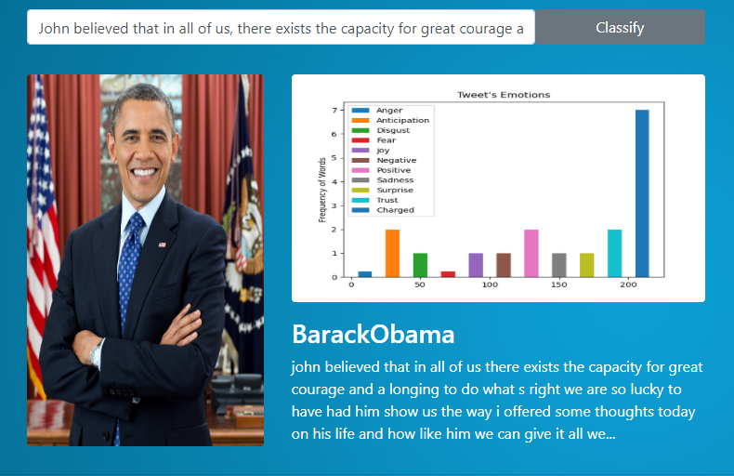
Cont…

Slide 10
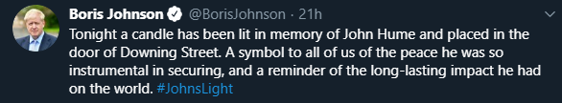
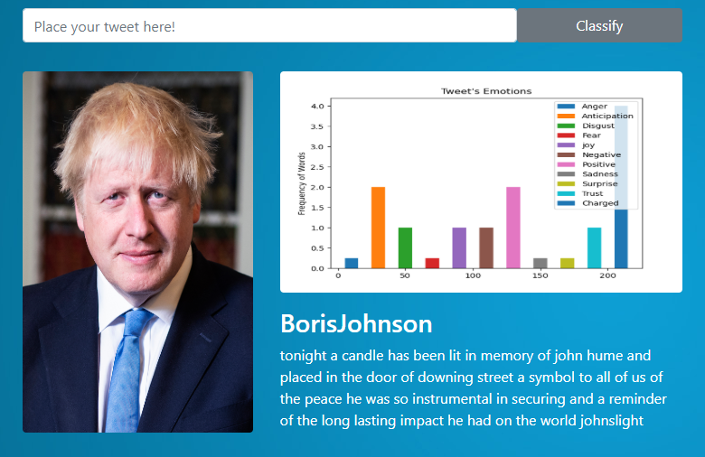
Cont…

Slide 11
Step 7: Frontend using Flask (Python).
Making Front end based on the pickled model for the input prediction and for comparative analysis of the algorithms being used in the project.

Slide 12
Comparative Analysis.
Algorithms | Accuracy | Precision | Recall
Decision Tree | 57.80% | 58.00% | 58.03%
Random Forest | 72.67% | 74.54% | 72.98%
Naïve Bayesian | 82.14% | 82.35% | 82.24%
Logistic Regression | 83.29% | 83.24% | 83.29%
Support vector Machine | 83.48% | 83.79% | 83.66%
Recurrent Neural Network | 92.44% | 93.82% | 93.84%

Slide 13
End.
That’s all.

