Slide 1
Introduction to Test-Driven Development in Mobile Development
Presented by: Mohamed Ezzat.

Slide 2


Agenda
What?
Why?
How?
Tools & Frameworks
Best Practices
Case Study
Q&A

Slide 3
What is TDD ?
Definition:
Test Driven Development is a software approach that make sure writing the test cases before code.

Slide 4
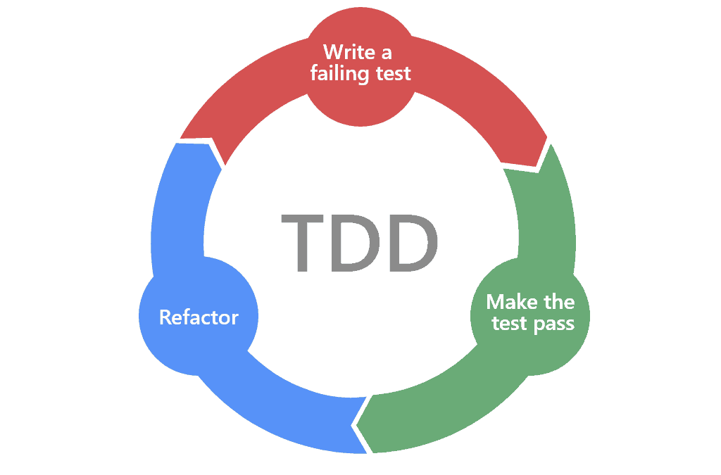
What is TDD ?
Writing tests before actual code.
Thoroughly tested.
Quality & Reliability .
Red – Green – Refactor .
Focuses in unit testing (Methods & Classes).

