Slide 1
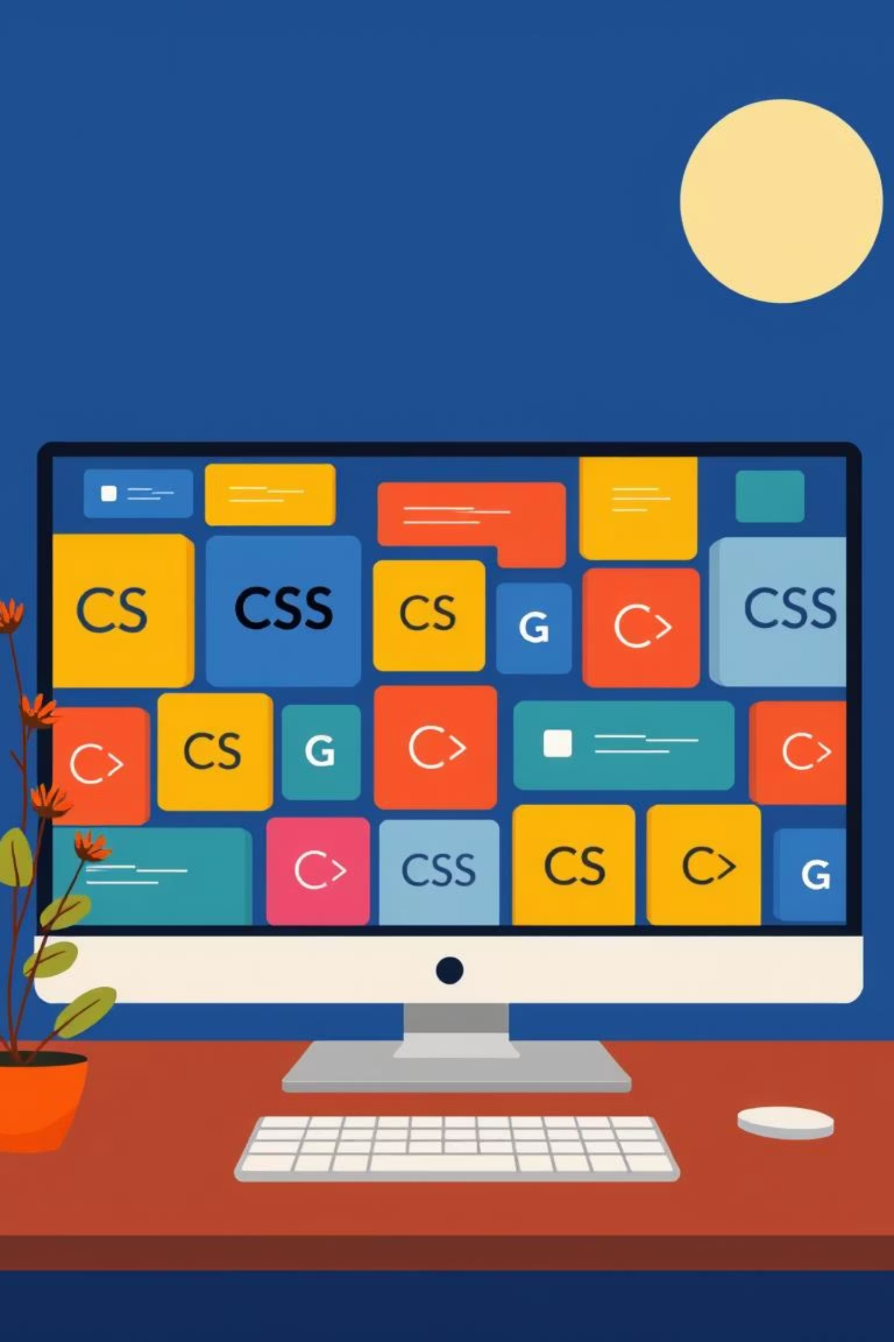
Learning CSS – session two
Cursor: pointer, move…
List-style: none, any shape
Visibility: hidden
Notes:
The different between display none and visibility hidden is that the display none is not exists but the visibility hidden is exists but u can not see it because it looks like that the opacity of it is 0
The different between opacity 0 and visibility hidden is that opacity 0 we can click on it but visibility hidden we cant click on it

Slide 2
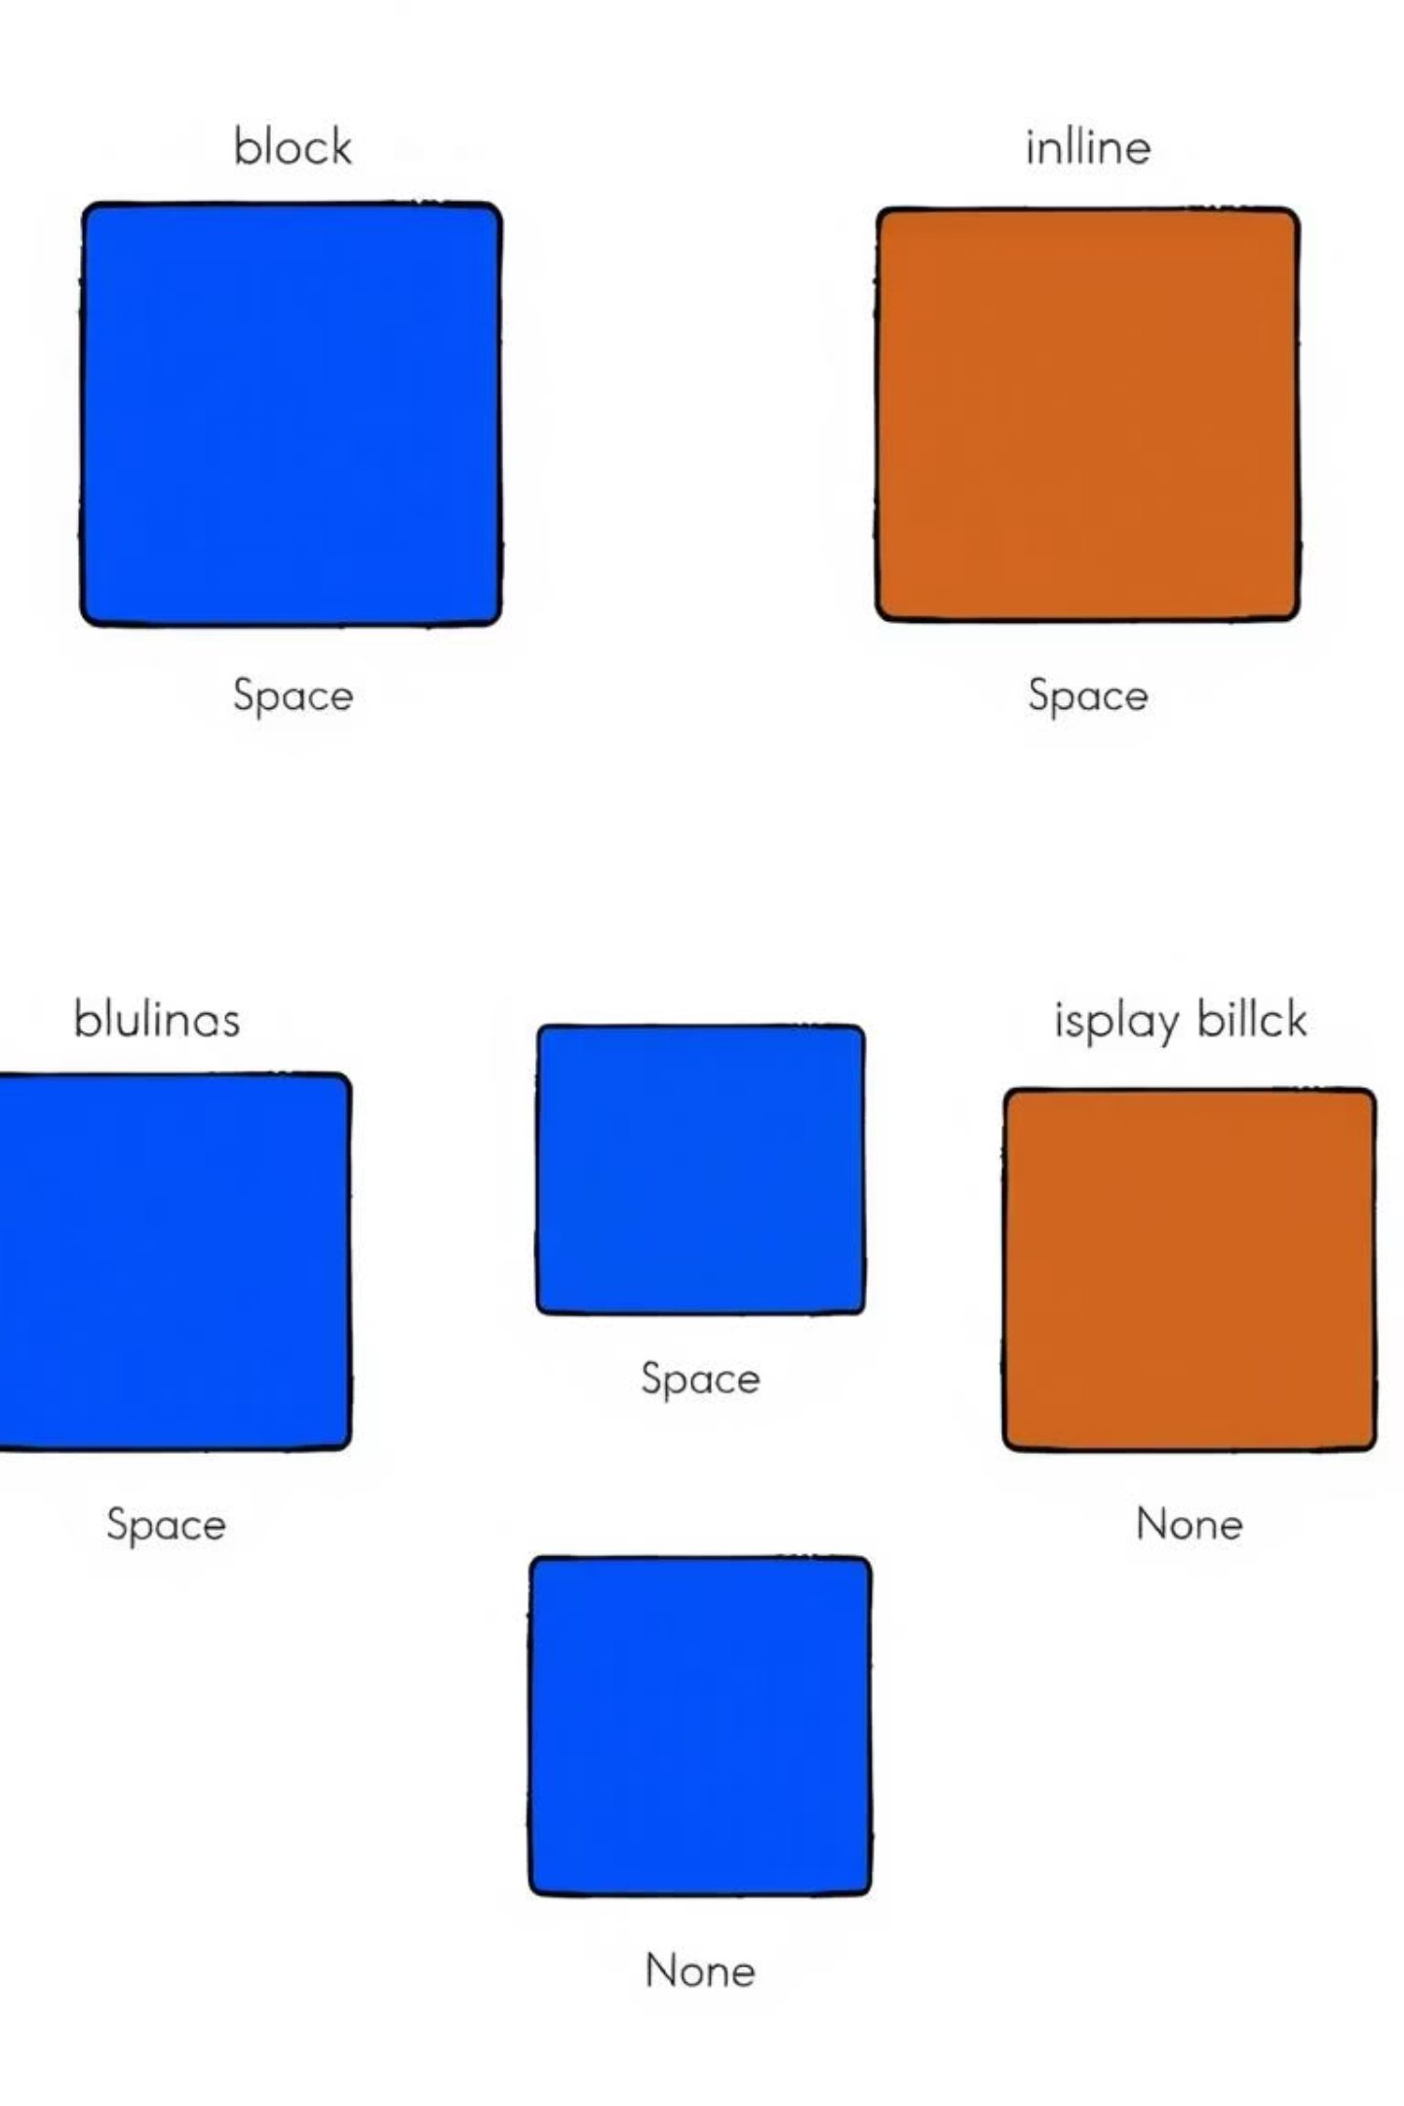
How Things Show Up: Display Types
The display property tells a web browser how an element should show itself. It changes how elements behave next to each other.
display: block
Takes up a whole line. Like a big box. Starts on a new line. Takes margin and padding normally
div, p, h1, ul, li, section
display: inline
Stays in the same line. Like a word in a sentence. Takes margin and padding but just left and right.
span, a, strong, img
display: inline-block
Like inline, but you can set its size. It sits on the same line, but acts like a small box.
<img> <button>
display: none
Hides the element completely. It's not there! It takes no space.
display: none;

Slide 3
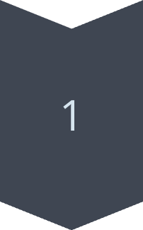
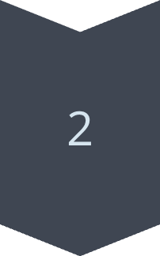
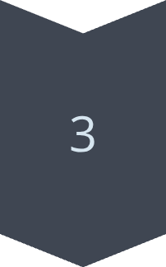
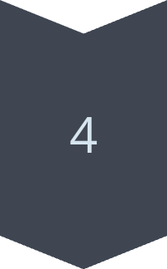
Where Things Sit: Position
The position property helps us place elements exactly where we want them on the page. Here are the five main types:
static
This is the normal way. Elements just go where they usually go.
div { position: static; }
relative
Move an element from its normal spot. Other things don't move because of it.
div { position: relative; top: 10px; }
absolute
Moves an element based on its closest parent that is relative or fixed. It moves out of the normal flow.
div { position: absolute; left: 50px; }
fixed
Stays in the same place on the screen, even if you scroll. Like a sticky header.
div { position: fixed; bottom: 0; }

Slide 4
Arranging Things: Flexbox (Part 1)
Flexbox helps us arrange items in one direction: a row or a column. It makes things line up easily.
Main Dev {
display: flex;
flex-direction: row, column, column reverse, row reverse
gap: 20px;
justify-content: flex-end, flex-start, center, space-around, space-between, space evenly;
align-items: flex-start, flex-end, center
flex-wrap- wrap
}
لما نكتب
(flex-direction: column)
المحور الرئيسي بيتحوّل من أفقي لرأسي.
وده معناه إن:
(justify-content) هو اللي بيرتّب العناصر فوق وتحت.
((align-items) هو اللي بيرتّب العناصر يمين وشمال.
------------------------------------------------------------------
أما لو الاتجاه العادي اللي هو
(flex-direction: row)
فالعكس بيحصل:
(justify-content) يمين وشمال بيظبط الاتجاه الأفقي.
(align-items) فوق وتحت بيظبط الاتجاه الرأسي.
justify-content
This controls how items are spaced along the main axis (row or column). Think of it as horizontal alignment for rows or vertical for columns.
flex-start: Items at the beginning.
flex-end: Items at the end.
center: Items in the middle.
space-between: Items with space between them.
space-around: Items with space around them.

Slide 5
Smooth Changes: Transition
A CSS transition makes changes to elements happen slowly, not instantly. It's like a smooth fade or growth!
Transitions allow you to define animated changes for CSS properties. Instead of an abrupt change, the property changes over a set duration.
What is a CSS Transition?
How it Works
Example: Button Gets Bigger
It makes a property change from one state to another over a set time. For example, a button might grow bigger when you point at it.
You tell CSS which property to change (like size or colour), how long it should take, and how fast it should go (like slow at start, fast at end).
When you put your mouse over a button, it can smoothly grow in size. This makes the website feel more alive.
.button {
transition-deley: .5s;
Transition-duration: 1s;
transition-property: ;
}

Slide 6
Moving Pictures: Animation
CSS animations are more powerful than transitions. They let you create complex movements and changes over time, defining many steps.
What is CSS Animation?
@keyframes
It's like making a short film for an element. You tell it exactly what to do at different times.
This is where you set the "scenes" for your animation. You say what the element looks like at 0% (start), 50% (middle), and 100% (end) of the animation.
@keyframes mymove { ... }
animation-duration
animation-name
How long the animation takes from start to finish. For example, 2 seconds.
The name you give to your @keyframes rule, so you can use it on an element.
animation-duration: 2s;
animation-name: mymove;
Example: A Box Moves
Here, a box moves from the left side to the right side of its space.
@keyframes slideBox {
from { left: 0px; }
to { left: 200px; }
}
.box {
animation-name: slideBox;
animation-duration: 3s;
animation-timing-function: linear;
animation-iteration-count: infinite;
animation-direction: alternate;

Slide 7
What We Learned Today: A Quick Look Back
We've covered many exciting ways to make your websites shine!
1
Display
How elements show up: block (new line), inline (same line), inline-block (same line, set size), none (hidden).
2
Position
Where elements sit: static (normal), relative (move from normal), absolute (move from parent), fixed (stays put), sticky (scroll then fixed).
3
Flexbox
Arranging items in rows or columns easily using display: flex, flex-direction, justify-content, align-items, flex-wrap, and flex-grow.
4
Transition
Making smooth changes for properties, like a button slowly getting bigger.
5
Animation
Creating complex movements over time using @keyframes, animation-duration, and animation-name.

