Slide 1
Frontend Development — HTML Session 1
Introduction to HTML, Web Basics, Document Structure & Core Tags
Instructor: Mohamed Saeed

Slide 2
Session Goals: Your Learning Roadmap
Welcome to your first step into frontend development! This session is designed to equip you with the foundational knowledge of HTML, the backbone of all web pages. By the end, you'll be able to build basic web structures and understand how the web works at a fundamental level.
1
Learn core HTML structure & tags
Familiarise yourself with the essential elements that form any HTML document.
2
Differentiate Block vs. Inline Elements
Understand how different HTML elements behave in terms of layout and flow.
3
Master Headings, Text, Lists, Links, Images
Learn to use fundamental tags to structure and display content effectively.
4
Grasp DOM Tree Basics
Discover how browsers interpret HTML into an organised, accessible document model.
5
Practice Writing HTML
Apply your new knowledge through hands-on coding exercises.
6
Prepare for Semantic HTML & Tables
Set the stage for advanced HTML concepts in our next session.

Slide 3
What Exactly is HTML?
HTML, or HyperText Markup Language, is the standard language for creating web pages. It provides the structure and content, acting as the skeleton upon which all other web technologies build. Without HTML, there would be no web pages as we know them.
The Foundation of the Web
HyperT
HTML = Structure (What's on the page)
Markup: Tags that define the structure and content of a document.
CSS = Style (How it looks)
Makes the colors
Size
Position
Responsive
Language: A system of communication with specific rules and syntax.
Is HTML a programming language?
Programming languages have: loops, if conditions, functions, vars…
Programming language can do logics, maths, run code, repeat task…
***** building structure ≠ programming. *******
Html just tell the browser that this is title, paragraph, image, video, table
JS = Interactivity (How it behaves)
The logic
Working with apis
Make maths operators
Interactive
Html: what is
CSS: how it looks
JS: How It Works

Slide 4


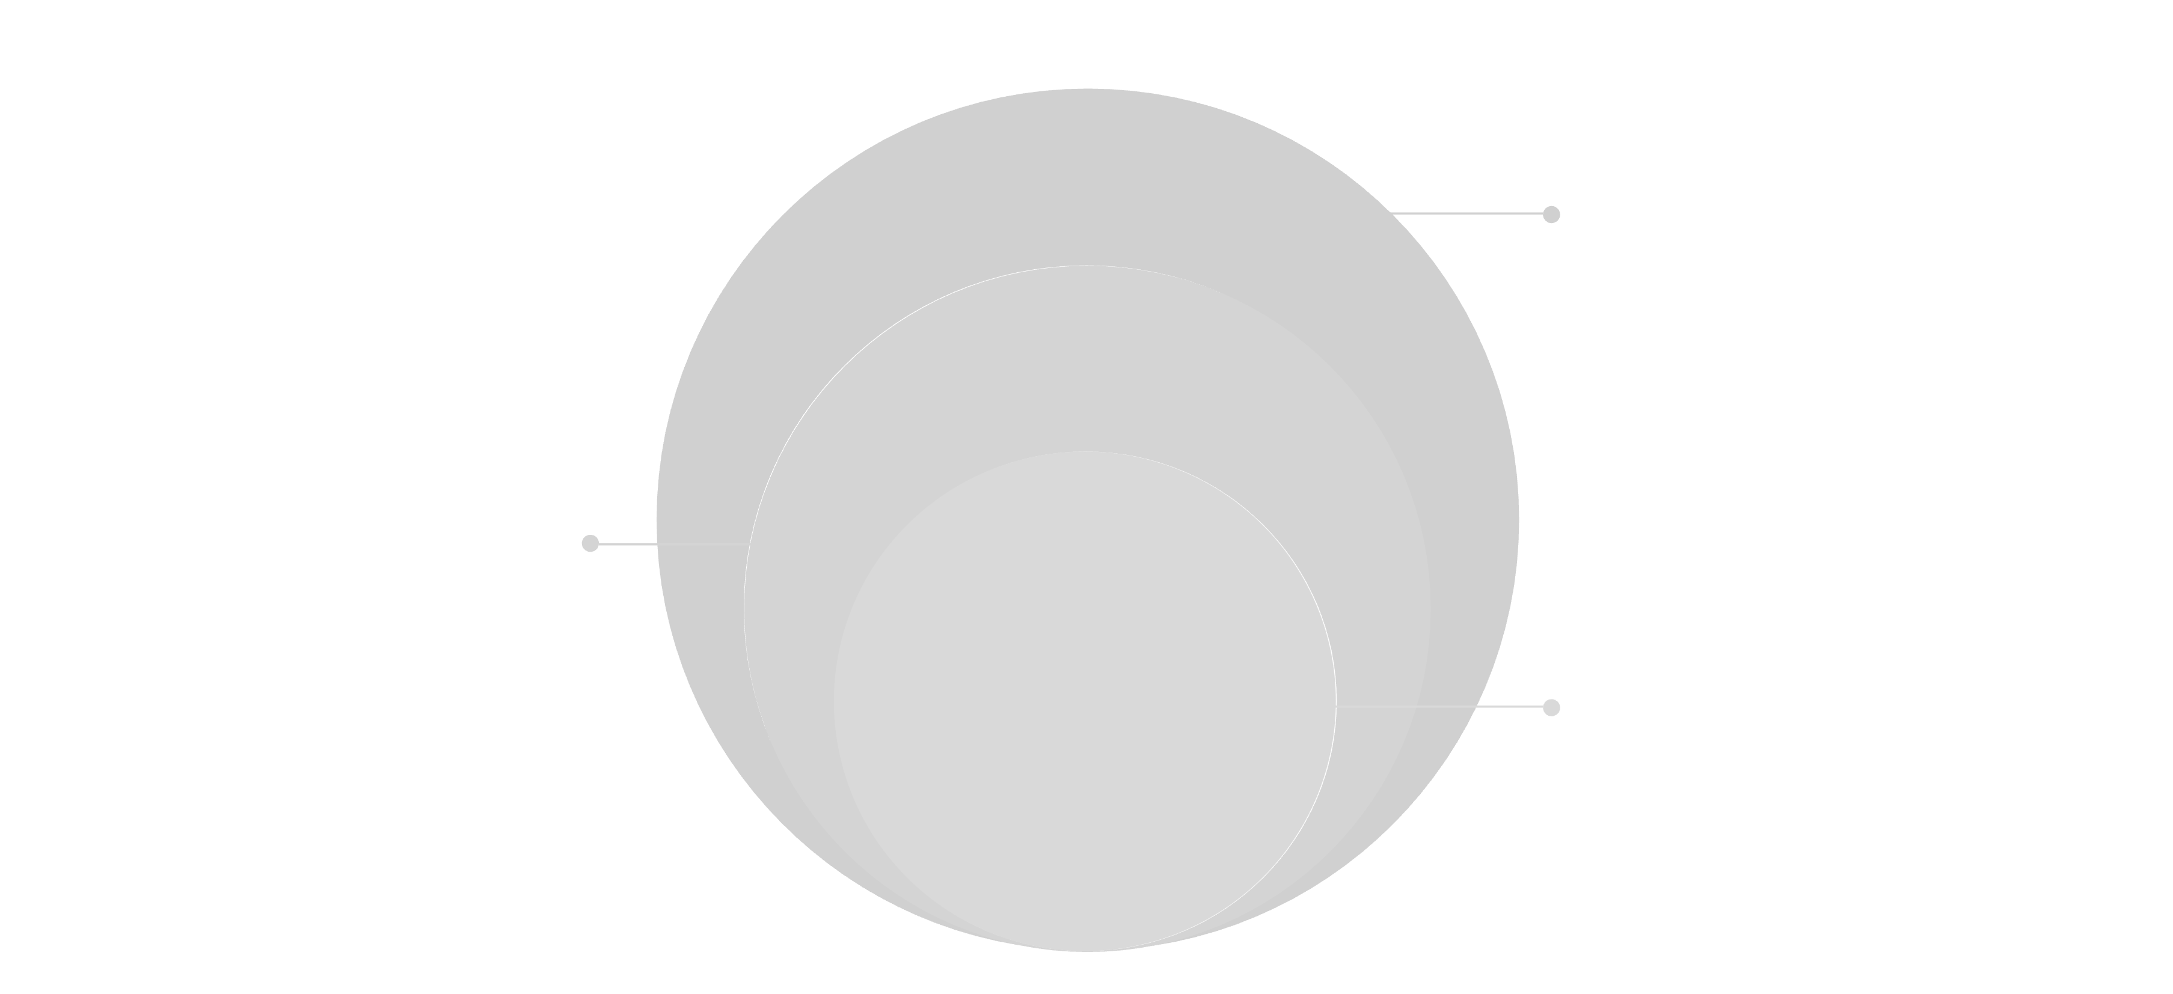



How the Browser Renders Your Web Page
Understanding how a browser processes your HTML is crucial for effective web development. It's a systematic process that transforms raw code into the visual experience you see.
Browser Downloads HTML
The initial step where your browser fetches the HTML file from a server.
Parses Line by Line
Body Children
The browser reads and interprets the HTML code sequentially, understanding its structure.
Builds the DOM
A tree-like representation of the HTML document is created, making each element accessible.
Loads & Applies CSS
External stylesheets are fetched, and their rules are applied to the DOM elements, defining the page's appearance.
Loads & Adds JS Interactivity
Head & Body
<head> and <body> sections
JavaScript files are loaded, allowing the page to become dynamic and respond to user actions
The browser downloads the HTML =>
parses it to build the DOM =>
loads the CSS to build the CSSOM =>
combines them into the Render Tree =>
calculates element sizes and positions (Layout) =>
paints everything on the screen (Paint) =>
then loads and runs JavaScript which can change the page and trigger new layout or paint updates.
<h1>, <p>, <img> elements
HTML Root
Document root <html>

Slide 5

Essential Tools for Frontend Developers
To start your journey in frontend development, you'll need a few key tools. These are industry standards that will streamline your workflow and provide a robust development environment.
VS Code
Browser (Chrome)
A powerful, free, and open-source code editor from Microsoft, essential for writing HTML, CSS, and JavaScript. It comes with a vast ecosystem of extensions.
Your primary tool for viewing and debugging web pages. Chrome's developer tools are robust and indispensable for inspecting elements and troubleshooting.
Live Server Extension
Basic Folder Structure
A VS Code extension that launches a local development server with live reload. This means your browser automatically refreshes whenever you save changes to your code.
Organising your project files (HTML, CSS, JS, images) in a logical hierarchy from the start is vital for maintainability and scalability.

Slide 6
Your First HTML File: "Hello World"
Let's create the most basic web page, the traditional "Hello World". This will introduce you to the fundamental structure of every HTML document.
<!DOCTYPE html>
<html lang="en">
<head>
<meta charset="UTF-8">
<meta name="viewport" content="width=device-width, initial-scale=1.0">
<title>My First Webpage</title>
</head>
<body>
<h1>Hello World</h1>
<p>Welcome to my first HTML page!</p>
</body>
</html>
Here’s a breakdown of the essential components:
<!DOCTYPE html>: Tells the browser to render the page using modern HTML5 standards.
<html lang="en">: The root element that encloses all other HTML elements. The lang attribute specifies the language.
<head>: Contains meta-information about the HTML document, not displayed on the page itself.
<meta charset="UTF-8">Sets the character encoding so the page can display all languages and symbols correctly. Not ????
<meta name="viewport" ...>:Makes the webpage responsive by matching its width to the device screen and setting the initial zoom level.
.
<title>: Sets the title that appears in the browser tab or window title bar.
<body>: Contains all the visible content of the web page.

Slide 7
Structuring Content with Text & Semantic Tags
HTML provides a rich set of tags to structure and semantically define your content. Using the correct tags is crucial for accessibility, SEO, and maintainable code.
Essential Text & Content Tags
Examples of Text Tags
<h1>-<h6>: Headings, from most important (h1) to least (h6). Use them hierarchically.
<h1>Welcome to My Page</h1><hr><p>This is a normal paragraph with <strong>important text</strong> and <em>emphasised words</em>.</p><p>Here is some <mark>highlighted text</mark>.</p><p>This is a new line.<br>And another one.</p><p>H<sub>2</sub>O is water and E=mc<sup>2</sup> is energy.</p><!-- This is a hidden comment -->
<p>: Paragraphs, for blocks of text.
<br>: Line break, for forcing a new line.
<hr>: Horizontal rule, creates a thematic break or separator.
<span>: An inline container for phrasing content, used for styling small parts of text.
<div>: A block-level container, typically used for grouping larger sections of content.
<strong>: Indicates strong importance, usually renders as bold.
<em>: Indicates emphasis, usually renders as italic.
<mark>: Highlights text, marking it as relevant or important.
Your Task:
<small>: Represents side comments, fine print, or copyright text.
Create a title and a paragraph.
<sub>: Subscript text (e.g., H2O).
Place a horizontal line directly under your title.
<sup>: Superscript text (e.g., E=mc2).
Add some marked text within your paragraph.
HTML Comments: <!-- This is a comment -->. Comments are ignored by the browser and are used for notes in your code.

Slide 8
Block vs. Inline Elements: Understanding Layout Flow
HTML elements behave differently in how they occupy space and interact with other elements. Understanding the distinction between block and inline elements is fundamental to controlling your page layout.
Block-Level Elements
Inline Elements
Block elements always start on a new line and take up the full available width. They are typically used for larger structural pieces of content.
Inline elements do not start on a new line and only take up as much width as necessary for their content. They typically sit within block elements.
Examples: <div>, <p>, <h1>-<h6>, <ul>, <li>
Examples: <span>, <a>, <strong>, <em>
This visual distinction is critical for predicting how your content will render and for effective CSS styling. You can't put block-level elements inside inline elements without breaking HTML rules.

Slide 9
Navigating the Web with Links (<a>)
Links are the cornerstone of the web, connecting documents and creating the "hypertext" in HTML. The <a> (anchor) tag is used to create hyperlinks.
Types of Links
Example Usage
External Links: Point to another website.<a href="https://google.com">Google</a>
<h2 id="about-section">About Us</h2><p>Learn more <a href="#about-section">about our company</a>.</p><p>Visit <a href="https://developer.mozilla.org" target="_blank">MDN Web Docs</a> for more info.</p>
Internal Links: Point to another page within your own website.<a href="about.html">About Us</a>
Anchor Links: Jump to a specific section on the same page. Requires an id attribute on the target element.<a href="#about-section">Go to About</a>
Important Attributes:
href: Specifies the URL of the page the link goes to.
target="_blank": Opens the linked document in a new browser tab or window, useful for external links.
id: A unique identifier for an HTML element, used as a target for anchor links.
Always ensure your links are descriptive and functional, providing a clear path for user navigation.

Slide 10

Enhancing Content with Images (<img>)
Images are vital for visual appeal and conveying information on a web page. The <img> tag is used to embed images, and it's a self-closing tag (it doesn't have a separate closing tag).
Key Attributes for Images
Image Example
src: (Source) This is the most crucial attribute. It specifies the path to the image file. This can be a relative path (e.g., "images/photo.jpg") or an absolute URL (e.g., "https://example.com/photo.jpg").
<img src="photo.jpg" alt="A serene landscape with mountains and a lake" width="500" height="300">
alt: (Alternative Text) Provides a text description of the image. This is essential for accessibility (screen readers), SEO, and when the image fails to load.
width / height: Specifies the dimensions of the image in pixels. While you can use these, it's often better to control image sizing with CSS for more flexible and responsive designs.
Remember that the src attribute is mandatory; without it, the browser won't know which image to display.
Your Task:
Embed an image on your page (you can use any placeholder image URL if you don't have one locally). Below the image, create a link to Facebook that opens in a new tab.

