Slide 1
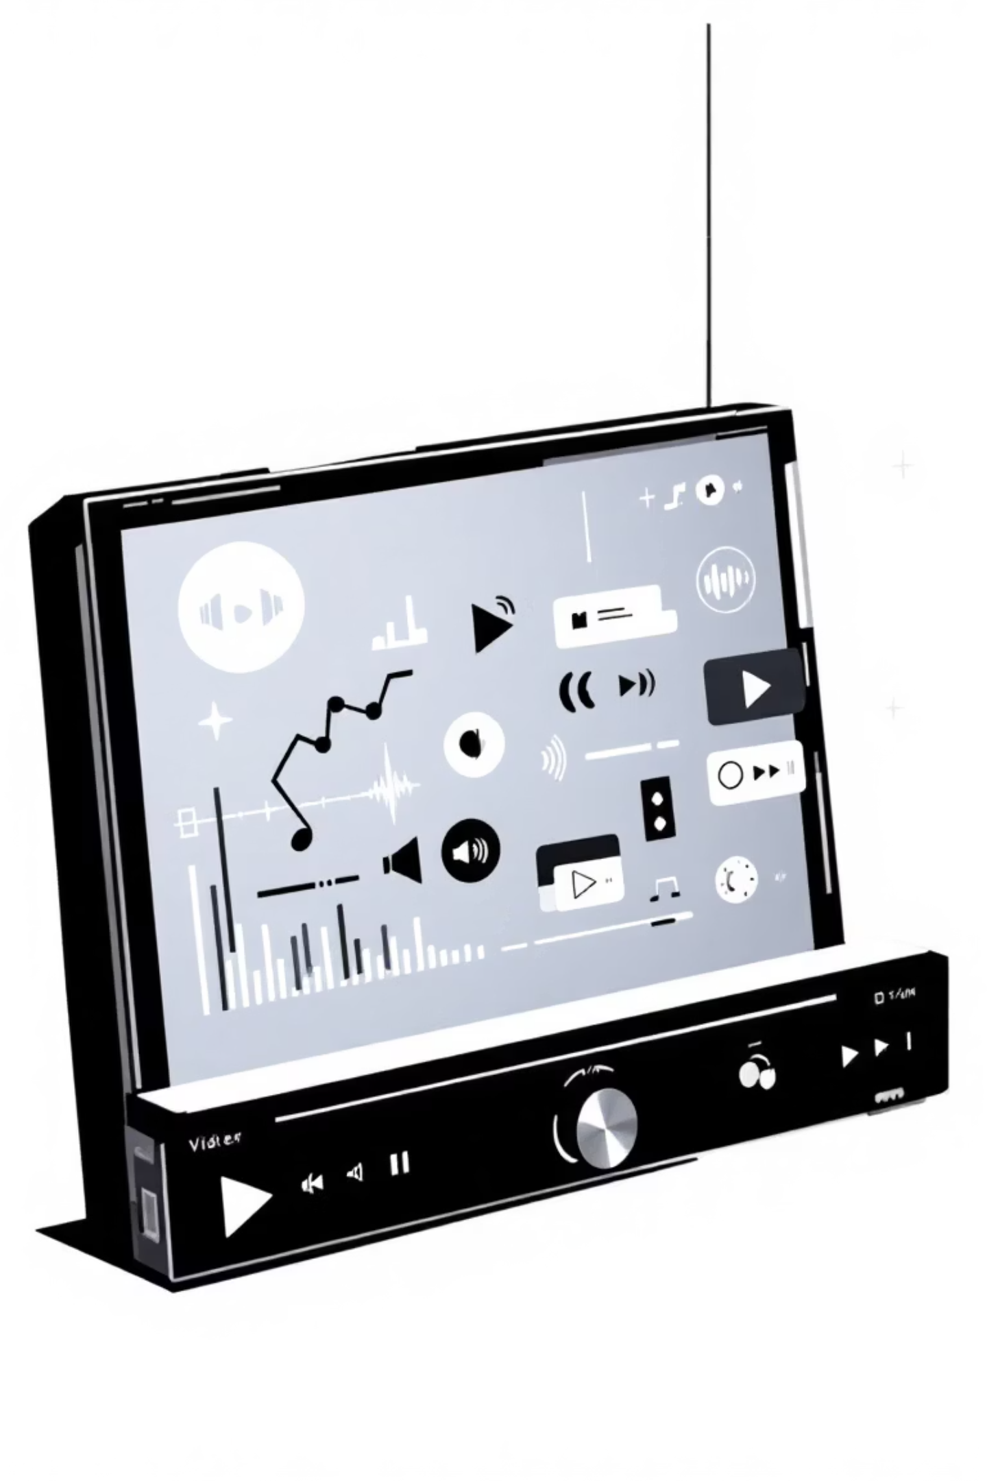
Adding Media to Your Webpage
Imagine your website comes alive with sounds and moving pictures! That's what media tags do. They let you put audio (sounds) and video (movies) right onto your web page.
We will look at these important tags today:
<audio>: For playing sounds like music or voice recordings.
<video>: For showing videos, like short films or animations.
<source>: To help your browser find the right media file to play.

Slide 2

The <audio> Tag: Play Sounds
What it does:
Main Attributes:
This tag adds sound to your webpage. It's like putting a music player directly on your site.
controls: Shows play, pause, volume buttons.
src: Tells the browser where to find the audio file.
loop: Makes the sound play again and again.
autoplay: Tries to play the sound as soon as the page loads (be careful, some browsers block this).
Code Example:
Your Task:
Add an audio player to your page with controls so people can play it.
<audio controls src="sound.mp3"></audio>
This code will show a player with buttons and play a file named sound.mp3.

Slide 3
The <video> and <source> Tags: Show Videos
What <video> does:
Main <video> Attributes:
What <source> does:
This tag puts a video player on your webpage. You can show movies, clips, or anything with moving pictures!
controls: Shows play, pause, volume, and full-screen buttons.
Inside <video>, you use <source> to tell the browser where to find video files. You can offer different file types so it works on many browsers.
width: Sets how wide the video player is.
height: Sets how tall the video player is.
poster: Shows an image before the video starts playing.
src: Where the video file is.
type: What kind of video file it is (e.g., "video/mp4").
loop: Makes the video play again and again.
Code Example:
Your Task:
Add a video player to your page that is 300 pixels wide and has controls. Use one source for the video.
<video controls width="300"> <source src="video.mp4" type="video/mp4"></video>

Slide 4
Tables: Organising Information
Tables are great for showing data clearly, like lists of names, numbers, or facts. They use rows and columns to keep everything tidy.
<table>
<tr>
This is the main tag for your table. Everything else goes inside it.
This stands for "table row." Each <tr> creates a new line in your table.
<th>
<td>
This stands for "table header." These are like the titles for your columns, usually bold and centred.
This stands for "table data." These are the actual pieces of information in each cell of your table.
Code Example:
<table> <tr> <th>Name</th> <th>Age</th> </tr> <tr> <td>Ali</td> <td>20</td> </tr></table>
Your Task:
Create a simple table with 2 rows and 2 columns. Put some data in it, like "Fruit" and "Colour" for the headers, and "Apple" and "Red" for the data.

Slide 5
Structuring Tables for Better Organisation
HTML tables can have special sections: a head, a body, and a foot. This helps browsers and people understand your table better.
01
02
<caption>
<thead>
Gives a title to your table. It explains what the table is about.
This holds the header rows (your <th> tags). It tells the browser that these are the column titles.
03
04
<tbody>
<tfoot>
This holds the main data rows (your <td> tags). This is where most of your table content goes.
This holds any summary or footer rows for your table, like totals or notes.
Code Example:
<table> <caption>Students</caption> <thead> <tr><th>Name</th></tr> </thead> <tbody> <tr><td>Ali</td></tr> </tbody> <tfoot> <tr><td>End</td></tr> </tfoot></table>
Your Task:
Take your previous table. Add a caption to it, and put your header row inside <thead>.

Slide 6
Semantic HTML: Giving Meaning to Your Page
Semantic HTML means using tags that describe the meaning of the content they hold, not just how it looks. This is super important for several reasons:
For search engines: Helps them understand your page better, so more people can find your website.
For screen readers: Helps people who cannot see your page understand its structure.
For other developers: Makes your code easier to read and work with.
Here are some common semantic tags:
<header>: Top part of the page or a section.
<nav>: Navigation links (menus).
<main>: The main content of your page.
<section>: A big section of content.
<article>: A piece of independent content, like a blog post.
<aside>: Content that is related but separate, like a sidebar.
<footer>: Bottom part of the page or a section.

Slide 7

Building Page Structure with Semantic Tags
These tags help you build the basic layout of any webpage, making it easy to understand what each part does.
<header>
<nav>
<main>
This is often at the top of your webpage. It might have your website's logo, title, and sometimes a search bar.
This tag holds all the links that help users move around your website, like "Home", "About Us", or "Contact".
This is for the unique content of your page. There should only be ONE <main> tag per page.
Code Example:
<header>My Website Logo</header><nav><a href="#">Home</a></nav><main> <p>Welcome to my awesome website!</p></main>
Your Task:
Create a simple page that has a header with your name, a navigation menu with one link, and a main section with a short welcome message.

Slide 8


Organising Content with <section>, <article>, <aside>
Once you have your main layout, these tags help you break down the content into smaller, meaningful parts.
<section>
<article>
<aside>
This groups related content together. Think of it as a chapter in a book. It often has a heading.
This is for self-contained content. It could be a blog post, a news story, or a comment. It should make sense on its own.
This is for content that is related to the main content but separate. For example, a sidebar with related links, ads, or author information.
Code Example:
<section> <h2>Latest Updates</h2> <article> <h3>New HTML Course!</h3> <p>Learn all about semantic tags.</p> </article> <aside> <p>Check out our other courses!</p> </aside></section>
Your Task:
Inside your <main> tag, create a section. Inside that section, add an article about something interesting and an aside with a small related note.

Slide 9
The <footer> and the Versatile <div> Tag
Every webpage needs a bottom part, and sometimes you need a simple box to group things together.
<footer>
<div>
This goes at the bottom of your page or a section. It often contains copyright info, contact details, or links to privacy policies.
This is a "division" or a simple container. It doesn't have special meaning like semantic tags, but it's very useful for grouping elements for styling.
Main <div> Attributes:
class: A name you give to a group of elements. You can use this name many times.
id: A unique name for one specific element. You can only use this name once per page.
Code Example:
<div class="contact-info"> <footer> <p>Contact me at info@example.com</p> </footer></div>
Your Task:
Add a footer to your page. Use a <div> tag with a class called "page-end" to wrap your footer and maybe a small text saying "Thank you for visiting!".

Slide 10
Your Final HTML Project: Build a Small Portfolio!
Now you have learned many HTML tags! It's time to build your very first project. You will create a simple portfolio webpage to show what you can do.
Semantic Structure
Data & Lists
Use <header>, <nav>, <main>, <section>, <article>, <aside>, and <footer>.
Include at least one <table> to show some organised data (e.g., a list of your skills).
This makes your page meaningful and organised.
Add an ordered (<ol>) or unordered (<ul>) list.
Media Elements
Details & Cleanliness
Choose to add either an <audio> or a <video> element.
Use class and id attributes on your <div> tags for styling later.
Make sure it has controls so users can interact with it.
Add <!-- comments --> to explain your code.
Keep your HTML code neat and easy to read.
Your Instructions: Build a simple portfolio webpage. Include all the elements mentioned above. We will learn to make it look beautiful with CSS later!

