Slide 1
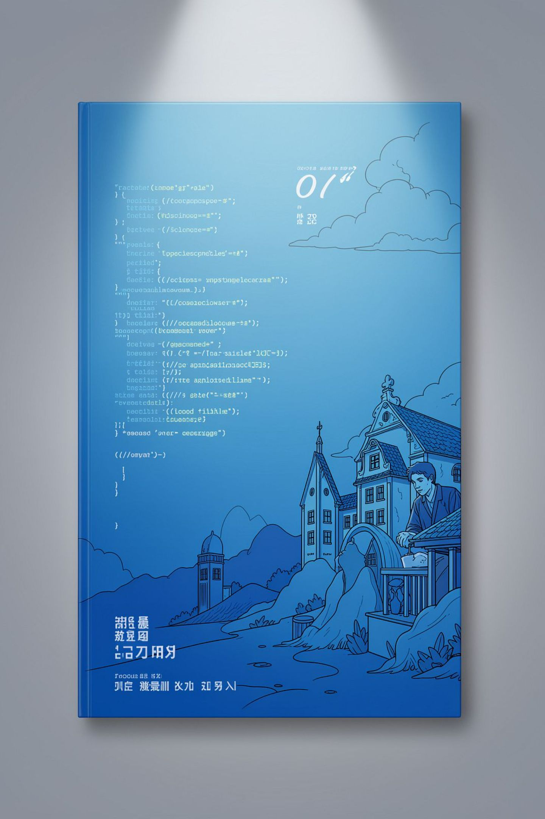
AI-Powered English <-> Urdu Translation System (Bilangual)
Presented by Muhammad Talha (2023-CS-12)
Supervised by Sir Samyan Wahla
Department of Computer Science, UET Lahore
Course: Programming for AI

Slide 2

Executive Summary
"Bilangual" is a translation platform engineered for the linguistic complexity of English and Urdu. It combines multi-script detection, conversation-state tracking, and a deterministic Risk Engine to ensure safe, auditable translations for high-stakes domains.
Key Differentiator
Core Triad
Conversation state tracking + hybrid script identification (Roman, Mixed) + deterministic risk evaluation (no silent failures).
Cost Efficiency (caching), Translation Quality (entity & numeric preservation), Latency (sub-5ms cache retrieval).

Slide 3
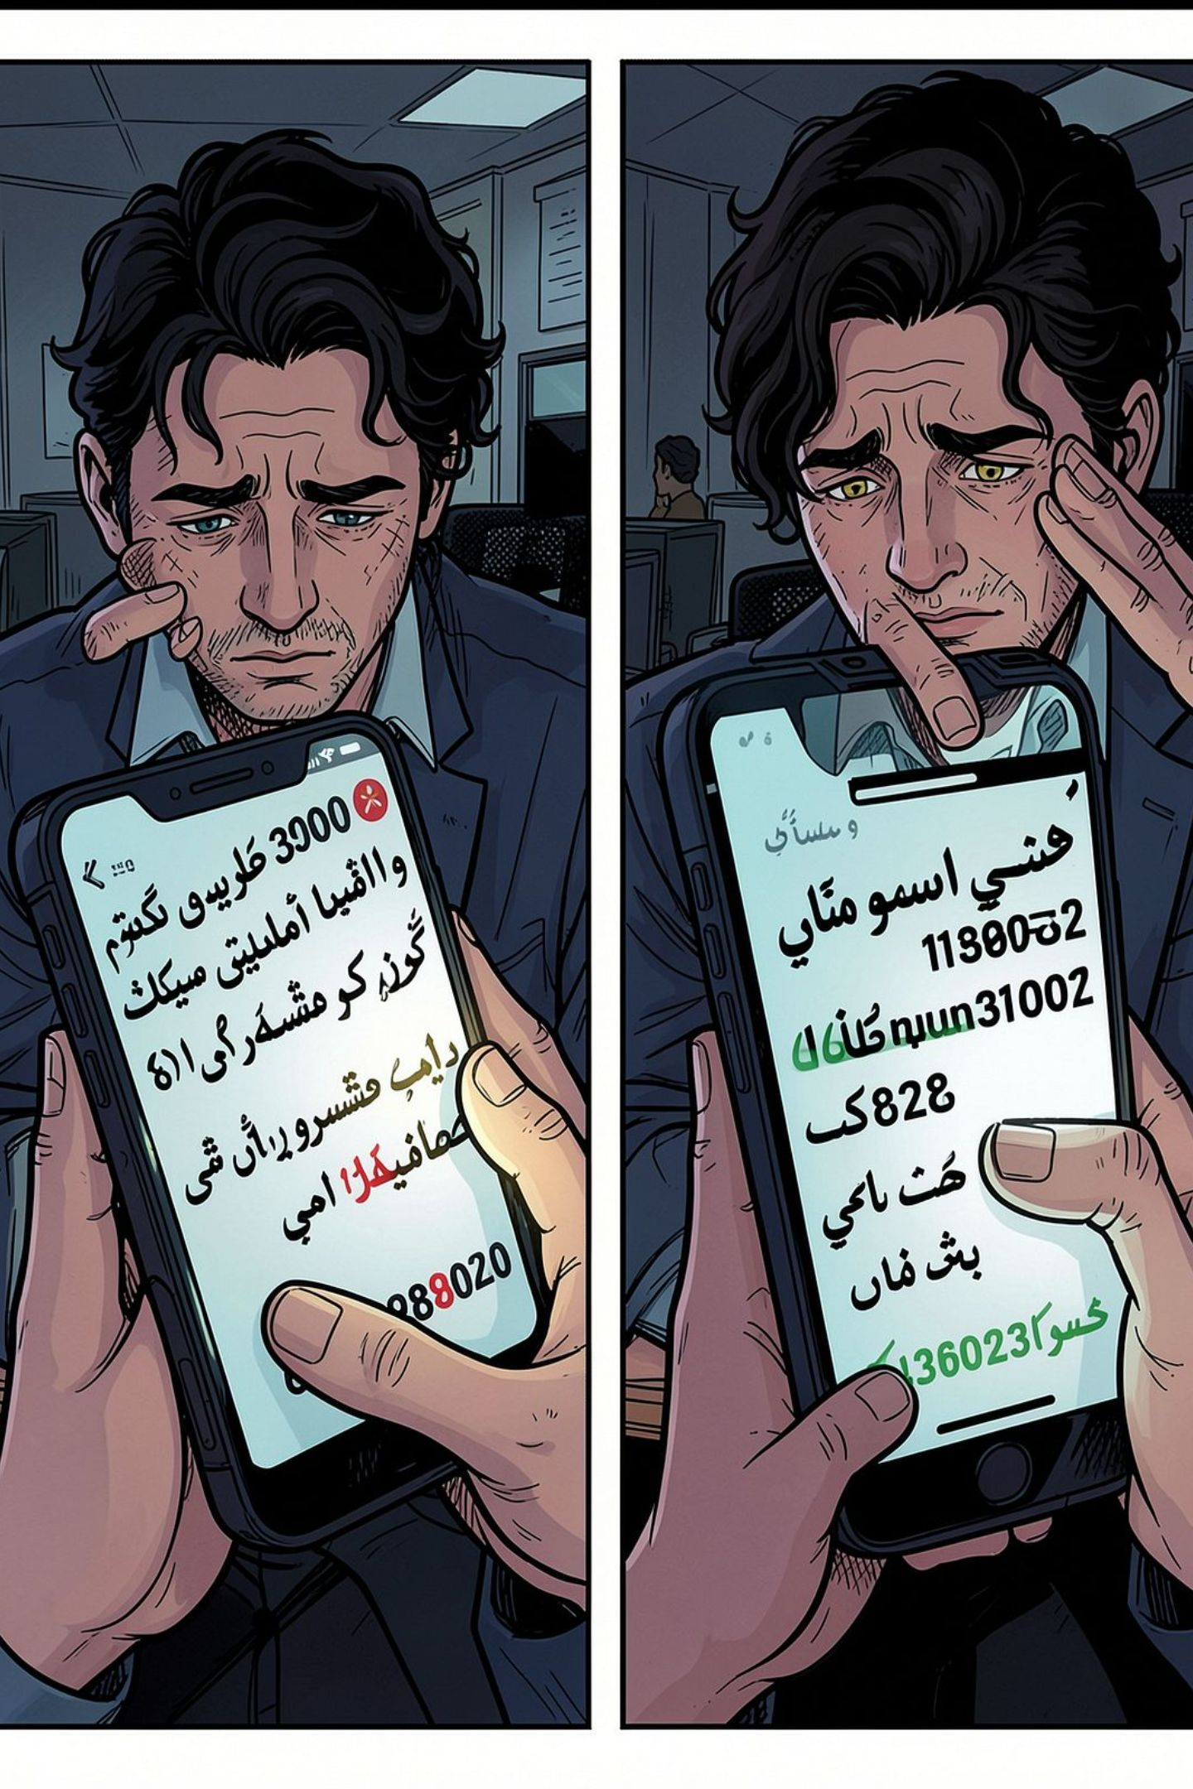
The Problem Statement
Stateless NMT: existing APIs translate isolated sentences and lose cross-sentence references.
Context Loss: pronouns and discourse markers (e.g., "us ne", "wahan") remain unresolved across turns.
Script Ambiguity: Roman Urdu and code-switching are misclassified as broken English.
Financial Hallucination: dropped or inverted identifiers, numbers, and transaction states create safety risks.

Slide 4
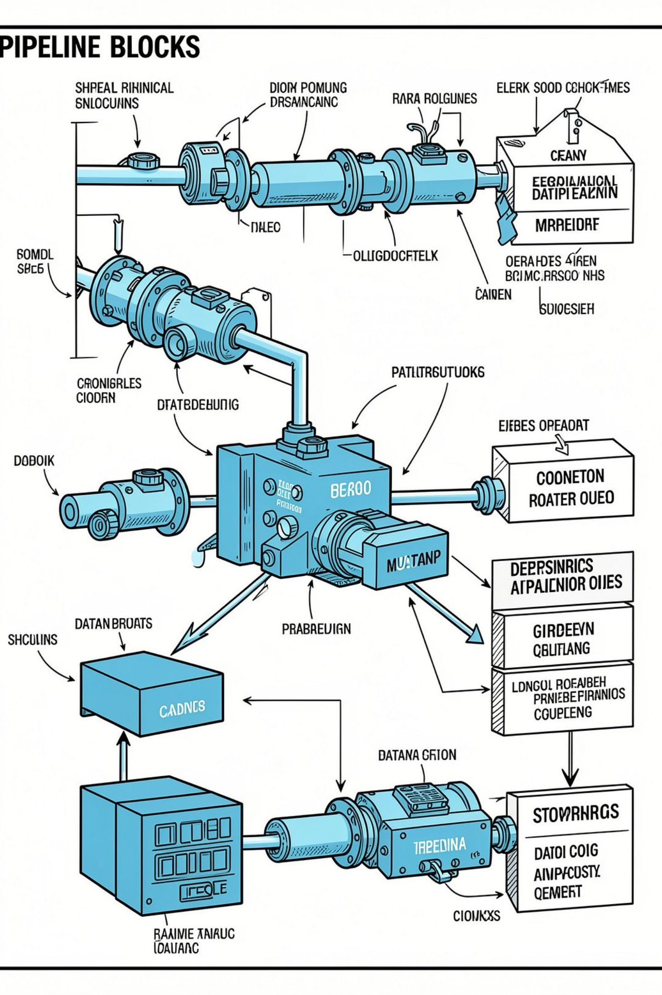
Project Objectives
Deliver a production-quality, multi-script translation pipeline with deterministic verification and human escalation for ambiguous or high-risk outputs.
1
2
3
Script Identification
Context Management
Few-Shot Exemplar System
Detect Urdu (Nastaliq), Roman Urdu, English, and mixed code-switching with high precision.
Sliding-window session history to resolve anaphora, co-reference, and ellipses across turns.
Seven frozen golden scenarios provide deterministic domain rules and edge-case anchors.
4
Foundation Model
Primary LLM client: Google Gemini (gemini-3.5-flash) with structured JSON outputs and fallback policies.

Slide 5




Target Audience & Use Cases
Fintech & Support Agents
Bilingual Students
Compliance Auditors
Everyday Users
Seamless handling of code-switching and mixed-script notes for study aids and automated summaries.
Risk Engine provides auditable decision traces and deterministic checks for high-risk financial translations.
Fast, accurate translations with Nastaliq rendering and low-latency cache hits for repeated queries.
Convert informal Roman Urdu complaints into formal, compliance-ready English tickets while preserving transaction semantics.

Slide 6
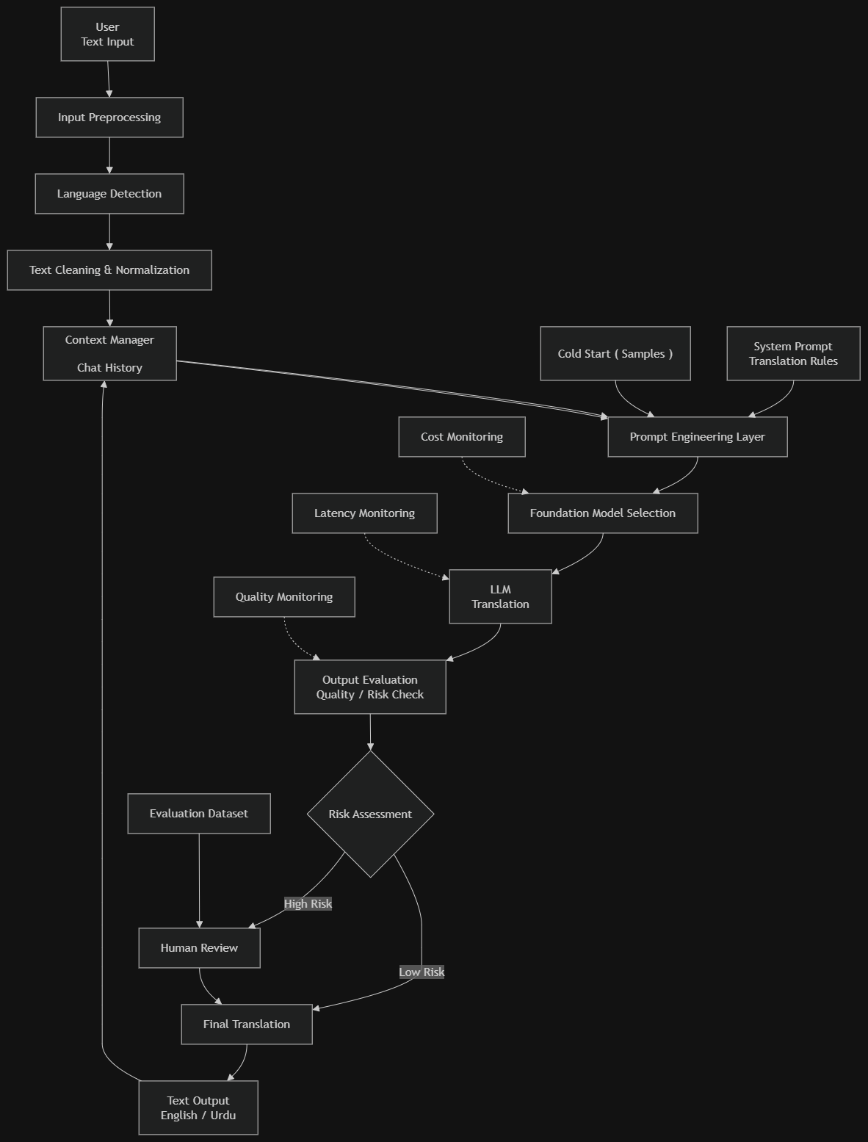
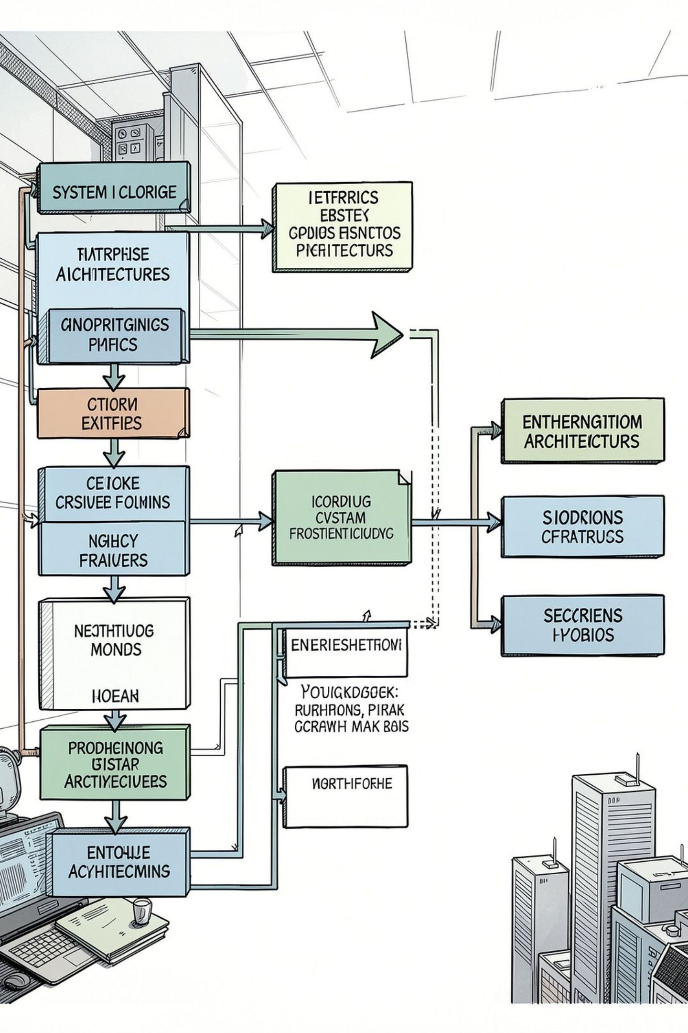

System Architecture
End-to-end modular pipeline designed for reliability, observability, and low-latency operation.
Preprocessor: normalize Unicode, preserve numerics, tokenize multi-script input.
Language Detector: regex + Unicode script analysis + statistical heuristics for Roman Urdu detection.
Context Manager: sliding-window session store, canonicalized entities, turn-level metadata.
Prompt Builder: injects exemplars, domain rules, and structured output schema into model prompt.
LLM Client: Gemini 3.5 Flash with JSON schema enforcement and timeout/fallback policies.
Risk Engine: deterministic audits, numeric/state checks, human-in-loop queueing.
Preprocessor
Language Detector
Context Manager
Prompt Builder

Slide 7
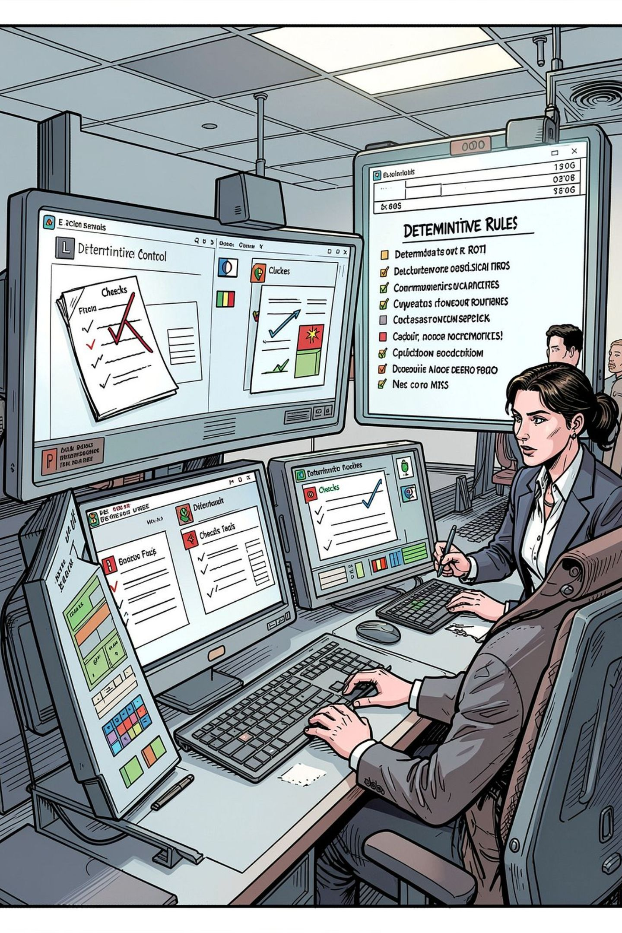
Deterministic Risk Engine
Audits candidate translations using rule-based validators before release. Deterministic checks ensure financial and state integrity.
Number Mismatch
State Inversion
Multiplier Retention
Checks semantic polarity for transactions (debit vs. credit) and flags inversions for review.
Validates numeric tokens and formats (e.g., "25k" → ensures "25,000" preserved or flagged).
Preserves multipliers and frequency markers (e.g., "2 dafa" → "twice") with unit consistency.
Human-in-the-Loop
High-risk or ambiguous results route to a human review queue with contextual logs and candidate alternatives.

Slide 8
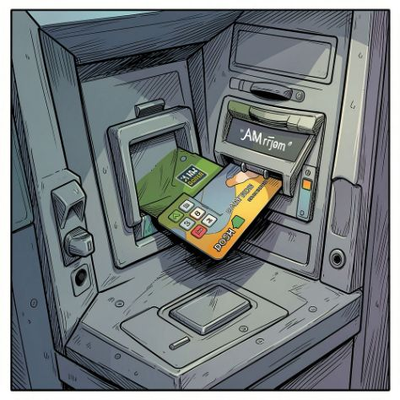
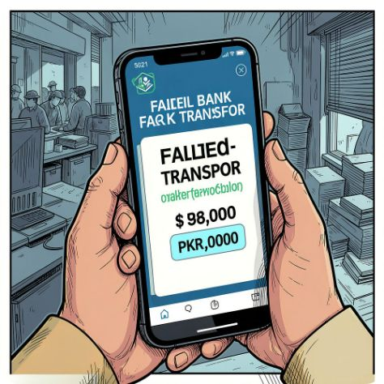
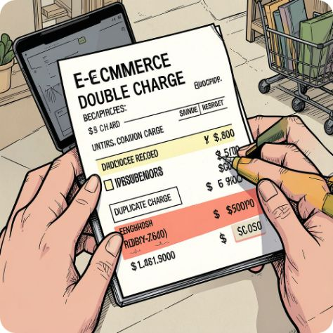
Cold-Start Few-Shot Scenarios
Seven frozen golden benchmarks anchor behavior during cold-starts and enforce compliance across fintech edge cases.
ATM Hardware Failure
Failed Transfer
Double Deduction
Preserve hardware state ("phans gaya" → "stuck") and avoid speculative remediation suggestions.
Exact PKR amounts and debit-only states must be retained verbatim for compliance triage.
Retain multiplier context (duplicate charges, '2 dafa') and map to precise English phrasing.

Slide 9

Success Criteria
Safety Guaranteed: deterministic detection of dropped numbers and inverted transaction states (target: 100% detection for benchmarked cases).
Contextual Accuracy: sustained multi-turn memory with correct anaphora and entity preservation across sessions.
Speed: sub-5ms cache retrieval for repeated queries; end-to-end p95 latency targets documented.
Resilience: graceful handling of rate limits, automated model fallbacks, and robust script-mismatch recovery without crashing.

