Slide 1
IMS Presentation
By Muhamed Jakupovic

Slide 2
Introduction
In this project, I have created a IMS system using Java, MySQL, Maven, Jira, GitHub and draw.io. I had a number of requirements for the IMS project and I believe I had achieved the majority of them. They can be seen below:
Add a customer to the system
View all customers in the system
Update a customer in the system
Delete a customer in the system.
Add an item to the system
View all items in the system
Update an item in the system
Delete an item in the system
Create an order in the system.
View all orders in the system.
Delete an order in the system
Add an item to an order.
Calculate a cost for an order.
Delete an item in an order
Furthermore, a customer also had to have a name, an item needs to have name and a value and an order needs to have a customer and contain items.

Slide 3
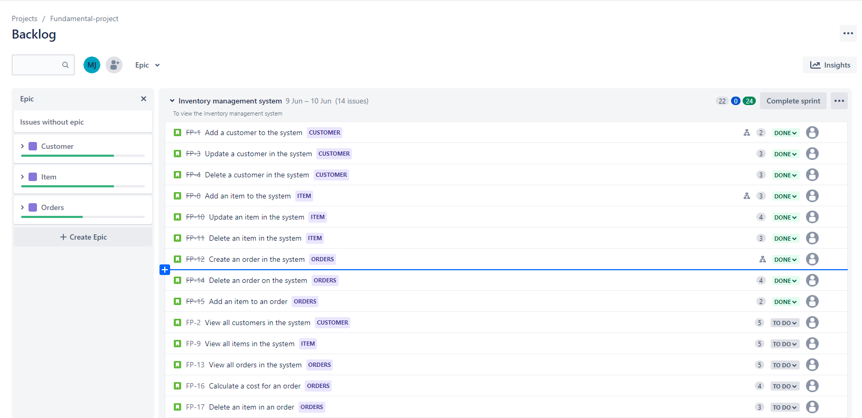
Jira
I used Jira to track my progress as I was making the IMS system. To begin with, I had fourteen tasks to do and I have succeeded in doing most of them.

Slide 4
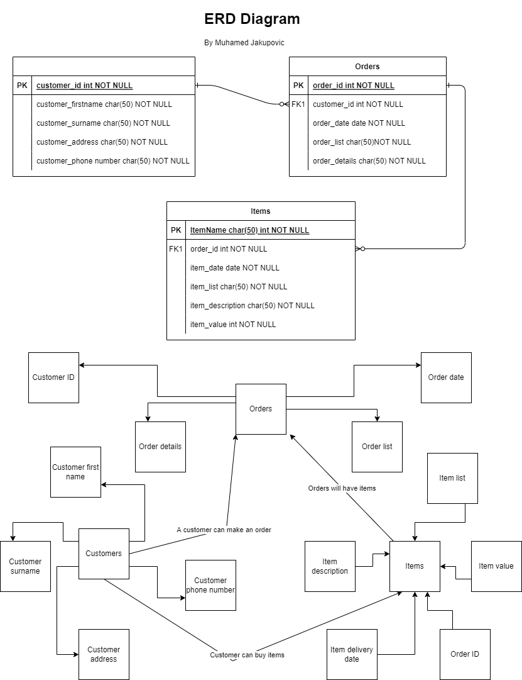
ERD diagram
I have also created a ERD diagram in which I have listed what items will fall under each category, such as customers, orders and items. I have also made connections to show what is the relationship between customers, orders and items.

Slide 5
Risk assessment
I have also created a risk assessment using Microsoft excel. In the spreadsheet, I came up with some scenarios that could occur if this system was to be used.

