Slide 1

Coberg Coding Tasks
By : Mohamed Elgindy

Slide 2
Agenda
Java Tasks
Bomb sweeper
Order the unorderd
Lost in parentheses
HTML and CSS
CSS – Scattered Boxes
LWC Task

Slide 3
JAVA – Bomb sweeper Algorithm
*.B.S.B
S.B.B.B
S.S.S.$
Patht: SSDDD
*.B.S.B
S.B.B.B
S.S.B.B
B.S.B.$
Path: SSDS ?
Can’t get out from maze safely.
Result: RTP.
Algorithm Steps Initialize:
1- Find the starting point (*) on the grid.
2- Use a queue to keep track of nodes to explore.
3- Use a Boolean array to keep track of visited nodes.
4- Define possible movements (up, down, left, right) and their corresponding direction characters.
5- Finally get path to exit from maze or RTP if can’t exit.

Slide 4
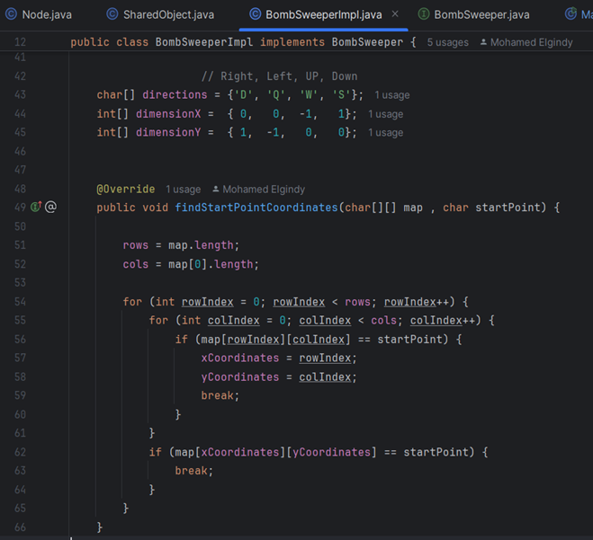
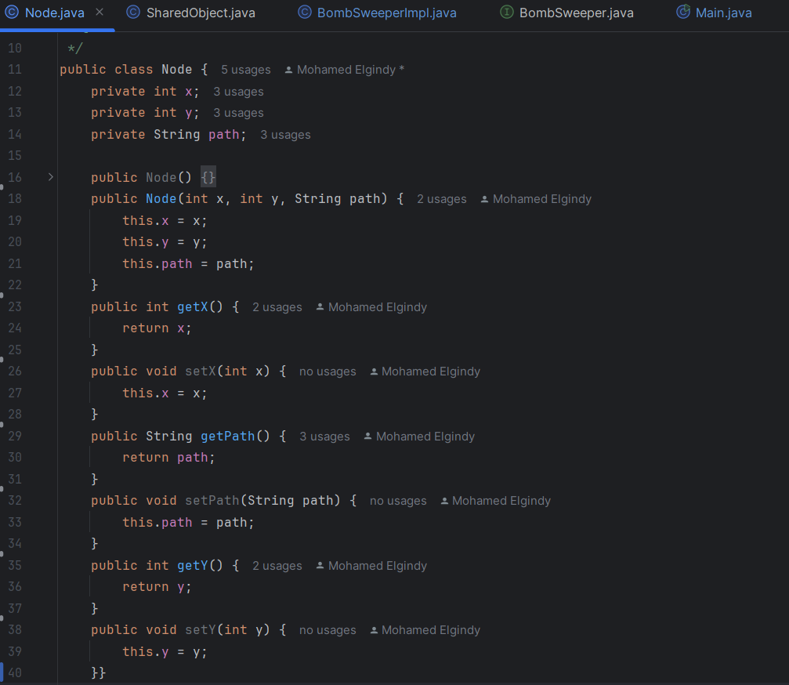
JAVA - Bomb sweeper Code

Slide 5
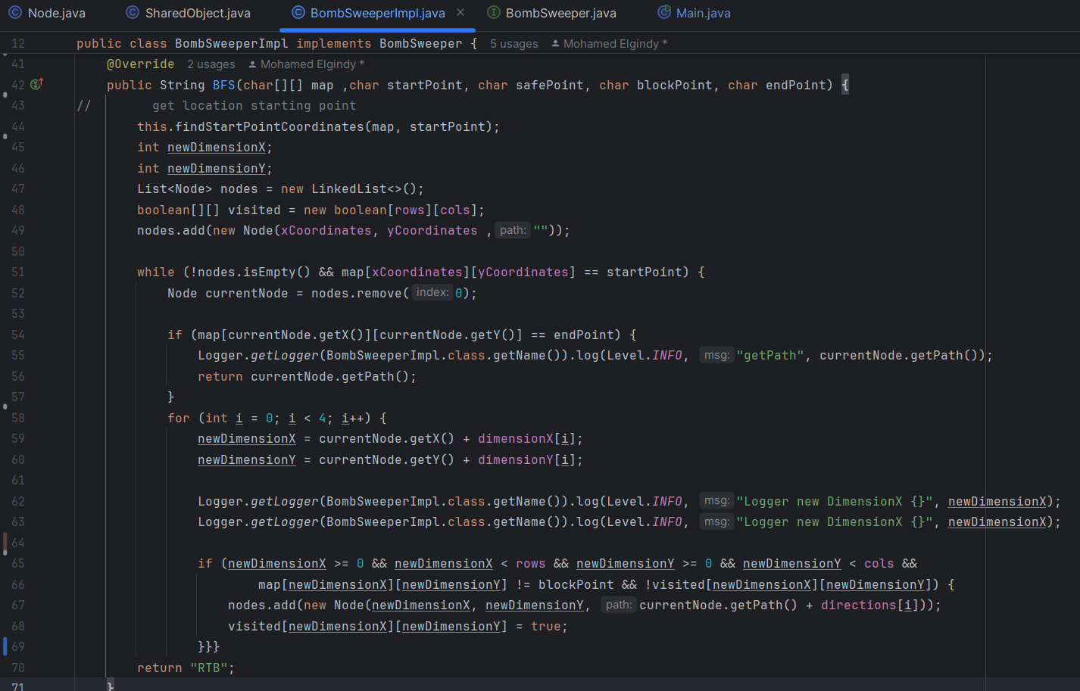
JAVA - Bomb sweeper Code

Slide 6
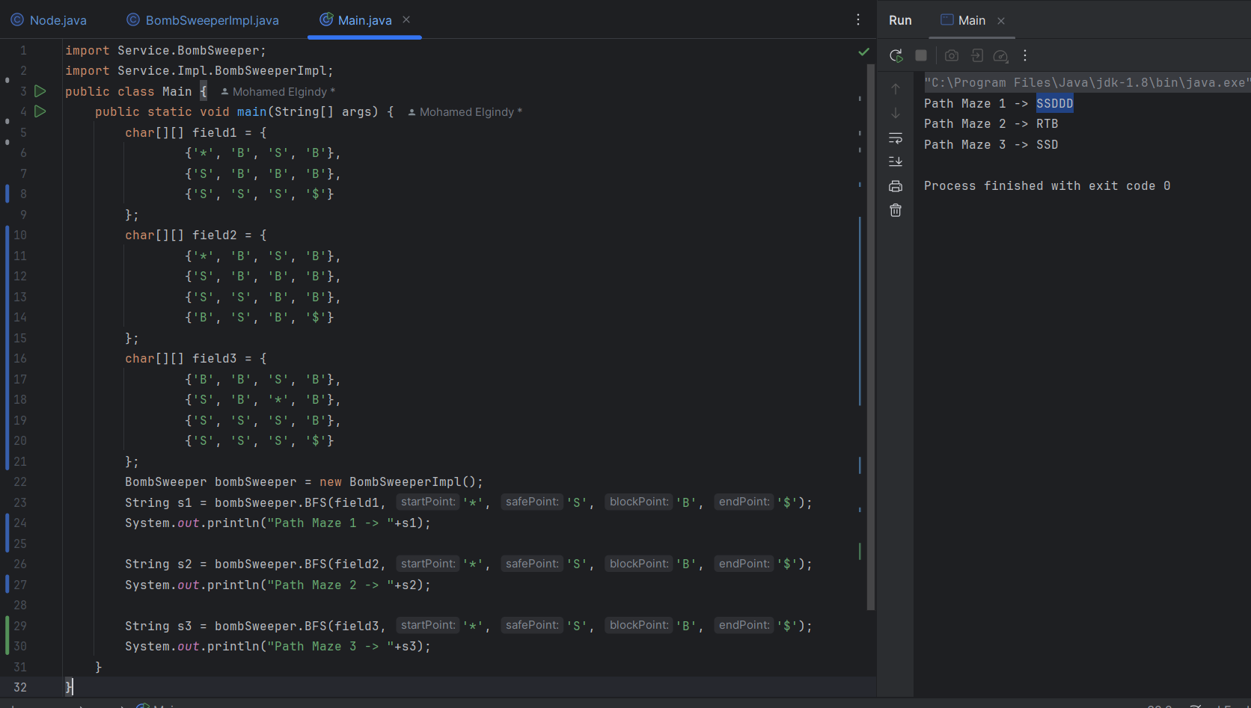
JAVA - Bomb sweeper Code

Slide 7
JAVA - Order the unordered Algorithm
5 % 8 R 1 = z
158
Rz
* + 4 - - , 5
45
8 W 5 * 2 _ A
258
AW
4 _ 7 & _ 4 *
447
The Idea of this task on regex
1- Remove special character and store it in new string.
2- Remove character from string and store it in new string.
3- Remove number from string and store it in new string.
4- Store characters and numbers in list then sort lists.
5- Extract characters and numbers from lists.

Slide 8
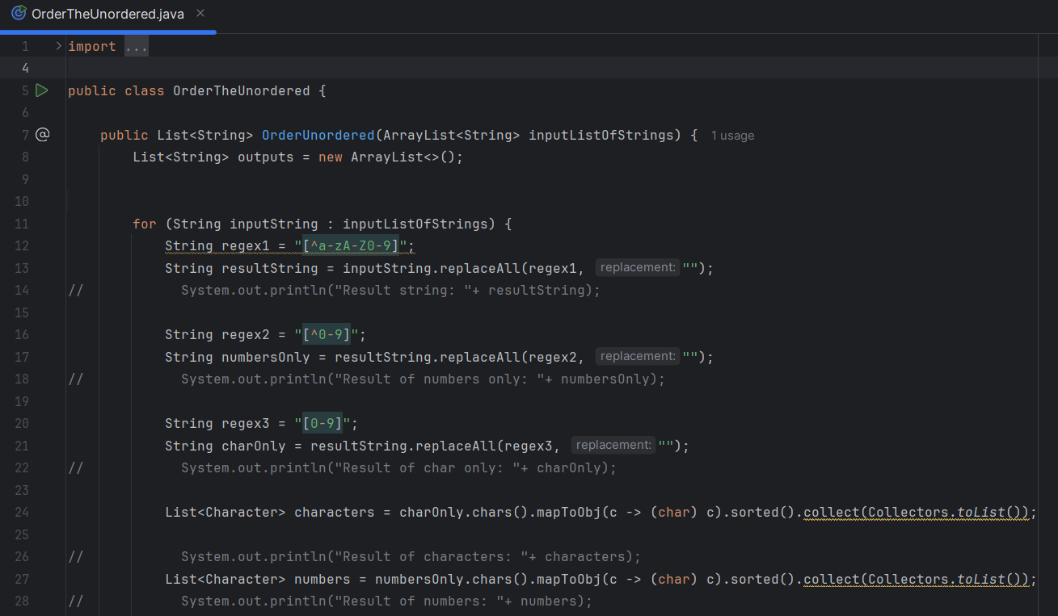
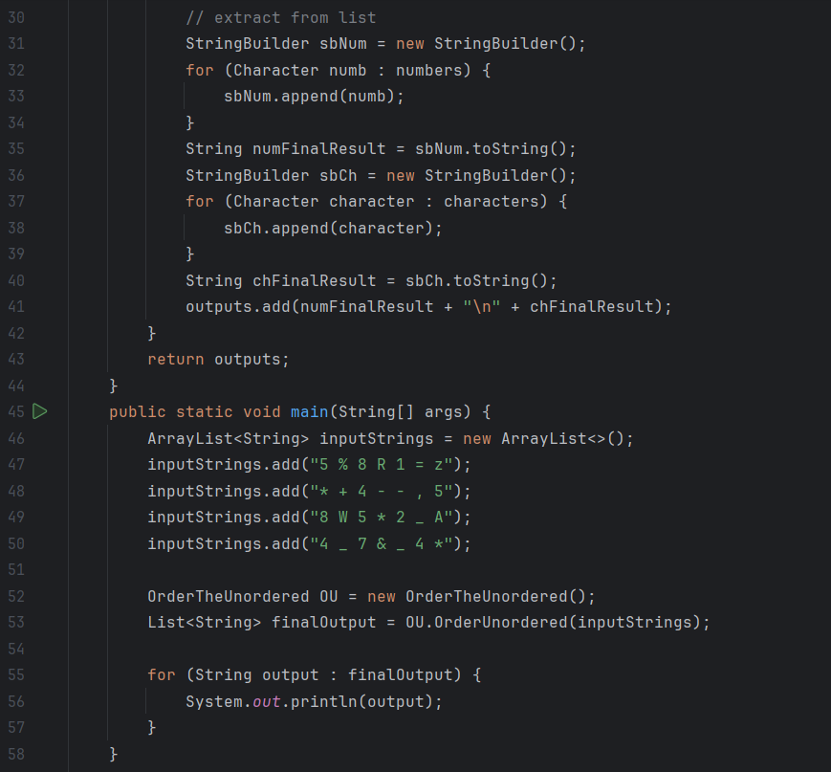
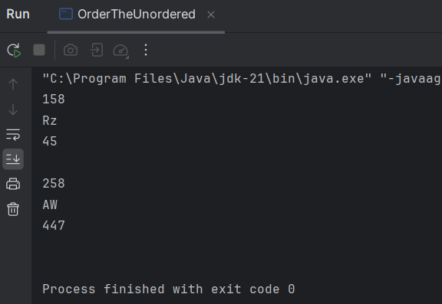
JAVA - Order the unordered Code

Slide 9
JAVA - Lost in parentheses Algorithm
The Idea of this task on difference open and close Parentheses is equals to zero.
1- Iterate for string to check parentheses.
2- Increase open parentheses.
3- Decrease closed parentheses.
4- Check difference is equals to zero.
false
false
true
true
true
(((()))()()((())))))
)()()()()()()()
()()()()
(((()()())))()
()

Slide 10
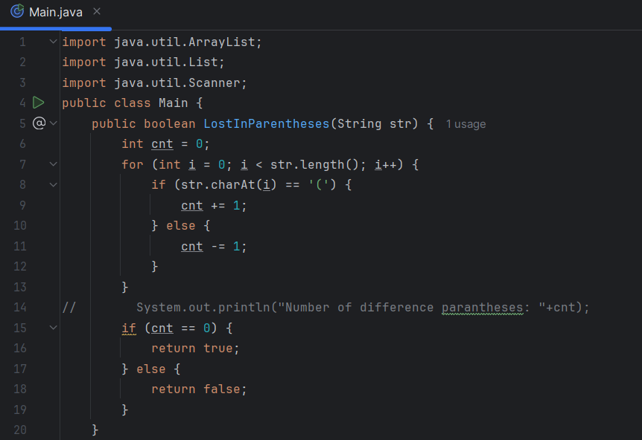
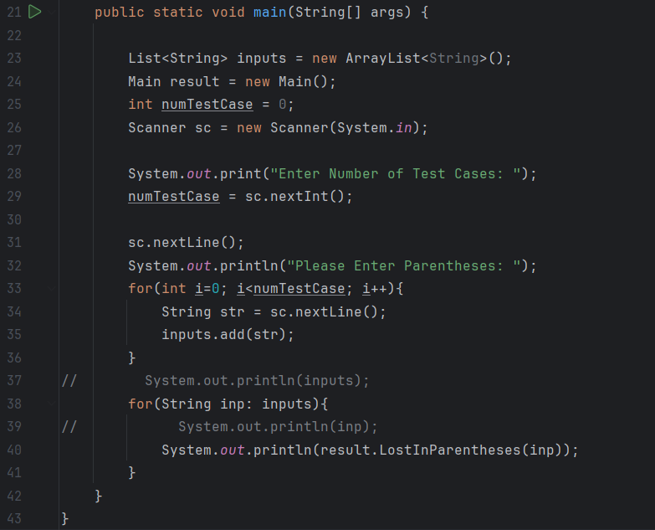
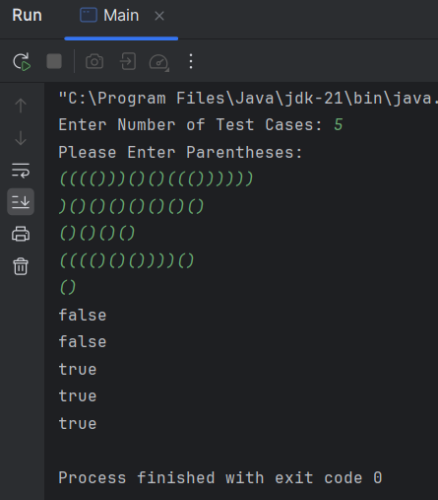
JAVA - Lost in parentheses code

Slide 11
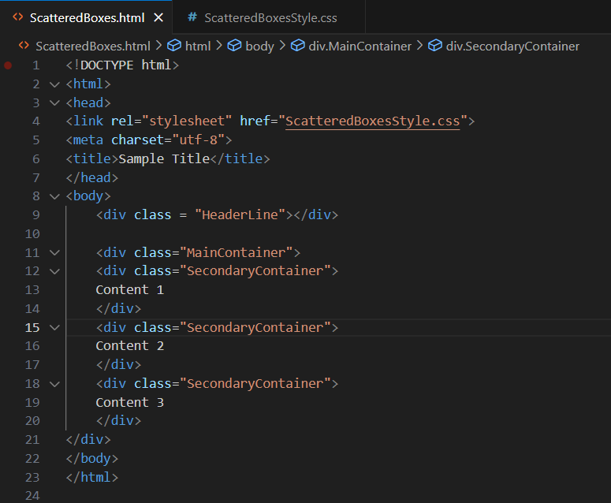
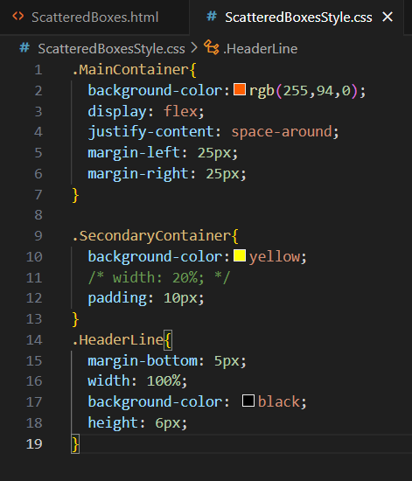
CSS - Scattered Boxes

Slide 12
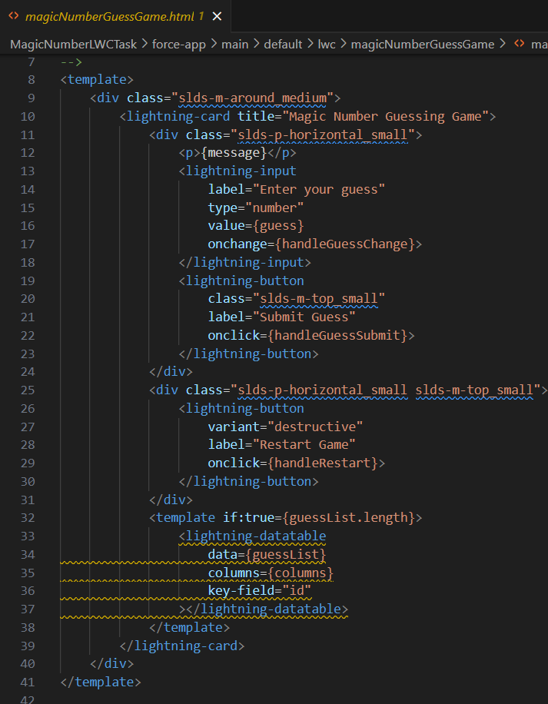
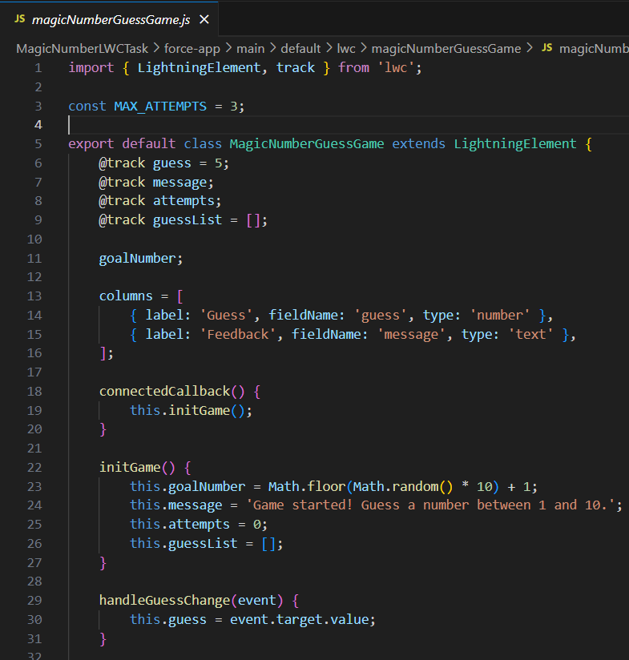
LWC – randomizer Code

Slide 13
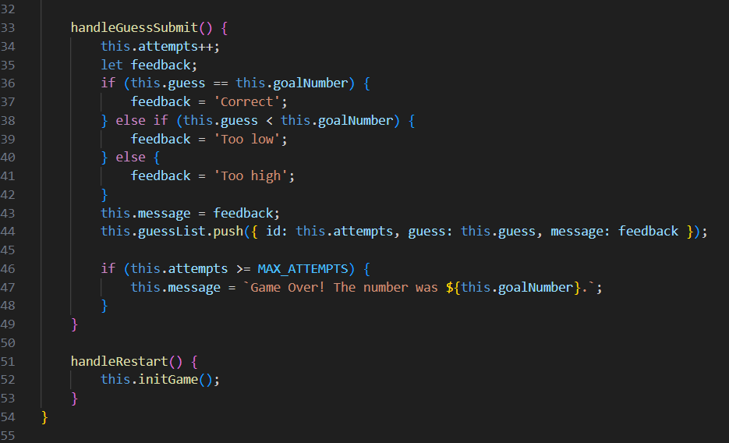
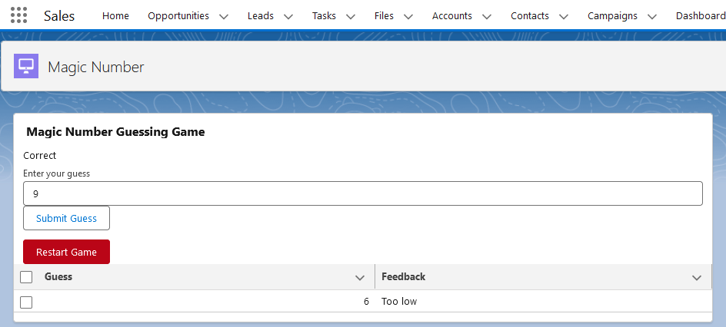
LWC – randomizer Code

Slide 14
Thank You

