Slide 1
Mask Detection

Slide 2
Mask detection
Dataset : images divided by 2 groups
- with_mask file have 690 images
- without_mask file have 686 images

Slide 3
Tools and Libraries
Tools : Jupyter Notebook
Important Libraries :
tensorflow-keras
Sklearn
Numpy
Sklearn
Opencv
Python
Argparse
imutils

Slide 4
Models: I used pre-trained models are :
MobilNetV2 Classifier (CNN Model)
ResNet-10
Model caffemode
mask_detector.model

Slide 5
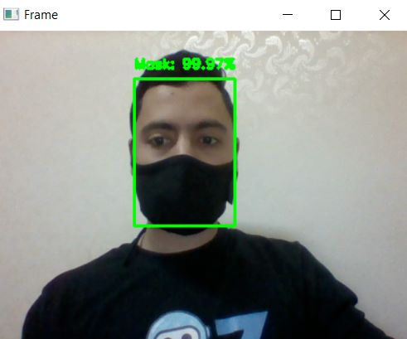
Deployment
Case 1 : model detect mask (correct)

Slide 6
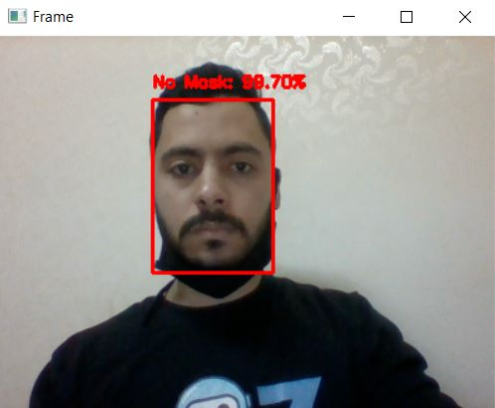
Case 2 : model detect without mask

