Slide 1
Computer Architecture

Slide 2
Recommended Books
Text Books:
Computer System Architecture by Morris Mano 3rd Edition
Reference Books:
Computer Organization & Architecture by William Stallings
Structured Computer Organization by Andrew S. Tanenbaum

Slide 3
E-mail:
abdul.khaliq@pucit.edu.pk

Slide 5
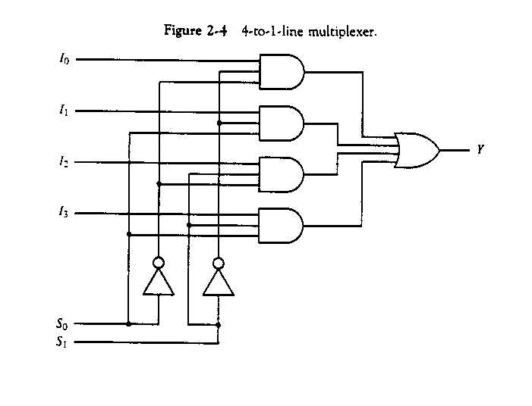
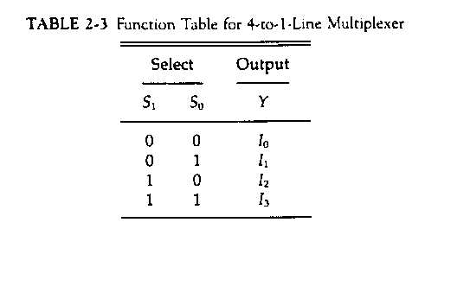
Function of Multiplexers

Slide 6
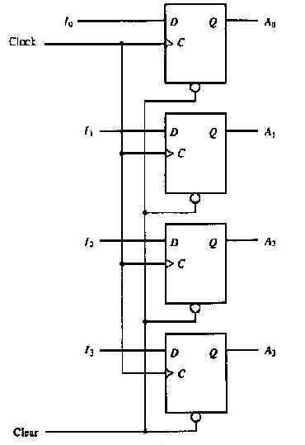
Registers

Slide 7
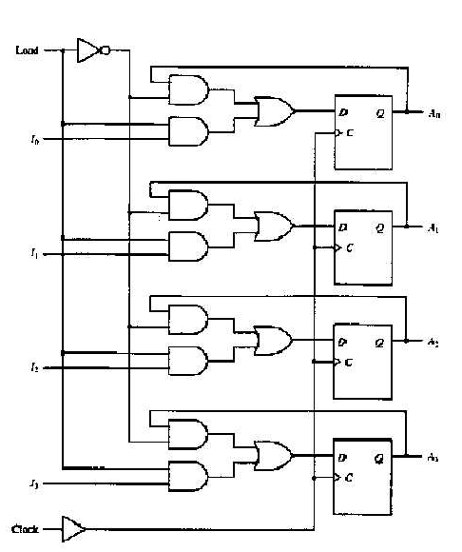
Registers with Load input

Slide 8
Memory Transfer Operations
A memory read operation has the following stages:
  The address is sent to the memory system
  The memory system produces the word stored in the specified location
  The memory word is read back into the digital system.
In most digital systems:
  A special register called the address register (AR) holds the address during the memory operation.
  A special register called the data register (DR) holds the data before or after the operation.

Slide 9
Read: M(AR) DR
1 0 1 ……… 1
bit 0
0
1
2
3
4
2^{n}-1
bit 1
Read
0 …………...…0 0 0 0 0
Address decoder
bit n - 1
0 1 2 m - 1
AR
CPU
DR
1 0 1 ………. 1

Slide 10
Write: DR M(AR)
bit 0
0
1
2
3
4
2^{n}-1
bit 1
Write
0 …………...…0 0 1 0 0
1 0 1 ……… 1
Address decoder
bit n - 1
0 1 2 m - 1
AR
CPU
DR
1 0 1 ………. 1

Slide 11
Memory Transfer in RTL
In RTL, a memory transfer is represented in a manner similar to a simple register transfer, except that the source or destination is replaced by M[AR].
Read: DR ← M[AR]
Write: M[AR] ← DR
  M[AR] means “the memory location whose address is in the address register AR”.

Slide 12
Bus Transfer Operations
How do we connect all of the registers in the Microprocessor to each other?
  Separate connection paths?
    Too many wires.
  Common bus scheme.
    This is the most often used technique to reduce the number of connections needed.
What is a bus?
  A bus consists of a set of common wires that are accessed by multiple modules or sub-systems.
  And, a mechanism to control who is allowed to use it.

Slide 13
Bus Control
To allow the multiple modules to access the bus without interfering with each other, some mechanism is required to control when and who uses the bus.
  One common way of controlling access to the bus from several registers is by utilizing a set of multiplexers.

Slide 14
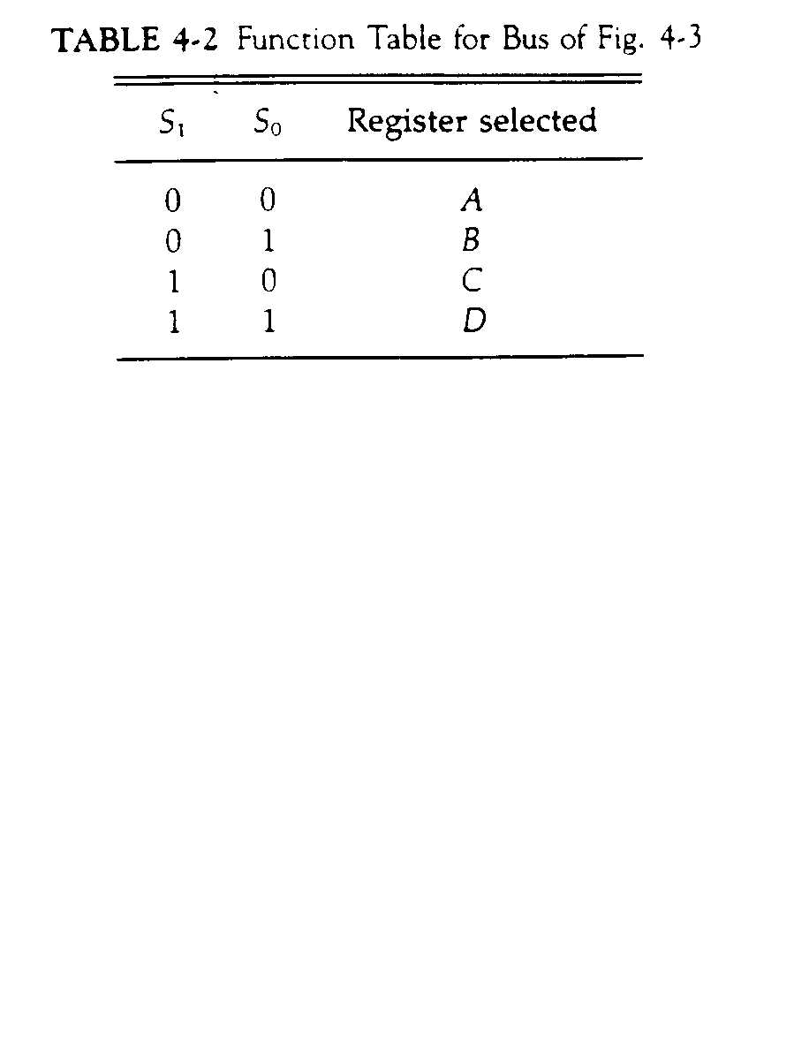
Controlling access to the bus

Slide 15
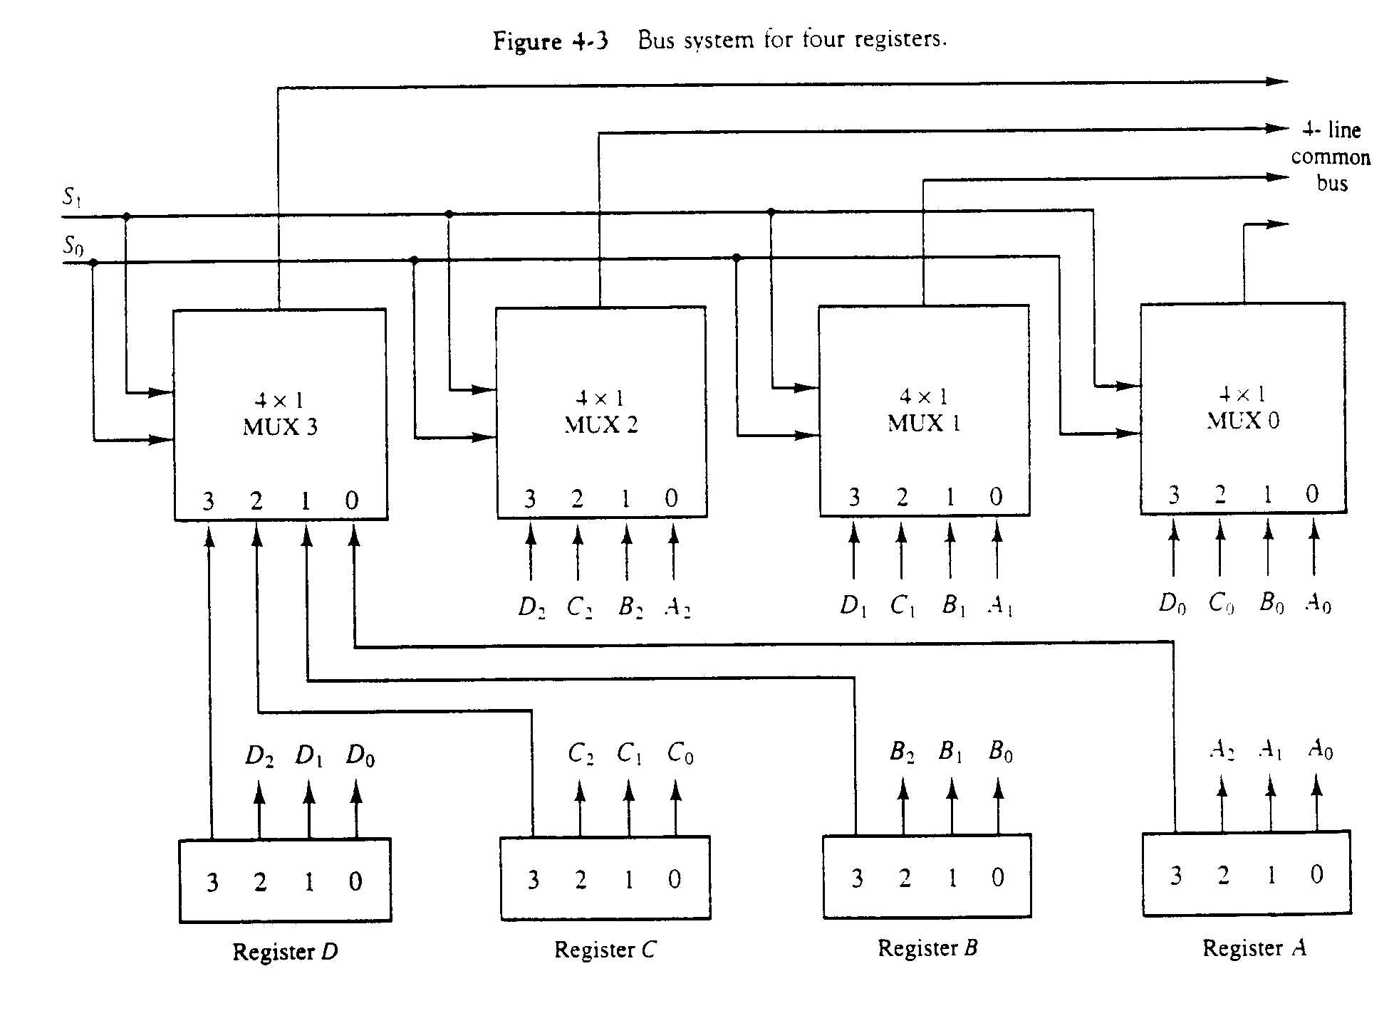
BUS Transfer Control

Slide 16
Each line of common Bus is associated with one bit of a register.
The selection lines choose the four bits of one register and transfer them into the four line common bus
(Size of Register) = (Number of MUX used)
(Number of Registers) = (Size of MUX used)

Slide 17
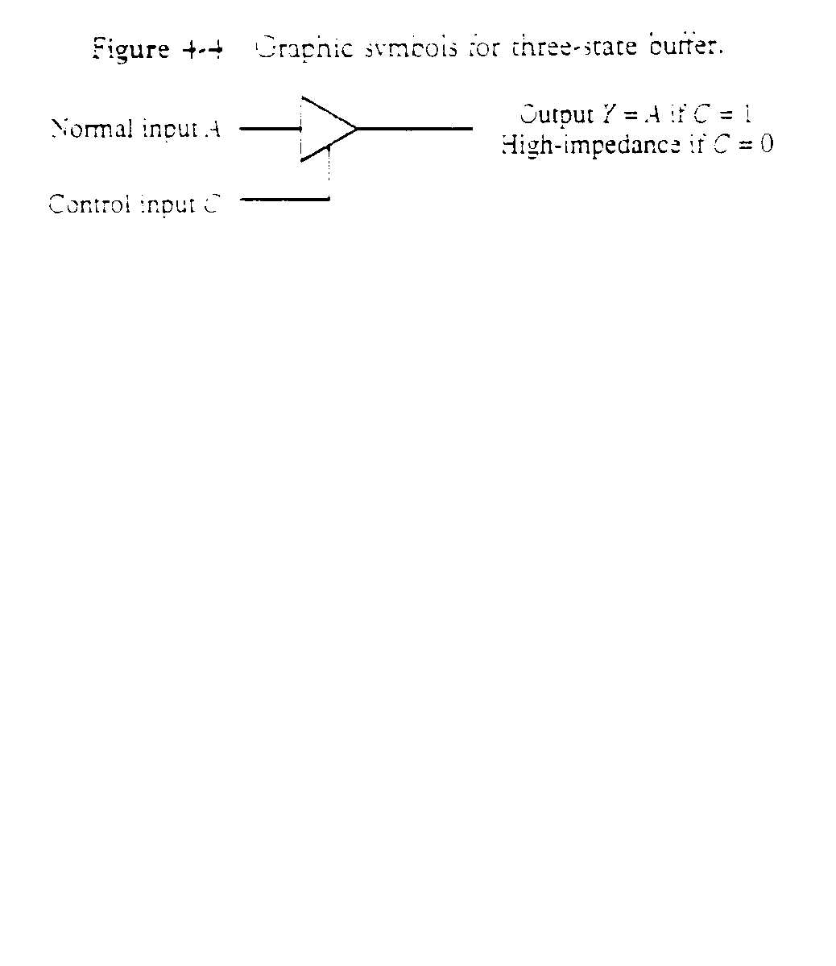
Tri – State Buffer
Two of the states are signals equivalent to logic 1 & 0 as in a conventional gate.
The third is a high impedance state which is like an open circuit i.e. the output is disconnected.

Slide 18
Controlling access to the bus
A bus system can be constructed with three-state gates instead of MUXs.
Tri-state buffers are used to isolate the bus from the modules not using it.

Slide 19
Alternative of MUX in common bus
Common
Wire
A0
2 to 4
Decoder
Control
Unit
0
S0
1
2
B0
S1
3
C0
D0

Slide 20
(Number of registers) = (number of tri-stat buffer in a buffer-unit)
(Size of register) = (number of buffer-unit)

Slide 21
Controlling access to the bus
The transfer of information from a bus into one of the many destination registers can be accomplished by connecting the bus lines to the inputs of all destination registers and activating the load control of the particular destination register selected.

Slide 22
Bus Transfer Representation
The operations executed on data stored in registers are called microoperations
A transfer involving the bus can be designated in one of three ways:
  R1 ← BUS, BUS ← C
  OR
  R1 ← BUS ← C
  OR
  R1 ← C

Slide 23
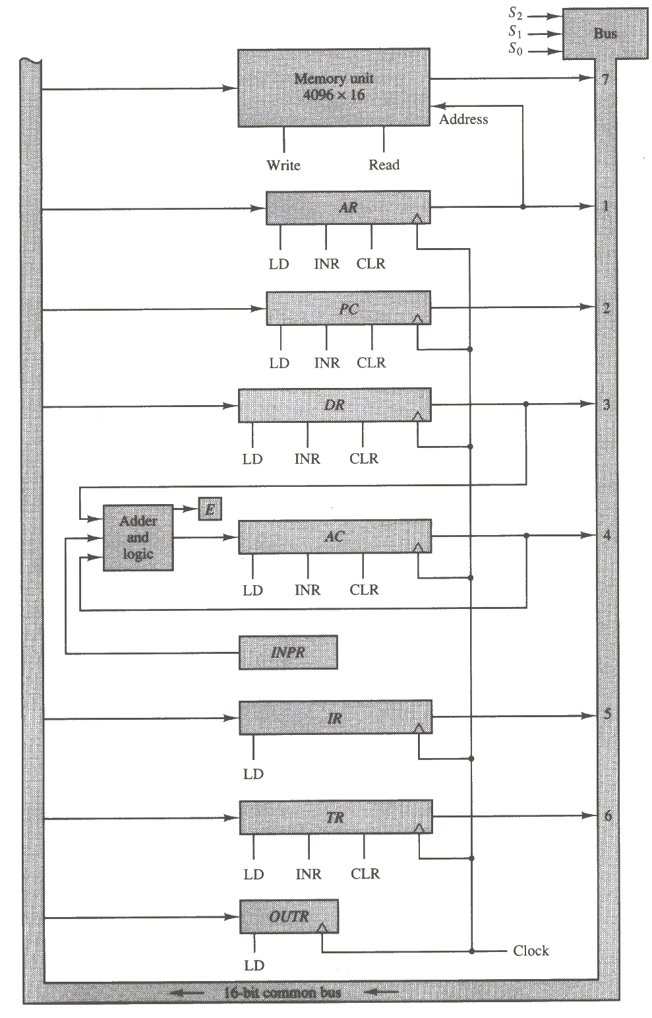
Common Bus
The best way to connect so many different entities is through a common bus system.
The picture on the right shows a depiction of such a system.
  All of the registers (and memory) are connected directly to the bus.
  The bus control mechanism (upper right corner) determines who gets write access to the bus.
    This control mechanism gets its signals from the control unit.
  Also, notice that some connections are direct and not through the bus.
    There is no connection between the input register or the ALU and the bus.

