Slide 1
Boolean and Comparison Instructions
Chapter - 7

Slide 2
Boolean and Comparison Instructions
  AND, OR, XOR, NOT, NEG, TEST
  CMP

Slide 3
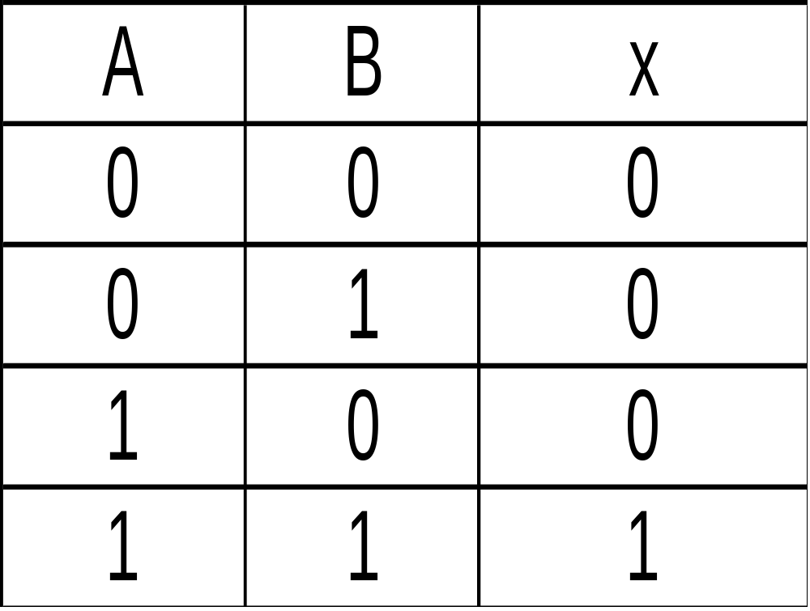

Boolean AND Operation
Truth table showing the results of ANDing individual bits:
A
x
x
B

Slide 4
AND Instruction
Each bit in the result is created by ANDing each of the input bits in the same positions:
op-1: 1 1 0 1 0 0 1 1
op-2: 0 1 0 0 1 1 0 1
result: 0 1 0 0 0 0 0 1
Permitted operands are:
and reg,reg and mem,reg
and reg,mem and mem,immed
and reg,immed
Segment registers cannot be used as operands.

Slide 5
AND Instruction
Performs a boolean AND operation between each of the corresponding bits in two operands and places the result in the first operand:
target
source
and ax,bx
and var1,edx
and bl,var2
and dx,02FAh
and al,00001111b

Slide 6
AND Instruction
.model small
.stack
.data
msg1 db ‘enter a letter :', '$ '
msg2 db 0dh,0ah, "equivalent is :"
msg3 db ?, '$'
.code
main proc
mov ax, @data
mov ds,ax
mov ah,9
mov dx,offset msg1
int 21h
mov ah,1
int 21h
and al,0df h
mov msg3,al
mov ah,9
mov dx,offset msg2
int 21h
mov ax,4c00h
int 21h
main endp
end main
a 01100001 = 97
df h 11011111
result: 01000001 = 65=“A”

Slide 7
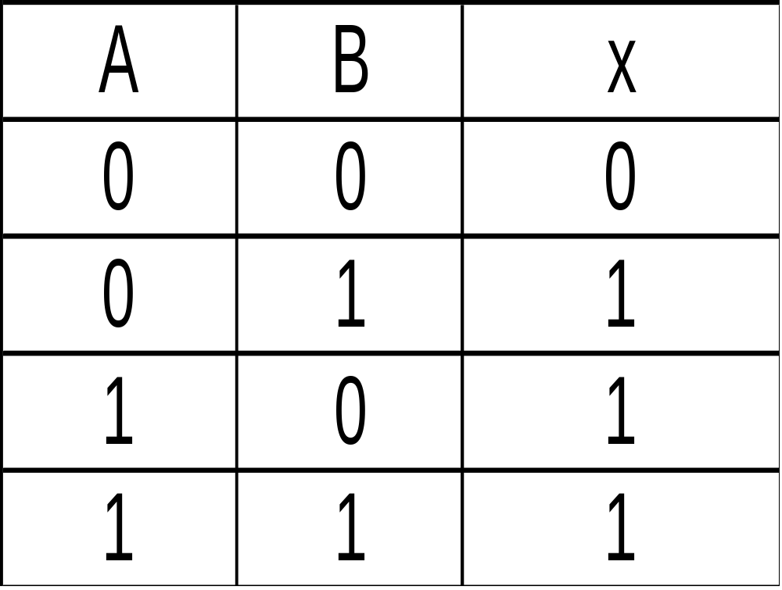

Boolean OR Operation
Truth table, showing the results of ORing individual bits:
A
bit-1
bit-1
x
B
x

Slide 8
OR Instruction
Each bit in the result is created by ORing each of the input bits in the same positions:
op-1: 1 1 0 1 0 0 1 1
op-2: 0 1 0 0 1 1 0 1
result: 1 1 0 1 1 1 1 1
Permitted operands are:
or reg,reg or mem,reg
or reg,mem or mem,immed
or reg,immed
Segment registers cannot be used as operands.

Slide 9
OR Instruction
Performs a boolean OR operation between each of the corresponding bits in two operands and places the result in the first operand:
target
source
or ax,bx
or var1,edx
or bl,var2
or dx,02FAh
or al,00001111b

Slide 10
OR Instruction Example
OR instruction can be used to convert a single decimal digit to its ASCII code by setting bits 4 and 5.
e.g., we can convert digit 5 to its ASCII code 35h (by Oring 5 with 30h)
Binary value:00000101 (05h)
boolean OR :00110000 (30h)
result :00110101 (35h)
mov al,5
or al,30h

Slide 11
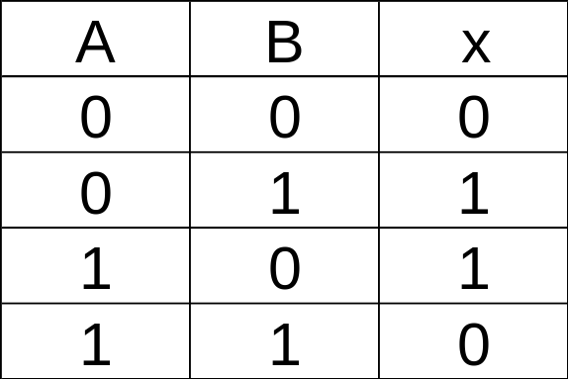

Boolean XOR Operation
The following is a truth table, showing the results of XORing individual bits:
A
bit-1
x
B

Slide 12
XOR Instruction
Each bit in the result is created by XORing each of the input bits in the same positions:
op-1: 1 1 0 1 0 0 1 1
op-2: 0 1 0 0 1 1 0 1
result: 1 0 0 1 1 1 1 0
(XOR yields a 1 only when the two input bits are different.) Permitted operands are:
xor reg,reg xor mem,reg
xor reg,mem xor mem,immed
xor reg,immed
Segment registers cannot be used as operands.

Slide 13
XOR Instruction
XORing any bit with 1 toggles (inverts) the bit:
mov al,10110011b
xor al,11111111b
;Result:AL = 01001100b
XORing any bit with 0 leaves the bit unchanged:
mov al,10110011b
xor al,00000000b
;Result:AL = 10110011b

Slide 14
XOR Instruction Example
Suppose it is reqired that lower 5 bits of register AL must be inverted while upper 3 remain same.
This can be achieved by XORing Register AL with value 1F h (0001 1111)
mov al,01010101b
xor al,00011111b
;Result:AL = 01001010b
(AL can be restored by XORing again with same value)
xor al,00011111b
;Result:AL = 01010101b

Slide 15

NOT Instruction
Performs a boolean NOT (inversion) operation on each of the bits in the operand. (1’s Complement)
Following operands are permitted:
Not reg
Not mem
Segment registers cannot be used.
mov bh,11001101b
not bh ; bh = 00110010

Slide 16
NEG Instruction
Converts the operand to its 2’s complement. Following operands are permitted:
neg reg
neg mem
Segment registers cannot be used.
mov bl,00000001 b
neg bl ; bl = 11111111
mov ah,11001101 b
neg ah ; ah = 00110011
mov al,-128
neg al ; al = 80h, OF=1

Slide 17
TEST Instruction
Performs an implied AND operation between corresponding bits in the two operands. Only the flags are affected. Following operands are permitted:
test reg,reg test mem,reg
test reg,mem test mem,immed
test reg,immed
Segment registers cannot be used.
mov bl,00000001b
test bl,00000001b ; ZF = 0
mov ah,11001101b
test ah,00110010b ; ZF = 1

Slide 18
TEST Instruction
Example: Jump to some other instruction if register AL contains an even number.
test al,1
jz next
.
.
next:

Slide 19
CMP Instruction
Performs an implied subtraction of the source operand from the target operand. Only the flags are affected.
target
source
mov ax,5
cmp ax,5 ; ax = 5 CF=0, ZF=1
cmp ax,7 ; ax < 7 CF=1, ZF=0
cmp ax,3 ; ax > 3 CF=0, ZF=0
test reg,reg test mem,reg
test reg,mem test mem,immed
test reg,immed
Segment registers cannot be used.

Slide 20
Using the CMP Instruction
Label1:
mov al,5
cmp al,10 ; CF=1, ZF=0
Label2:
mov ax,1000
mov cx,1000
cmp cx,ax ; CF=0, ZF=1
Label3:
mov si,105
cmp si,0 ; CF=0, ZF=0

Slide 21
  Instructions Summary
Operation
Description
AND
Result is 1 only when both input bits are 1.
OR
Result is 1 when either input bit is 1.
XOR
Result is 1 only when the input bits are different (called
exclusive-OR).
NOT
Result is the reverse of the input bit (in other words, 1 becomes
0, and 0 becomes 1).
NEG
Convert a number to its twos complement.
TEST
Perform an implied AND operation on the destination operand,
setting the flags appropriately.
CMP
Compare two operands, setting the flags appropriately.

