Slide 1
Instruction Formats
Memory and Branch Instructions.
  Direct/Indirect addressing (1-bit for flag).
  12 bit address field.
  7 instructions, 3 bits are needed for the opcode.
  16-bit instruction.
  All instructions will be 16-bits.
15
14
12
11
0
I
OPCODE
ADDRESS

Slide 2
Register Reference Instructions.
  Can use all 16-bits for opcode.
  However, must clearly distinguish these instructions from memory reference.
    Use a unique prefix for register reference instruction.
      The opcode combination 1 1 1 is unused in memory reference instructions.
      Use it with a 0 in the Direct/Indirect field to identify register reference instructions.
15
11
0
0 1 1 1
OPERATION

Slide 3
Input/Output and Interrupt instructions.
  No possibility to provide port number in the instruction.
  Can use all 16-bits of the instruction to specify the opcode.
  However, must clearly distinguish these instructions from memory and register reference.
    Use the combination 1 1 1 for the opcode with a 1 in the Direct/Indirect field.
    These instructions will all begin with an F.
15
11
0
1 1 1 1
OPERATION

Slide 4
Memory and Branch Instructions
15
11
0
`
I
OPCODE
ADDRESS
Operation | Direct | Indirect
AND | 0xxx | 8xxx
ADD | 1xxx | 9xxx
LDA | 2xxx | Axxx
STA | 3xxx | Bxxx
BUN | 4xxx | Cxxx
BSA | 5xxx | Dxxx
ISZ | 6xxx | Exxx

Slide 5
Register Reference Instructions
We will use a different bit in the operation field to signify the different instructions.
  This will greatly simplify the instruction decoding scheme.
Operations | OPCODE
CLA | 7800
CLE | 7400
CMA | 7200
CME | 7100
CIR | 7080
CIL | 7040
INC | 7020
SPA | 7010
SNA | 7008
SZA | 7004
SZE | 7002
HLT | 7001
15
11
0
0 1 1 1
OPERATION

Slide 6
I/O Instructions
We will use a different bit in the operation field to signify the different instructions.
  This will greatly simplify the instruction decoding scheme.
Operations | OPCODE
INP | F800
OUT | F400
SKI | F200
SKO | F100
ION | F080
IOF | F040
15
11
0
1 1 1 1
OPERATION

Slide 7
Design of Control Unit
The Hardwired Implementation

Slide 8
Control Unit Design
It can be seen very easily that the Instruction register is central to the operation of the Control Unit.
  Instructions read from memory are stored in IR
  The contents of IR are decoded to determine what operations are to be executed next.
The control unit can be thought of as the IR surrounded by several decoders.

Slide 9
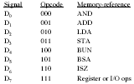
Decoding the instruction
IR
15
14
13
12
11 - 0
3 to 8 Decoder
Control
Logic
7
6
5
4
3
2
1
0
I
Control
Signals

Slide 10
Decoding the instruction
In our instruction format design, the instruction is decoded in the following steps:
  Decode bits 12 – 14 of the instruction.
    If they are equal to 7, the instruction is “non-memory”
      If bit 15 is 0, then register transfer, look at bits 0 – 11 to determine the operation.
      Else, the input/output operation, look at bits 0 – 11 for the operation.
    Else, the instruction is “memory”
      If bit 15 is 0, then direct memory reference, bits 0 – 11 contain the effective address
      Else, indirect memory reference, bits 0 – 11 contain the address of the memory location containing the effective address

Slide 11
Timing Signals
Each instruction is made up of several micro-operations that need to be executed in sequence.
  A mechanism is needed to allow the sequencing of these operations,this requires timing signals.
  The solution is a “sequence counter”. This along with the decoder provides the timing signals.
    Similar to the program counter. Except that it sequences at the micro-operation level within the instruction.
  How large?
    Depends on the complexity of the instructions.
    Needs to generate enough combinations to allow sequencing the most complex instruction.

Slide 12
Sequencing the execution
IR
15
14
13
12
11 - 0
3 to 8 Decoder
7
6
5
4
3
2
1
0
D0
Control
Logic
I
D7
Control
Signals
T15
T0
15
14
2
1
0
4 to 16 Decoder
4-bit
Sequence
Counter
Increment
Clear

Slide 13
The Sequence Counter
In our example we will use a 4-bit sequence counter.
  It will generate 16 different combinations allowing a maximum of 16 different micro-operations within an instruction.
  This counter is automatically incremented at the end of each micro-operation.
  The last micro-operation of the instruction will reset the counter to 0 to initiate the execution of the next instruction.
  The counter’s output will be decoded and fed into the control logic.

Slide 14
The Sequence Counter
As an example consider the case where SC is incremented to provide timing signals T0,T1,T2, T3 and T4 in sequence. At time T4, SC is cleared to 0 if decoder output D3 is active. This is expressed as:
D3T4: SC 0
The timing diagram on next slide shows the time relationship of the control signals

Slide 15
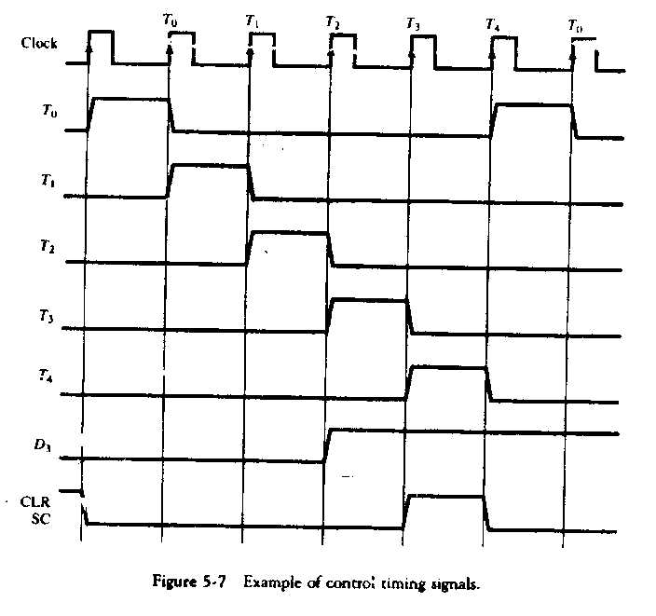

Slide 16
Initially the CLR input of SC is
active. The first positive transition
of the clock clears SC to 0, which in
turn activates the timing signal T0
out of the decoder. T0 is active during one clock cycle.
The positive clock transition labeled T0 in the diagram will trigger only those registers whose control inputs are connected to the timing signal T0.
SC is incremented every positive clock transition unless its CLR input is active. This produces the sequence of timing signals T0, T1, T2, T3, T4 and so on.

Slide 17
The last three waveforms show
how SC is cleared when D3T4=1
When timing signal T4 becomes active the output of the AND
Gate that implements the control function D3T4 becomes active.
This is applied to the CLR input of the SC.

