Slide 1
Instruction Cycle
The instruction execution cycle for our example consists of the following four steps:
  Fetch an instruction from memory
  Decode the instruction
  Read the effective address from memory if the instruction has an indirect address
  Execute the instruction.
  Go back to 1.

Slide 2
Fetching the instruction
Only AR is connected to the Address pins
  The instruction address (in PC) must be moved to AR at the beginning of each fetch cycle.
A memory read operation is then executed, and the PC is incremented at the same time.
The micro-operations that make up the fetch cycle are:
T0: AR ← PC
T1: IR ← M[AR], PC ← PC + 1

Slide 3
Fetching the instruction
T0: AR ← PC
The timing signal T0 is to be used to provide the following:
Place content of PC on bus S2S1S0=010
Transfer content of the bus to AR by enabling LD input of AR

Slide 4
Fetching the instruction
T1: IR ← M[AR], PC ← PC + 1
The timing signal T1 is to be used to provide the following:
Enable the read input of the memory
Place content of memory on bus S2S1S0=111
Transfer content of the bus to IR by enabling LD
Increment PC by enabling the INR input of PC

Slide 5
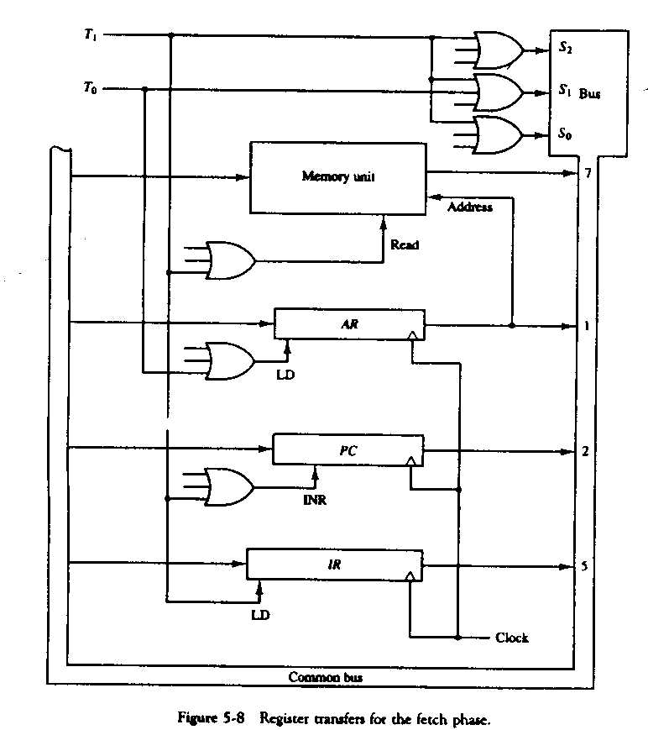

Slide 6
Decoding the Instruction
When cycle T1 is over, the instruction code read from memory is in IR.
  It needs to be decoded to determine what operations are to be done next.
  Bits 12 – 14 of the instruction contain the instruction code.
  Bit 15 is the Direct/Indirect bit
  Bits 0 – 11 May carry the effective address or the operation depending on the type of instruction.
In Micro-operation form, this can be written as:
T2: D0, …, D7 ← Decode IR(14-12), AR ← IR(11-0), I ← IR(15)

Slide 7
The T3 cycle
When T3 starts, the instruction has already been decoded, bits 0 – 11 of the instruction have been copied to the AR in case the instruction is a memory reference instruction.
During T3, the controller determines the type of instruction and branches to one of 4 possibilities:
  Direct Memory Reference
  Indirect Memory Reference
  Register Instruction
  Input/Output Instruction

Slide 8
The Instruction Cycle
Start
SC ← 0
AR ← PC
T0
IR ← M[AR], PC ← PC + 1
T1
Decode
T2
1
D₇
0
1
0
1
0
I
I
T3
T3
T3
T3
AR ← M[AR]
Nothing
Execute
I/O Instruction
SC ← 0
Execute
Register - Reference
SC ← 0
Execute Memory-Reference
SC ← 0

