Slide 1
Execute: Register - Reference Instructions
Looking at the flowchart, the micro-operations for register-reference instructions start executing during T3.
How does the controller know when to execute them?
  D₇ = 1
  I = 0
  T3 = 1
Every micro-operation for register-reference instructions must be prefixed with:
  D₇I’T₃ (Lets call it r for simplicity).

Slide 2
Register-Reference Instructions
Looking back at the instruction formats, we note that bits 0 - 11 of register-reference instructions were used to code the operations.
  One bit was used for each of the 12 operations.
Therefore, the controller can combine the prefix with the appropriate bit from 0 to 11 to determine if the particular instruction is being executed.
  The bits are in the IR after fetch and decode.
CLA can be recognized by:
  rB₁₁ (Where B₁₁ means bit 11 of IR)

Slide 3
Register-Reference Instructions
The following table gives the conditions for each of the register-reference instructions.
Inst.
Cond
Operations
Meaning
CLA 7800
rB
11
AC
←
0
Clear AC
CLE 7400
rB
10
E
←
0
Clear E
CMA 7200
rB
9
AC
←
AC
Complement AC
CME 7100
rB
8
E
←
E
Complement E
CIR 7080
rB
7
AC
←
shr
AC, AC(
15
)
←
E, E
←
AC(
0
)
Circulate Right
CIL 7040
rB
6
AC
←
shl
AC, E
←
AC(
15
), AC(
0
)
←
E
Circulate Lef
t
INC 7020
rB
5
AC
←
AC +
1
Increment AC
SPA 7010
rB
4
If (AC(
15
) =
0
) then PC
←
PC +
1
Skip if positive
SNA 7008
rB
3
If (AC(
15
) =
1
) then PC
←
PC +
1
Skip if negative
SZA 7004
rB
2
If (AC =
0
) then PC
←
PC +
1
Skip if AC is
0
SZE 7001
rB
1
If (E =
0
) then PC
←
PC +
1
Skip if
E is
0

Slide 4
Register-Reference Instructions
It is clear that all operations can be done in one clock cycle.
  Therefore, SC ← 0 can also be executed during T3 of register-reference instructions.
  Or,
  r: SC ← 0

Slide 5
Memory-Reference Instructions
In order to understand these instructions, lets look at the functions they implement:
Inst.
Operations
Meaning
AND
D
0
AC
←
AC
∧
M[AR]
And memory word to AC
ADD
D
1
AC
←
AC + M[AR], E
←
Cout
Add memory word to AC
LDA
D
2
AC
←
M[AR]
Load AC from memory
STA
D
3
M[AR]
←
AC
Store AC in memory
BUN
D
4
PC
←
AR
Branch Unconditional
BSA
D
5
M[AR]
←
AC, PC
←
AR +
1
Branch and Save return Address
ISZ
D
6
M[AR]
←
M[AR] +
1
,
Increment memory word, skip
If (M[AR] +
1
=
0
) then PC
←
PC +
1
next Instruction if result is
0

Slide 6
Memory-Reference Instructions
It is clear that some of these instructions cannot be implemented in one step.
  The data bus is not connected to the inputs of the ALU logic. (Figure 5-4 Page 130)
  These instructions must be executed in multiple steps.
What about Direct vs. Indirect?
  It was taken care of during T3 before the execution began.
  After T3, the address in AR is the effective address.

Slide 7
Memory-Reference Instructions
The previous table should be re-written as:
Inst.
Cond
Operations
AND
D
0
T
4
DR
←
M[AR]
D
0
T
5
AC
←
AC
∧
DR, SC
←
0
ADD
D
1
T
4
DR
←
M[AR]
D
1
T
5
AC
←
AC + DR, E
←
Cout
, SC
←
0
LDA
D
2
T
4
DR
←
M[AR]
D
2
T
5
AC
←
DR, SC
←
0
STA
D
3
T
4
M[AR]
←
AC, SC
←
0
BUN
D
4
T
4
PC
←
AR, SC
←
0
BSA
D
5
T
4
M[AR]
←
PC, AR
←
AR +
1
D
5
T
5
PC
←
AR, SC
←
0
ISZ
D
6
T
4
DR
←
M[AR]
D
6
T
5
DR
←
DR +
1
D
6
T
6
M[AR]
←
DR, If (DR =
0
) then PC
←
PC +
1
, SC
←
0

Slide 8
Input Output Instructions
Looking at the flowchart, the micro-operations for input & output-reference instructions start executing during T3.
How does the controller know when to execute them?
  D₇ = 1
  I = 1
  T3 = 1
Every micro-operation for InputOutput-reference instructions must be prefixed with:
  D₇IT₃ (Lets call it p for simplicity).

Slide 9
Input Output Instructions
Looking back at the instruction formats, we note that bits 0 - 11 of I/O-reference instructions were used to code the operations.
  One bit was used for each of the 6 operations.
Therefore, the controller can combine the prefix with the appropriate bit from 0 to 11 to determine if the particular instruction is being executed.
  The bits are in the IR after fetch and decode.
INP can be recognized by:
  pB₁₁ (Where B₁₁ means bit 11 of IR)

Slide 10
Input Output Instructions
The following table gives the conditions for each of the register reference Instruction
Inst. cond. Operation Meaning
INP pB11: AC(0-7)← INPR, FGI← 0 Input Character.
OUT pB10: OUTR← AC(0-7), FGO← 0 Output Character.
SKI pB9: If (FGI = 1) then (PC ← PC+1 ) Skip on input flag.
SKO pB8: If (FGO = 1) then (PC ← PC+1 ) Skip on output flag .
ION pB7: IEN← 1 Interrupt enable on.
IOF pB6: IEN← 0 Interrupt enable off.

Slide 11
Input Output Instructions
It is clear that all operations can be done in one clock cycle.
  Therefore, SC ← 0 can also be executed during T3 of I/O reference instructions.
  Or,
  p: SC ← 0

Slide 12
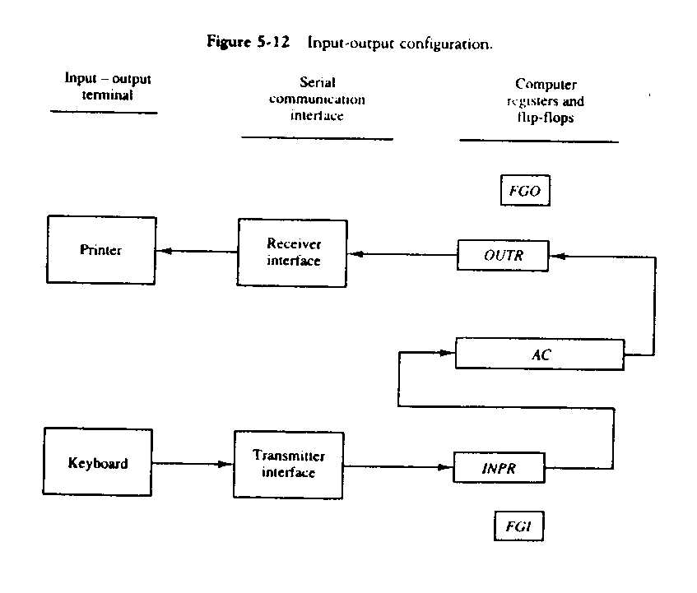
How I/O operation are performed ?

Slide 13
“INTERFACES between CPU & I/O Devices”
Special Hardware Components used between the two devices to supervise & synchronize all inputs & outputs transfers.e.g
Interfaces between Computer & Peripherals ,Which have following differences:-
Peripherals are electromagnetic & electro mechanical where as CPU is electronic device.
Data transfer rate of peripherals is slower than transfer rate of CPU.
Data Code & Formats in Peripherals differ from Word format in CPU.

Slide 14
Input Output Configuration
We are going to consider two I/O devices i.e Keyboard , Printer. Also, we have two Registers of size 8 bits. having ASCII Code of 8 bits for Alphanumeric) called INPR & OUTR. There are two control flip-flop used as flag.i.e FGI & FGO.

Slide 15
Input Output Configuration
First the flag FGI is set to ‘1’,and information can be transferred from INPR to AC (parallel) .Then, FGI is set to ‘0’.So ,Keyboard transfer data to INPR.
In this way ,the timing rate difference between the input device & the computer can be synchronized.

Slide 16
Input Output Configuration
First the flag FGI is set to ‘1’,and information can be transferred from AC to OUTR(parallel) .Then, FGI is set to ‘0’.So,OUTR transfer data to Printer.
In this way ,the timing rate difference between the output device & the computer can be synchronized
.

Slide 17
Execute I/O when D7 IT3 =1
Start
SC ← 0
AR ← PC
T0
IR ← M[AR], PC ← PC + 1
T1
Decode
T2
1
D₇
0
1
0
1
0
I
I
T3
T3
T3
T3
AR ← M[AR]
Nothing
Execute
I/O Instruction
SC ← 0
Execute
Register - Reference
SC ← 0
Execute Memory-Reference
SC ← 0

Slide 18
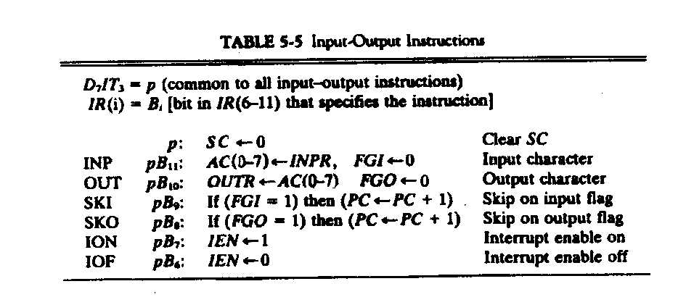
I/O Instructions

Slide 19
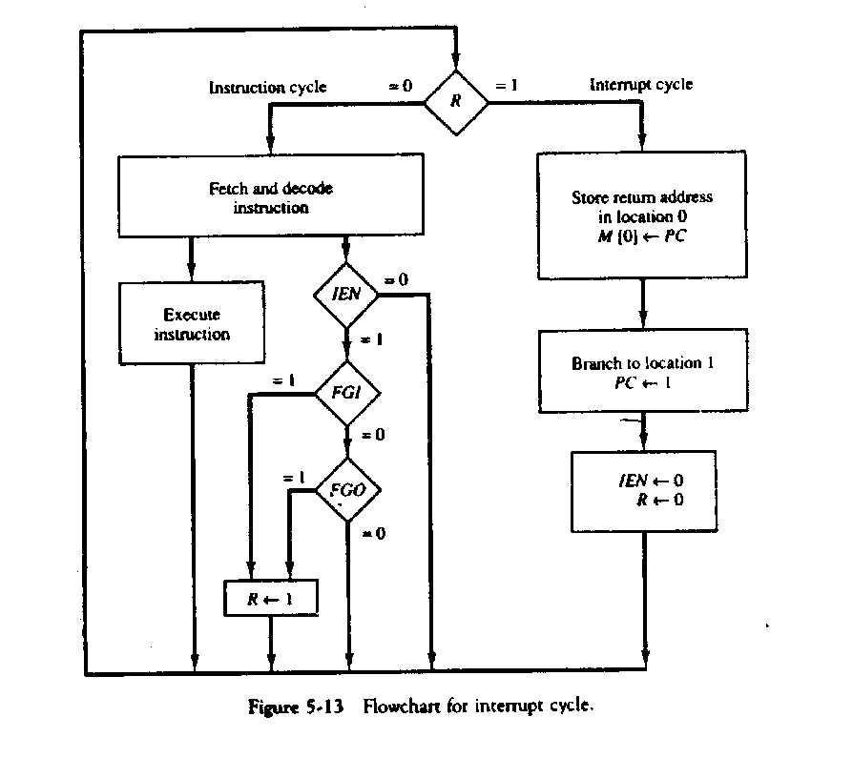
The condition for setting flip-flop R to ‘1’ is a register transfer statement:
T0’ T1’T2’ (IEN)(FGI +FGO): R ← 1

Slide 20
How Interrupt is handled?
An Interrupt flip flop R is included.
When R= 0, Instruction Cycle & at R= 1, Interrupt Cycle.
When R=0 i.e in instruction cycle .
IEN is checked .
If IEN=0 ,No interrupt concept.Keep on going to Instruction Cycle.
If IEN=1 ,so interrupt can occur.Check the two flag bits,i.e FGI & FGO.

Slide 21
How Interrupt is handled--
If both flags are ‘0’I.e neither the input nor the output registers are ready to transfer data(to & from AC).
If either flag is set to ‘1’.Then Interrupt flip flop ‘R’ is set to ‘1’.Hence,the control enter into the Interrupt Cycle instead of Instruction Cycle.
While dealing any interrupt in an interrupt cycle,IEN & R are set to ‘0’.So that only one interrupt can be handle at one time.

Slide 22
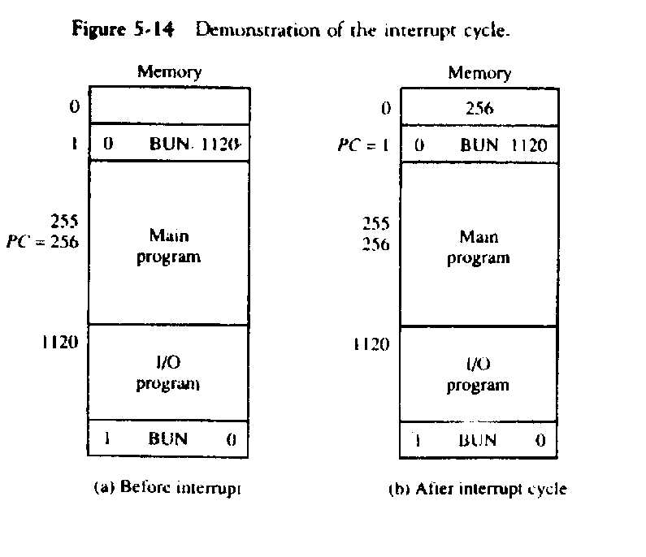
Interrupt Cycle (Example)
Sequence of micro-operations in Interrupt Cycle.
RT0: AR ← 0, TR ← PC
RT1: M[AR] ←TR, PC ← 0
RT2: PC ←PC+1, IEN ← 0, R ← 0,SC ← 0,

Slide 23
.
The control cycle is actually a hardware implementation of a branch & return save address.
When interrupt occur (at any instruction in the instruction cycle).then the address of next instruction(stored in PC) is moved in a specific location.This location may be a register,a memory stack od a specific memory location.

Slide 24
.
Now to handle the interrupt,the address of the BUN instruction is stored in PC .Actually this BUN instruction takes the control towards I/O service Program area.Where Interrupt is handle.
Then ,there is again a BUN instruction which brings back the control to the address,where it was interrupted.

