Slide 1
Control Unit Design(Hardwired)
Control Logic gates.

Slide 2
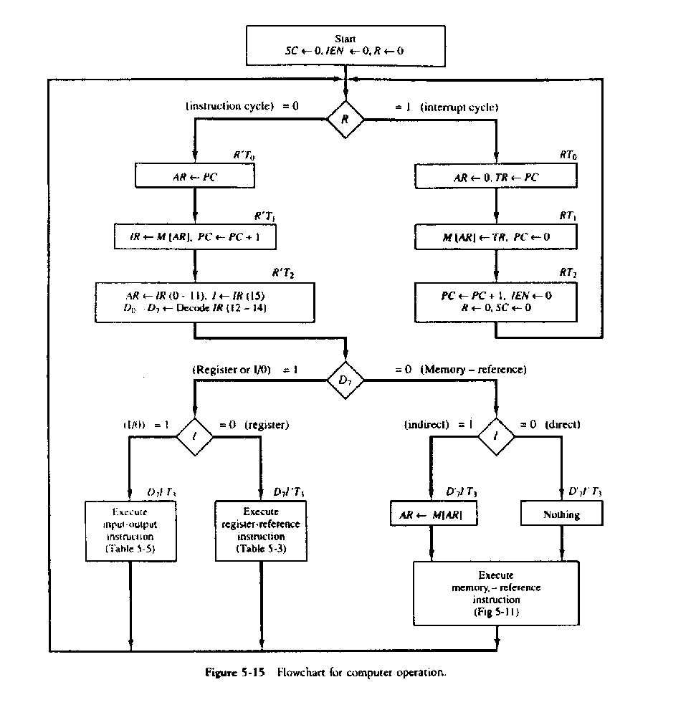
Complete Computer Operation

Slide 3
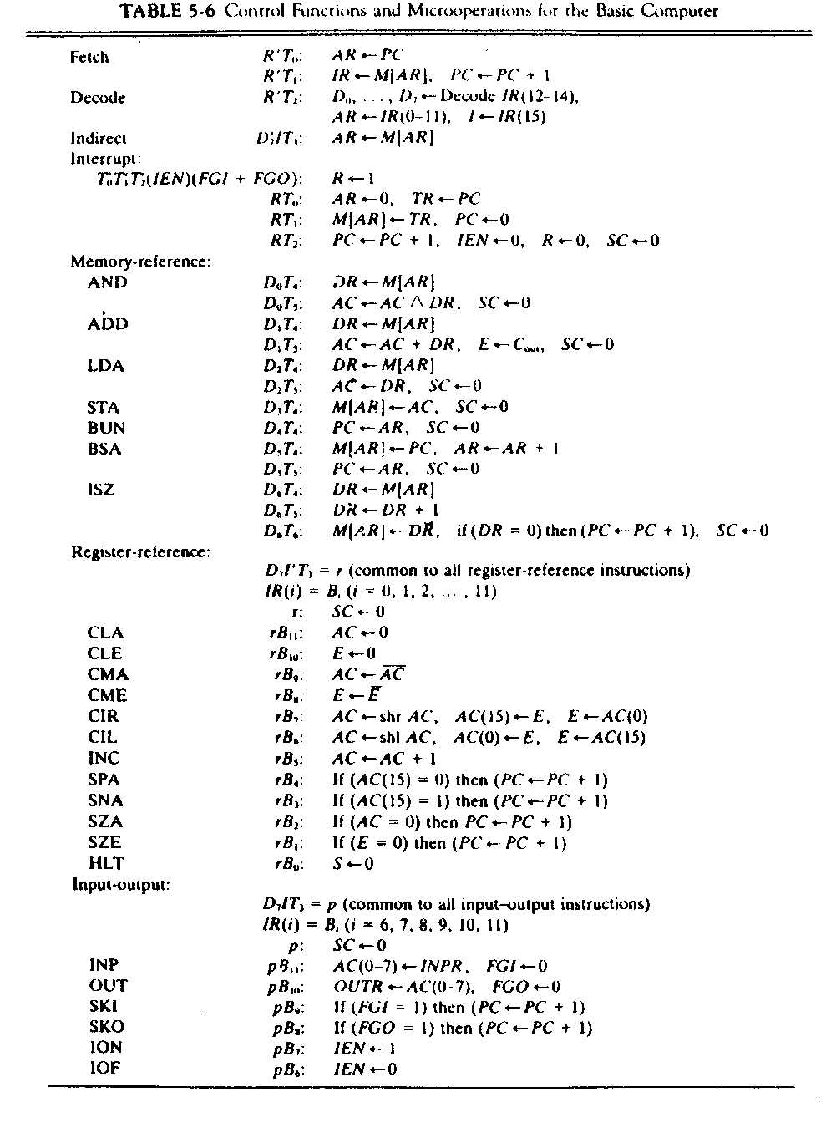

Slide 4
Design of Basic Computer
The basic computer consist of the following hardware components:-
1)A memory unit with 4096 words of 16-bit each.
2)NineRegisters:AR,PC,DR,AC,IR,TR,INPR,OUTR & SC
3)Seven Flipflops:I,S,E,IEN,FGI,FGO,R.
4)Two Decoders: (3x8) to decode instruction,
(4x16)to generate timing signals.
5)A 16-bit common bus.
6)Control Logic Gates.

Slide 5
Control Unit of Basic Computer
IR
15
14
13
12
11 - 0
3 to 8 Decoder
7
6
5
4
3
2
1
0
D0
Control
Logic
gates
I
D7
Control
output
T15
T0
15
14
2
1
0
4 to 16 Decoder
4-bit
Sequence
Counter
Increment
Clock
Clear

Slide 6
Control Logic Gates
Input of Control logic gates comes from:-
Two Decoders,I Flipflop,bits (0--11) of IR.
Output of Control logic gates are:-
Signals to control the input of nine Registers.
Signals to control the read,write input of Memory.
Signals to set, clear & complement the FlipFlop.
Signals for S2,S1 & S0 to select a register for the bus.

Slide 7
Control of Registers by CLG
Example:AR Register.
    Fetch R’T0 : AR← PC.
    Decode R’T2 : AR← IR(0--11).
    Indirect D7’IT3 : AR← M[AR].
    Interrupt RT0 : AR← 0.
    BSA D5T4 : AR← AR+1.
    LD(AR)=R’T0+R’T2+D7’IT3.
    CLR(AR)=RT0.
    INR(AR)=D5

Slide 8
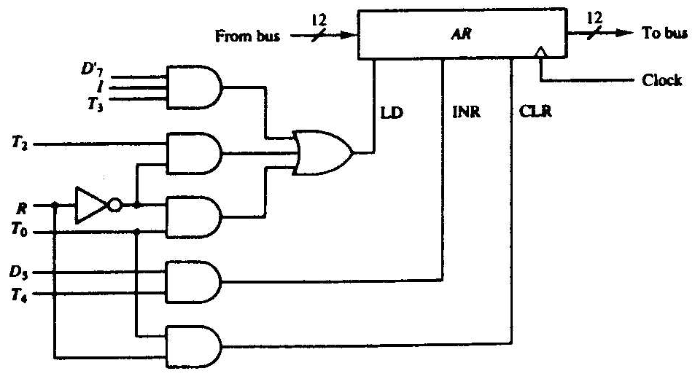
Control gates associated with AR

Slide 9
Control of Memory
Example, Control of Read input of Memory:
    R’T1 :IR←M[AR]
    D7’IT3 :AR←M[AR]
    D0T4:DR←M[AR]
    D1T4:DR←M[AR]
    D2T4:DR←M[AR]
    D6T4:DR←M[AR]
    Read=R’T1+D7’IT3+D0T4+D1T4+D2T4+D6T4.

Slide 10
Control of FlipFlop
Example IEN.
    PB7 :IEN←1
    PB6 :IEN←0
    At the end of interrupt cycle IEN is set to 0 i.e
    RT2 :IEN←0

Slide 11
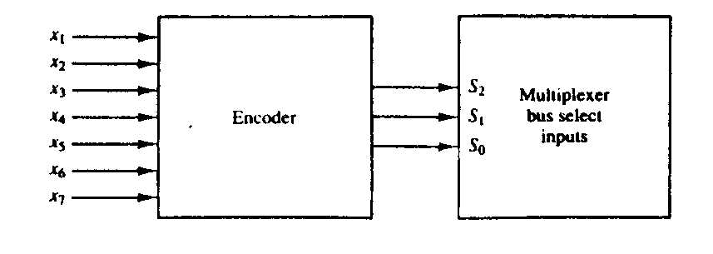
Bus Selection Logic

Slide 12
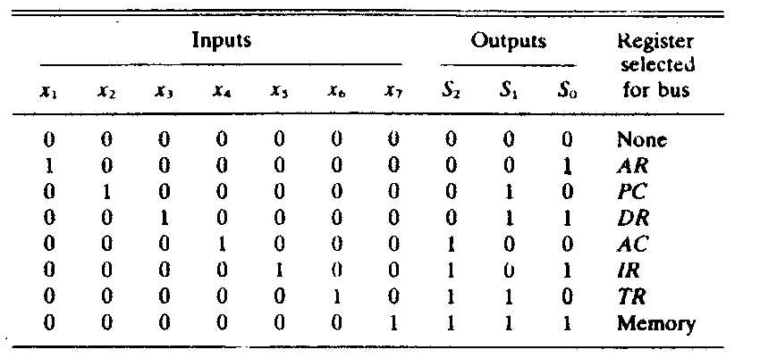
Bus Selection Logic

