Slide 1
Computer Organization and Assembly Language
Abdul Khaliq [Assistant Professor, PUCIT]
  PhD. (CS) in progress at PUCIT, University of the Punjab Lahore
  MPhil. (CS) PUCIT, University of the Punjab Lahore.
  M.Sc (CS) Comp.Sc.Dept, University of the Punjab Lahore.
  PGD (CS) Comp.Sc.Dept, University of the Punjab Lahore.
  M.Sc (Physics) , Govt. College Lahore.

Slide 2
Course Objectives
Course Outlines
Grading (Marks Division)
Text Book
  “Assembly Language Programming and Organization of the IBM PC ” by Ytha Yu and Charles Marut.

Slide 3
Computer Organization
Computer Components:
  CPU/ Microprocessor
  Memory/RAM
  Storage Devices
  Input/Output Devices
  I/O Interfaces/Modules
  Buses/ports/expansion/slots

Slide 4
Microprocessor
Control Unit
Arithmetic Logic Unit
Registers
  Fetch execution cycle

Slide 5
Memory
Number of Locations
Size of each Location (data or contents)
Address
Read and Write Operations

Slide 6
Read: M(MAR) MDR
1 0 1 ……… 1
bit 0
0
1
2
3
4
2^{n}-1
bit 1
Read
0 …………...…0 0 0 0 0
Address decoder
bit n - 1
0 1 2 m - 1
MAR
CPU
MDR
1 0 1 ………. 1
Computer Organization & Progrmming by Abduil Khaliq

Slide 7
Write: MDR M(MAR)
bit 0
0
1
2
3
4
2^{n}-1
bit 1
Write
0 …………...…0 0 1 0 0
1 0 1 ……… 1
Address decoder
bit n - 1
0 1 2 m - 1
MAR
CPU
MDR
1 0 1 ………. 1
Computer Organization & Progrmming by Abduil Khaliq

Slide 8
Storage Devices
Hard Disk
Compact Disks (CD)
Tape Drive
……..Access Method
….(Random\Sequential\Direct)
Memory Hierarchy
  (Storage Capacity and Speed)
  Registers, cache, RAM, disks

Slide 9
Input Output Devices
Devices for Human interaction with this Machine (Computer)
    Input/Output devices
      Working principle, construction and working
      Data Format and Data Rate

Slide 10
Input Output Devices
Device Input/Output Data Rate (Kbytes/s)
Keyboard Input 0.01
Mouse Input 0.02
Voice input (microphone) Input 0.02
Scanner Input 200
Dot-matrix printer Output 1
Laser printer Output 100
Graphics display Output 30,000
Local area network Input/output 200 – 20,000
Optical disk Storage (I/O) 500
Magnetic tape Storage (I/O) 2,000
Magnetic disk Storage (I/O) 2,000

Slide 11
IO Modules/Interfaces
I/O devices cannot be interfaced directly to CPU or Memory
Due to reasons like:
Peripherals are electromechanical and electromagnetic, whereas CPU is electronic.
Data transfer rate is different
I/O modules are required to cope for these incompatibilities

Slide 12
Buses
Data communication inside Computer
Read / Write……..(data) from …..(address)
  Control bus
  Data bus
  Address bus
  Point to Point / Multipoint buses.

Slide 13
Buses
  Internal/system buses and External buses.
External buses/ports:
(Serial,Parallel,PS/2,USB)
connectors for I/O devices
Expansion buses/slots
(ISA,PCI,SIMM,DIMM)
slots for I/O cards, storage devices, Memory
Point to point ,multipoint

Slide 14
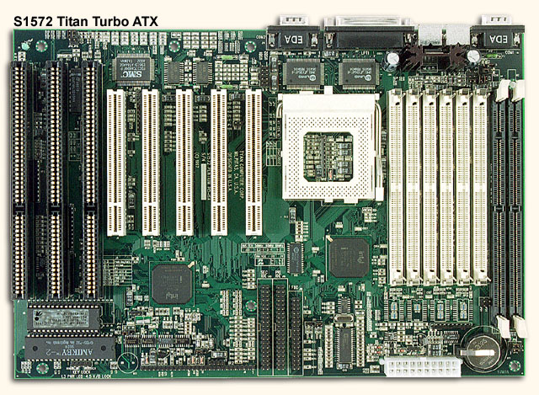
3 ISA
slots
5 PCI slots
Pentium CPU
6 SIMM
slots
2 DIMM slots

Slide 15
Data
Form {Text, Number)
      ASCII
      Binary, octal, decimal, hexadecimal
      Signed/Unsigned Numbers
Storage
Processing (Arithmetic /Logical)
Movement

Slide 16
Software…Systems/w..os..booting
Hardware
Firmware

Slide 17
Structure of Program in Memory
Code
Data
Stack

Slide 18
Intel Microprocessors
1973 8080
1976 8085
1978 8086
1983 80286
1986 80386
1989 80486
1992 Pentium
1995 Pentium Pro
1997 Pentium II
1999 Pentium III
2001 Pentium 4

Slide 19
Each processor detail
  Clock speed
  Address bus ,data bus size
  Register’s size
  Maximum Addressable memory
  Real/Protected mode pf Memory Management

Slide 20
  Others parameters like,
  Singleuser,multitasking,multiprogramming,timesaharing,
Cache
Pipeling
Super scaling
Etc….

Slide 21
Intel Microprocessor 8086/8088
Registers
  General purpose registers
  Address Registers (segment , offset)
  Flag Registers
  Segment-offset Memory model
  Effect on flag register of the execution of instructions.

Slide 22
Debugger (in DOS)
Real Mode

