Slide 1
The Intel Microprocessors
(an Introduction)

Slide 2
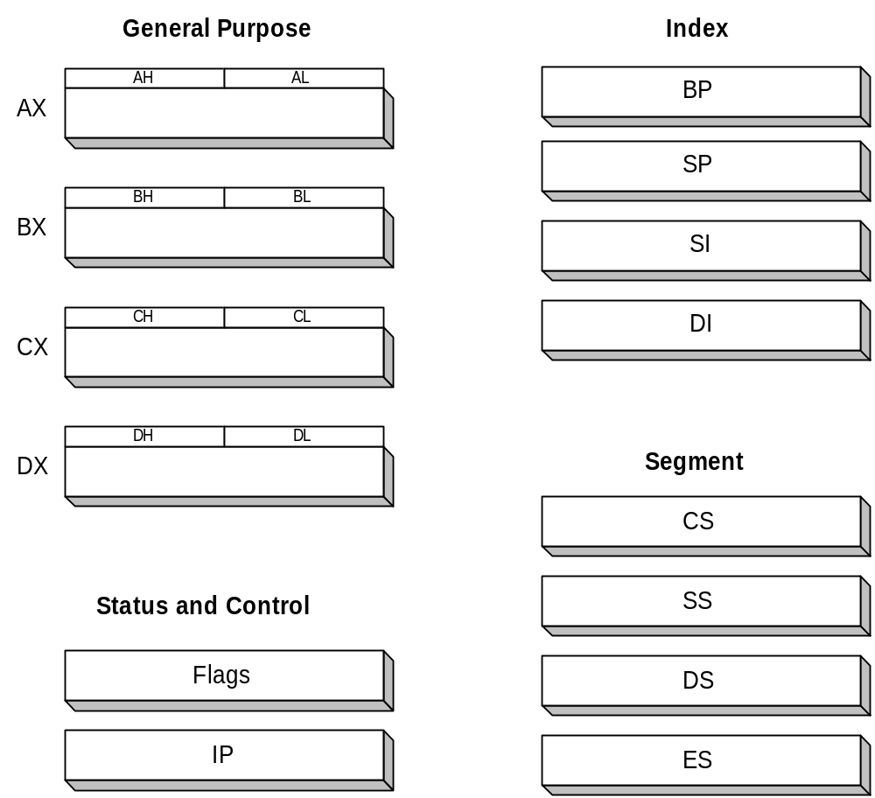
Intel 16-bit Registers (8086~80286)

Slide 3
Intel 16-bit Registers
Data or General Purpose registers
Used for arithmetic calculations and data movement, can be addressed as either 8-bit or 16-bit registers. E.g., AX register is a 16-bit register its upper 8 bits are called AH and Lower 8-bits are called AL.
Instructions can address as 16 bit data registers as AX, BX, CX and DX or 8-bit Registers as AH, AL, BH, BL, CH, CL, DH and DL.
16-bit register modification means modification of both its constituent 8-bit registers.
7----------0
7----------0
AH
AL
CH
CL
AX
CX
15----------------------0
BH
BL
BX
DH
DL
DX

Slide 4
Intel 16-bit Registers
Features of General Purpose Registers
AX (Accumulator Register) is the preferred register to use in arithmetic, logic and data transfer instructions because its use make CPU operations more efficient..
AH
AL
AX
BH
BL
BX (Base Register) can hold the address of a procedure or variable. Three other registers with this ability are SI, DI, BP. The BX register can also perform arithmetic and data movement.
BX
CH
CL
CX (Count Register) acts as counter for repeating or looping instructions
CX
DH
DL
DX (Data Register) commonly used in multiplication and division.
DX
All of these registers can be used for addition and subtraction

Slide 5
Memory Segmentation
As all registers are of 16 bit, so maximum addressable memory is 2 byte or 64 KB.
Intel removed this barrier by combining 2 registers for addressing memory more than 64 KB.
One 16-bit register give the base value and other the offset from the base value.
16

Slide 6
Intel 16-bit Registers
Features of Segment Registers
CS (Code Segment Register) contains the starting address of program’s code segment. This segment address, plus an offset value in the IP register, indicates the address of the instruction to be fetched from memory for execution. For normal programming purpose you need not use reference the CS register.
CS
DS
DS (Data Segment Register) contains the starting address of programs data segment. Instructions use this address to locate data. This address plus an offset value in an instruction, causes a reference to specific byte location in the data segment.
SS
SS (Stack Segment Register) permits the implementation of stack in memory, which a program uses for temporary storage of addresses and data. The system stores the starting address of program's stack segment in SS register. This segment register plus an offset value in the SP register, indicates the current word being addressed in the stack. For normal programming purpose you need not directly reference the SS register.
ES
ES (Extra Segment Register) additional base location for memory

Slide 7
Intel 16-bit Registers
Features of Index Registers
SP (Stack Pointer Register) indicates the complete address of top stack when combines with SS Register
SP
BP
BP (Base Pointer Register) is used primarily to access data on the stack. However unlike SP, we can also use BP to access data other than stack segment.
SI
SI (Source Index Register) used for string instructions in conjunction with DS register to point the source string.
DI
DI (Destination Index Register) acts as the destination for string movement instructions (used along with ES register)

Slide 8
Intel 16-bit Registers
IP (Instruction Pointer register)
IP register always contains the address of next instruction to be executed within the current code segment. The IP and CS registers combine to form the complete address of the next instruction.
Unlike the other registers , the IP cannot be directly manipulated by an instruction , I.e., an instruction may not contain IP as an operand.
IP

Slide 9
Intel 16-bit Registers
Flags
15 14 13 12 11 10 9 8 7 6 5 4 3 2 1 0
The Flag register is the special register with individual bit positions assigned as to show the status of the CPU or the results of the arithmetic operations.
Status Flags:
Reflect the result of an instruction executed by the processor e.g., when a subtraction operation result in 0, the ZF (Zero Flag) is set to 1. A subsequent instruction can examine the ZF and branch to some code.
Control Flags:
The control Flags enable or disable certain operations of the processor e.g., if IF (interrupt Flag) is set to 0, interrupts will be ignored by the processor.

Slide 10
Intel 16-bit Registers
Status
Flags
15 14 13 12 11 10 9 8 7 6 5 4 3 2 1 0
X
X
X
X
O
D
I
T
S
Z
X
A
X
P
X
C
CF: Carry Flag - Sets when result of an unsigned arithmetic is too large to fit into the destination i.e., an invalid result is produced. (sets when carry out from MSB during addition or borrow into the MSB during subtraction)
OF: Overflow Flag - Sets when result of a signed arithmetic produces an in valid result..
SF: Sign Flag - Sets when result of an arithmetic or logic operation generates a negative result.
ZF: Zero Flag - Sets when result of an arithmetic or logic operation generates a zero result.
AF: Auxiliary Carry Flag - Sets when an operation causes a carry from bit 3 to bit 4 (or a borrow from bit 4 to bit 3) of an operand. Less often used.
PF: Parity Flag - Sets when number of “1” bits are even in an operation.

Slide 11
Intel 16-bit Registers
Control
Flags
15 14 13 12 11 10 9 8 7 6 5 4 3 2 1 0
X
X
X
X
O
D
I
T
S
Z
X
A
X
P
X
C
DF: Direction Flag - Selects increment or decrement mode for DI and/or SI registers during execution of string instructions (data transfer in block) “0” for increment and “1” for decrement.
IF: Interrupt Flag - Interrupts are disabled when flag value = 0.
TF: Trap Flag - The flag determines whether or not the CPU enables step by step execution . With this flag is set, a debugging program can execute each program instruction one at a time.

Slide 12
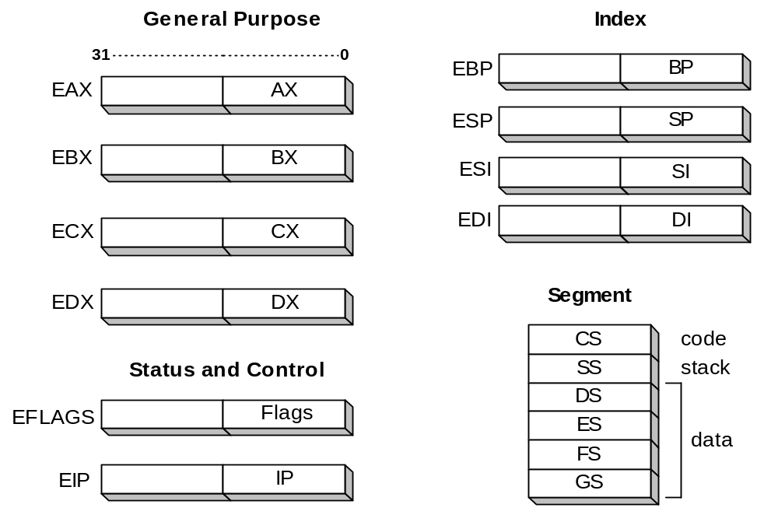
32-bit Register Set (Intel386~Pentium 4)

Slide 13
Segmented Memory Architecture
(real mode)
A segment addresses 64K of memory
A segment register contains the starting location of a segment
  the absolute location of a segment can be obtained by appending a hexadecimal zero
An offset is the distance from the beginning of a segment to a particular instruction or variable

Slide 14
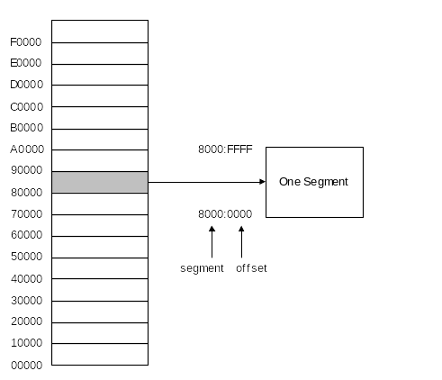
Segmented Memory Architecture

Slide 15
Example Using Index Register
1 MB
EPROM
Logical address (segment/offset)
DS
SI
(unused)
OA16
0005
DRAM
0A165
(X 10h
0A160
00000

Slide 16
DEBUG Examples

Slide 17
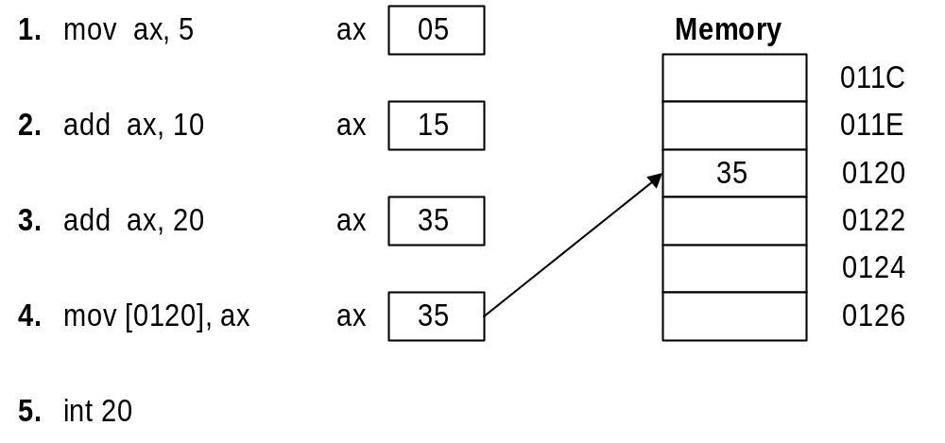
Sample Program Written in Debug.

Slide 18
Running DEBUG.EXE, Assembling a Program
C:\>debug
-A 100
0AFE:0100 mov ax,5
0AFE:0103 add ax,10
0AFE:0106 add ax,20
0AFE:0109 mov [120],ax
0AFE:010C int 20
0AFE:010E
assemble, starting at offset 100
Press ENTER to return to command mode

Slide 19
Tracing the Sample Program.
-T
AX=0005 BX=0000 CX=0000 DX=0000 SP=FFEE BP=0000 SI=0000 DI=0000
DS=0AFE ES=0AFE SS=0AFE CS=0AFE IP=0103 NV UP EI PL NZ NA PO NC
0AFE:0103 051000 ADD AX,0010
-T
AX=0015 BX=0000 CX=0000 DX=0000 SP=FFEE BP=0000 SI=0000 DI=0000
DS=0AFE ES=0AFE SS=0AFE CS=0AFE IP=0106 NV UP EI PL NZ NA PO NC
0AFE:0106 052000 ADD AX,0020
-T
AX=0035 BX=0000 CX=0000 DX=0000 SP=FFEE BP=0000 SI=0000 DI=0000
DS=0AFE ES=0AFE SS=0AFE CS=0AFE IP=0109 NV UP EI PL NZ NA PE NC
0AFE:0109 A32001 MOV [0120],AX

Slide 20
Tracing the Sample Program (2)
MOV [0120],AX
-D 120,121
0AFE:0120 35 00
AX=0035 BX=0000 CX=0000 DX=0000 SP=FFEE BP=0000 SI=0000 DI=0000
DS=0AFE ES=0AFE SS=0AFE CS=0AFE IP=010C NV UP EI PL NZ NA PE NC
0AFE:010C CD20 INT 20
-G
Program terminated normally

Slide 21
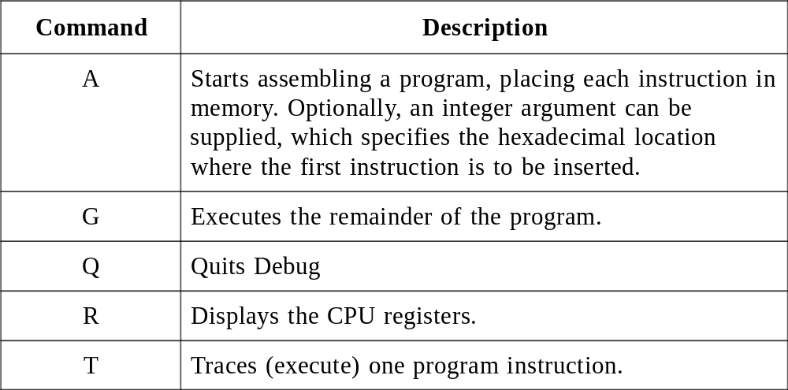
Commonly Used Debug Commands.

Slide 22
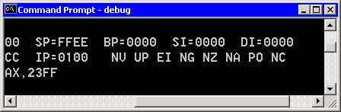
DEBUG Flag Mnemonics
Carry flag: CY=set, NC=clear
Overflow flag: OV=set, NV=clear
Sign flag: NG=set, PL=clear
Zero flag: ZR=set, NZ=clear

Slide 23
Testing the Carry Flag
0100 mov ax,FFFF
0103 add ax,1 ; CY, AX=0000
0106 sub ax,1 ; CY, AX=FFFF
Adding 1 to FFFF sets the Carry flag because the unsigned sum is too large for the 16-bit register. Subtracting 1 from 0000 also sets the Carry flag because the unsigned result cannot be equal to -1.

Slide 24
Testing the Carry Flag
0100 mov ax,23FF
0103 add al,1 ; CY, AX=2300
0106 sub ax,1 ; NC, AX=22FF
Adding 1 to FF in AL sets the Carry flag because the unsigned sum is too large for the 8-bit register. Subtracting 1 from 2300 clears the Carry flag because the result (22FF) is still a valid unsigned integer.

Slide 25
Testing the Sign Flag
0100 mov ax,7FFF
0103 add ax,1 ; NG, AX=8000
0106 sub ax,1 ; PL, AX=7FFF
Adding 1 to 7FFF in AX sets the Sign flag because the sum in AX is negative (the high bit equals 1). Subtracting 1 from 8000 returns AX to a positive value, so the Sign flag is cleared.

Slide 26
Testing the Overflow Flag
0100 mov ax,FFFF
0103 add ax,1 ; NV, AX=0000
0106 sub ax,1 ; NV, AX=FFFF
Adding 1 to -1 (FFFF) in AX clears the Overflow flag because the signed sum (0) is perfectly valid. Subtracting 1 from 0 clears the Overflow flag because the result (-1) is a valid signed result.

Slide 27
Testing the Zero Flag
0100 mov ax,FFFF
0103 add ax,1 ; ZR, AX=0000
0106 add ax,1 ; NZ, AX=0001
Adding 1 to FFFF in AX sets the Zero flag because the sum in AX is 0000. Adding 1 to 0000 clears the Zero flag because the sum (0001) is not equal to Zero.

