Slide 1

Using the Assembler

Slide 2
Exchanging Two Variables
  title Exchange Two Variables (Exchange.asm)
  .model small
  .stack 100h
  .data
  value1 db 0Ah
  value2 db 14h
  .code
  main proc
  mov ax,@data ; initialize DS register
  mov ds,ax
  mov al,value1 ; load the AL register
  xchg value2,al ; exchange AL and value2
  mov value1,al ; store new value of AL
  mov ax,4C00h ; exit program
  int 21h
  main endp
  end main

Slide 3
Source Listing File
  Exchange Two Variables (Exchange.asm)
  0000 .model small
  0000 .stack 100h
  0000 .code
  0000 main proc
  0000 B8 ---- R mov ax,@data ; initialize DS register
  0003 8E D8 mov ds,ax
  0005 A0 0000 R mov al,value1 ; load the AL register
  0008 86 06 0001 R xchg al,value2 ; exchange AL and value2
  000C A2 0000 R mov value1,al ; store new value of AL
  000F B8 4C00 mov ax,4C00h ; return to DOS
  0012 CD 21 int 21h
  0014 main endp
  0014 .data
  0000 0A value1 db 0Ah
  0001 14 value2 db 14h
  end main

Slide 4
Map File
  Start Stop Length Name Class
  00000H 00012H 00013H _TEXT CODE
  00014H 00015H 00002H _DATA DATA
  00020H 0011FH 00100H STACK STACK
  Program entry point at 0000:0000

Slide 5
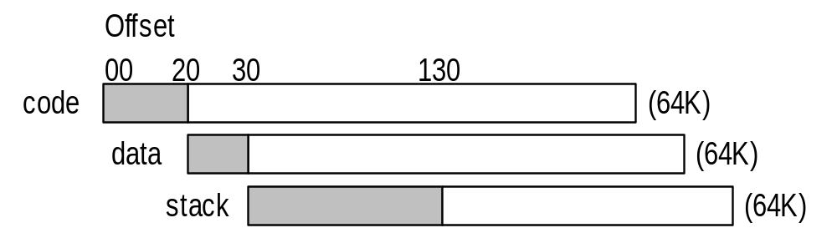
Overlapping Segments
Start Stop Length Name Class
00000 00010 00011 _TEXT CODE
00020 0002F 00010 _DATA DATA
00030 0012F 00100 STACK STACK
Program entry point at 0000:0000

Slide 6
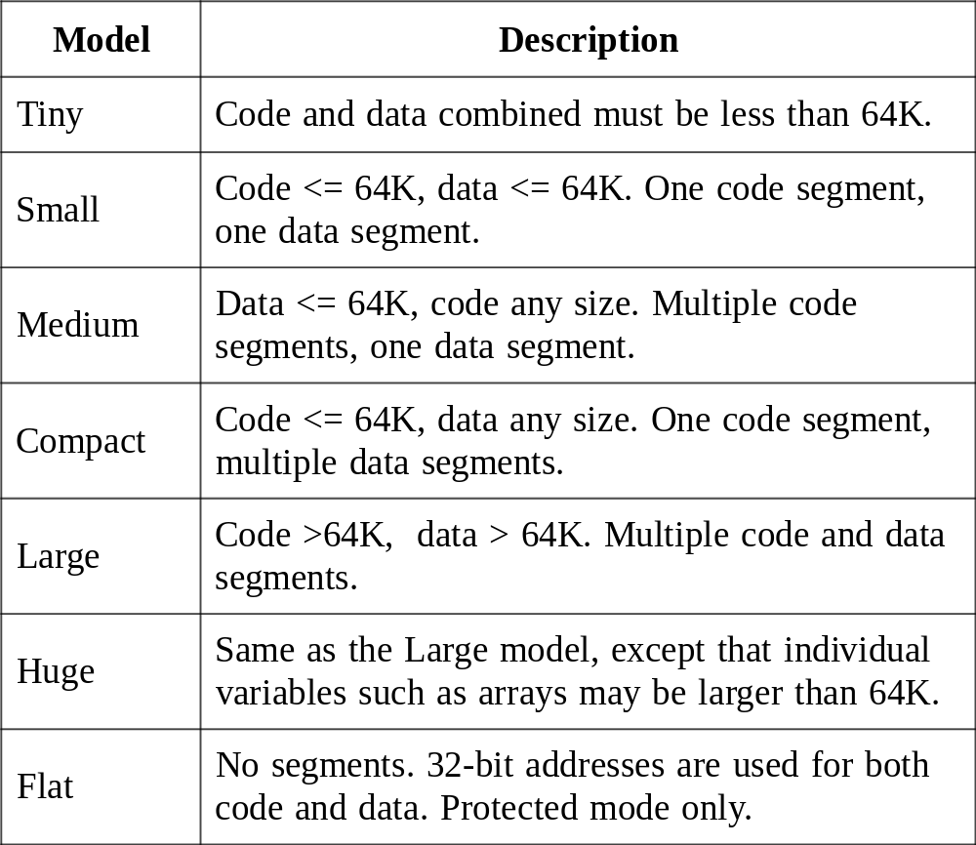
Memory Models

Slide 7
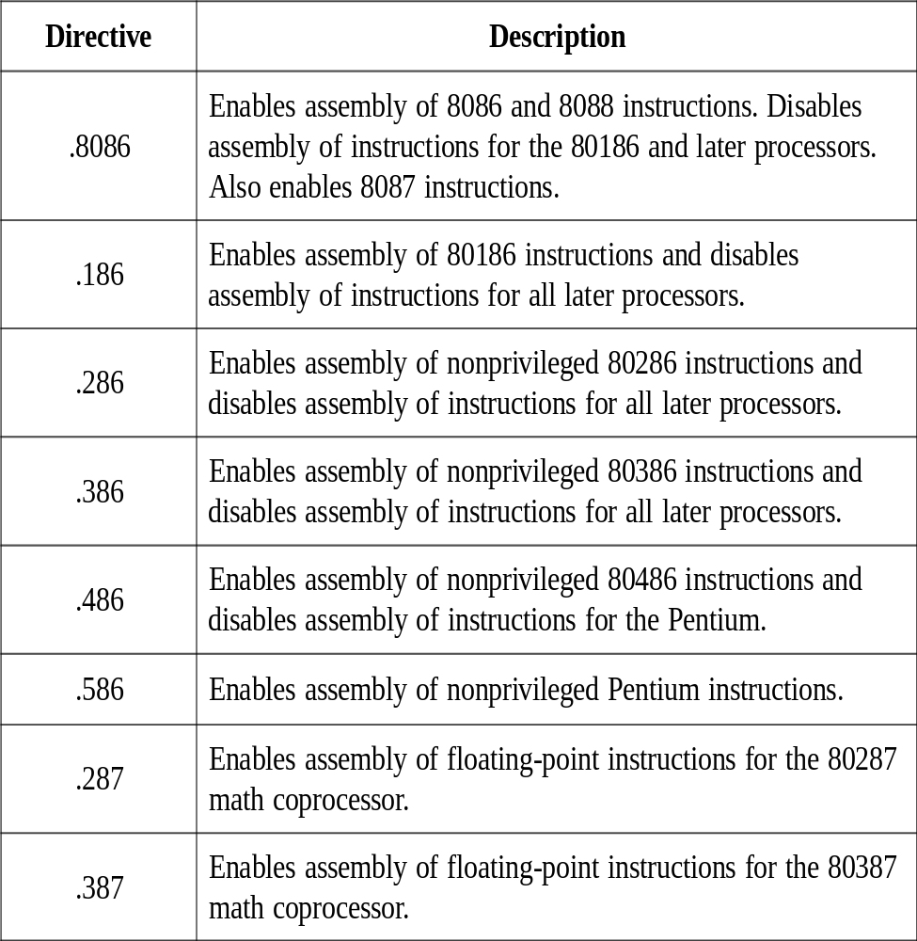
Target Processor Directives

Slide 8
OFFSET Directives
OFFSET returns the 16-bit address (offset) of a label.
.data ;say variable “bytes” located at offset 0000
bytes db 10h,20h,30h,40h
words dw 1000h,2000h,3000h
.code
mov di,offset bytes ;DI =
mov ax, offset bytes +1 ;AX =
mov si, offset words +2 ;SI =
0000
0001
0006

Slide 9
PTR Directives
PTR is used to:
1-overrides the default size of an operand.
2- make clear the operand size.
.data
val32 dd 12345678h
.code
mov ax, val32 ;get low word (error)
mov bx, val32+2 ;get high word (error)
mov ax, word ptr val32 ;AX = 5678h
mov bx, word ptr val32+2 ;BX = 1234h

Slide 10
PTR Directives
PTR is used to:
1-overrides the default size of an operand..
2-To make clear the operand size.
Inc [bx] ;operand must have ;size (error message)
inc byte ptr [bx] ;operand size made ;clear

Slide 11
TYPE
Returns the size, in bytes of a single element of a data name (variable)
.data
myByte db 1,2,3,4
myWord dw 1000h,2000h,3000h
myDouble dd 12345678h
.code
mov ax,TYPE myByte ; 1
mov ax,TYPE myWord ; 2
mov ax,TYPE myDouble ; 4

Slide 12
LENGTH
Returns a count of the number of individual elements in a data label that uses the DUP operator:
.data
myByte db 20 dup(?)
myWord dw 5 dup(0)
.code
mov ax,LENGTH myByte ; 20
mov ax,LENGTH myWord ; 5

Slide 13
SIZE
Returns TYPE multiplied by LENGTH:
.data
myByte db 20 dup(?)
myWord dw 5 dup(0)
.code
mov ax,SIZE myByte ; 20 (20 * 1)
mov ax,SIZE myWord ; 10 (5 * 2)

Slide 14
Operator Precedence Table
Operator
Level
Description
( )
1
Parentheses
+, -
2
Positive and negative signs
*, /,MOD
3
Multiplication, Division
+, -
4
Addition, Subtraction
Property of associativity also applies

Slide 15
JMP and LOOP Instructions
JMP is an unconditional jump to a code label
LOOP creates a counting loop, using CX as the default counter

Slide 16
JMP: Distance Modifiers
  JMP SHORT destination
    Jump within -128 to +127 bytes (an 8-bit value is added to IP)
  JMP NEAR PTR destination
    Jump within same code segment.
    16-bit offset is moved to IP)
  JMP FAR PTR destination
    Jump to a different code code segment.
    Segment address moves to CS and Offset to IP.

Slide 17
JMP Example
Unconditional Transfer of control to a label:
Label1:
.
.
jmp Label1

Slide 18
JMP Example
.model small
.stack 100h
.data
.code
main proc
mov ax,@data
mov ds,ax
start: mov ah,2
mov dl,"A"
int 21h
jmp start
mov ax,4c00h
int 21h
main endp
end main

Slide 19
LOOP Instruction
Automatically uses CX as the counter
  decrements it automatically
If CX > 0, LOOP transfers control to a label
  otherwise, execution drops through

Slide 20
LOOP Example
mov cx,3 ; loop counter
mov bx,1 ; value to be added
mov ax,0 ; holds the sum
L1:
add ax,bx
inc bx
Loop L1
AX=
BX=
CX=0000

Slide 21
LOOP Example
.model small
.stack 100h
.data
.code
main proc
mov ax,@data
mov ds,ax
mov cx,26
mov dl,41h
NextChar: mov ah,02h
int 21h
inc dl
loop NextChar
mov ax,4c00h
int 21h
main endp
end main
mov cx, 0h
inc cx

Slide 22
Indirect Addressing
Indirect Operands
  An indirect operand is a register that contains the offset of a data in memory.
    In 16 bit registers, SI, DI, BX and BP can be used as indirect operands.
    Any 32 bit general purpose register can be used as indirect oprand (provided .386 or higher directive is used).

Slide 23
Indirect Addressing
Indirect Operands
  [si], [di], [bx], [bp]
Based and Indexed Operands
    array[si], array[di], array[bx]
Base-Index Operands
    [bx+si], [bx+di]
Base-Index with Displacement
    array[bx+si], array[bx+di]

Slide 24
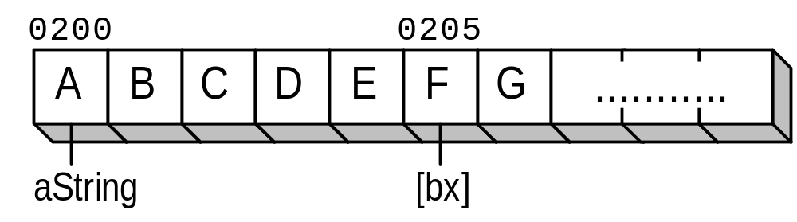
Indirect Operand Example
.data
aString db "ABCDEFG“
.code
mov bx,offset aString
add bx,5
mov dl,[bx]

Slide 25
Adding 8-bit Integers
.data
aList db 10h,20h,30h
sum db 0
.code
mov bx,offset aList
mov al,[bx] ; AL = 10h
inc bx
add al,[bx] ; AL = 30h
inc bx
add al,[bx] ; AL = 60h
mov si,offset sum ; get offset of sum
mov [si],al ; store the sum
mov bx, offset aList
mov al,[bx]
add al,[bx+1]
add al,[bx+2]
mov [bx+3],al

Slide 26
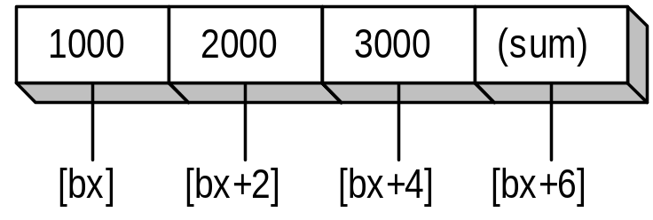
Adding 16-bit Integers
.data
wordList dw 1000h,2000h,3000h
.code
mov bx,offset wordList
mov ax,[bx] ; first number
add ax,[bx+2] ; second number
add ax,[bx+4] ; third number
mov [bx+6],ax ; store the sum

Slide 27
Displaying a String
.data
string db "This is a string."
COUNT = ($–string)
.code
mov cx,COUNT
mov si,offset string
L1:
mov ah,2
mov dl,[si]
int 21h
inc si
Loop L1

Slide 28
Summing an Integer Array
.data
abc dw 0100h,0200h,0300h,0400h
COUNT = ($ – abc) / (TYPE abc)
.code
mov ax,0
mov di,offset abc
mov cx,COUNT
L1:
add ax,[di]
add di,TYPE abc
Loop L1

Slide 29
Based and Indexed Operands
The microsoft assembler permits the same address expression to be notated in various ways:
Register Added to an
Register Added to a
Offset
Constant
mov dx,array[bx]
mov ax,[bx + ROWVAL]
mov dx,[di + array]
mov dx,[bp+4]
mov dx,[array+si]
mov dx,2[si]

Slide 30
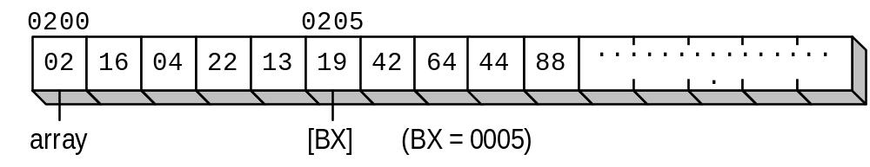
Based and Indexed Operands
Each row of this table contains five bytes. BX points to the beginning of the second row:
.data
ROWSIZE = 5
array db 2h, 16h, 4h, 22h, 13h
db 19h, 42h, 64h, 44h, 88h
.code
mov bx,ROWSIZE
mov al,array[bx] ; AL = 19h

Slide 31
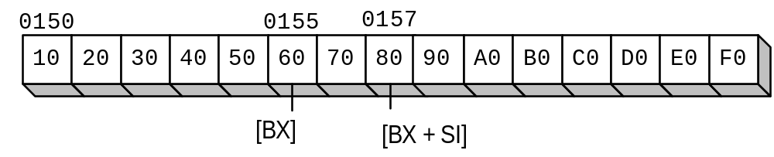
Based-Index Operands
Add the value of a base register to an index register, producing an effective address of 0157:
BX = 0155, SI = 0002
Example...

Slide 32
Base-Index Example
.data
ROWSIZE = 5
array db 10h, 20h, 30h, 40h, 50h
db 60h, 70h, 80h, 90h,0A0h
db 0B0h,0C0h,0D0h,0E0h,0F0h
.code
mov bx,offset array ; point to the array at 0150
add bx,ROWSIZE ; choose second row
mov si,2 ; choose third column
mov al,[bx + si] ; get the value at 0157

Slide 33
Base-Index Restriction
There is one important restriction in using Base-Idexed addressing i.e., you cannot combine two base registers or two index registers.
Following statements are invalid:
mov al,[bp+bx]
mov al,[si+di]

Slide 34
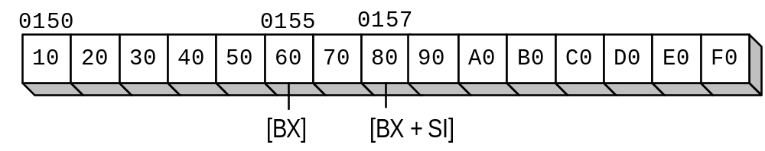
Base-Index with Displacement
.data
ROWSIZE = 5
array db 10h, 20h, 30h, 40h, 50h
db 60h, 70h, 80h, 90h,0A0h
db 0B0h,0C0h,0D0h,0E0h,0F0h
.code
mov bx,ROWSIZE ; row 1
mov si,2 ; column 2
mov dl,array[bx + si] ; DL = 80h

