Slide 1

Presented by:
Muhammad Abdul Sabor BSEF23M015
Haroon Ashraf Chowdary BSEF23M009
Muhammad Abdul Kareem BSEF23M014

Slide 2

RMTrack: A Comprehensive Requirement Elicitation Solution
RMTrack is a web-based tool used for requirement management and issue tracking. It helps teams efficiently collect, organize, and manage requirements, bugs, tasks, and workflows within projects. It centralizes project-related data, allowing teams to collaborate effectively, track project progress, and ensure tasks are completed on time.

Slide 3
Understanding Requirement Elicitation
Definition
Why Tools Matter
Requirement Elicitation is the process of gathering and documenting the needs and expectations of stakeholders for a software project. This involves understanding the problem, the desired solution, and the project’s constraints and limitations.
Tools like RMTrack play a vital role in improving the efficiency and effectiveness of the requirement elicitation process. They provide structured frameworks for capturing, organizing, and tracking requirements, ensuring clarity, consistency, and traceability throughout the project lifecycle.

Slide 4
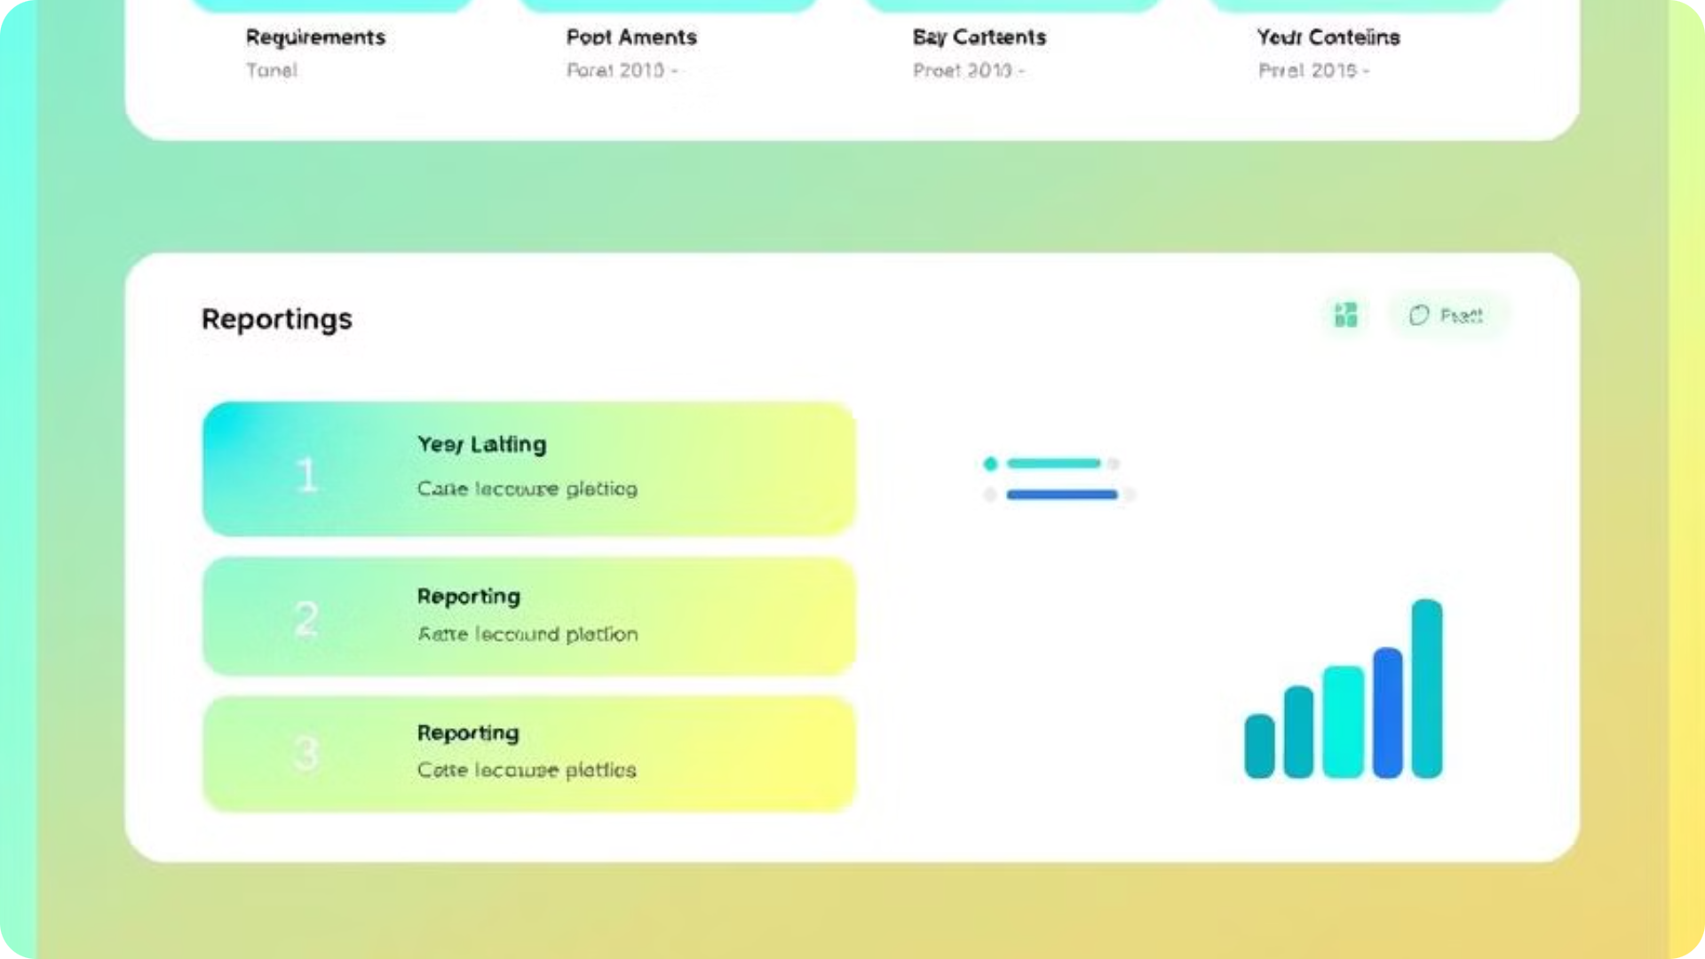
RMTrack: A Web-Based Solution
1
Web-Based Customization
2
Comprehensive Management
3
Targeted Audience
RMTrack caters to development teams, project managers, and organizations looking for a user-friendly platform to streamline their requirement management processes.
RMTrack is a cloud-based solution that enables teams to access and collaborate on requirements from any location with internet access.
It offers a comprehensive suite of features for managing requirements, bugs, tasks, and related activities, providing a centralized platform for project coordination.
4
Key Features
RMTrack boasts a range of features, including customizable workflows, robust reporting and dashboards, integration capabilities, and workflow automation.

Slide 5
Steps to Use RMTrack
Setting Up RMTrack
Start by visiting the RMTrack website, signing up for a trial, or logging in with your user credentials. Review the Installation Guide (pdf), or follow the instructions of the installer
1
2
Creating Projects
Access the administration panel and create a new project or choose an existing project.
Adding Requirement Entries
3
Navigate to the "Issues" section and add new issues or requirements. Fill out details such as title, description, priority, and responsible team members.
4
Configuring Workflows
Customize workflows based on your project's requirements, defining stages like "New," "In Progress," and "Complete" to manage the flow of tasks and requirements.
Generating Reports
5
Use the comprehensive reporting and dashboard features to track progress, identify bottlenecks, and analyze data. Export results in PDF, Excel, or other formats for sharing and analysis.
6
Collaboration and Communication
Add team members to collaborate on requirements, utilize notifications and alerts to stay updated on changes, and leverage RMTrack’s communication tools for efficient collaboration.
LINKS
https://www.youtube.com/@rmtrack702

Slide 6
Pros and Cons of RMTrack
Pros(Advantages)
Cons(Dis-Advantages)
RMTrack is user-friendly
Offering an intuitive interface that simplifies managing requirements.
It is highly customizable.
Allows teams to tailor workflows to their specific needs.
Additionally, its robust reporting and dashboard features provide valuable insights into project progress and potential issues.
The free version of RMTrack has limited features
Advanced features require initial training.
While suitable for small to medium-sized teams, RMTrack might not be the ideal choice for very large enterprise-scale projects with complex needs.

Slide 7



Cognitive and Group Elicitation Techniques
Cognitive Elicitation
Group Elicitation
Focuses on understanding the mental models and processes of individuals, utilizing techniques like interviews, Think-Aloud Protocols, and brainstorming to gather requirements.
Employs collective methods for requirement gathering, such as focus groups, workshops, and Joint Application Development (JAD), emphasizing collaboration and consensus building.

Slide 8






Applying RMTrack to Improve Requirements Management
Define Goals
1
Enhance repository searchability and streamline stakeholder requirement input.
2
Categorization of Requirements
Group requirements into modules using RMTrack's Custom Fields feature for better organization and management.
3
Workflow Customization
Design a step-by-step flow for requirements: Initial → Reviewed → Approved → Implemented → Verified.
Collaborative Workshops
4
Conduct requirement elicitation workshops using Think-Aloud Protocols and focus groups for collective requirement validation.
5
Integration of Feedback Loop
Utilize RMTrack notifications to incorporate stakeholder feedback directly into the repository.
6
Automated Reporting
Generate requirement completeness and bottleneck reports weekly for continuous improvement.

Slide 9
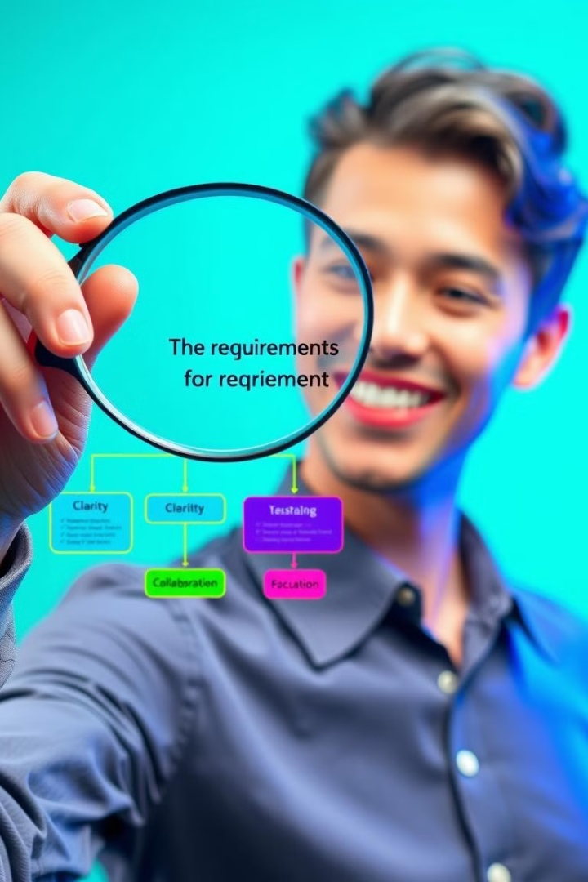
Conclusion: Utilizing RMTrack for Enhanced Requirements Management
RMTrack provides a comprehensive solution for efficient requirement management, offering a user-friendly interface, customizable workflows, and robust reporting capabilities. By incorporating cognitive and group elicitation techniques into your workflow, you can leverage RMTrack to effectively gather, analyze, and manage requirements, resulting in improved project outcomes and enhanced stakeholder satisfaction. We encourage you to explore RMTrack and adopt its features for your future projects.

Slide 10

References
For more information, please refer to the RMTrack Official Website: https://www.rmtrack.com/
YouTube Tutorial Link: https://www.youtube.com/@rmtrack702
RMTrack Official Guide: https://downloads.rmtrack.com/InstallationGuidev4.0.pdf

