Slide 1


RMTrack:
Welcome to this presentation on RMTrack, a powerful tool for efficient requirement elicitation and management. This presentation will cover key features, steps, pros and cons, and design considerations for effective use.
by Muther Saeed

Slide 2
Introduction to Requirement Elicitation
Requirement Elicitation
Importance of Tools
The process of gathering and documenting requirements from stakeholders.
Streamline the process, improve communication, and ensure accurate documentation.

Slide 3
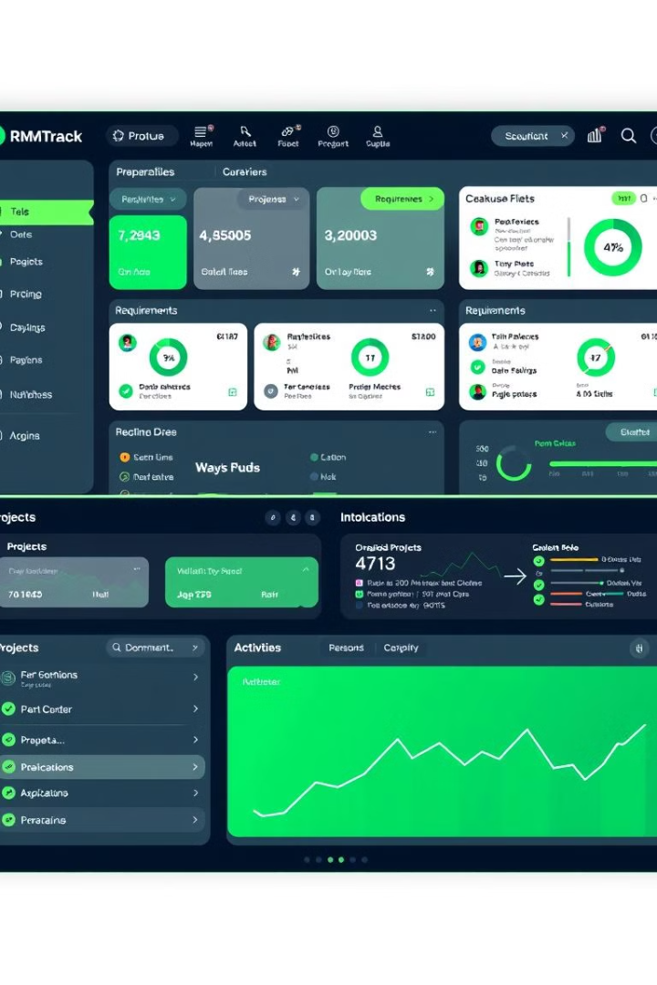
Overview of RMTrack
Web-based Tool
Requirement Management
RMTrack is a web-based solution, accessible from any device with internet access.
Provides a centralized platform to manage requirements, bugs, tasks, and related activities.
Target Audience
Development teams, project managers, and organizations of all sizes.

Slide 4
Steps to Use RMTrack
Setup
1
Register for a trial or log in with existing credentials.
2
Project Creation
Customize project fields (priority levels, categories, workflow stages).
Requirement Entry
3
Add new issues/requirements with details, priority, and responsible team members.
4
Workflow Configuration
Define workflows based on project needs (e.g., "New" → "In Progress" → "Complete").
Reporting & Dashboards
5
Track progress and identify bottlenecks through detailed reports and dashboards.
6
Collaboration & Feedback
Add team members, use notifications, and leverage features for effective collaboration and feedback.

Slide 5
Pros and Cons of RMTrack
Pros
Cons
Easy-to-use interface
Limited free version
Highly customizable workflows
Requires initial training for advanced features
Robust reporting and dashboard features
May not be suitable for extremely large projects.

Slide 6

Cognitive and Group Elicitation Techniques
Cognitive Techniques
Group Techniques
Focus on understanding individual mental models and perspectives.
Used for collecting requirements collectively from multiple stakeholders.

Slide 7





Design of Thai Technique for Repository
1
Define Goals
2
Categorization
3
Workflow Customization
4
Collaborative Workshops
5
Integration of Feedback Loop

Slide 8




Conclusion
RMTrack Overview
Key Highlights
Value of RMTrack
Steps, pros/cons, and effective cognitive and group elicitation techniques.
Improves requirement management processes and promotes efficient collaboration.
A comprehensive requirement elicitation and management tool.

Slide 9

References
For more information, please refer to the following resources:
RMTrack Official Website: https://www.rmtrack.com/
YouTube Tutorial Link: \[YouTube Link\]
Academic/Technical references on cognitive and group elicitation techniques.

