Slide 1
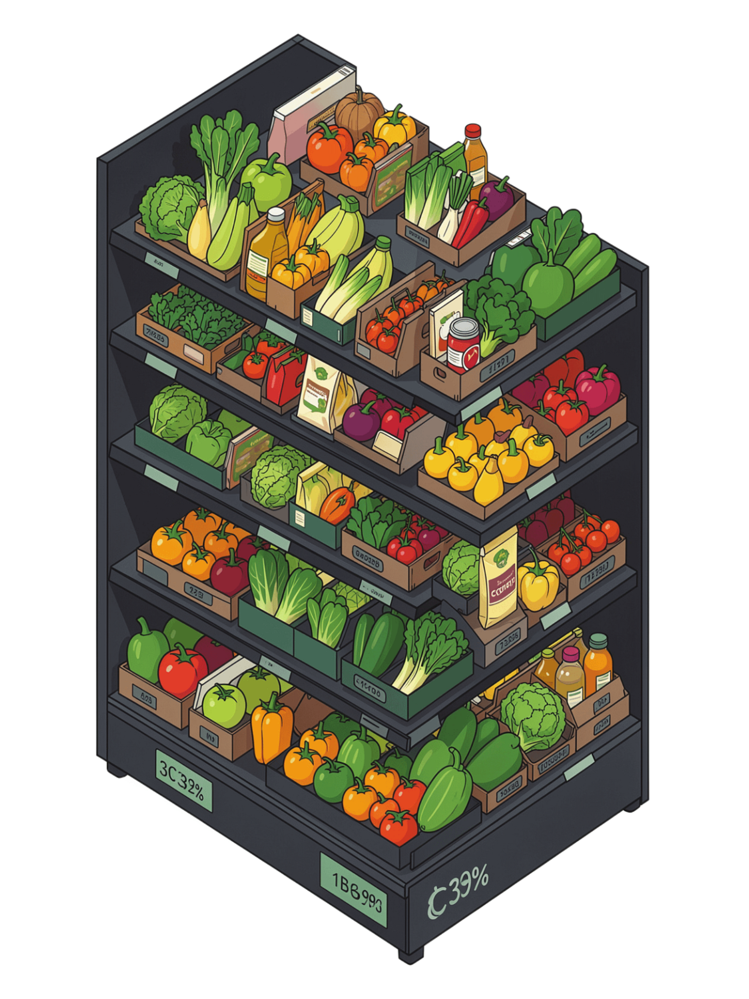
SmartStock AI
AI-Powered Grocery Demand Forecasting & Inventory Optimization

Slide 2
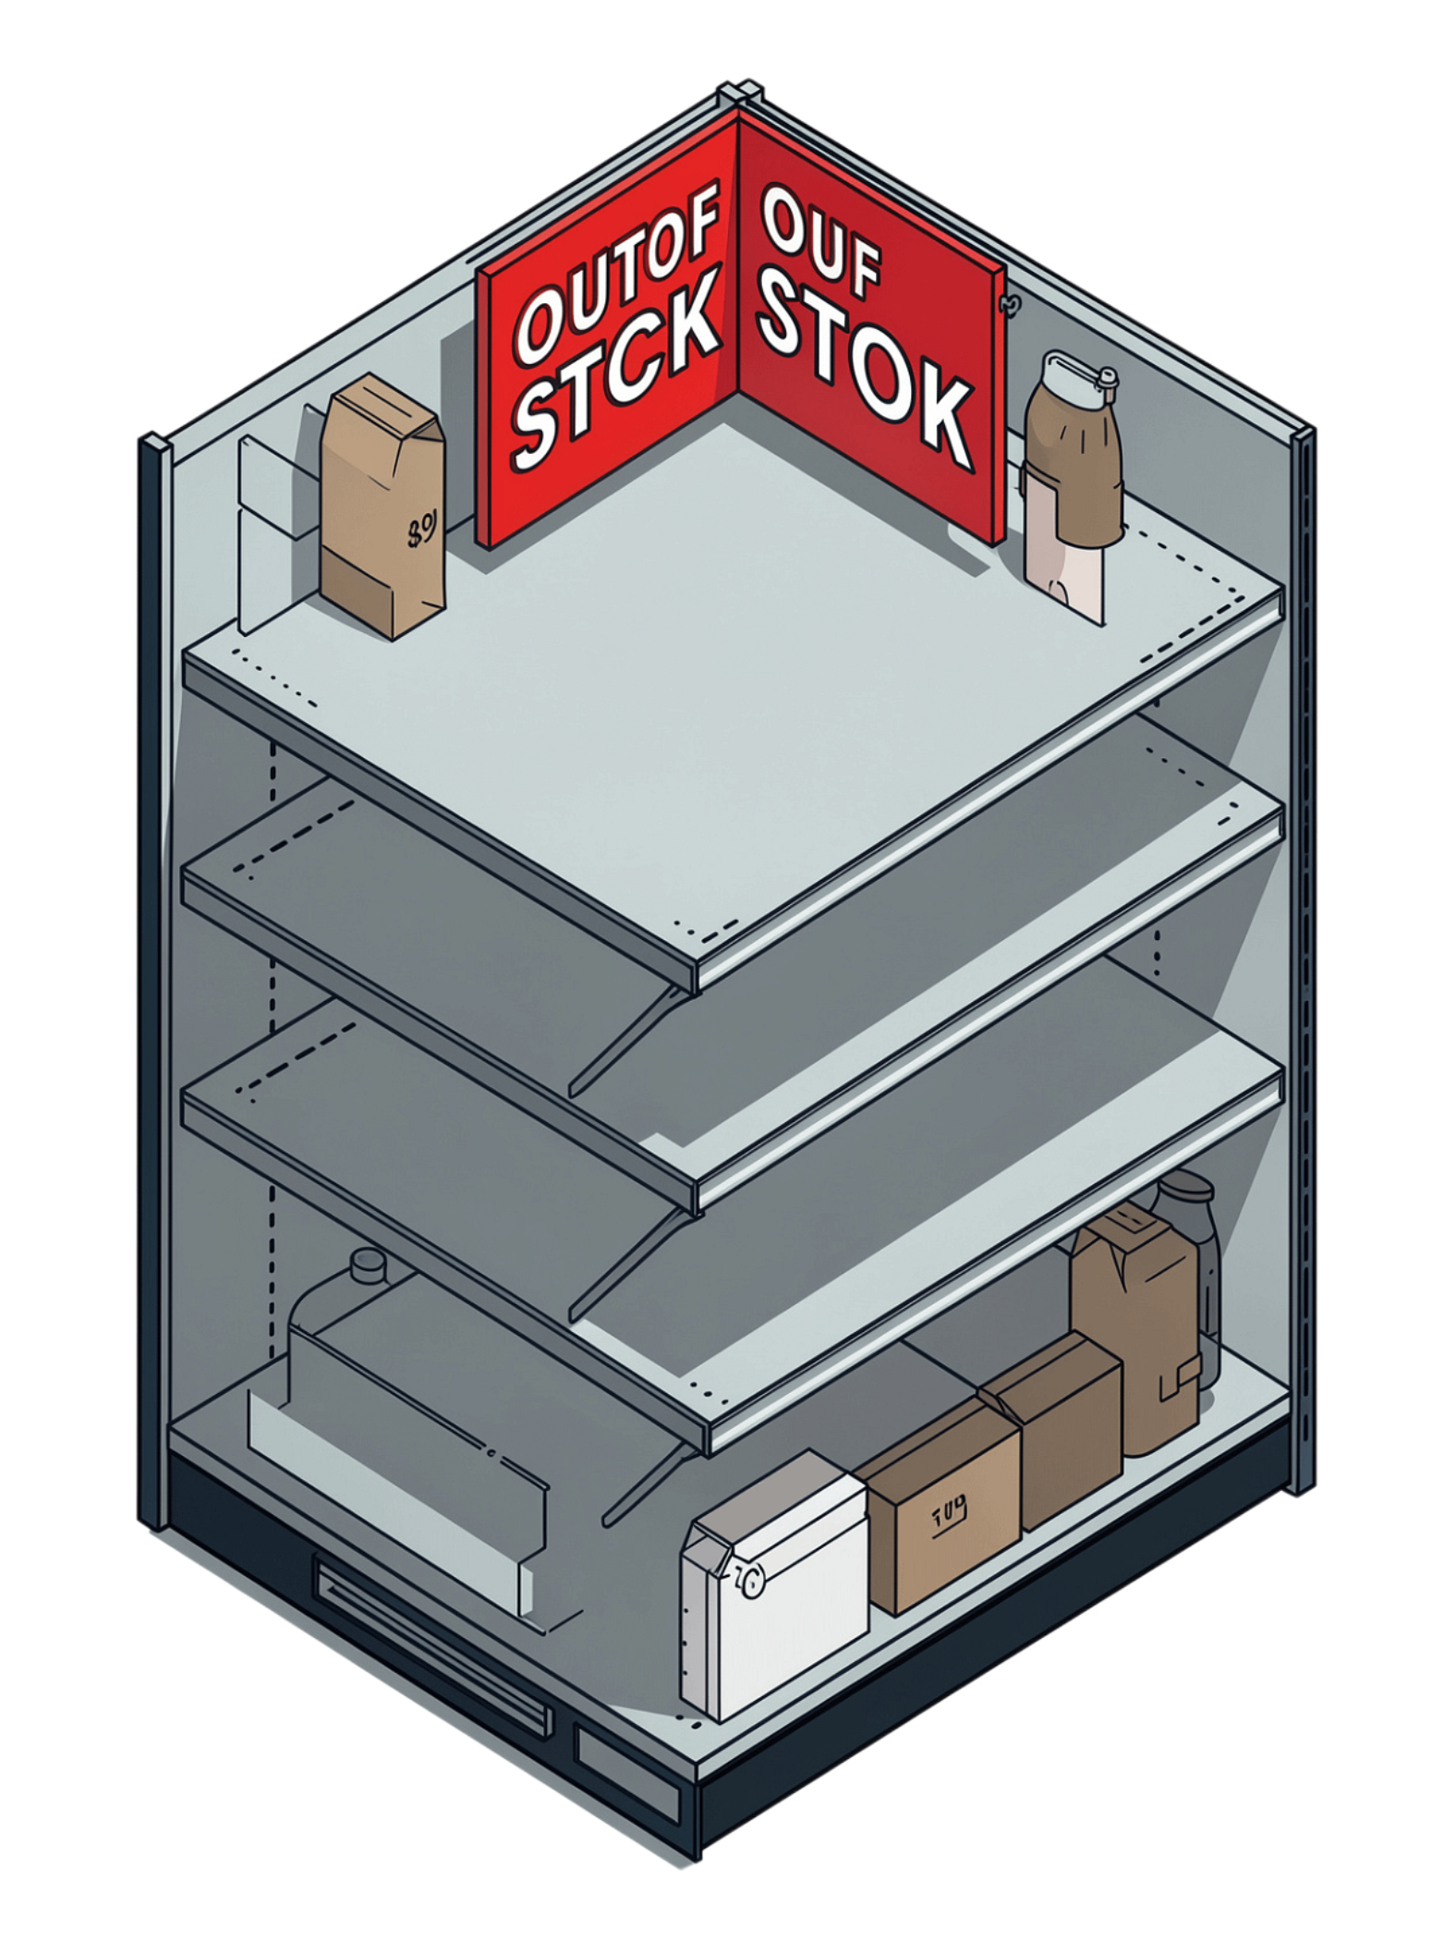
The Problem
20–30%
Capital Waste
Revenue lost to stockouts
Overstocking ties up cash and drives spoilage
Manual Guesswork
Slow, inaccurate forecasting

Slide 3
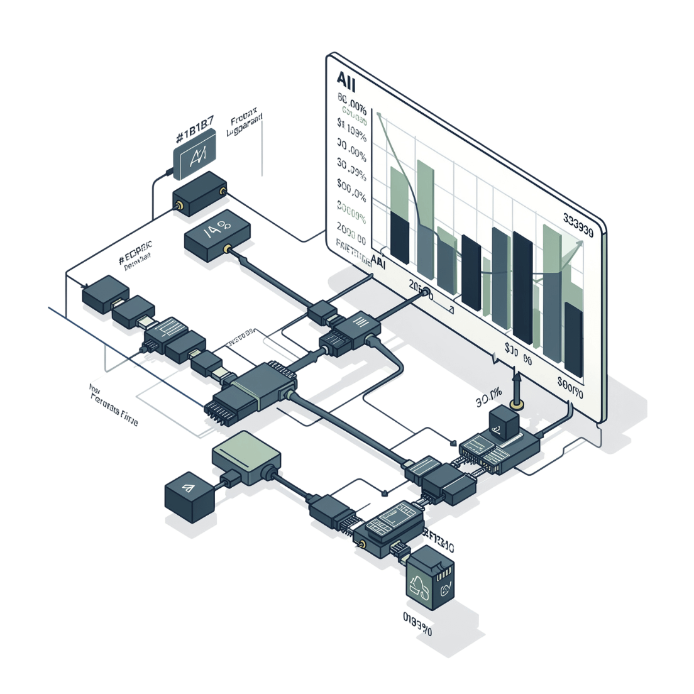
The Solution
1
Ingest
2
Predict
Historical sales + calendar + promotions
Chronos-2 AI forecasts demand 7 days ahead — 85%+ accuracy
3
Optimize
Auto-recommends ideal inventory levels

Slide 4
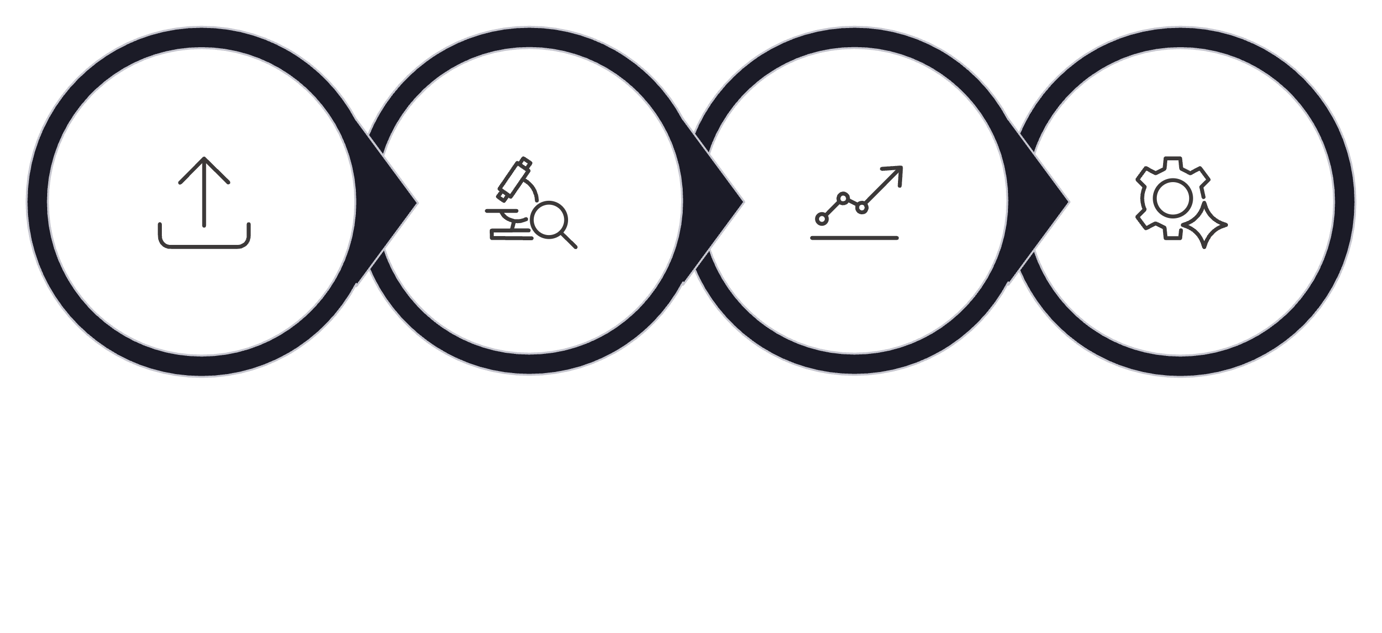
How It Works
Upload
Analyze
Forecast
Optimize

Slide 5




The Tech Stack
AI Engine
Backend
Amazon Chronos-2 via Hugging Face
Python Flask REST API
Frontend
Database
HTML / CSS / JS + Bootstrap
SQLite + Pandas

Slide 6

Live Demo: Top Predicted Products
🥇 Milk
🥈 Bread
420 units — 91% confidence
385 units — 88% confidence
🥉 Eggs
350 units — 86% confidence

Slide 7
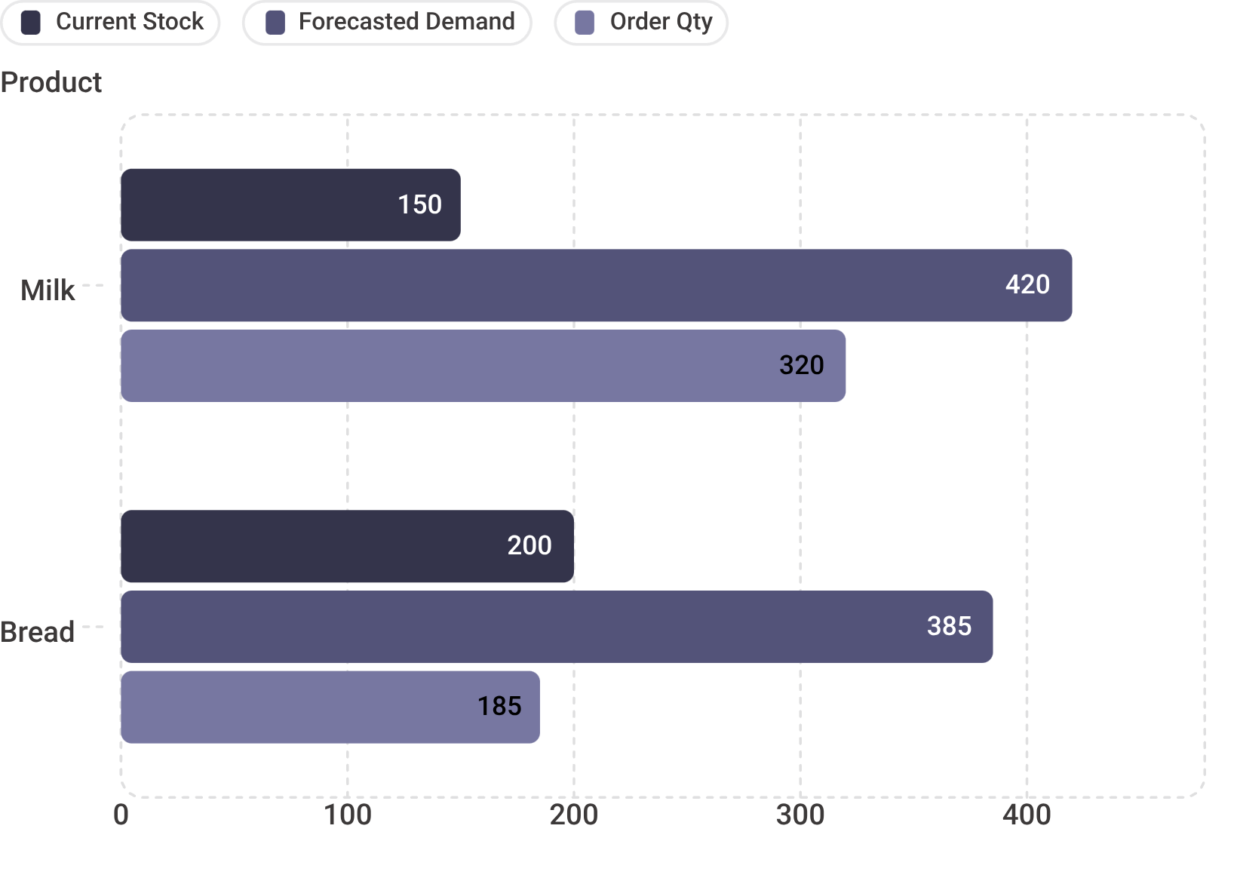
Smart Inventory in Action
-40%
-35%
Stockout reduction
Waste reduction

Slide 8
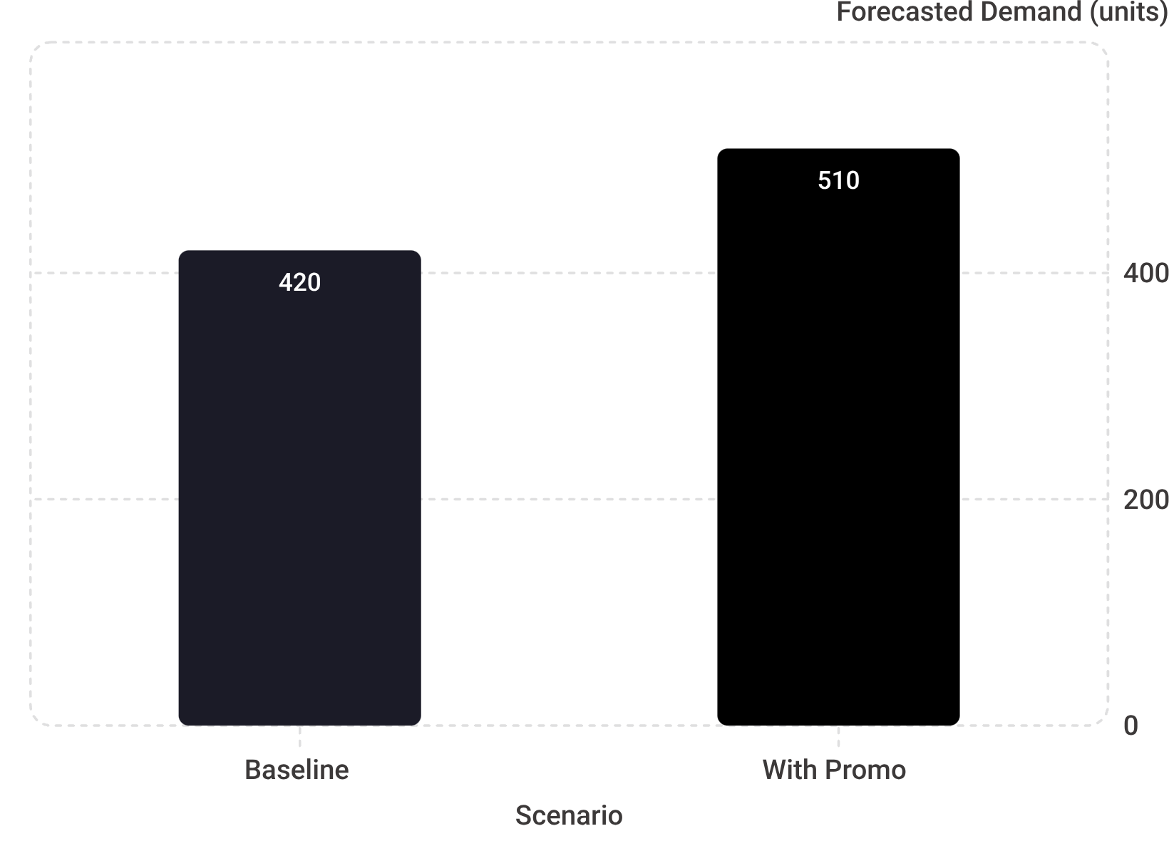
Promotion Impact
Scenario
Add 20% discount on Milk — Sept 20–22
AI Recalculates
Demand: 420 → 510 units (+21%)
Inventory Adjusts
Order quantity updates automatically — no manual intervention

Slide 9


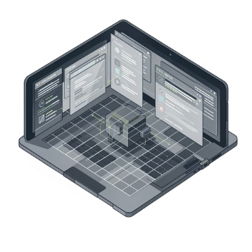
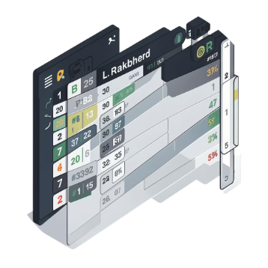
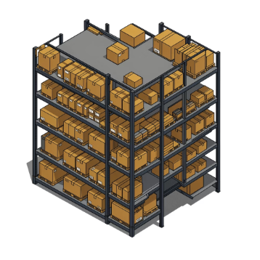
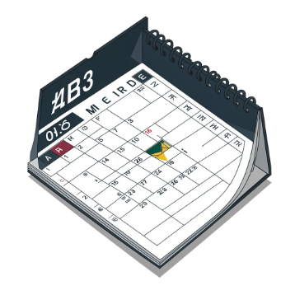

Team & Architecture
Dashboard
Data
ML
Ranking
Unified overview & reporting
Ingestion & preprocessing
Chronos-2 forecasting engine
Top product prioritization
Inventory
Calendar
Order recommendations
Promotions & events
Unified API contract — zero integration conflicts across all 6 modules.

Slide 10
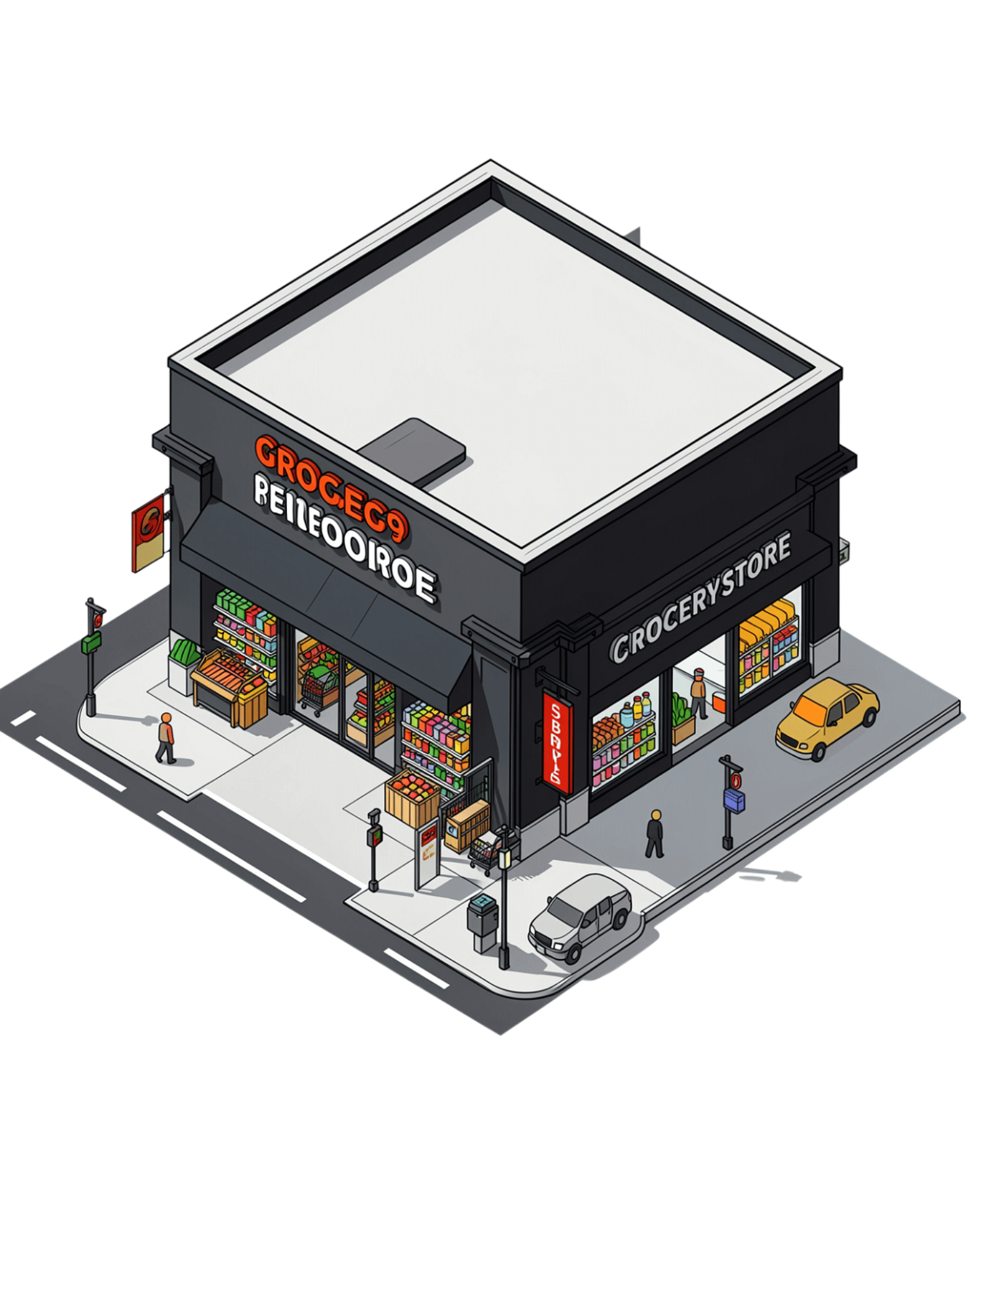
Impact & Next Steps
+15%
Revenue Uplift
-40%
Stockouts
-35%
Waste
2M
Transactions
85 products · 1 pilot store
Next: Multi-store SaaS platform rollout

