Slide 1


Slide 2

E-Drug Store Administration

Slide 3
Members Introduction
ID :BC170202448 Name: Ahmad Arshad

Slide 4

INTRODUCTION OF PROJECT
Purpose:
The main object of E-Drug Store Administration is to provide the medical stores and medical professionals the service to aid in their regular work through the software which will manage sale purchase, medicine details, the stock information and the profit loss of the month or year etc.

Slide 5
Software Features
Save the information about daily sale purchase like cost and received money from the customers transection time date etc.
Save the item info specially medicines info like name, salt, purchase price, sell price and company name
Can generate the receipt

Slide 6
Software Features
Can generate profit loss, sell and purchase report of the desired timeline.
Very user-friendly
Very fast specially designed specially easy to use for peoples who are not more familiar with computers.

Slide 7
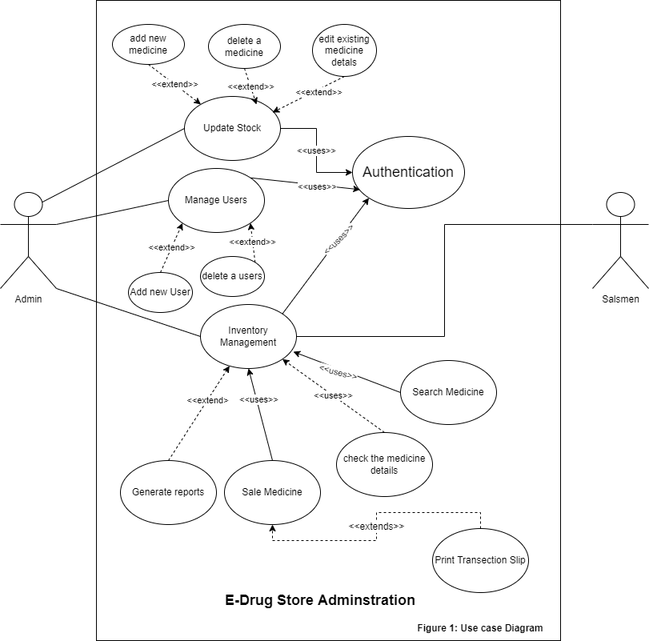
Use Case Diagram

Slide 8
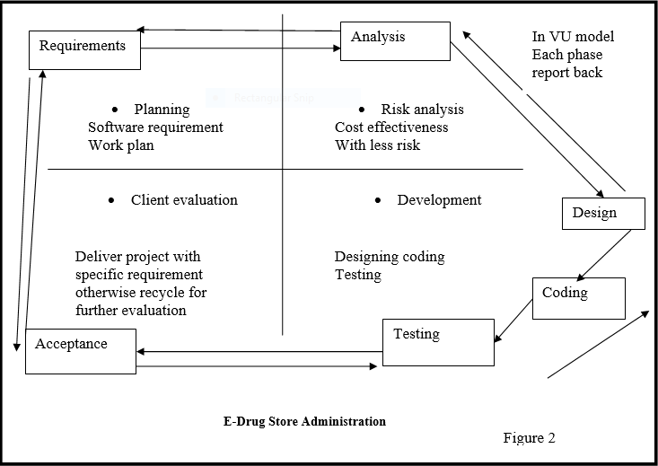
Vu Process Model

Slide 9
Business Rules Catalog
The administrator can add, modify or delete the medicine or medicine details
Both the administrator and salesmen can sale the medicine or drug store items
Only admin can create or delete new user
Only after successful login one can utilize the software

Slide 10
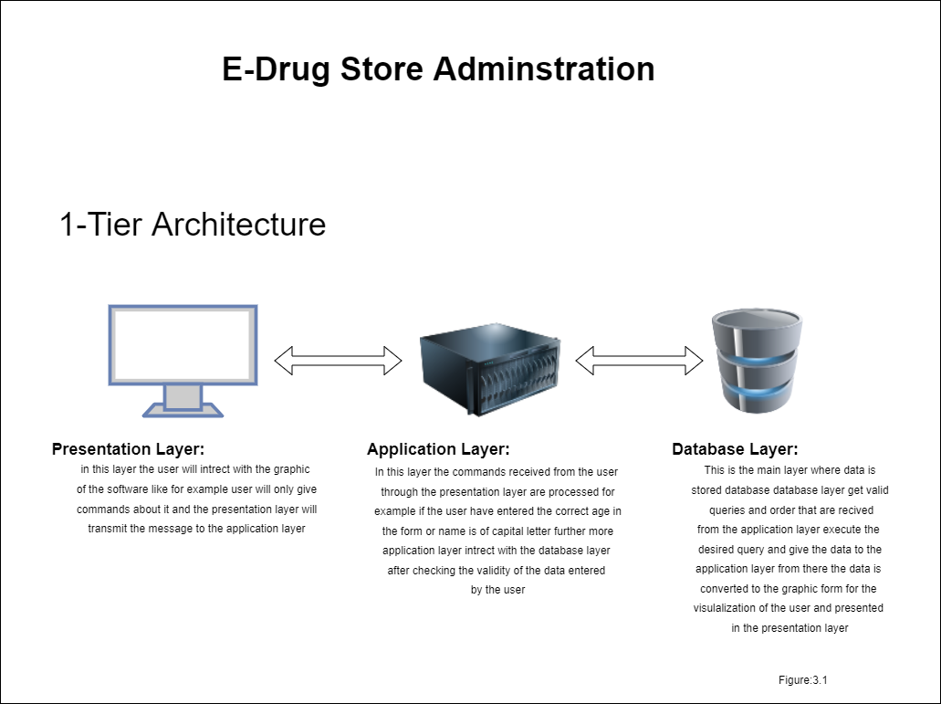
Architectural Design

Slide 11
Project Schedule
Schedule (Gantt Chart) of project here.

Slide 12
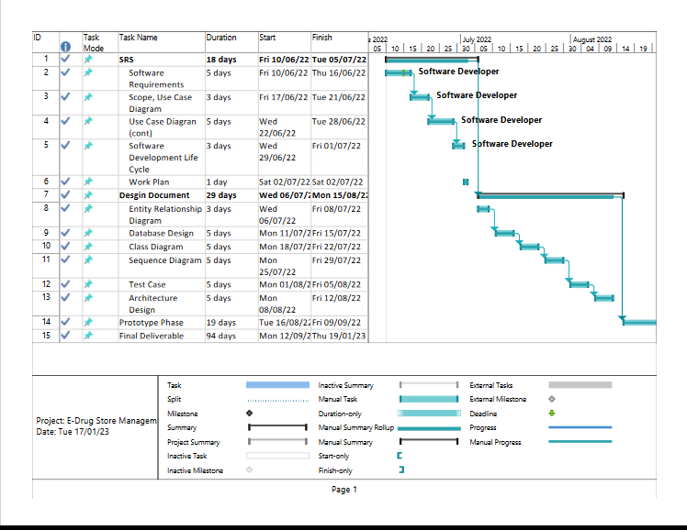

Slide 13
Sequence Diagrams
Some core sequence diagrams.

Slide 14
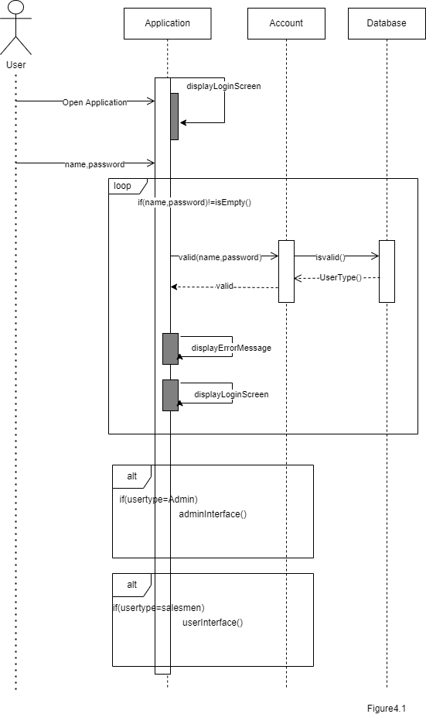

Slide 15
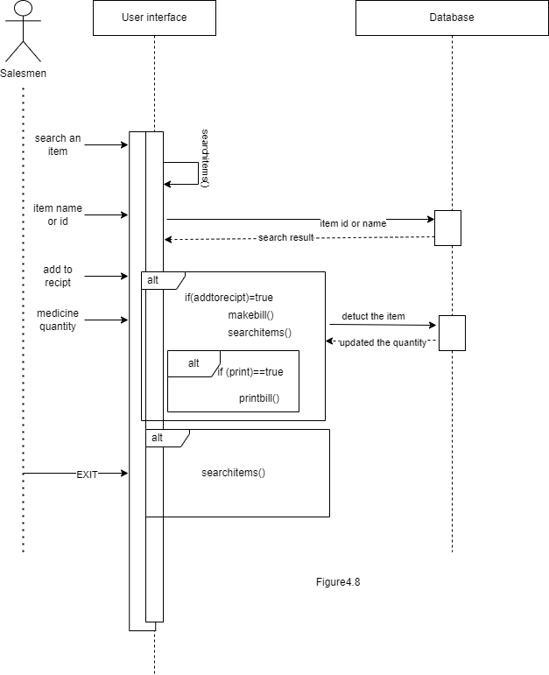

Slide 16
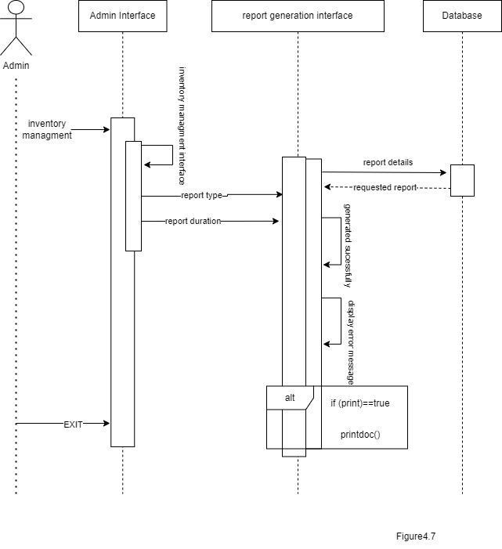

Slide 17
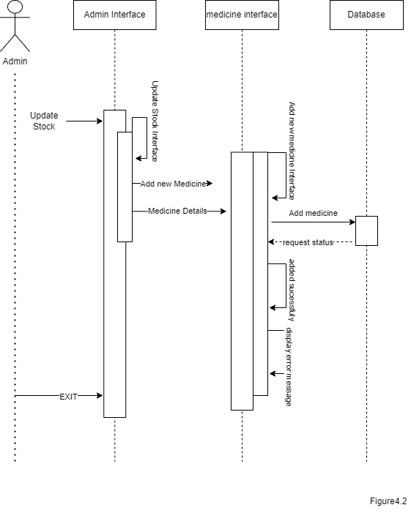

Slide 18
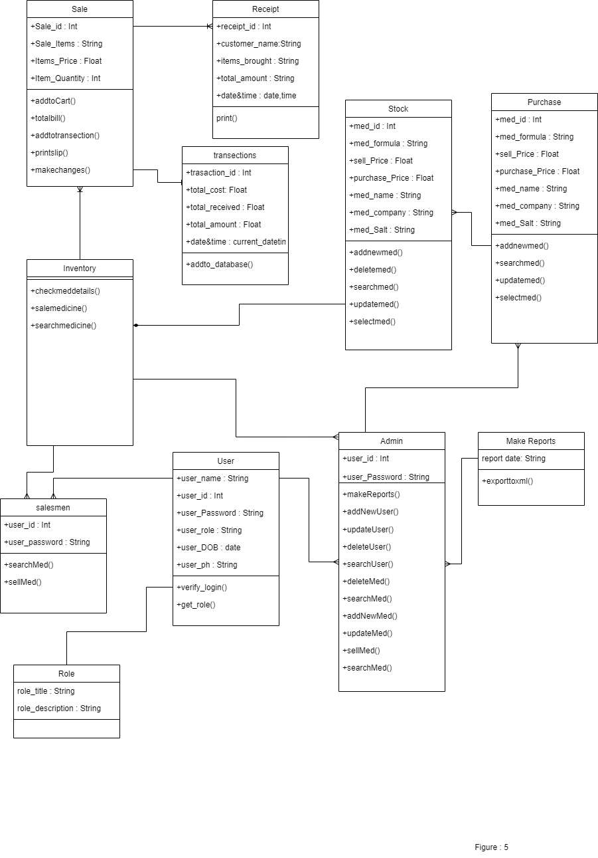
Logical Model/Class Diagram

Slide 19
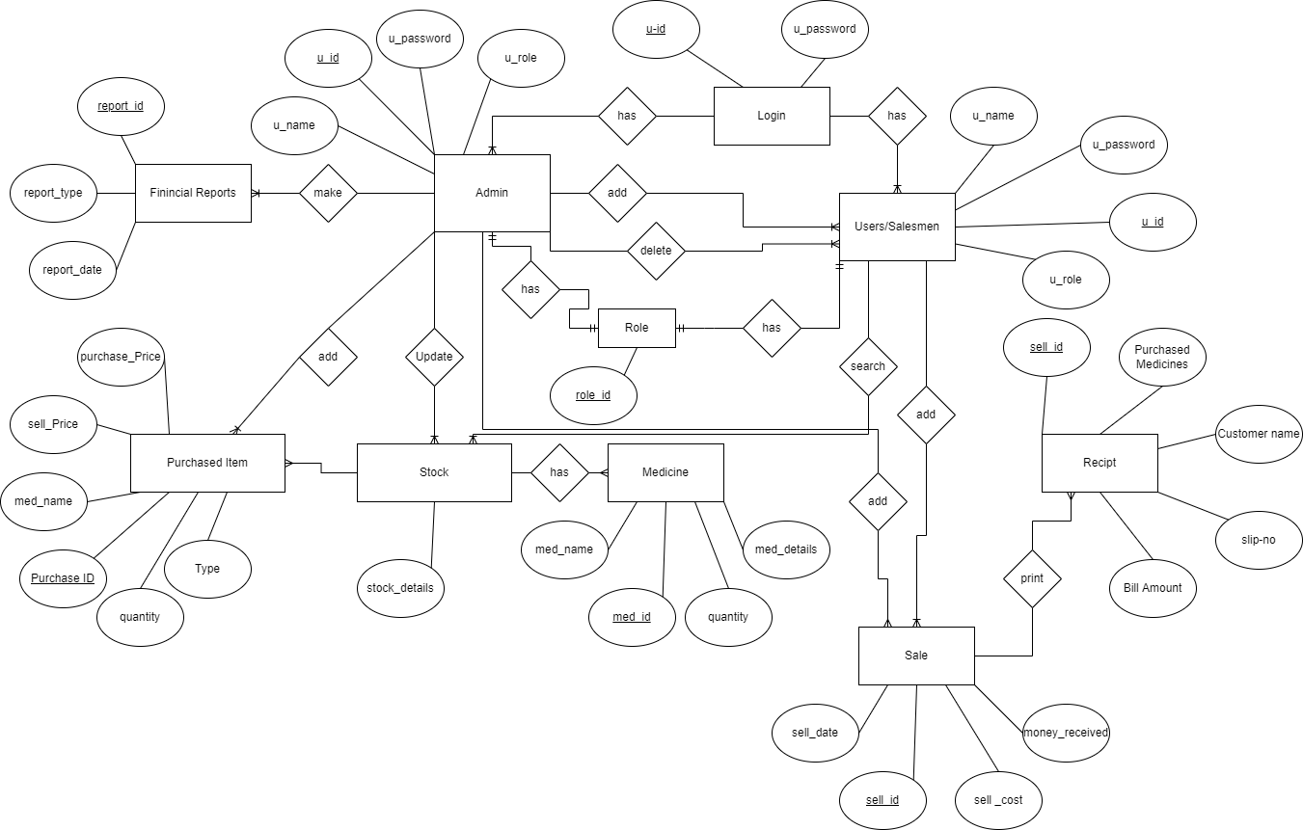
Entity-Relationship Diagram

Slide 20
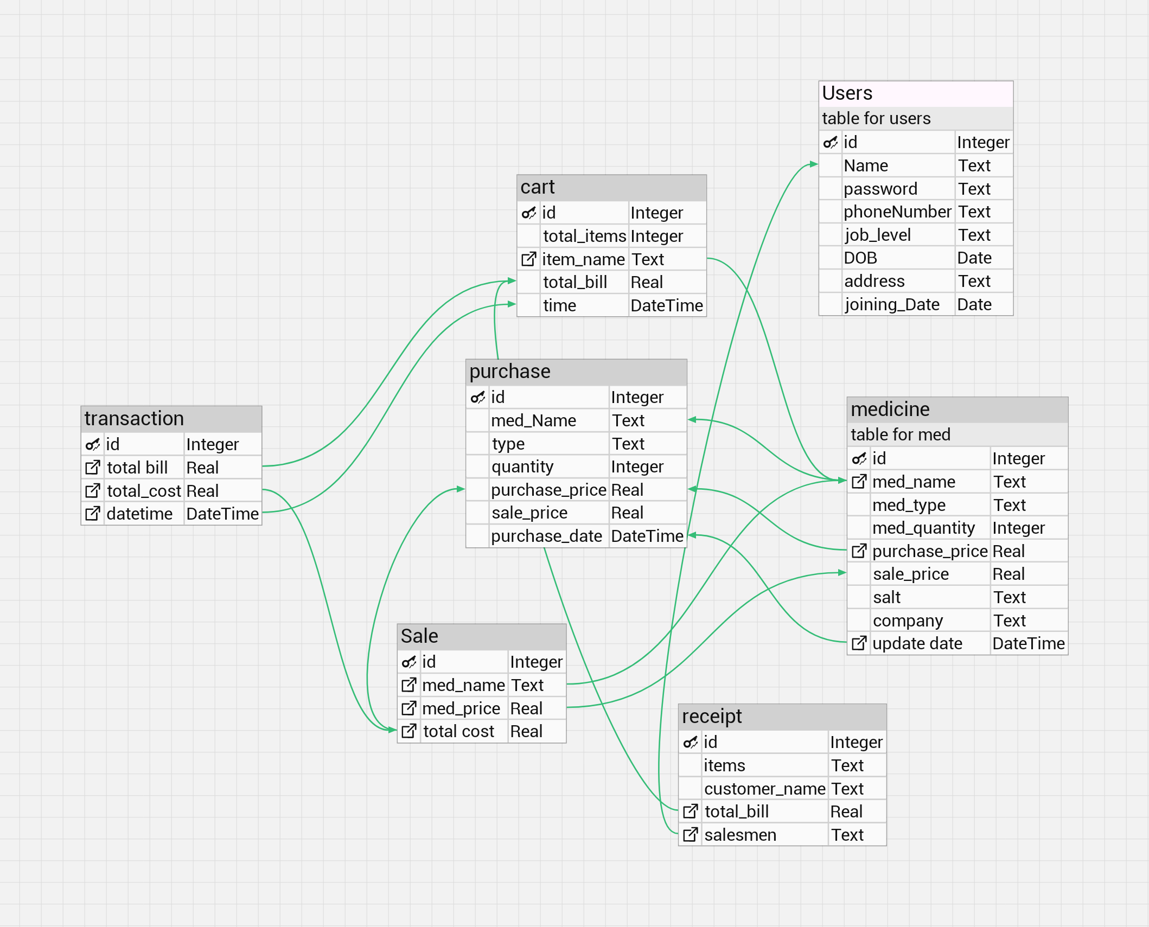
Database Diagram

Slide 21
User Interfaces
Screen shots of GUI

Slide 22
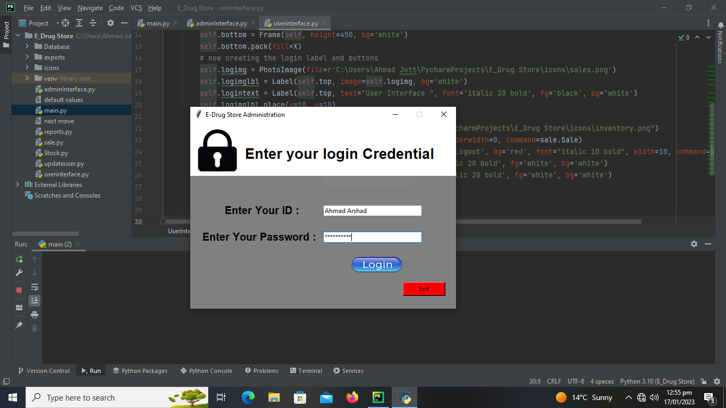

Slide 23
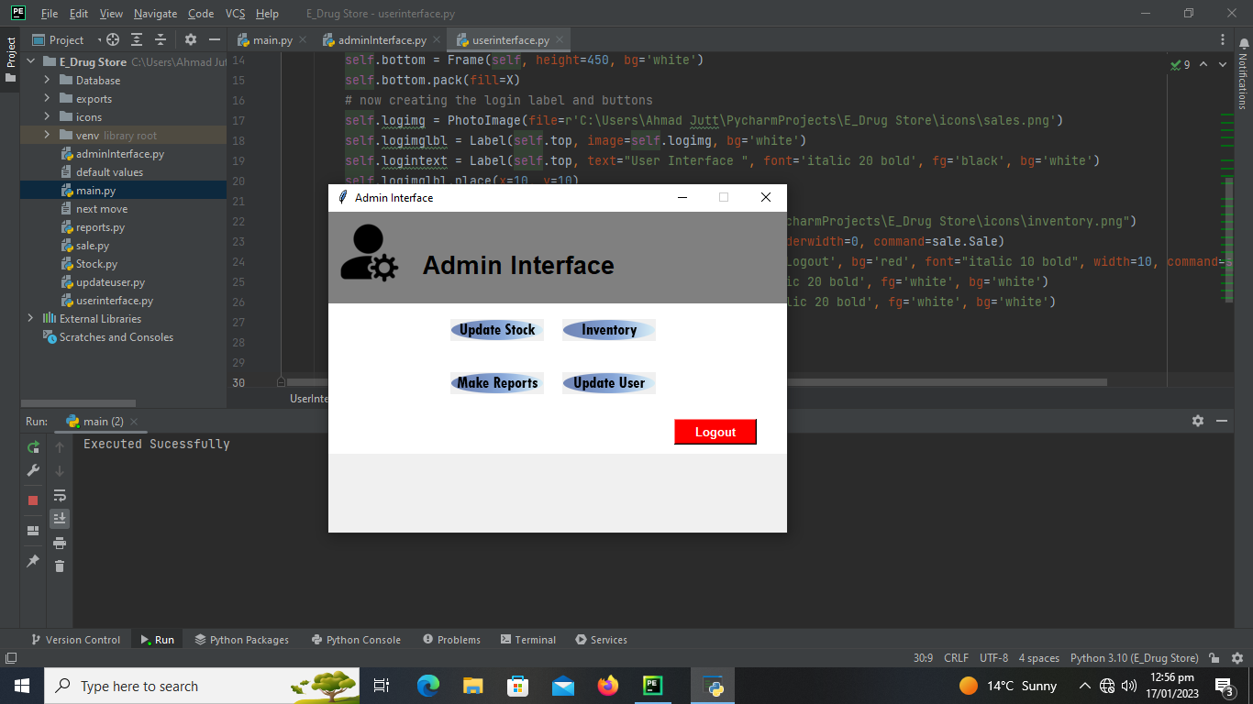

Slide 24
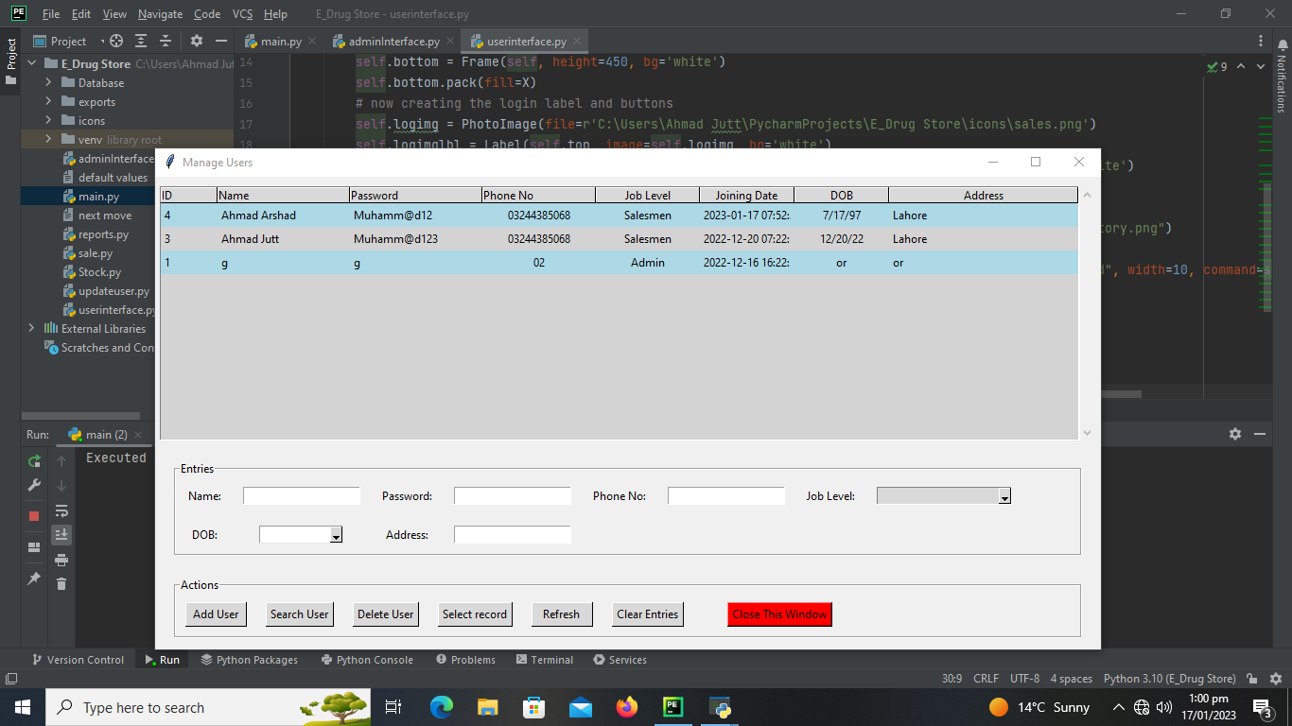

Slide 25
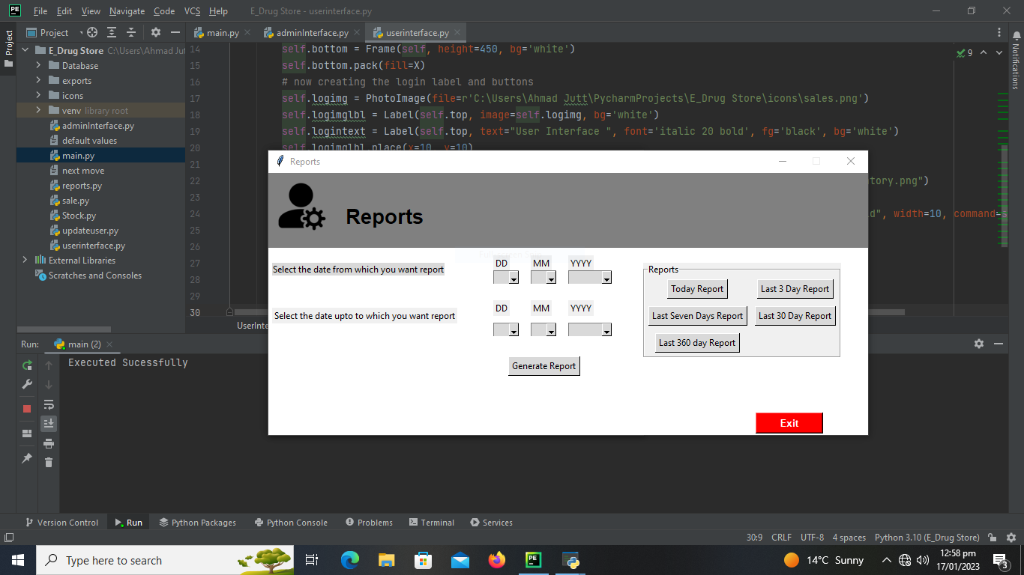

Slide 26
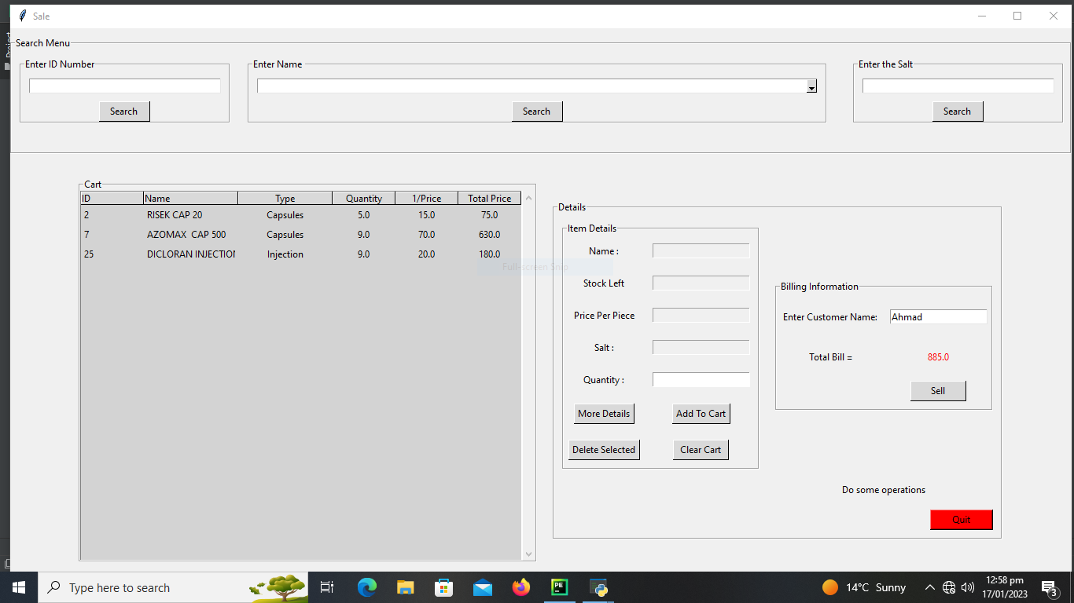

Slide 27
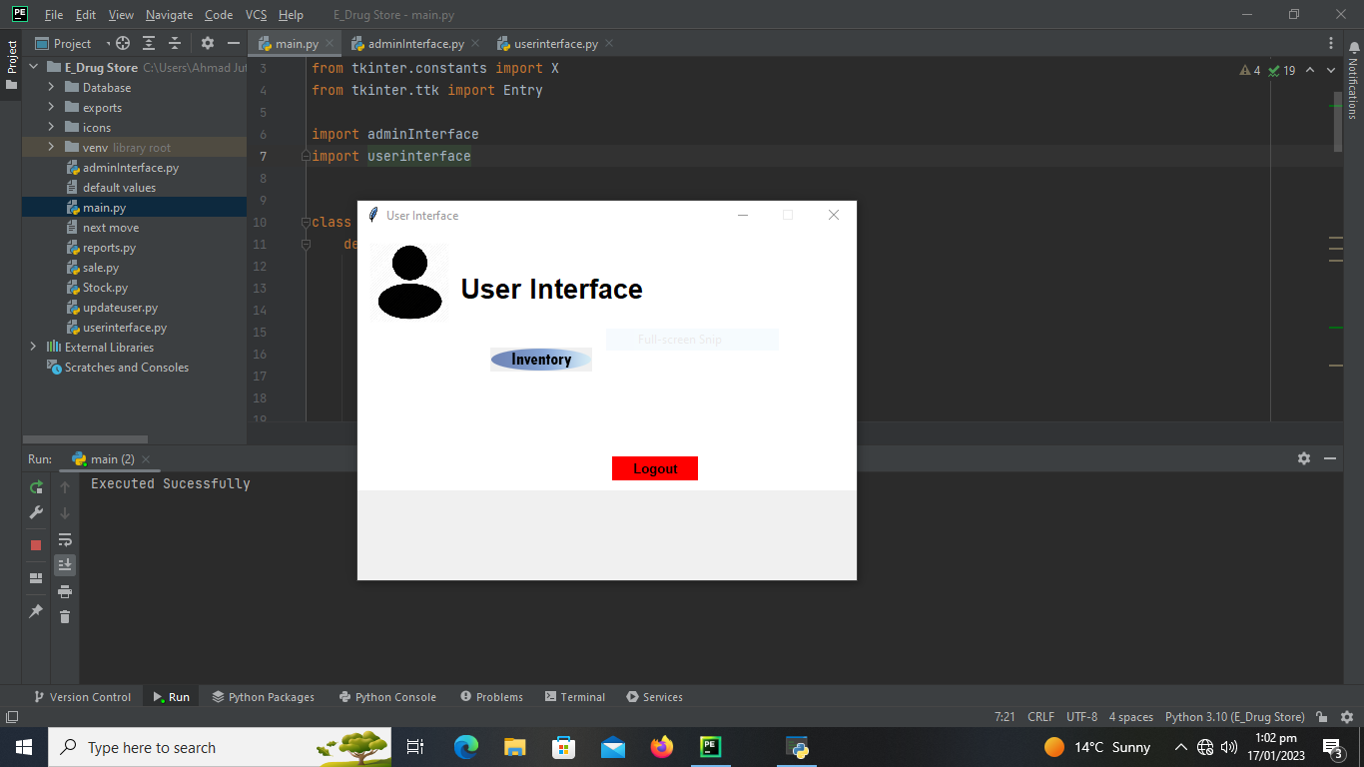

Slide 28
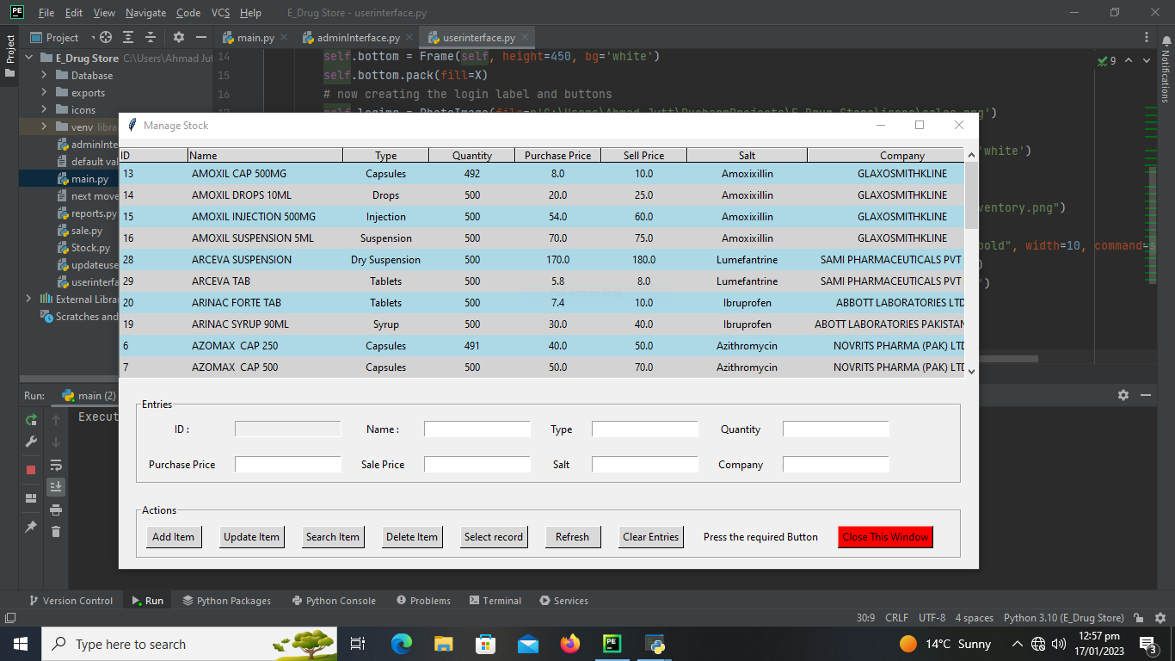

Slide 29
Tools
Pycharm
Python 3
Draw.io
Microsoft project planner
Photoshop
Microsoft word
Db browser

