Slide 1
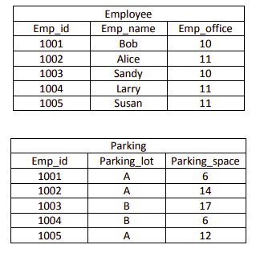

Slide 2
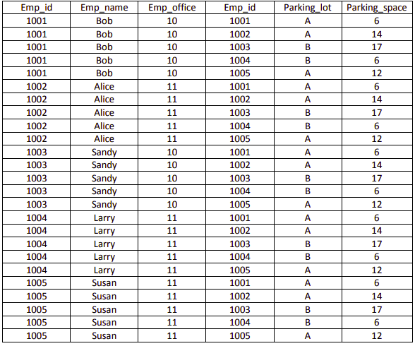
Cross Product / Cartesian Product
Employee x Parking

Slide 3
What is the list of employee names and their associated parking spaces?

Slide 4
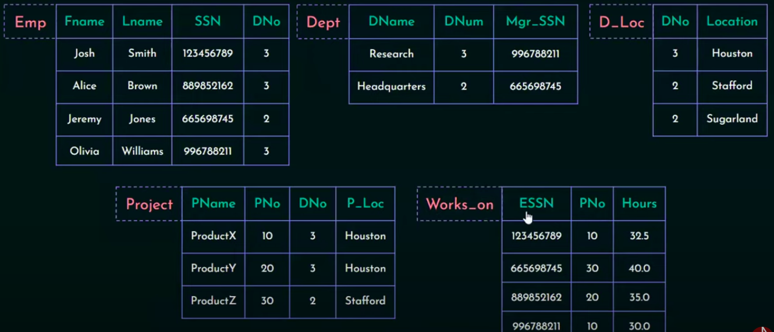

Slide 5
Retrieve the name of all employees who work in headquarters department
For all the projects located in Stafford, list the project number, controlling department and the manager’s name
Find the names of all employees who work on the projects controlled by department number 3
Make a list of project numbers for projects that involve an employee with last name ‘Smith’ either as a worker or as a manager of the department that controls the project

